Slide 1
Decoder
aka Codec and DCD
Stephane Gros

Slide 2

Introduction
Why a decoder? Offload the host
Third party IP from Allegro DVT
Features: AVC, HEVC, JPG, post-processing, up to 4K

Slide 3
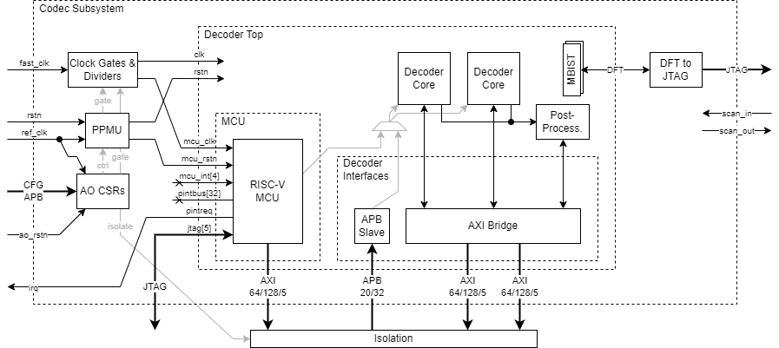
Block diagram – IP level
DCD wrapper (dcd_p)
Allegro DVT IP
Credit: Stefan Mach

Slide 4
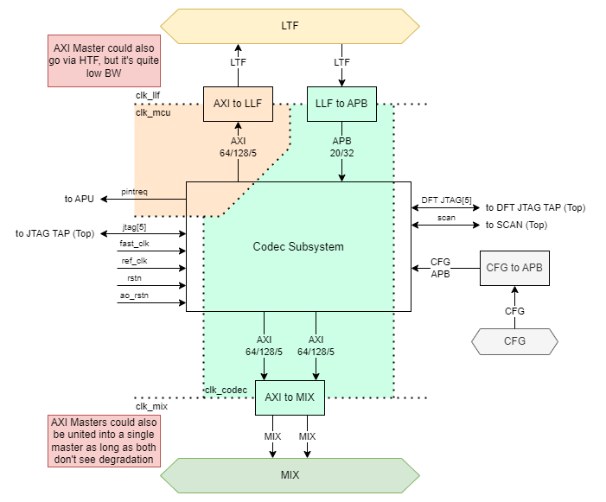
Block diagram – System integration
MCU code + data (DDR, L2)
IP configuration (APU)
Credit: Stefan Mach
Read/Write frame buffers (DDR, L2)

Slide 5
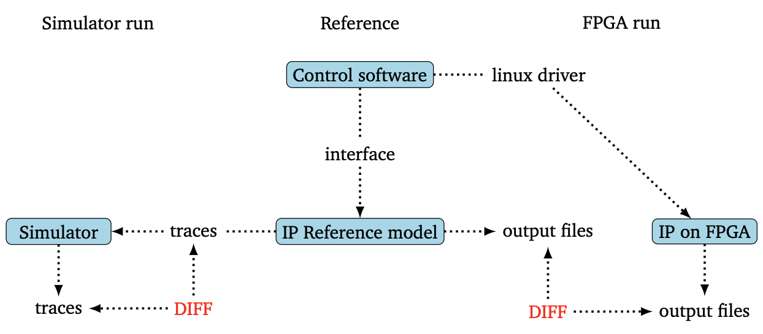
Verification strategy
Strategy
The IP is already verified by the vendor
What we want to verify
Integration of RAMs and other technology components → block level
Integration to the rest of the system → system level
Performances → system level
Tests:
Pre-built: traces provided by Allegro DVT for a first level of validation (block level only)
Baremetal
Traces generated with Allegro DVT’s validation flow and streams
Converted to C for system level verification or directly run on the block level testbench
Linux: tests using the linux driver provided by Allegro DVT
Coverage
Testplan
Toggle coverage on the interface
Performances
Source: Allegro DVT

Slide 6
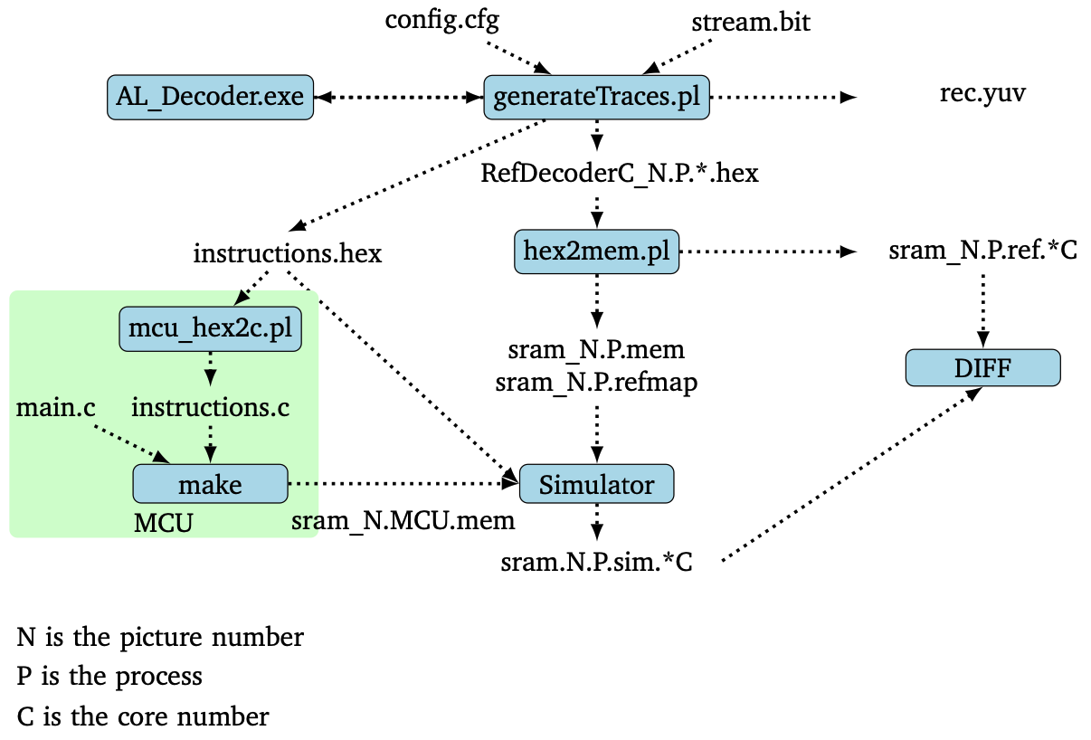
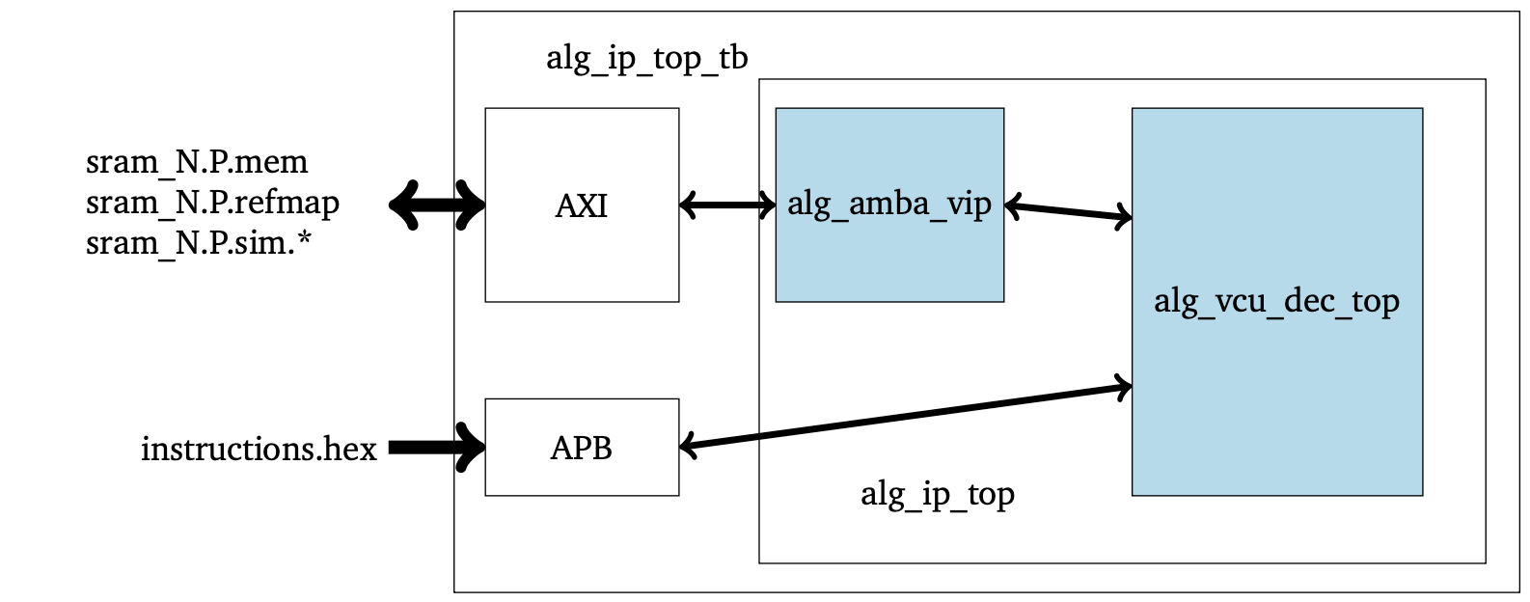
Block level testbench
AXI MCU
AXI Core0
AXI Core1
decoder_scoreboard
alg_amba_sram
read
load
DIFF
read
alg_amba_ctrl
load
Executes
Source: Allegro DVT
Based on the testbench delivered by Allegro → plug and play with their validation flow
Modifications
Adaptation to our env (vsim support, pass/fail condition)
Comparison done by the testbench
UVM friendly
Added a scoreboard for debug
Source: Allegro DVT

Slide 7
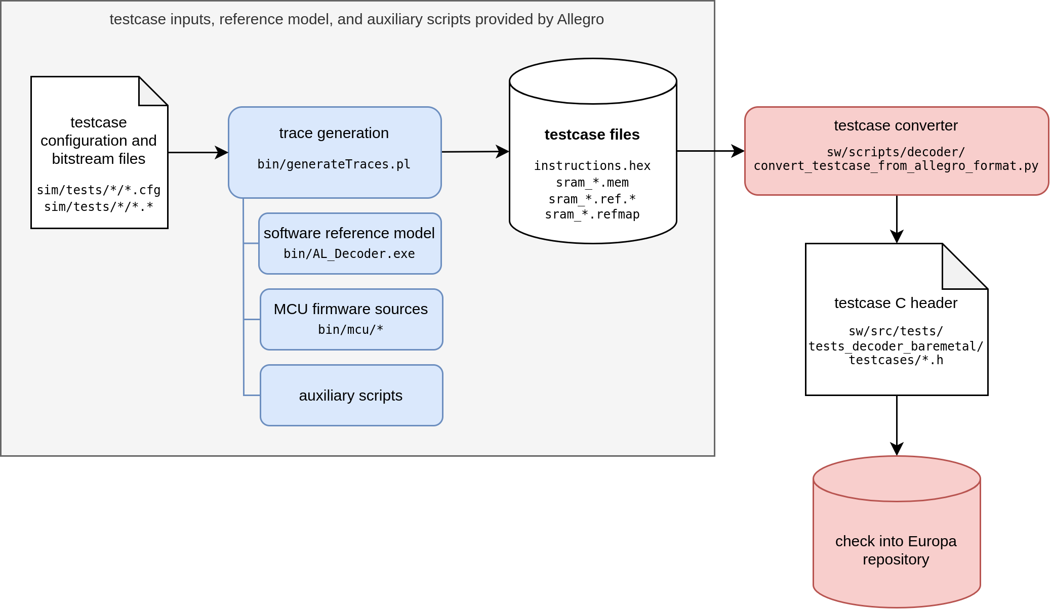
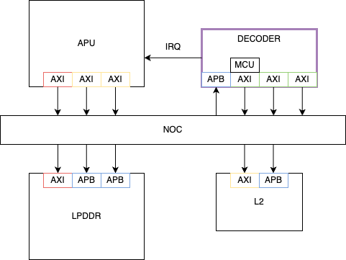
System level testbench
Baremetal driver
compile
Load .elf
Credit: Max Wipfi

Slide 8
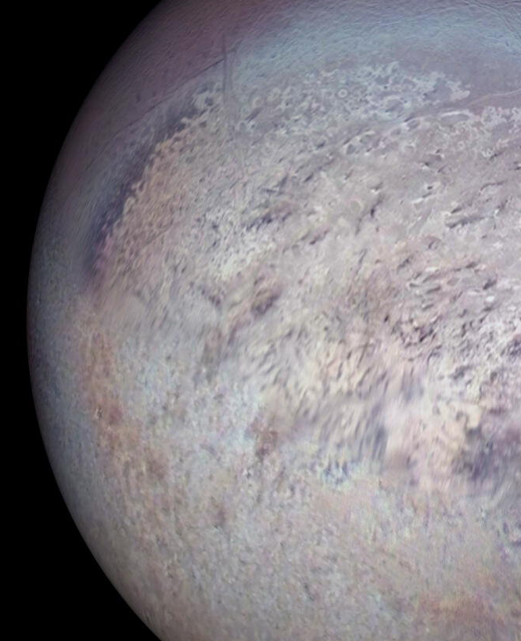

Thank you!
Any questions?

Slide 9
Useful link
Architecture specification: https://doc.axelera.ai/prod/europa/latest/europa_architecture/blocks/dcd/dcd_block_spec/
Verification document: https://doc.axelera.ai/prod/europa/latest/europa_verification/dcd_verification_document/#verification-strategy
Recording: Decoder verification presentation-20240801_103259-Meeting Recording.mp4

