Slide 1
Sign Language Detection using NLP
Guide:
A.V.L. Prasunna
NAME ROLLNO
Rajdeep 22261A1210
SRIKANTH KATEPALLY 22261A12134
HARSHITHA 22261A1221
UDAY 22261A1206

Slide 2
CONTENTS
INTRODUCTION
ABSTRACT
EXISTING SYSTEM
PROPOSED SYSTEM
BLOCK DIAGRAM
SYSTEM REQUIREMENTS
OBJECTIVES
APPLICATIONS
REFERENCES

Slide 3
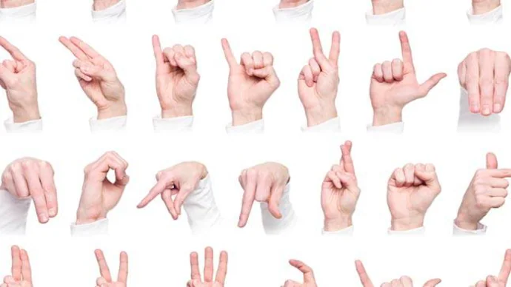
INTRODUCTION
There is no proper treatment and cure for deaf and mute individuals, yet there is a lack of knowledge about sign language among the general population worldwide. Our project aims to develop a system that can detect and interpret sign language gestures, making communication more inclusive.
Compared to the traditional methods, our project using NLP offers a cost-effective alternative that can significantly reduce the financial burden on individuals and healthcare systems.
Our project leverages the latest advancements in machine learning, computer vision, and natural language processing to interpret hand gestures used in communication.

Slide 4
ABSTRACT
Sign language is an essential form of communication that is used by the deaf and mute, but since not many people understand what the person is trying to convey and as a result of this there are many challenges for him to communicate.
However, an evident solution to this issue is present in the world of Machine learning, Computer Vision, and Natural Language Processing to interpret hand movements and translate them into written language. There are several ways to build a model. In our project, we will be building a two-way communication system in which the sign language will be converted into text using a sign language translation method, and the spoken language will be converted into sign language avatars using a sign language production technique.
With the above solution there can be effective and efficient two-way mutual communication.

Slide 5
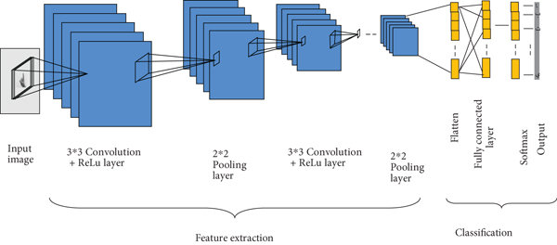
EXISTING SYSTEM
Data Acquisition: Here the system camera will be used to take the real-time input image and will be fitted into a frame of 128*256 Pixels.
Pre-Processing: The image Pre-Processing step uses the median and Gaussian filters which are some of the most frequently used methods to reduce noise in input images or videos.
RGB AND HSV MODEL:- The RGB model is used to indicate the specific coordinate points and skin colour segmentation.
CNN: The convolution neural network model is perceived as the most important deep learning neural network model to perform about recognizing and classifying images. It uses multilayer superposition to extract low-level features into relevant features. CNN is made up of many layers which include convolution, pooling, classification, etc.

Slide 6
PROPOSED SYSTEM
Image Frame Acquisition: Training the Model with our samples having 26 classes and each class having 100 samples
Hand Tracking: Using the media pipeline module, to perform accurate hand tracking which offers robust and efficient hand pose estimation
Landmarks: We point out approximately 20 landmarks or more for each hand. These landmarks serve as an essential feature for subsequent stages of the sign language recognition model.
Multiple Layers: Data Modification, Normalization, flattening and Format, and classification
NMT: Neural Machine Transmission
GAN: Generative Adversarial Networks

Slide 7
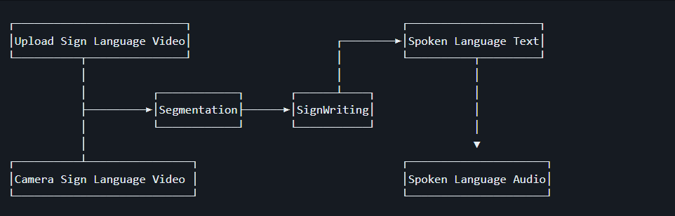
Sign language translator (Block Diagram)

Slide 8
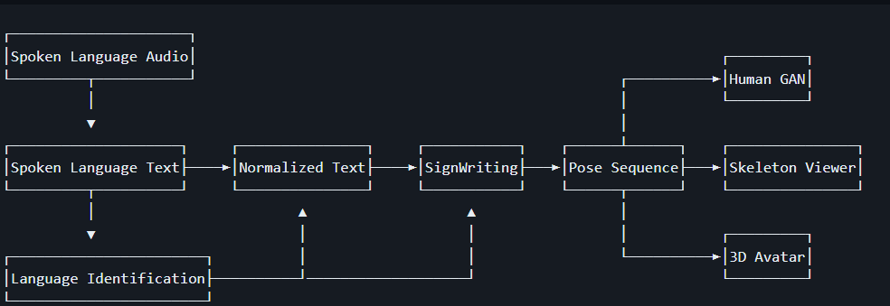
Sign language Generator (Block Diagram)

Slide 9
APPLICATIONS
Education: The system can be used in educational purposes
Healthcare: To improve communication between patients and healthcare providers
Travel and Tourism: To provide information and assistance to travels with hearing impartments
Research and Development: Used in development to advance the field of sign language recognition.
International Communications: Used to facilitate international communication between individuals who use different sign languages.

Slide 10
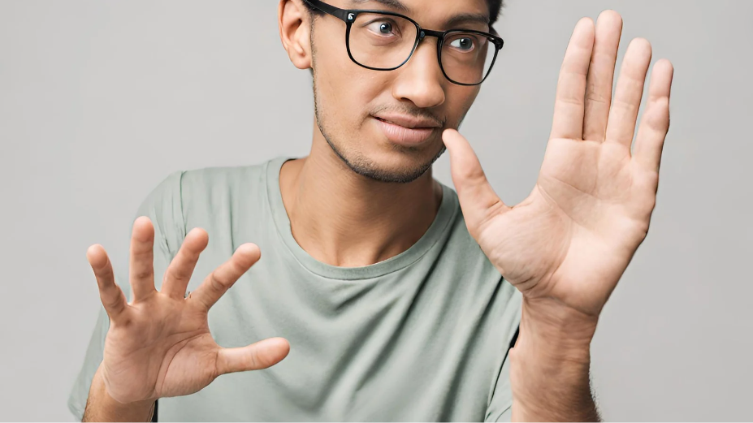
OBJECTIVES
Develop a sign language detection system using NLP that can accurately interpret sign language gestures.
Create a system that can translate sign language gestures into text in real-time.
Explore the use of advanced machine learning techniques to enhance the accuracy and speed of sign language detection
Evaluate the performance of the system and gather feedback from users for further improvements.

Slide 11
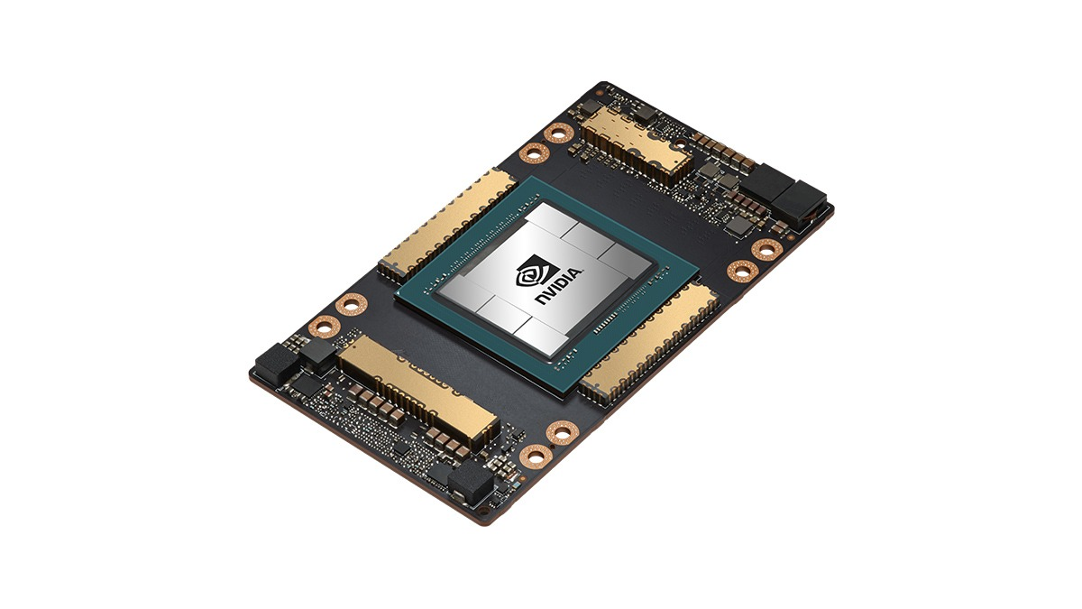
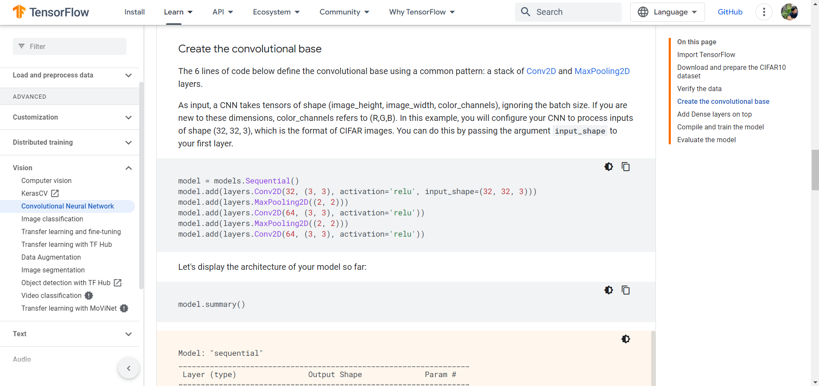
SOFTWARE And Hardware Requirements
Hardware:
A laptop with a dedicated Graphical Processing Unit(GPU)
A webcam for capturing the video in real-time.
A microphone for taking input voice.
Software:
Language: Python
TensorFlow, Keras, and frameworks like PyTorch
IDE: Jupyter Notebook or Pycharm
SVM, SL-GCN,SSTCN

Slide 12

References
1.Johnson.A.(2019).Sign Language Detection Using Action Recognition in Python.
2. Patel.R.Sign Language Recognition using Python. Journal of Artificial Intelligence Research,52(4),567-584.
3. Chen, X.Sign Language Detection.International Journal of Computer Vision,110(1),78-93.
4.Adams, B.Interational Journal Pattern of Recognition and Artificial Intelligence,33(5),789-804.

