Slide 1
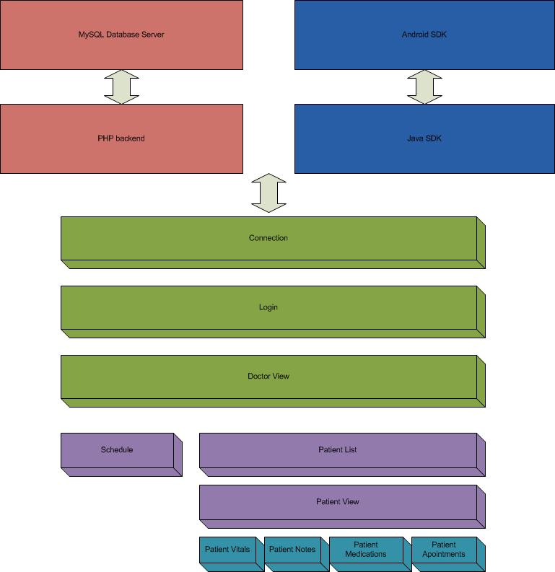
Health Foundation Android App
Binh Vu - Jerry Arnold - Muhammad Khan – Joshua Reisenauer
GOAL: Provide quick, easy and reliable access to patient medical records on the Android phone from a OpenEMR database systems.
APPROACH:
Secure Transactions
PHP server to act as a conduit from OpenEMR MySQL database to Android OS
Outcome:
One of the few Android mobile apps in patient centric healthcare industry
Accessible interface to OpenEMR system (a small to mid-size clinical and financial management system)
Quick, easy, and reliable patient's data management
Cost effective, value added service on the go for after office hours calls when information is critically needed
Senior Design Day Erik Jonsson School of Engineering & Computer Science Fall 2010
Notes:
Walter Reed Army Institute of Research
James Meyerhoff [James.Meyerhoff@NA.AMEDD.ARMY.MIL]
University of Colorado Boulder
Center for Spoken Language Research
John Hansen [John.Hansen@colorado.edu]
Our Basic Research Task is focused on addressing the detection, modeling, and classification of speech under stress in realistic military conditions, and to contribute to improved automatic speech recognition performance (ASR) in such environments.
Slide 1: Using physiological measures of psychological stress [psychometrics, heart rate, blood pressure (BP) and stress hormones] during a stressful military interview, we discovered an optimal platform for developing an ASR stress-recognizing algorithm. Six questions requiring the answer “no” were asked and during stressful and non-stressful conditions. The phoneme “o” was extracted from the word “no” and subjected to non-linear analysis. The effect of gender will also be evaluated.
A second approach also uses physiological measures of psychological stress [psychometrics, heart rate, blood pressure (BP) and stress hormones] but employs them during a highly stressful assessment of survival skills during training for use of lethal force. The paradigm involves exchange of small arms fire at very close range (using color-coded paint munitions for scoring “hits”) with loud ambient noise and a very high degree of psychological stress as well as a requirement to maintain radio contact.
Our technical approach for automatic detection and classification focuses on the nonlinear Teager Energy Operator.
Linear Speech Models which assume a plane-wave air flow pattern are not realistic approximations for speech produced under high task stress conditions. Our formulation of nonlinear based energy features seeks to track changes in nonlinear air turbulence flow above the vocal folds, and thereby represent rapid changes in speaker stress state.
The right figure show the linear and more realistic nonlinear air flow models of speech production. It is our belief that the linear model is a reasonable approximation for speech produced under neutral speech settings, but that under extreme stress conditions where coordinated muscle control of the vocal folds is critical, changes in airflow above the vocal folds are dramatic (I.e., votices dominate instead of linear plane wave airflow).
The TEO-CB-Auto-Env feature: is based on the Teager Energy Operator, partitioned across an auditory based critical band partition; an autocorrelation analysis is performed to track the “regularity” of the resulting instantaneous energy profile (optained across 3 adjacent sample points), and the area under this autocorrelation envelope is obtained as a measure of stress content.
We propose to formulate TEO based features that are capable of detecting speech under stress (an AM/FM model of the TEO profile). We will consider:
speaker dependent nature of stress across critical frequency bands – (I.e., which bands are more sensitive to stress and are these speaker dependent),
impact of stress detection based on phonemes versus increased data streams (words, phrases, etc.),
need for anchor models of neutral and stressed speech (needed for new speakers where stress models may not be known).
We propose to explore how this knowledge could help improve ASR performance in high stress military speech conditions.

