Slide 1

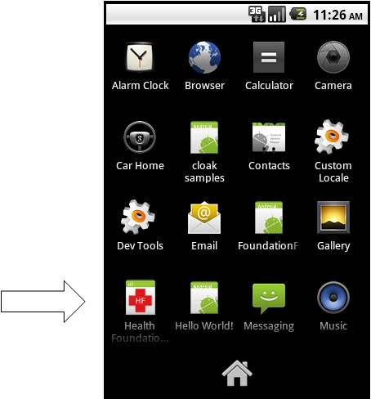
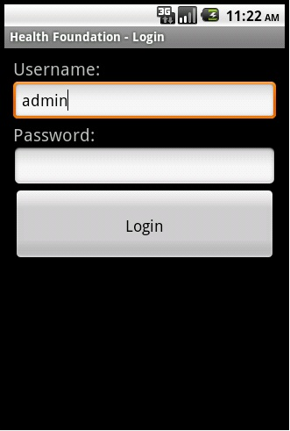
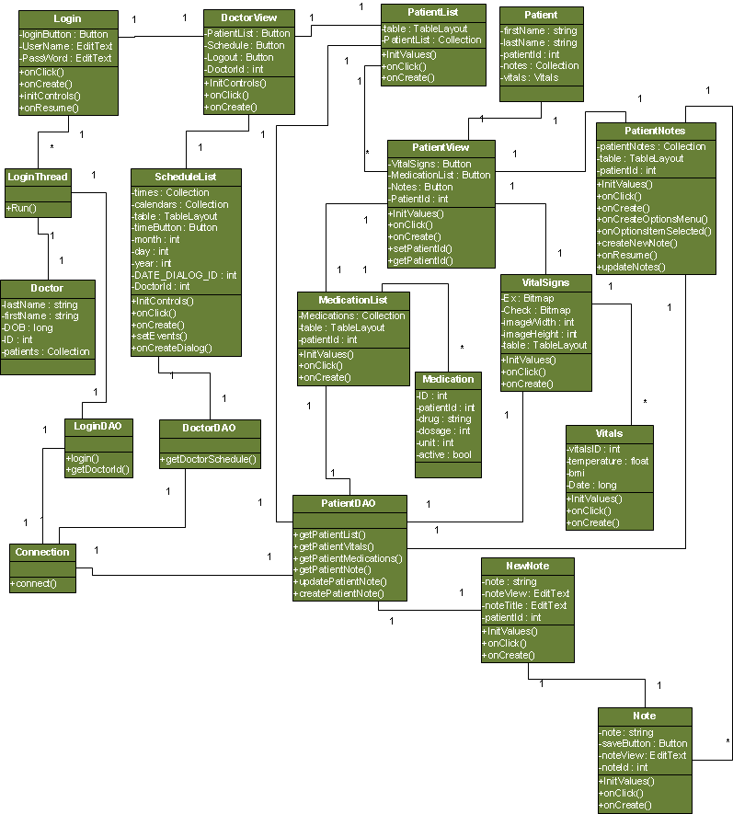
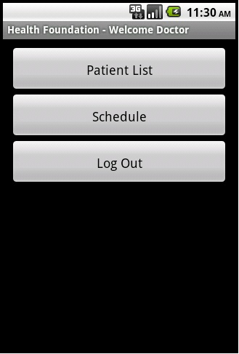
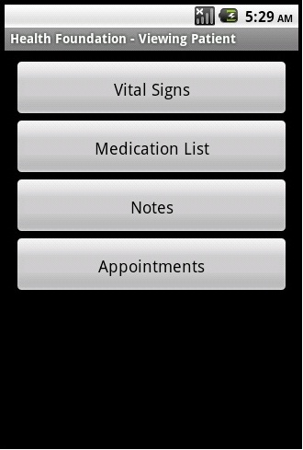
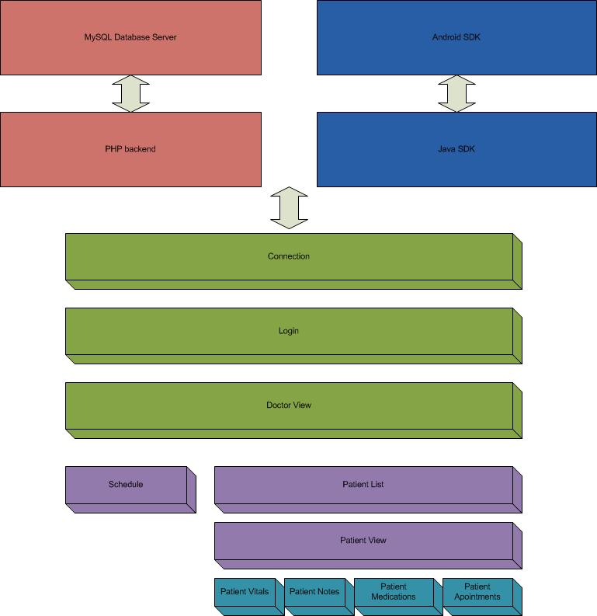
HFA
Health Foundation Android App
List of authors
Binh Vu - bnv061000@utdallas.edu Jerry Arnold - jxa074000@utdallas.edu Muhammad Khan – mik016000@utdallas.edu Joshua Reisenauer - jar055100@utdallas.edu
ECS 4485.501
Department of Computer Science
Erik Johnson School of Engineering & Computer Science
University of Texas at Dallas
Richardson, Texas 75083-0688, U.S.A.
Abstract
Results
Health Foundation App (HFA) is:
One of the few Android mobile apps in patient centric healthcare industry
Accessible interface to OpenEMR system (for small to mid-size clinical and financial management system)
Quick, easy, and reliable for patient's data management
Useful for on the go or after office hours when information is critically needed
Architecture
Block Diagram
Summary
Health Foundation App (HFA) is:
One of the few Android mobile apps in patient centric healthcare industry
Accessible interface to OpenEMR system (a small to mid-size clinical and financial management system)
Quick, easy, and reliable patient's data management
Cost effective, value added service on the go for after office hours calls when information is critically needed.

