Slide 1


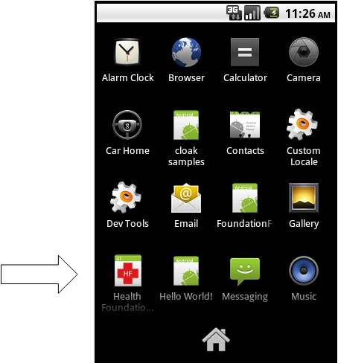
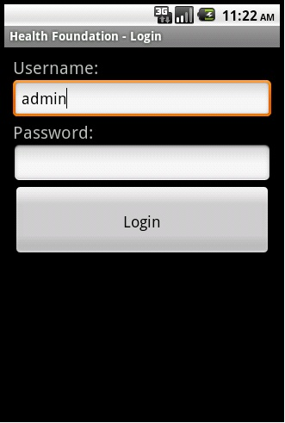
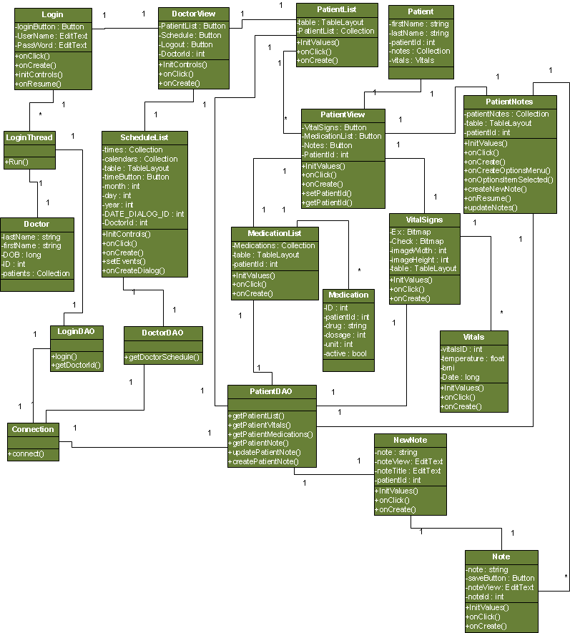
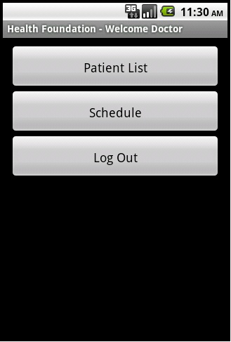
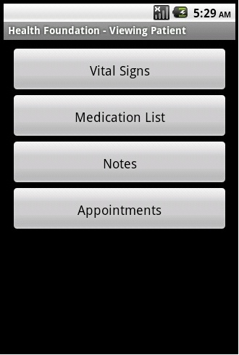
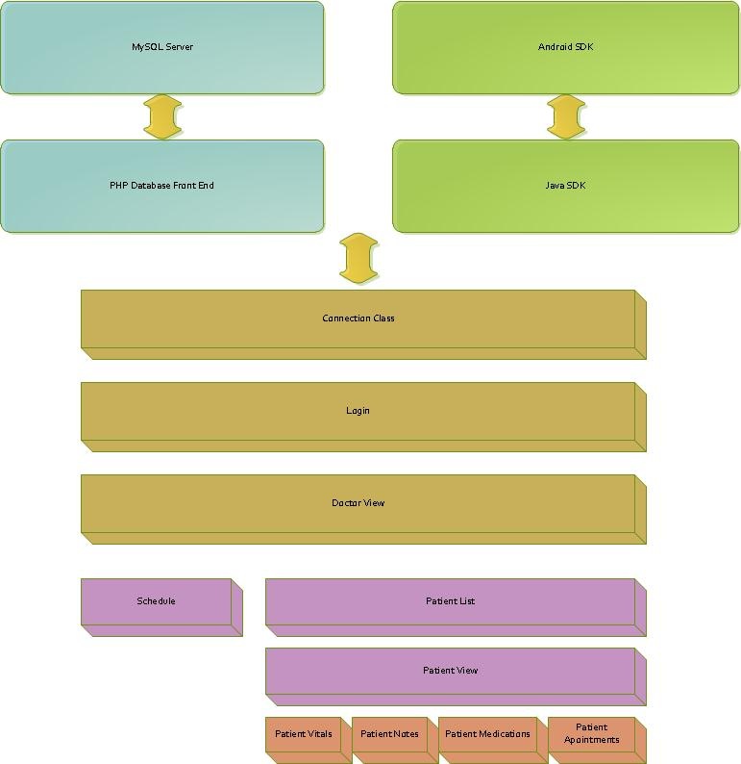
HFA
Android App
List of authors
Binh Vu - bnv061000@utdallas.edu Jerry Arnold - jxa074000@utdallas.edu Muhammad Khan – mik016000@utdallas.edu Joshua Reisenauer - jar055100@utdallas.edu
Open Networking and Advanced Research (OpNEAR) Lab
Department of Electrical Engineering
Erik Johnson School of Engineering & Computer Science
University of Texas at Dallas
Richardson, Texas 75083-0688, U.S.A.
Abstract
Results
The characteristic challenges and opportunities of mobile services design have recently led software designers to develop wide variety of mobile apps that leverage the user needs of many small to mid-range markets, as evidenced by many white papers.
HFA is one of the few Android mobile apps in patient centric healthcare industry. HFA provides a valuable access interface to OpenEMR system (a small to mid-size clinical and financial management system) for Android Market. HFA Android app creates exceptional value for clinician with Android devices using the OpenEMR system.
HFA is an instance based healthcare Android app with navigational queues that renders the secure data calls in compliance with HIPAA (Health Insurance Portability and Accountability Act) and assist clinicians for quick, easy, and reliable patient’s data management.
Architecture
HFA brings many advantages for clinicians using Android devices:
Anytime, anywhere access of some critical patient data.
Quick and easy access makes the app a handy tool for after hours patient calls.
HFA provides fast and easy notes capture makes doctors life easier.
Quick view of patient schedule management.
Easier interoffice clinical communication.
Patient referral are easier than ever using HFA.
HIPAA compliance access of patient data.
Reliable and fully integrated access of OpenEMR.
On the go and real time data is here.
Small fractional cost to use the service.
Block Diagram
Summary
With the rapid growth of smart phones, Android devices stands out with new opportunities for java software developers to build robust new applications. Many of such apps are geared toward helping the existing businesses. However, not very many health care apps exist in Android market to facilitate clinicians of small to mid size practices. HFA steps up to this challenge and brings in the first Android app for OpenEMR (a small to mid-size clinical and financial management ) system, that can be extended to other standard electronic medical record systems (EMRs).
HFA provides a valuable access to OpenEMR for Android Market. HFA application is intended to assist clinicians with mobile data integration/retrieval services from OpenEMR, for quick clinical evaluations. HFA controls different levels of users, parsing the terms and prompting the clinician for any abnormalities. Encrypted communication of HFA with OpenEMR database contents provides a quick, easy, and reliable access for fast clinical decision making process. HFA is an Android app with navigational queues that renders the secure data calls in compliance with HIPAA and assist clinicians for quick, easy, and reliable patient’s data management.

