Slide 1

ANALYSIS OF YELP USERS

Slide 2
Contents
What is YELP!
The YELP Dataset
Data Preprocessing
Initial Explorations and Visualizations
User-based Collaborative Filtering

Slide 3
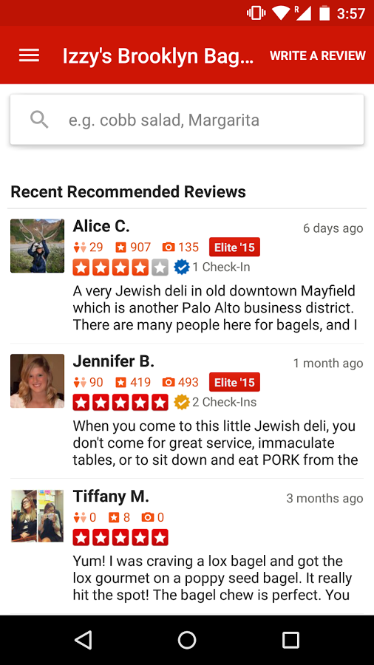
What is Yelp?
Yelp, a website that serves as a directory for local businesses, both big and small, in major cities and towns across the world in over 15 different languages.
One can:
-> find the type of store that sells what you're looking to buy
-> leave reviews and ratings for those you've already done business with
-> can comment on reviews that others have posted.

Slide 4
Our Dataset
Participated in ‘Round 8 Of The Yelp Dataset Challenge’
2.7M reviews and 649K tips by 687K users for 86K businesses
The data was categorized in 5 datasets:
1. Business
2. Reviews
3. User
4. Check in
5. Tip
review
{ 'type': 'review', 'business_id': (encrypted business id), 'user_id': (encrypted user id), 'stars': (star rating, rounded to half-stars), 'text': (review text), 'date': (date, formatted like '2012-03-14'), 'votes': {(vote type): (count)}, }

Slide 5
Data Preprocessing
Size of the dataset: above 2gb!!
Each of 5 datasets were in form of a JSON file
Used Python to convert each dataset from json format to csv format
The ‘review.csv’ dataset was further divided into chunks to facilitate faster initial analysis

Slide 6
Data Preprocessing
Identified relevant variables for our research question
Extract of “Restaurant” Business data in the tagging for prediction and recommendation?? Did we do this??
Decided to use the ‘Business’, ’User’ and ‘Review’ dataset
Merged Business data with Review & User

Slide 7
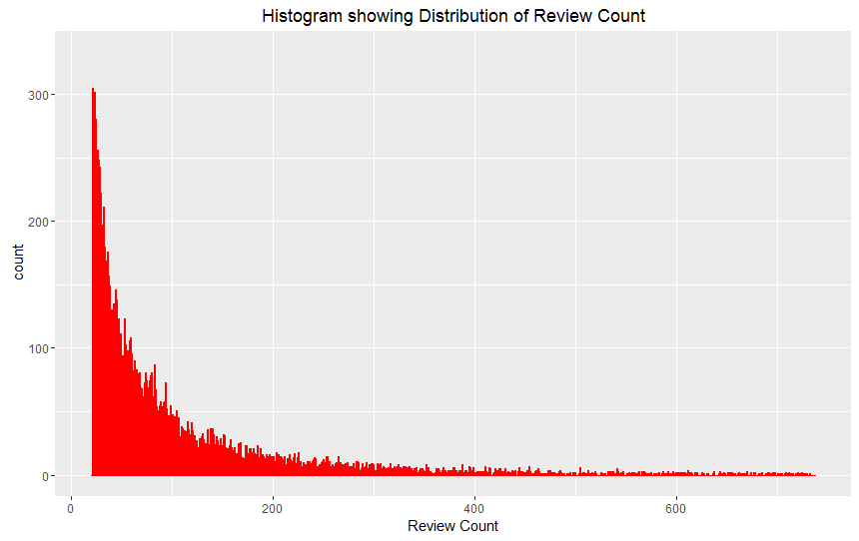
Initial Explorations and Visualizations
Frequency Distribution of Review Count
Most restaurants have the total review count between 0 to 150

Slide 8
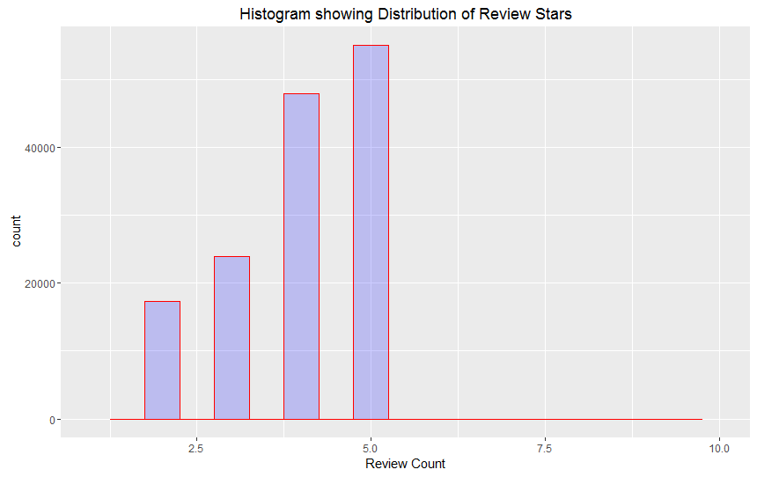
Distribution of Review Stars

Slide 9
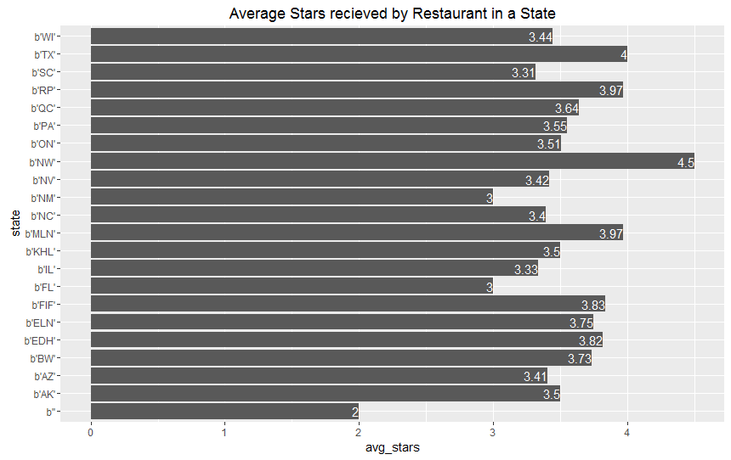
State-wise comparison of Average-Stars received

Slide 10
Prediction Model for User Satisfaction
Research Question: What factors would help predict the rating received by a restaurant?
Our Target Variable: Review rating (satisfied or unsatisfied)
Feature Engineering:
Added new feature to th datasets based on the existing features/variables
Good_for_score: which combined scores of all the ‘Good_for’ attributes such as good_for breakfast, good_for_kids.
Park_score: which combined scores of all Parking related attributes
Compliment_score: combined scores of all compliment related attributes
Votes_score: which sums up all votes given by an individual user till date

Slide 11
Split the dataset in Train and test set (75:25)
We implemented three classification models to compare accuracy and determine the best model
Logistic regression
Decision Trees
SVM
Results Obtained:
Model | Average Accuracy
Logistic Regression | 0.73
Decision Trees | 0.80
SVM

Slide 12
RESULTS
……. Model was finalized as the best model for prediction
Final model
The feature combination of :
- Star rating of a business
- Review count of a business
- Number of Yelp fans
- Average stars of a user
- Review count of a user
- Number of Yelp friends
- WiFi availability
Helps us predict if a user will give a satisfied or unsatisfied rating to a business …….% of the times

Slide 13
User-based Collaborative Filtering
Purpose: To predict the rating from a user for a business based on the ratings given to that business from similar users.
The similarity between users is defined by the differences of the ratings they've given to the same businesses.
For n users and m business, a matrix is created where question marks in the matrix are where we would like to predict using Cosine similarity.

Slide 14
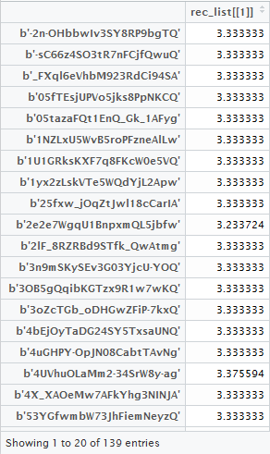
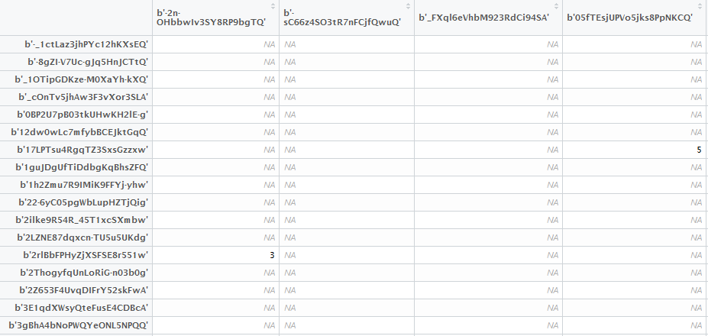
Our Results:
Initial Matrix with many NA’s (No Prediction)
Matrix with Prediction

Slide 15
Need to add data sources and other slides

