Slide 1

Fundamentals of Programming
Java Programming Language

Slide 2
What is OS?
OS is a program and an interface between user and computer hardware.
These are basic functions of any OS:
Memory Management – manages main/primary memory, whenever a program is bound to be executed; it has to be present in main memory and there is more than one program present at a time. Thus, OS required to manage the memory.
Scheduling or Processor management – When there is more than one process runs, OS decides when and how a process will use the CPU. Therefore, it is also known as CPU scheduling.
Device Management – Manages devices such as allocation or de-allocation of devices, keep records of devices, determines which process can use which device for how much time.
File Management – Keeps records of files/directories location and its status, allocates/de-allocates resources.
Security – Provides authentication of users.
Accounting – It keeps track of all functions of a computer system and maintains record of all activities taken place in the system.

Slide 3
What is a Program
A program is composed of one or more elements described below:
Variables
Statements
Method – function or procedure
Operators
Loops
Conditionals
Input/Output operations
Comments
Classes (depends on programming paradigm)

Slide 4
Programming Paradigms
A programming paradigm is a way to classify programming languages based on their features. In simple terms it is a style or a way of programming.
Imperative – Languages such as Fortran, BASIC, Pascal, COBOL, ALGOL
Declarative – Languages such as Prolog, Lisp, Haskell, Miranda, Erlang, SQL
Structured – Languages such as ALGOL, C, Pascal etc.
Procedural – Languages such as Fortran, ALGOL, COBOL, BASIC, Pascal and C
Functional – Languages such as Haskell, Closure, Scala, Erlang, Clean, F#, Elixir, Kotlin, Rust, Swift etc.
Object oriented – Languages such as C++, Java, Scala, Python, PHP, R, Java Script, Ruby, Groovy, Kotlin, SmallTalk, C#, VB.NET etc.
Event Driven – Almost all OO and visual languages support this paradigm e.g. Java, VB.NET, VC++
Many more such as Aspect oriented, Logic and Constraint Programming etc.
Note: Modern programming languages are mixed paradigm languages, meaning they combine more than one paradigm.

Slide 5
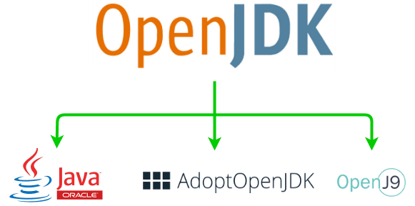
Java History
Version | Year
JDK Beta | 1995
JDK 1 | 1996 (1.1 in 1997)
J2SE 2 | 1998
J2SE 3 | 2000
J2SE 4 | 2002
J2SE 5 | 2004
Java SE 6 | 2006
Java SE 7 | 2011
Java SE 8 | 2014
Java SE 9 | 2017
Java SE 10 & 11 | 2018
Java SE 12 | 2018, 2019
Java SE 13 | 2019
Java SE 14 | 2020
Java SE 15 | 2020
Java SE 16 | 2021
Java SE 17 | 2021 (current)
Java SE 18 | 2022 (planned)
It was designed to build software for small embedded systems for electronic appliances such as set top boxes.
James Gosling, Mike Sheridan and Patrick Naughton initiated the Java Language at Sun Micro Systems in 1991 and they are called “Green Team”.
It’s initial name was “Greentalk” by James Gosling.
Later renamed to “Oak”.
In 1995, It was again renamed as “Java”.
The biggest difference between OpenJDK and Oracle JDK is Licensing.

Slide 6
OpenJDK vs. OracleJDK
Features | OracleJDK | OpenJDK
Release schedule | Long-Term Support (LTS) releases happen every 3 years. But this cycle will change from 3 years to 2 years since Java 17. | OpenJDK releases happen every 3/6 months.
Support | Provides LTS for its releases. Oracle offers no commercial support for its OpenJDK distribution. | Support the changes to a release until the next version.
License | Oracle Binary Code License Agreement. Since Java 11, Oracle change BCL license with a combination of GNU GPL v2 with CPE (class path exception). Essentially both Oracle JDK, OpenJDK builds are identical from Java 11 onward. Since JDK 17, Oracle is free for production again under new “Oracle-No-Fee-Terms-And-Conditions” (NFTC) license. It means that Java 17 is free for commercial and production use. | GNU general public license (GPL) v2 with linking exception. Essentially both Oracle JDK, OpenJDK builds are identical from Java 11 onward.
Performance | Better responsiveness Good JVM performance | But this is changing as its performance is continually improving and builds are becoming more stable with contributions of OpenJDK community.
Features | Flight Recorder Java Mission Control (JMC) Application Class Data Sharing Better GC options Better renderers | - Font Renderer
Development & Popularity | - Developed by Oracle corporation | - Developed by Oracle, OpenJDK, RedHat, Azul, IBM, Apple, SAP AG and other Java Community.
Distribution | Includes installers, branding, JRE packaging | As .zip or .tar.gz files
Notable Providers | Oracle JDK | Eclipse Temurin from Adoptium (changed name after joining Eclipse foundation and formerly called AdoptOpenJDK). Azul Zulu

Slide 7
OracleJDK vs. OpenJDK
https://i.stack.imgur.com/P4Gmt.png
https://stackoverflow.com/questions/52431764/difference-between-openjdk-and-adoptium-adoptopenjdk

Slide 8
Open Source
Open Source is a term that originally referred to open source software (OSS). Open source software is code that is designed to be publicly available – anyone can see, modify, and distribute the code. Most of the open source projects run by non-profit organizations or foundations.
Some notable open source foundations are:
Apache Software Foundation (ASF) - It is founded by a group of developers of Apache HTTP server. It is the creator of almost 350+ projects.
Eclipse Foundation – It is founded by IBM. It is the creator of Eclipse IDE, OpenJ9, Jakarta EE etc.
Cloud Native Computing Foundation (CNCF) – It is part of the Linux Foundation. It is the creator of Kubernetes, Prometheus, Envoy etc.
Linux Foundation – It is founded by Linus Torvalds and leading technology companies.
Mozilla Foundation – advocates the idea of Internet must always remain an open and accessible to everyone.
NetBSD – Creators of free and highly portable Unix-like open source operating system.
OASIS Open - is where individuals, organizations, and governments come together to solve problems through the development of open code and open standards.
Some notable orgs are – Digital Freedom Foundation (DFF), The Document Foundation, Drupal Foundation, Drupal Association, Free Software Foundation (FSF), GNOME Foundation, KDE e.V, Linux Professional Institute, Open Biometric Foundation, Open Education Consortium, Open Source Automation Development Lab, Open source Geospatial Foundation, Software In the Public Interest (SPI) etc..

Slide 9
Buzzwords of Java
Java is a Simple, Secure, Portable, Object-oriented, Robust, Multi-threaded, Architectural Neutral, Interpreted, High performance, Distributed, Dynamic programming language.
Simple – The core Java language is small and many constructs of Java are familiar to other programmers notably from C/C++ background. It has no complex features like pointers.
Object Oriented – Unlike other OOP languages, Java is advocates use of classes and objects from the beginning.
Distributed (Network-savvy) – Java has built-in classes to support various levels of network connectivity. They are found in java.net package.
Interpreted – Java is both compiled and interpreted. The source code is compiled into platform independent bytecode and then interpreted by platform dependent JVM.
Robust – Robustness is the ability of a computer system to handle the errors during execution and handle the erroneous input. Java is robust because it uses strong memory management/allocation. There is a lack of pointers that avoids security problems, automatic garbage collection, exception handling, strict type checking (type safety) at compile & run time.

Slide 10
Buzzwords of Java
Secure – Java programs run inside JVM aka sandbox, does not support pointers, byte code verification for code that violates access right to object, provides javax.security that implements explicit security, cryptographic security, security managers, library level safety, run time security check takes place when new code is loaded, automatic memory management.
Architecture Neutral – Any machine architecture that has JVM running, can execute compiled Java code aka byte code which is platform independent.
Portable – Java derives portability from platform independent byte code i.e. Write Once Run Anywhere (WORA).
High Performance – object memory allocation on heap for a short and medium time, native code generation, cross module optimization aka inline access between different code components, automatic garbage collection etc.
Multi threaded – Java provides rich set of built-in classes that support multi-threading aka concurrency.
Dynamic – Java is dynamic because of dynamic dispatch aka late binding aka method overriding, class loaders, reflection API.
Strongly typed – Java is strongly typed language and safety, robustness comes from this fact.

Slide 11
Java is a Strongly typed language
Java is a strongly typed language.
First, every variable has a type, every expression has a type, and every type is strictly defined.
Second, all assignments, whether explicit or via parameter passing in method calls, are checked for type compatibility.
There are no automatic coercions or conversions of conflicting types as in some languages.
The Java compiler checks all expressions and parameters to ensure that the types are compatible. Any type mismatches are errors that must be corrected before the compiler will finish compiling the class.

Slide 12
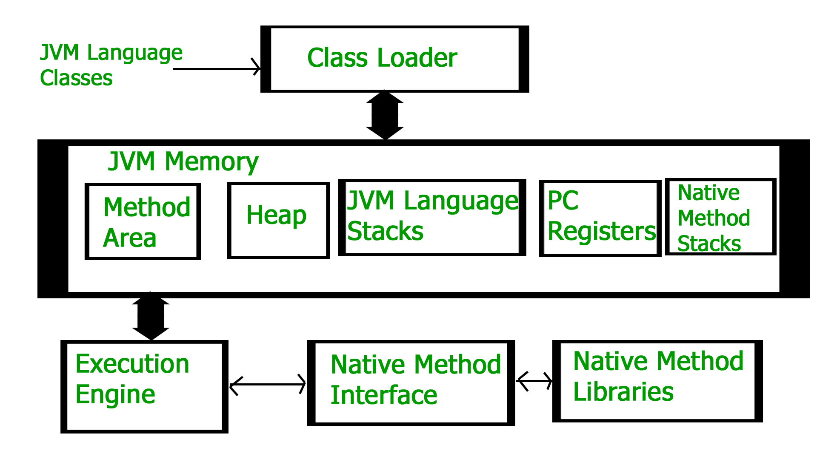
JVM Architecture
JVM memory elements such as Method Area, Heap, Stack, PC registers, are collectively called as Runtime Data Areas.

Slide 13
JVM architecture - Class Loader
Functions of a Class Loader
Loading - Stores meta information about a class in Method Area. Meta Information such as fully qualified class name, Immediate parent type name (class/interface/enum), access modifiers, variables, method information etc. After loading the .class file, JVM creates an object of type Class to represent this file in Heap memory. For every .class file that is loaded, only one object of that class is created.
Linking - Performs Verification, Preparation, Resolution (optional) steps. Verification phase means bytecode-verification, Preparation phase is about allocating memory for class variables and initialize memory to default values. Resolution phase means establishing direct references to referenced classes. It means All symbolic references that were now loaded into the method area in form of the runtime constant pool are resolved to actual types loaded by this JVM.
Initialization – All class variables (static variables) and static block (if any) are now assigned with their values.
Types of Class Loader
Bootstrap Class Loader – Loads all trusted classes such as Core Java API classes from $JAVA_HOME/jre/lib location. Every JVM implementation must have a bootstrap class loader.
Extension Class Loader – It is like extension to bootstrap class loader and loads classes from $JAVA_HOME/jre/lib/ext location.
Application or System Class Loader – It loads classes from application class path.
Important:
JVM follows delegation hierarchy principle to load classes in bottom to top fashion. First, application class loader delegate load request to extension class loader and extension class loader further delegate load request to bootstrap class loader. If system class loader fails to load a class, then we may get runtime exception i.e. ClassNotFoundException.

Slide 14
JVM architecture – Method Area
There is only ONE method area per JVM.
It is a shared resource.
It stores all class level information such as class name, immediate type parent type name (class/interface/enum), constructors, methods, variables information (including static variables).
Runtime constant Pool – It is a subset of Method Area. String literals are stored in Runtime constant Pool.

Slide 15
JVM architecture – Heap Memory (Brief Intro)
Heap memory is used for dynamic memory allocation of Java objects and JRE classes at runtime.
New objects are always created in heap space and the references to these objects stored in stack memory. These objects have global access and we can access them from anywhere in the application.
There is only ONE heap memory per JVM. It is a shared resource means that not thread-safe, need to be guarded by synchronizing the code.
When JVM is started, heap memory is created and any objects in the heap can be shared between threads as long as application is running.
It broadly classified into small parts named Young Generation, Old Generation, Permanent Generation.
Access to this memory is slower compared to stack memory.
This memory, in contrast to stack, isn’t de-allocated automatically. It needs Garbage Collector (GC) to free up unused objects to keep the efficiency of memory usage.
Note: We will discuss in detail about Heap Memory in upcoming section.

Slide 16
JVM architecture – Stack Memory/Area/Frame/Activation Record
It is used for static memory allocation and execution of a thread. Stack has memory limit depending upon OS and is smaller than the heap.
Contains values specific to a method and references to objects referred from method that are in heap.
Access to this memory is in Last-In-First-Out (LIFO) order.
Whenever we call a new method, a new block is created on top of stack and this block contains values specific to that method, primitive variables and references to objects.
Stack memory is not a shared resource since it is specific to per thread.
It grows and shrinks as new methods are called and returned.
Variables inside a stack exist as long as method that created them is running.
It is automatically allocated and de-allocated when the method finishes execution. It means once a thread is finished/terminated, JVM destroys runtime stack.
If stack memory is full, JVM throws StackOverflowError.
Access to this memory is faster compared to heap memory.
This memory is thread-safe as each thread operates in its own stack.

Slide 17
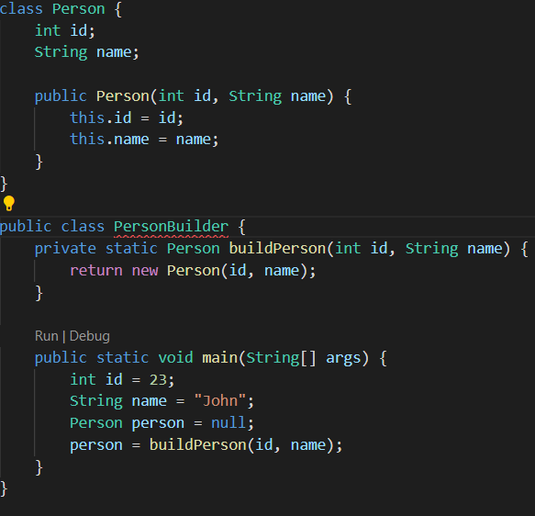
Simple Example to demonstrate memory storage
When we enter the main() method, a space in stack memory is created to store primitives and references of this method.
  Stack memory directly stores the primitive value of integer id.
  The reference variable person of type Person will also be created in stack memory, which will point to the actual object in the heap.
The call to the parameterized constructor Person(int, String) from main() will allocate further memory on top of the previous stack. This will store:
  The this object reference of the calling object in stack memory
  The primitive value id in the stack memory
  The reference variable of String argument name, which will point to the actual string from string pool in heap memory
The main method is further calling the buildPerson() static method, for which further allocation will take place in stack memory on top of the previous one. This will again store variables in the manner described above.
However, heap memory will store all instance variables for the newly created object person of type Person.

Slide 18
JVM architecture – PC registers
Program Counter (PC) register contains the address of the instruction currently being executed in its associated thread.
In other words, PC registers keep track of the current instruction executing at any point of time.
It is like a pointer to the current instruction in sequence of instructions in a program.
It is very small data area and has a fixed size.

Slide 19
JVM architecture – Execution Engine
Execution Engine executes .class file (byte code). It reads bytecode line by line, uses data stored in various memory areas and executes instruction.
It is classified as:
Interpreter – Interprets bytecode line by line and then executes. Disadvantage is when one method is called multiple times, every time interpretation is required.
Just-In-Time (JIT) compiler – It increases efficiency of Interpreter. It compiles the entire bytecode and changes it to native code. Therefore, whenever the interpreter sees repeated method calls, JIT provides direct native code for that part so re-interpretation is not required, thus efficiency is improved.
Garbage Collector – It flushes/destroys un-used/un-referenced objects.
It is technically possible to compile Java down to native code ahead-of-time and run the resulting binary. It is also possible to interpret the Java code directly.
To summarize, depending on the execution environment, bytecode can be:
Compiled ahead of time and executed as native code (similar to most C++ compilers).
compiled just-in-time (JIT compiler) and executed. It uses code cache i.e. special heap to hold compiled code.
Interpreted.
Directly executed by a supported processor (bytecode is the native instruction set of some CPUs).

Slide 20
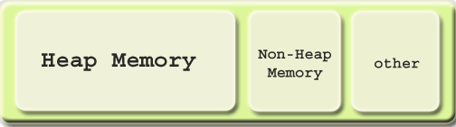
JVM Memory Model
JVM memory is broadly classified into three parts and
collectively called Runtime Data Areas.
Heap Memory
Non-Heap Memory (all Method area, stacks, PC registers etc.)
Other
Non-Heap Memory – It is created at JVM startup and stores per class structures and default size is 64MB.
Other - JVM uses this space to store the JVM code itself, JVM internal structures, loaded profiler agent code, and data etc.

Slide 21
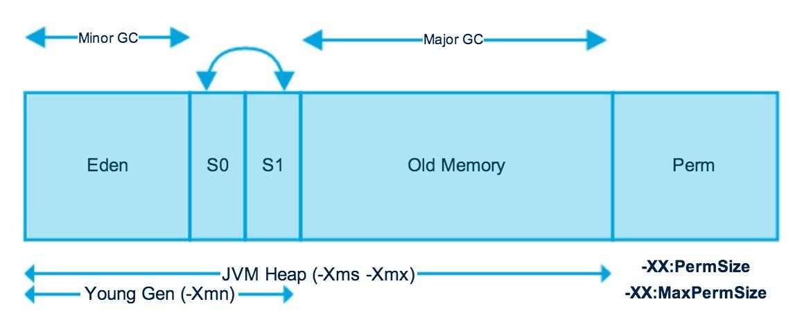
JVM architecture - Heap Memory
It allocates memory for all java class instances and arrays.
The Heap is created when JVM startsup and may increase and decrease in size while the application is running.
The Heap can be fixed size or variable size depending on Garbage Collection (GC) strategy.
The size of Heap can be set using –Xms VM option.
By default heap size is 64MB.
Heap is further physically divided into two parts:
Nursery or Young space or Young Generation
Old Space or Old Generation
Heap Memory Structure

Slide 22
JVM architecture - Heap Memory – Nursery / Young Space / Young Generation
The Nursery or Young Space or Young Generation is part of the Heap and reserved for the allocation of new objects. Young Generation is further divided into 3 parts: Eden and Two survivor spaces i.e. S0 and S1.
Most of the newly created objects are in Eden memory space. When Eden space is filled with objects, Minor GC is performed by JVM and all the survivor objects are moved to one of the survivor spaces.
Minor GC also checks the survivor spaces and moves them to other survivor space. So, at a time one of the survivor spaces are empty.
Objects that are survived after many cycles of Minor GC, are moved to Old Generation memory space. Objects that are in Young Generation is temporary or short-lived. Young Generation frees memory faster than Young Generation.
Some recent releases of JVM include an area called Keep Area and it is reserved. The keep area contains the most recently allocated objects in the nursery and is not garbage collected until the next young generation. This prevents objects from being promoted just because they were allocated right before a young collection is started.
Minor GC - When the nursery becomes full, garbage is collected by running a special young collection, where all the objects lived long enough in the nursery are moved to old space, thus freeing up the nursery for more object allocation. This garbage collection is called Minor GC.

Slide 23
JVM architecture - Heap Memory – Old Space / Old Memory / Old Generation
Old generation memory contains the objects that are long-lived and survived after many rounds of Minor GC. When the old generation becomes full, garbage is collected there and this process is called old collection or Major GC.
Major GC takes a longer time compared to Minor GC and the reason is that a Nursery holds objects that are short-lived and temporary.

Slide 24
JVM architecture – PermGen Memory
Note: PermGen or Permanent Generation(Replaced by Metaspace from Java 8)
Permanent Generation or PermGen contains the application metadata required by the JVM to describe the classes and methods used in the application. In other words, It is the Method Area.
Perm Gen is populated by JVM at run-time based on the classes used by the application.
Perm Gen resides in Java Heap i.e. part of Heap Memory Structure.
Perm Gen also contains Java SE library classes and methods.
Perm Gen objects are garbage collected in a full garbage collection.
Perm Gen has a fixed size i.e. one of the reasons for OutOfMemoryError.

Slide 25
JVM architecture – Metaspace Memory
Since Java 8, there is no PermGen means that there is no more “OutOfMemoryError:PermGen” space problems.
The theme behind metaspace is that the lifespan of classes and their metadata matches the lifespan of class loaders. That is, as long as the class loader is alive, the metadata remains alive in Metaspace and can’t be freed.
Unlike Perm Gen, Metaspace is not part of the Java heap. Most allocations of class meta data are now allocated out of native memory.
Unlike PermGen, Metaspace by default auto increases its size (upto what OS provides). But PermGen always has fixed memory size.
To set the metaspace size, use -XX:MetaspaceSize and -XX:MaxMetaspaceSize

Slide 26
JVM architecture – Garbage Collection
As we know that objects in Heap aren’t deallocated automatically and requires Garbage Collection. Any GC algorithm has three phases: Mark, Sweep, and Compaction.
There are different types of GC algorithms exist.
Serial GC
Parallel GC and Parallel Old GC
Concurrent Mark & Sweep GC
G1 GC (Garbage first). It uses a concept called segments.
Shenandoah GC
Epsilon GC – Since Java 11 as experimental algorithm.
ZGC – Since Java 11 as experimental algorithm. It uses a concept called pages.

Slide 27
Time for First Java Program

Slide 28
Java Keywords
There are 61 keywords defined in the language.
_ (underscore) is added in Java 9.
const and goto are reserved but not used. In early days of Java, several other keywords were reserved for future use but current specification defines only the keywords shown here.

Slide 29
Identifiers
Identifiers in Java are symbolic names used for identification. They can be a class name, variable name, method name, package name, constant name, and more.
A valid identifier must have characters [A-Z] or [a-z] or numbers [0-9], and underscore(_) or a dollar sign ($). for example, @srikanth is not a valid identifier because it contains a special character which is @.
There should not be any space in an identifier.
An identifier should not start with a number.
We can't use the Java reserved keywords as an identifier such as int, float, double, char, etc. For example, int double is an invalid identifier in Java.
Since Java SE 9, Underscore (_) itself cannot be used as an identifier (or variable name) and throws a compilation error. It is declared as a keyword. Ex: int _32;

Slide 30
Data Types
Java has 8 primitive types of data. The primitive represent single values; not complex types.
Whole valued signed numbers - byte, short, int, long
Floating point numbers – float, double represents numbers with fractional precision.
Characters – char which supports Unicode character set
Boolean – boolean (memory representation is JVM vendor specific)
Data types | storage | Signed/unsigned
byte | 8 bits or 1 byte | Signed
short | 2 bytes | Signed
int | 4 bytes | Signed
long | 8 bytes | Signed
float | 4 bytes | Signed
double | 8 bytes | Signed
char | 2 bytes | unsigned
boolean | JVM implementation specific. normally 8 bits | true/false

Slide 31
Data Types - Integers
Java does not support positive-only unsigned integers.
Java designers felt that unsigned integers are unnecessary as the concept of unsigned was used mostly to specify the behavior of higher-order bit. Higher-order bit defines the sign of integer value.
Java manages higher-order bit differently by adding a special unsigned right shift operator. Thus, the need for an unsigned integer type is eliminated.
when byte and short values are used in an expression, they are promoted to int when the expression is evaluated. Widening conversion rules are the reason behind this promotion.

Slide 32
Data Types – Floating point types
For floating point types, Java implement IEEE-754 standard.
Float precision is faster on some processors and takes half as much space as double precision. But will become imprecise when the values are either very large or very small. Variables of type float are useful when you need a fractional component, but don’t require a large degree of precision.

Slide 33
Class Data Types - String
String is not a primitive data type and it is a class data type. Every string is an object of java.lang.String. However, Java provided a sophisticated way to define a String literal.
Every class or interface can be a data type to a variable.

Slide 34
Wrapper Classes
All wrapper classes are part of java.lang package
Primitive Data Type | Wrapper Class
byte | Byte
short | Short
int | Integer
long | Long
float | Float
double | Double
char | Character
boolean | Boolean
Void | Void

Slide 35
Variables
Java defines various kinds of variables:
  Instance variables /non-static variables (non-static fields) – Objects store their state in instance variables (non-static). Instance variable values are unique to each instance of a class.
  Class variables / static variables (static fields) – A class variable is a field that is declared with static modifier. It tells compiler that there is only copy of this variable in existence regardless of how many times that class has been instantiated.
  Local Variables – Local variables are only visible to the methods in which they are declared. They are not accessible from the rest of the class.
  Parameters – Parameters are always classified as variables and not fields.
Variable names are case-sensitive.
A variable name must be any legal identifier i.e. Java identifier rules apply for variable names.

Slide 36
Literals
Any constant value which can be assigned to the variable is called literal/constant.
Integral Literals - For Integral data types (byte, short, int, long). Decimal (Base 10), Octal (base 8), Hexadecimal (base 16) and binary (base 2 – since Java 7). By default every integer literal in Java is int type. Whenever we are assigning integral literal to the byte variable and if the value is within the range of byte then the compiler treats it automatically as byte literals.
Decimal Literals – For Decimal data types (float, double). By default, every floating-point literal is of double type, and hence we can’t assign directly to the float variable. But we can specify floating-point literal as float type by suffixed with f or F. We can specify explicitly floating-point literal as double type by suffixed with d or D. Ofcourse this convention is not required. We can’t specify octal, hexadecimal forms in decimal literals.
Char Literals – Can define using single quote, as integral literal and Unicode representation(\u0061) and escape sequences.
String literals and multi line strings
Boolean literals
Null literal
Note: Since Java SE 7, Java supports the use of underscore (_) in defining numeric literals. Examples are 1_3_4, 1_45_32.3_324 etc.

Slide 37
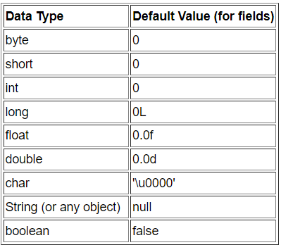
Default values and Dynamic Initialization
Default values
Dynamic Initialization
Java allows variables to be initialized automatically using any expression valid at the time of variable declaration.
Ex. double d = a * a (b * b)
Variable Scoping & Lifetime of a Variable
Scoping rules provide the foundation for encapsulation. There are block or method, class, instance scoping of variables. Scopes can be nested. Each time we create a block of code, we are creating a new, nested scope. When this occurs, the outer scope encloses the inner scope. This means that objects declared in the outer scope will be visible to code within the inner scope. However, the reverse is not true. Objects declared within the inner scope will not be visible outside it. Variables are created when their scope is entered and destroyed when their scope is left. This means that a variable will not hold its value once it has gone out of scope.
Scoping and Lifetime of a variable. An example.
Note: Compiler never assign a default value to an uninitialized local variable. We should assign a value to local variable otherwise Java compiler throws compilation error.

Slide 38
Automatic Type Conversions
Widening conversion – If two types are compatible, then Java will perform the conversion automatically. When one type of data is assigned to another type of variable, an automatic type conversion or Widening Conversion takes place if the following two conditions are met:
The two types are compatible
The destination type is larger than the source type
Type casting (narrowing conversion) – If conversion will not be performed automatically i.e. between two incompatible types we must use cast aka type casting. A cast is simply an explicit type casting or narrowing conversion.
Automatic type promotion in expressions –
All byte, short or char values are promoted to int when evaluating an expression.
If one type is long, then whole expression is promoted to long.
If one type is float then whole expression is promoted to float.
If one type is double then whole expression is promoted to double.

Slide 39
Arrays
In Java, arrays are objects. An array is a container that holds a fixed number of values of a single type.
The length of an array is established when the array is created.
Each item in an array is called an element, and each element is accessed by its numerical index.
We can also declare an array of arrays aka multi-dimensional arrays.
There are some useful utility classes and methods provided by Java to handle arrays such as System.arraycopy, java.util.Arrays.

Slide 40
Local Variable Type Inference
From Java 10, Local variable type inference was added to the Java language. This feature lets the compiler infer the type of a local variable based on the type of its initializer using a reserved type name i.e. var. ex: var name = “something”; var was added as a context-sensitive identifier i.e. Its usage depends on where it is used.
Rules for Local variable type inference:
The variable must be declared with var as type.
Context-sensitive Identifier: However a variable can also be declared with var name. It is allowed. ex: int var = 10;
It must include a initializer i.e. must assign a value or literal. var counter; is wrong.
var variable CANNOT be initialized to NULL.
Only one variable can be declared at a time. i.e. var one, two, three = 10; // is wrong.

Slide 41
Local Variable Type Inference
var CAN be used ONLY to declare a local variable.
  It CANNOT be used when declaring instance variables i.e class level variables.
  It CANNOT be used when declaring parameters.
  It CANNOT be used when declaring return types. ex. private var say() {..}
  It CANNOT be used as name of other reference types, interface, enumeration, annotation, as name of generic type parameter.
  It CANNOT be used to declare the exception type caught by a catch statement.
  It CANNOT be used in lambda expressions.
  It CANNOT be used in method references.
var CANNOT be used as a class name. ex: class var

Slide 42
Local Variable Type Inference
Arrays: var can also be used to declare arrays. But in wrong cases shown below, the use of [] is wrong because the type is inferred from the type of the initializer.
  var a = new int[10] // valid
  var[] a = new int[10] // wrong
  var a[] = new int[10] // wrong
  We CANNOT use var with array initializer i.e. var a[] = {1,2,3} // wrong.

Slide 43
Operators
Ternary, instanceof, unary, postfix, prefix,
Arithmetic
Increment, Decrement
Comparison Operators
Boolean Operators
Bitwise and Shift
Assignment (compound assignment as well)
Lambda Expression operator,

Slide 44
Operators
Simple Assignment Operator
= Simple assignment operator
Arithmetic Operators
+ Additive operator (also used for String concatenation)
Subtraction operator
* Multiplication operator
/ Division operator
% Remainder operator
Unary Operators
+ Unary plus operator; indicates positive value (numbers are positive without this, however)
Unary minus operator; negates an expression
++ Increment operator; increments a value by 1
-- Decrement operator; decrements a value by 1
! Logical complement operator; inverts the value of a Boolean
Equality and Relational Operators
== Equal to
!= Not equal to
> Greater than
>= Greater than or equal to
< Less than
<= Less than or equal to
Conditional Operators
&& Conditional-AND
|| Conditional-OR
?: Ternary (shorthand for if-then-else statement)
Type Comparison Operator
instanceof Compares an object to a specified type
Bitwise and Bit Shift Operators
~ Unary bitwise complement
<< Signed left shift
>> Signed right shift
>>> Unsigned right shift
& Bitwise AND
^ Bitwise exclusive OR
| Bitwise inclusive OR

Slide 45
Control Statements
If (if, if-else, if-else if, while, do-while, for (enhanced for loop), switch (nested switch)
Break, continue, return

Slide 46
Object Oriented Programming
Encapsulation
Inheritance
Polymorphism
SOLID principles

Slide 47
Strings

Slide 48
Static variables and methods
Static variable is a class level variable and they are common to all the instances of a class.
Only single copy of a static variable is created and shared among all the instances of that class.
Memory allocation of static variables only happens ONCE when the class is loaded (even before object initialization) into memory.
Static variables do not get inherited to sub classes.
Static members can access only static members.
Before Java 8, static variables are stored in Method Area. But from Java 8, static variables too are stored in (PermGen until Java 7) Metaspace Memory.

