Slide 1
PRINCIPLES OF DATA SCIENCE
Final project

Slide 2
Fuel Price Prediction
Submitted by:
Udiptaman Das 16340325
Muhammad Zeshan 16322691
Srikanth Pinisetti 16335581
Yaseen Shaik 16337624

Slide 3
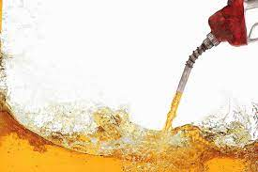
Introduction
Objective : Gasoline price prediction
Source: The raw dataset is created using multiple sources from the website https://www.eia.gov/

Slide 4
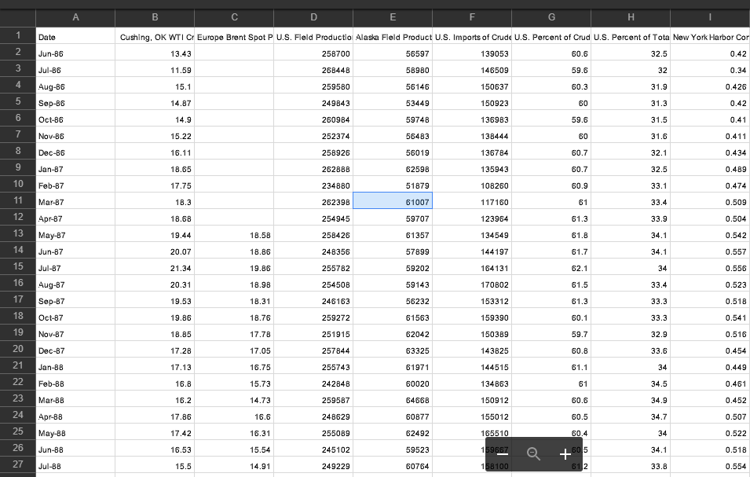
Data Cleaning
Alongside we have a snapshot of raw dataset
First we clean raw data using user defined classes available in Packages folder
QC
DP
In cleaning process, we specify our target variable and then fill missing values with respective medians

Slide 5
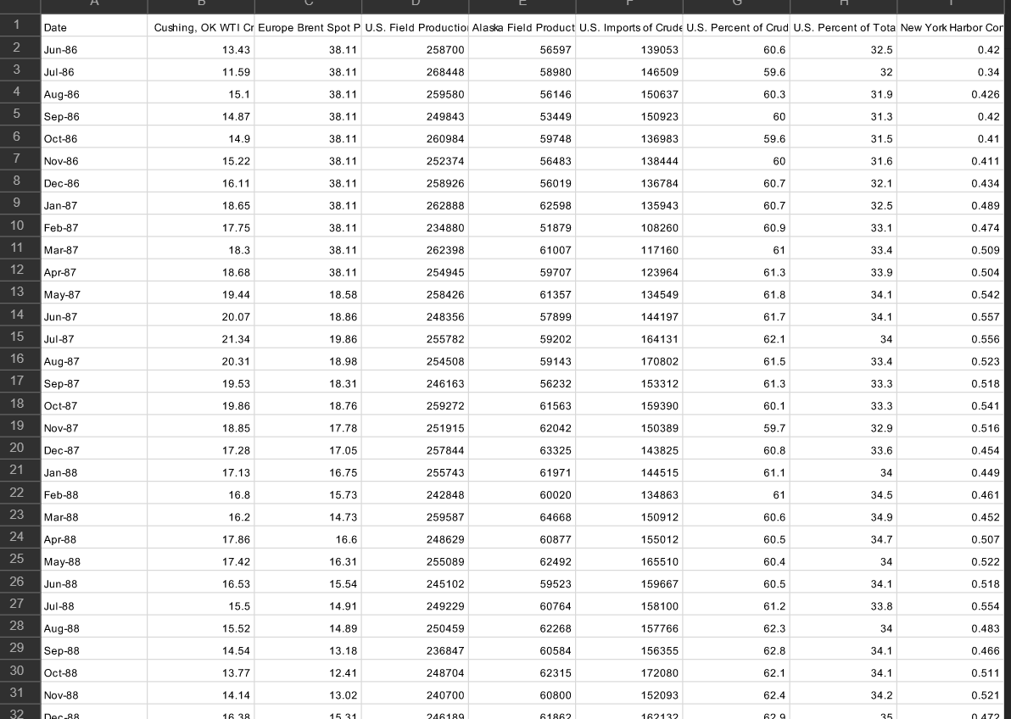
Data Cleaning
Save the cleaned data in another directory within the project
Perform quality check again on the cleaned data to confirm that our data is cleaned
This cleaned dataset is used to perform necessary predictions

Slide 6
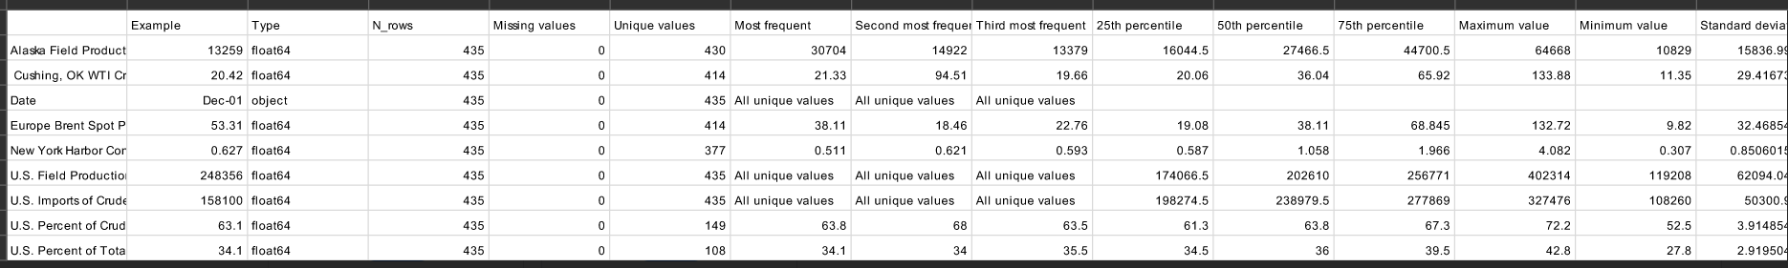
Data Cleaning
Here is the quality check of cleaned data. All missing values have been filled

Slide 7
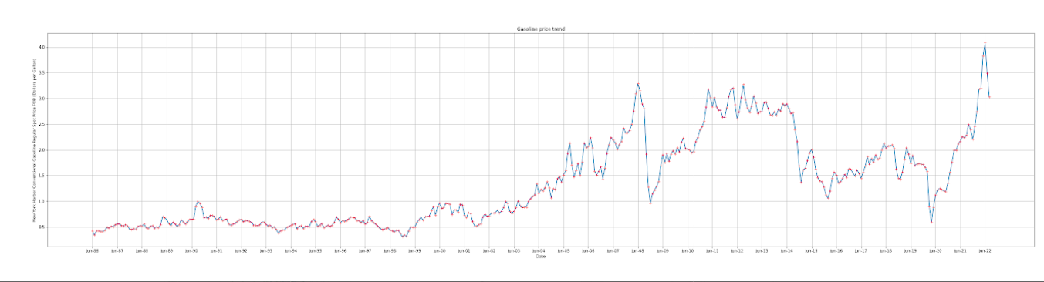
Exploratory data analysis
First we analyse the trend of our target variable throughout time.

Slide 8
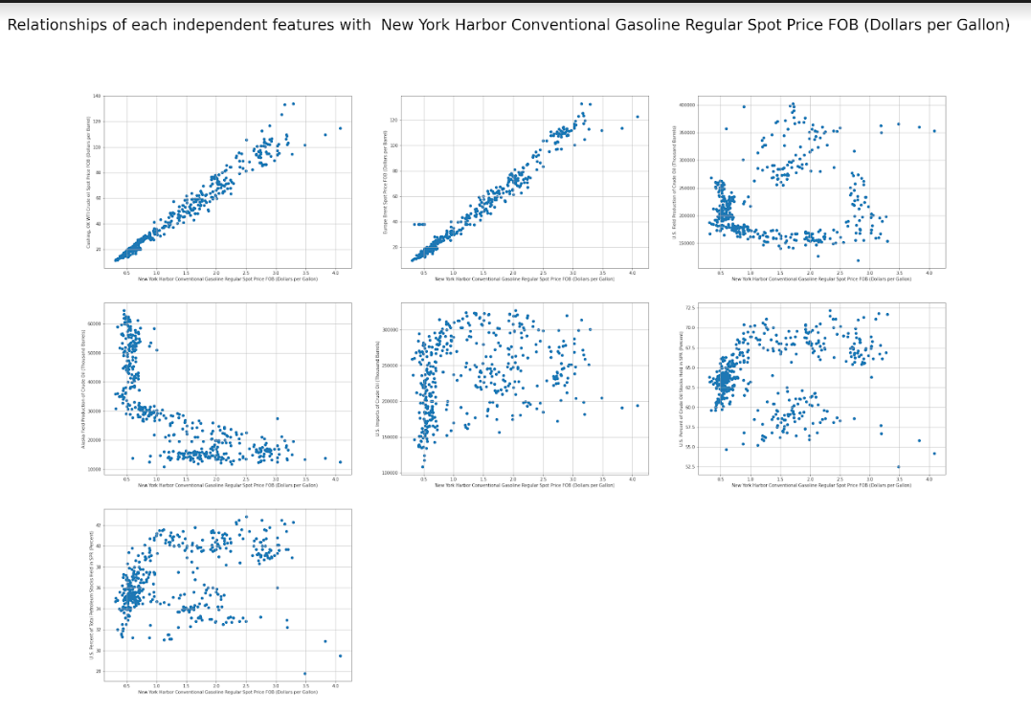
Exploratory data analysis
Next, we check relationship of each predictor with the target variable

Slide 9
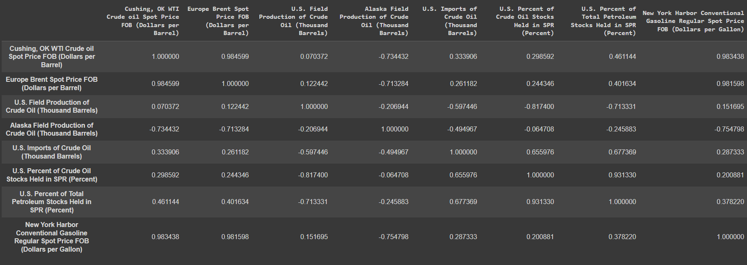
Exploratory data analysis
Here is the correlation matrix

Slide 10
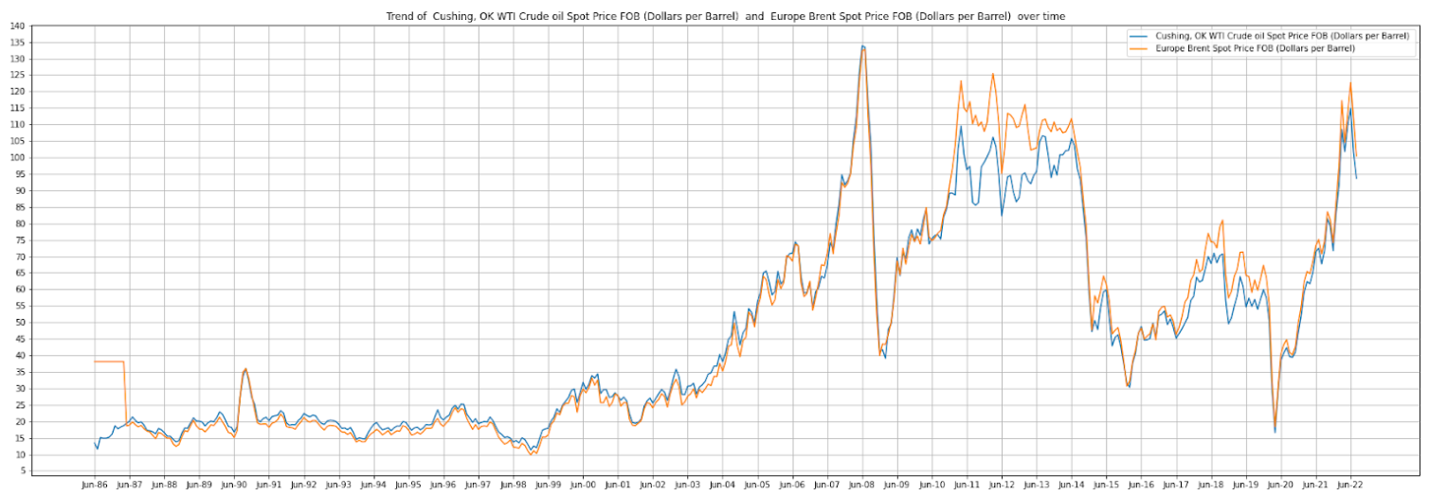
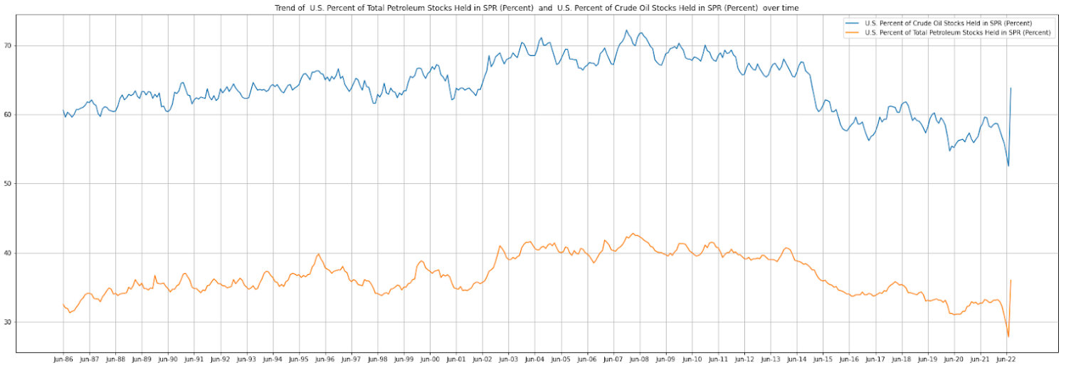
Exploratory data analysis
Correlation analysis
Correlation trend for crude oil price
Correlation between percentage of stock held in SPR

Slide 11
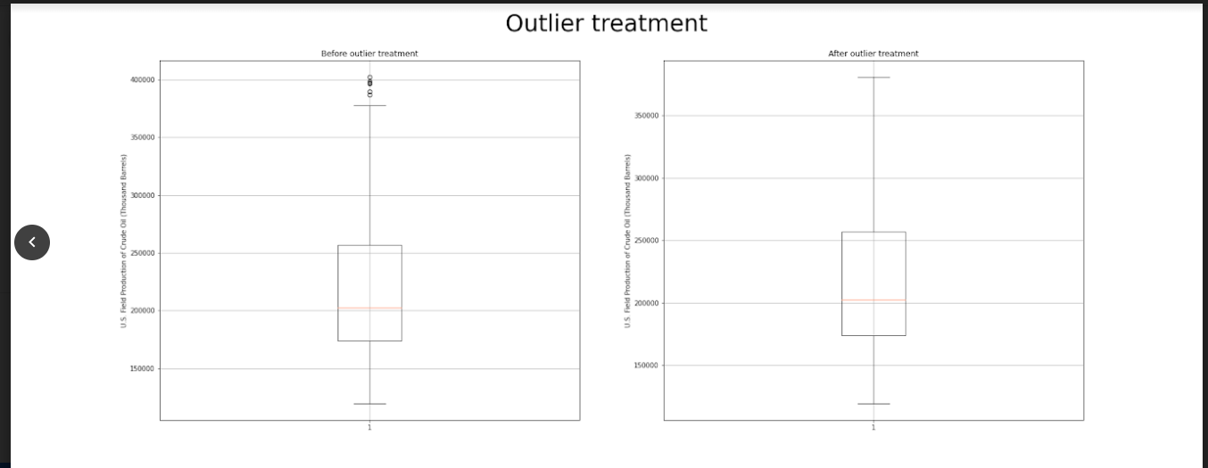
Model ready data
We take cleaned data , and prepare to fit it to the model
From quality check, we make sure that all values are numerical for prediction and there are no missing values
Next, we treat outliers

Slide 12
Model ready data
We have split the data into two parts:
80% into training set
20% into testing set
We then use min-max scaler to normalize the data and save all transformed and untransformed training and testing set in Model ready data folder

Slide 13
Linear Regression
We have two linear regressors one is for normalized data and other for untransformed data
Compare coefficients with transformed data and un transformed data.
Untransformed training data : [(' Cushing, OK WTI Crude oil Spot Price FOB (Dollars per Barrel) ', 0.017502729606208675), (' Europe Brent Spot Price FOB (Dollars per Barrel) ', 0.010081874940562134), (' U.S. Field Production of Crude Oil (Thousand Barrels) ', -4.1421025511866744e-08), (' Alaska Field Production of Crude Oil (Thousand Barrels) ', -1.3157210300967365e-06), (' U.S. Imports of Crude Oil (Thousand Barrels) ', 4.81028658661474e-07), (' U.S. Percent of Crude Oil Stocks Held in SPR (Percent) ', -0.030438789949787246), (' U.S. Percent of Total Petroleum Stocks Held in SPR (Percent) ', 0.013784801873997209)] Bias / Intercept = [1.4282748]
Normalised training data : [(' Cushing, OK WTI Crude oil Spot Price FOB (Dollars per Barrel) ', 2.140408803542702), (' Europe Brent Spot Price FOB (Dollars per Barrel) ', 1.2345255864722682), (' U.S. Field Production of Crude Oil (Thousand Barrels) ', -0.010537954166479013), (' Alaska Field Production of Crude Oil (Thousand Barrels) ', -0.06811356200707264), (' U.S. Imports of Crude Oil (Thousand Barrels) ', 0.10348850562463041), (' U.S. Percent of Crude Oil Stocks Held in SPR (Percent) ', -0.5996441620108095), (' U.S. Percent of Total Petroleum Stocks Held in SPR (Percent) ', 0.20677202810995748)] Bias / Intercept = [0.55244521]

Slide 14
Linear Regression
​ | Transformed data​ | Untransformed data​
Mean squared error​ | Train = 1.3856933287936959%​ Test = 1.3539917984432766%​ | Train = 1.3856933287936963% Test = 1.3539917984429322%​
Test R-2 & Test Adjusted R-2​ | R-2 = 97.81357344162683% Adjusted R-2 = 97.61983944278364%​ | R-2 = 97.81357344162738% Adjusted R-2 = 97.61983944278425%​
From the above We can observe that data normalisation did not affect prediction. Difference was observed only in coefficients due to normalization

Slide 15
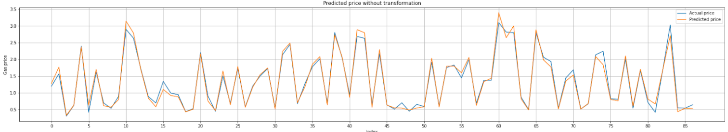
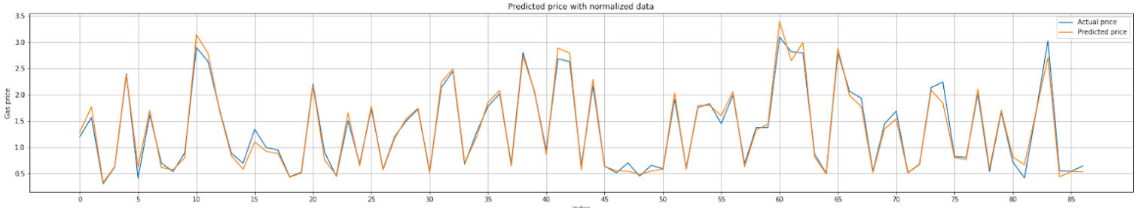
Linear Regression
Linear regressor predictions of test set without normalized predictors
Linear regressor predictions of test set with normalized predictors

Slide 16
Linear Regression
Observation:
Normalization of predictors show changes in their respective coefficients only
On examining the above plots, we can conclude that feature transformation had no effect on the predictions
The effect of feature transformation can be seen more distinctly in case of feature importance; as seen in case of the coefficients

Slide 17
Decision tree regressor
These are the parameters and their default values of our decision tree regressor: 'ccp_alpha': 0.0, 'criterion': 'squared_error', 'max_depth': None, 'max_features': None, 'max_leaf_nodes': None, 'min_impurity_decrease': 0.0, 'min_samples_leaf': 1, 'min_samples_split': 2, 'min_weight_fraction_leaf': 0.0, 'random_state': 10, 'splitter': 'best'
On performing GridSearchCV, we find best parameters based on best score: {'criterion': 'squared_error', 'max_depth': 7, 'max_features': 'sqrt'} with best score of 0.9644057200188911
And next we compare performance of models with best parameters and manually set parameters.
 | Grid search params |  | Manually set params
 | Training | Testing | Training | Testing
Mean squared error | 0.29810% | 2.40019% | 0.84220% | 1.44189%
R-2 score | 99.60117% | 96.12417% | 98.87323% | 97.67163%
Adjusted R-2 score | 99.59296% | 95.78074% | 98.85003% | 97.465%

Slide 18
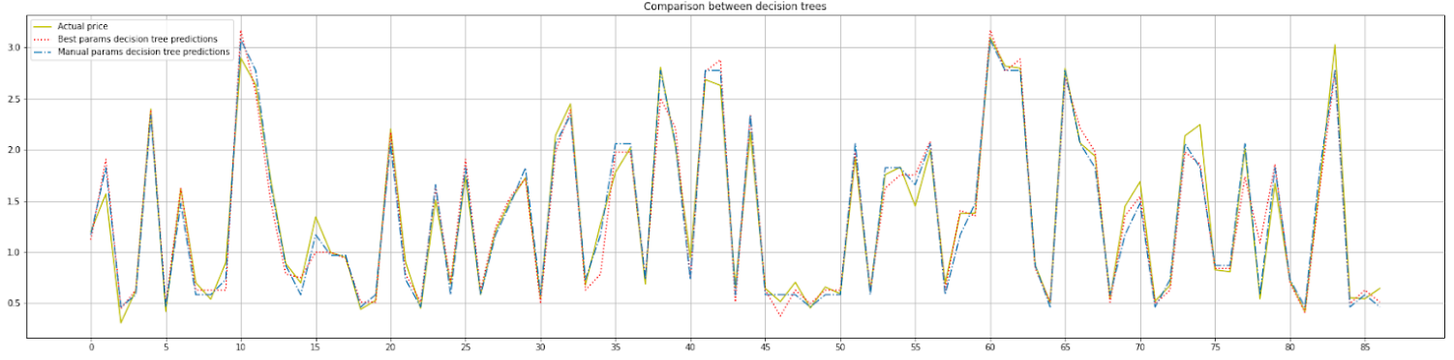
Decision tree regressor
Decision tree parameters from grid search seems to have overfit compared to manually selected parameters. Thus merely considering score on training set or test set alone to determine model performance is not advisable
Next, we compare predictions of the decision trees from the following visualization

Slide 19
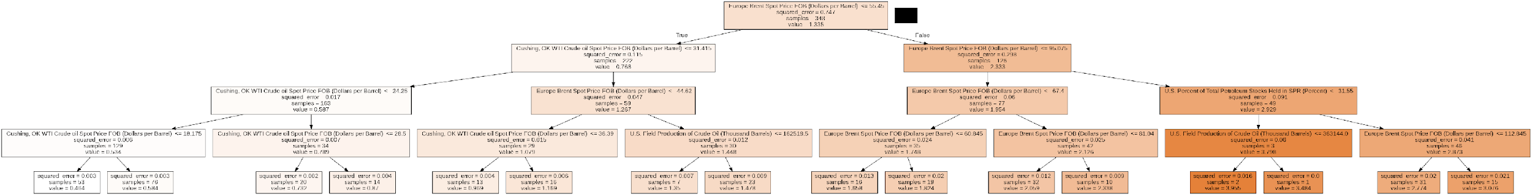
Decision tree regressor
We can even plot the decision tree if anyone is interested in knowing the underlying workflow

Slide 20
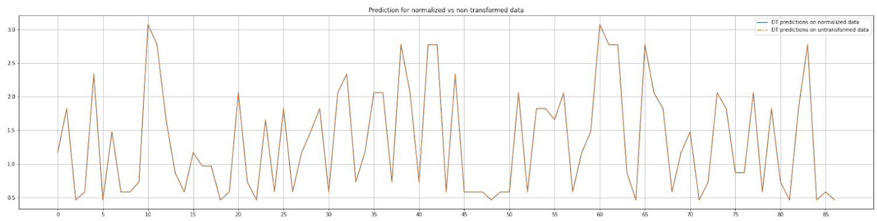
Decision tree regressor
We also compare prediction of decision tree with manual parameters on normalized data and untransformed data
There is an overlap, which suggests feature scaling has no effect on prediction

Slide 21
Random forest
We perform Grid search cross validation to find these best parameters: {'bootstrap': True, 'criterion': 'squared_error', 'max_features': 'auto', 'n_estimators': 110}; based on best score: 0.9872783596886215
Next, we compare training and testing performance of the model
 | Training | Testing
Mean squared error for best params | 0.12763% | 1.15746%
R-2 score | 99.82924% | 98.13093%
Adjusted R-2 score | 99.82573% | 97.96532%

Slide 22
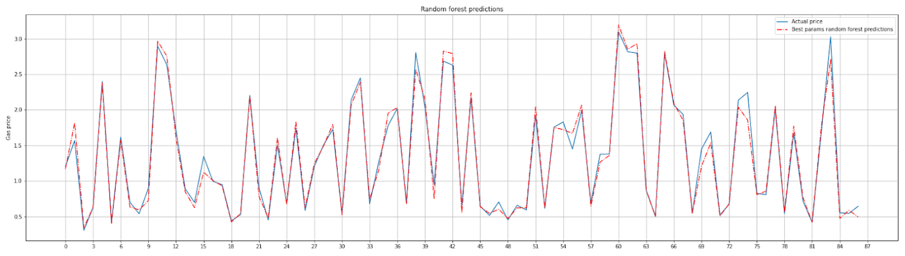
Random forest
Following plot helps us visualize performance of our model

Slide 23
XGBoost
Grid search cross validation gives us the following best parameters: 'base_score': 0.9, 'booster': 'gbtree', 'gamma': 0, 'learning_rate': 0.07, 'max_depth': 3, 'n_estimators': 175, 'subsample': 0.75}; based on best score: 0.9875181255362901
Next, we analyse the model’s performance
 | Training | Testing
Mean squared error for best params | 0.15284% | 1.07420%
R-2 score | 99.79552% | 98.26538%
Adjusted R-2 score | 99.79131% | 98.11168%

Slide 24
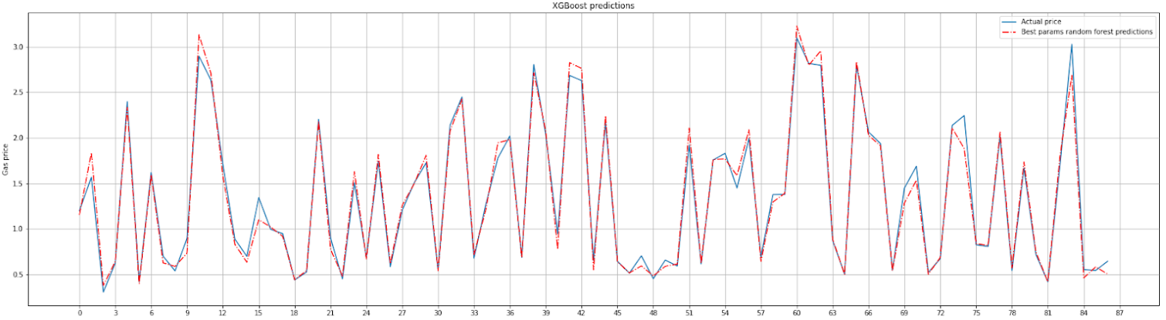
XGBoost
We can visualize our model’s performance using the following plot

Slide 25
Scope for development
Check effect of correlation on predictions for all the regressors
Check feature importance and retrain decision tree on those features
Compare performance of random forest regressor with grid searched parameters with regressors having different manual parameters
Take a larger parameter grid for XGBoost regressor for grid search

Slide 26
Thank you !!!

