Slide 1

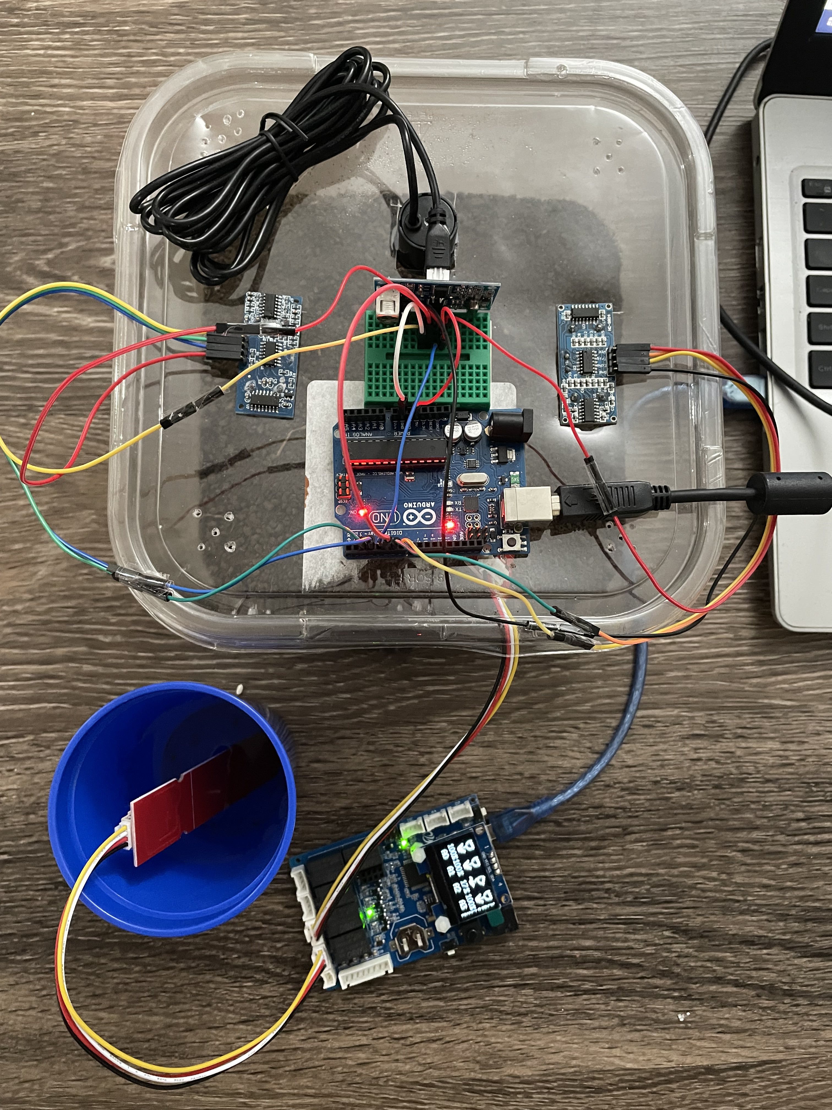
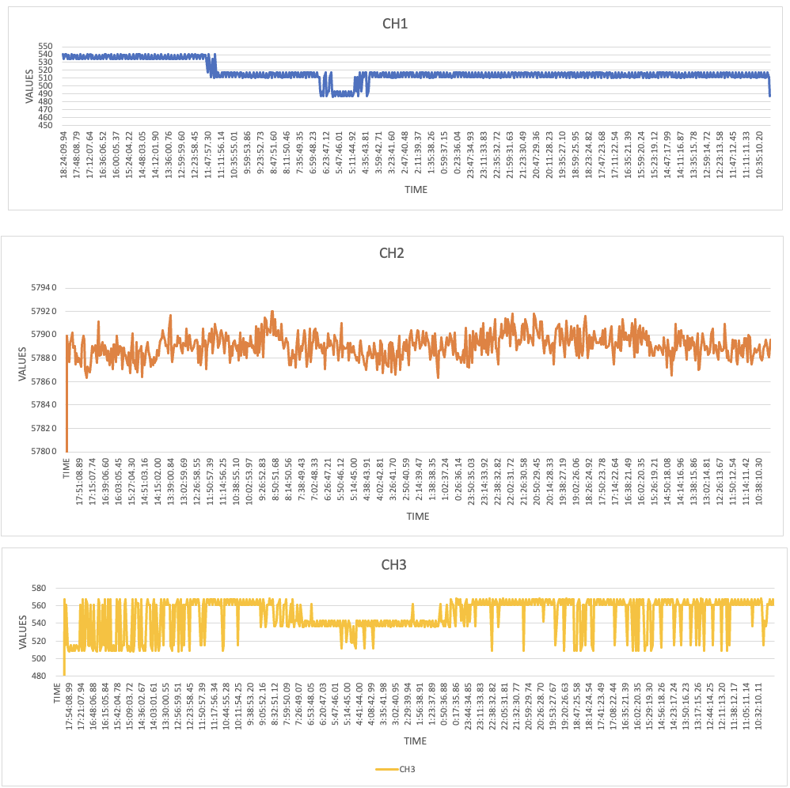

Smart Irrigation using Ultra Sonic Senor
Rajesh Kumar, Babji Kilaru, Sai Charan, Ranjit Reddy, Srikanth, Aravind, Sandeep, Janardhan Movva
Advisor: Dr. Sejun Song, University of Missouri – Kansas City
MOTIVATION:
Several IOT projects have been emerging on soil moisturizing methods for agricultural fields over the past decade. The current soil moisture method is applicable to smaller areas, but it is ineffective in wider agricultural fields. So, our main motivation is to implement the soil moisture technique in large area of agriculture field which accurately monitors the moisture of soil.
MOTIVATION:
CURRENT PROBLEMS SOIL MOISTURE SENSOR
WORKING OF SMART IRRIGATION
In wider agricultural area, soil moisture sensors has to be placed in entire field & main disadvantage is Cost expensive and it is not wireless.
These moisture sensors can be damaged by access amount of water due to natural calamities like Floods, Cyclone etc.
Devices used Arduino Uno, Ultrasonic sensor, Wet soil & Dry soil and Excel Data Stream in soil moisture project.
Firstly, To analyze the moisture levels of wet soil and dry soil using soil moisture sensor, we used existing methodology and captured the data into excel stream.
Replaced soil moisture sensors with ultrasonic sensors in both the soil types. An algorithm is written in a way that collects the time duration of moisture molecules of both wet & dry soil in a time interval of every 1 minute..
These ultrasonic sensors should be facing towards soil and kept in different position.
For every 1-minute interval of time, the data is collected form all the three sensors and sent to excel sheet.
Finally, the data collected after three days and drawn a graphical representation where x-axis as time and y-axis as ultrasonic sensor value.
A slight difference is shown in the graph of wet soil and dry soil as shown in the output graph.
OUR SOLUTION FOR WIDER AGRICULTURAL AREA
Using RSSI(Received Signal Strength Indicator) and Triangulation for tracking the devices indoor.
Using signal strengths, gives accurate and precise distances.
It is of low cost, does not require extra hardware requirements.
Main advantage of RSSI is, it does not have line of state channel compared to other approaches.
ULTRASONIC SENSOR
It measures the distance of a moisture level by emitting ultrasonic sound waves and converts the reflected sound into an electrical signal.
The time duration of a wave sent and reflected when hits by moisture molecule of soil is taken.
OUTPUT GRAPH
CONCLUSION
Successfully, we are able to measure the moisture level of different soil groups using ultrasonic sensor.
Future work involves the path tracking using GPS which keeps the track of each route.
https://github.com/therealsrikanth/soilMoistureDetectionUsingUltrasonicSensor.git

