Slide 1
Tourism Package Adoption
Srikanth PR
July 2021

Slide 2
Business Problem Understanding
Company is planning to launch a long term travel package for their customer’s.
Product Manager have access to existing customer’s data and information from which he wishes to analyse the trend of customers to figure out which customer is going to purchase the long term travel package.
Objective:
Identify which customer’s will purchase long term travel package.
To understand the interaction between the customer demographics and the company sales strategy.
Explore and visualize the dataset using central tendency and other parameters.

Slide 3
Business Problem Understanding
Analyze the different attributes of the customer with the product purchased which can help us in analyzing the prediction of tourism package adoption.
Build various classification models to predict whether a person will take travel package or not.
Understand which variables are most significant?
Generate a set of insights and recommendations that will help the business to increase their sales revenue.

Slide 4
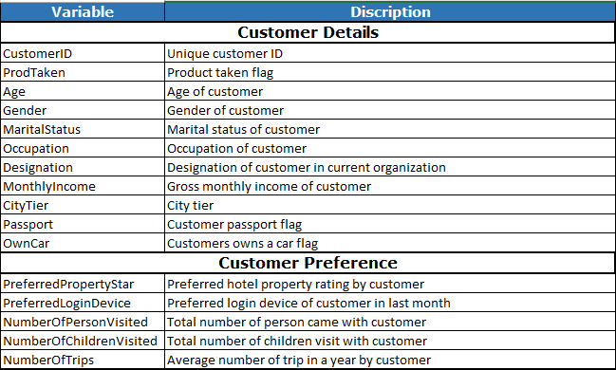
Data Information
Tourism dataset has 4888 records and 20 variables including the target variable.

Slide 5
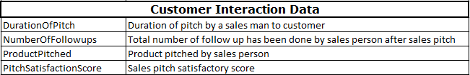
Data Information
Data–types of the variables:
Age, Monthly Income and Duration of Pitch are of continuous numerical data-type.
City-tier, preferred property star, Pitch Satisfaction Score and Designation are of ordinal data-type.
Customer ID is an unique Identifier and ProdTaken is our target variable which is of binary data-type.
Number of Follow-ups and Number of trips variable is of continuous data-type needs to be converted to categorical data-type by creating bins using quantile method or manual method.
Rest all of the variables are of categorical data-type.

Slide 6
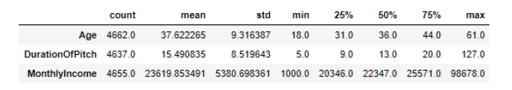
Exploratory Data Analysis
Summary statistics of Numerical Variables:
Age of the customers vary from 18 years to 61 years.
Minimum duration of Pitch is 5 and Maximum is 127. Measurement of Pitch is in minutes, seems to have a presence of an outlier.
Monthly Income vary from 1000 to 98678. Variance is too high.

Slide 7
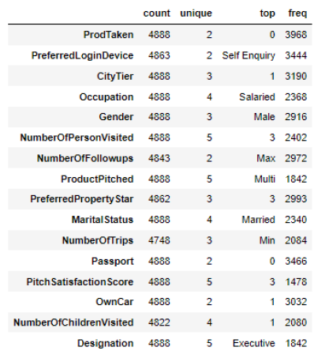
Exploratory Data Analysis
Summary statistics of Categorical Variables:
Most of the customers are male and are married.
Most of the customer’s occupation type are salaried and their designation is executive.
Most of the customers do not have a passport.
Most of the customers have their own car.
Most of the customers are from City-Tier 1
Most of the customer preferred 3 star rating property.
Most of the customers came into the company's contact by doing a self-Enquiry and number of person visited along with customer is 3 and at least 1 child visited along with the customer.
Average number of trips in a year made by most of the customers is either 1 or 2.
Maximum number of follow-ups have been made by sales person most of the times.
Product ‘Multi’ is pitched by sales person most of the times.
Sales pitch satisfactory score for most of the sales person is 3.

Slide 8
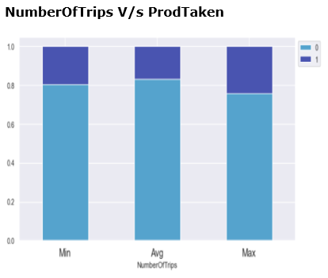
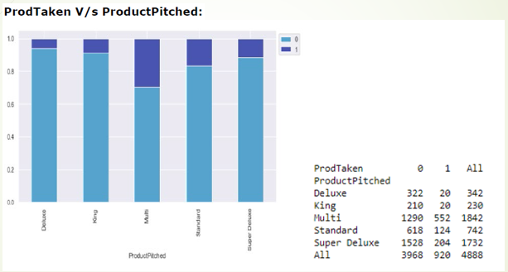
Exploratory Data Analysis
Customer who prefers to travel min(1 or 2) trips per year and max(>6) trips per year has higher chances of buying tourism package.
The package was purchased by those customers to whom the Multi product was pitched, followed by standard product.

Slide 9
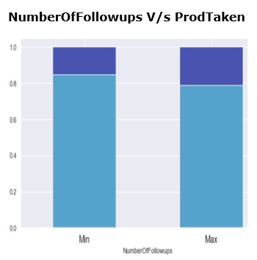
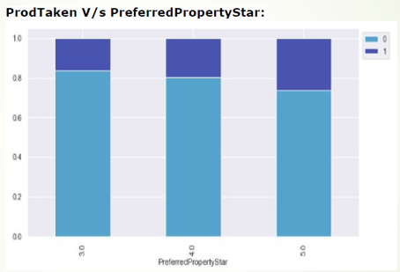
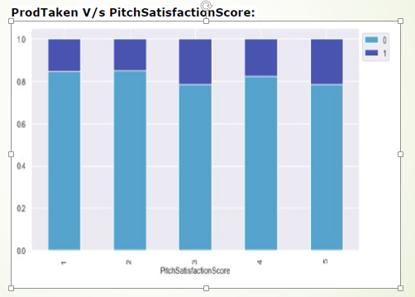
Exploratory Data Analysis
The chances of purchasing increased as the number of follow-ups went up. With max (>4) showing good chance of the customer purchasing the package.
Chances of purchasing product increases has the property rating increases.
Customers who have given a PitchSatisfactionScore of 3 or 5 have purchased the travel package more.

Slide 10
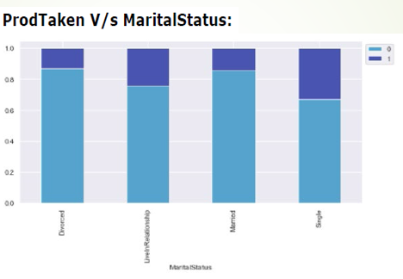
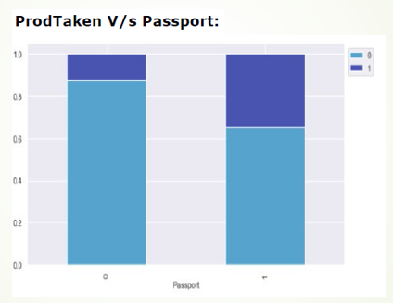
Exploratory Data Analysis
Customers who are single and LiveInRelationship people has purchased the travel package more than married or divorced.
Customers who have a passport have higher chance of purchasing the travel package than those without one.

Slide 11
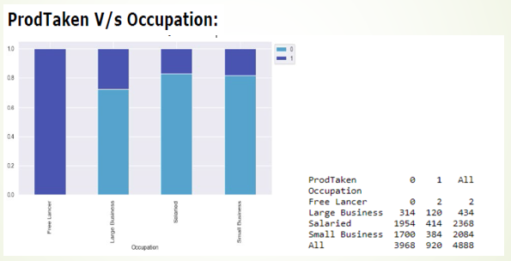
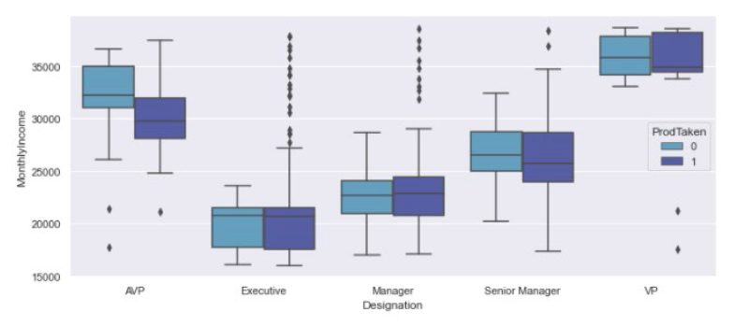
Exploratory Data Analysis
We can see that all of the customers who are Free Lancers (though we have only 2 such customers in this dataset) have purchased the product.
Customers who are into Large Business have purchased the product.
As Designation of a person changes monthly income increases, and buying pattern for VP and AVP most of the customers did not prefer to buy.

Slide 12
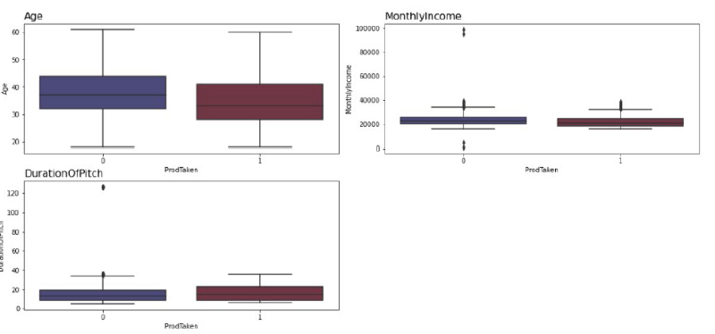
Exploratory Data Analysis
Tourism package has been taken mostly by customers who are of less than 40 years of age.
There isn't a much difference in the monthly income of customers who have and have not taken the package. Majority of the customers monthly income is less than 40000.
Package has been taken when there is higher duration of pitch.

Slide 13
Data Pre-processing
Missing Value: There were a lot of missing values in the data set which were treated on case by case basis.
Outlier Detection: Outlier Detection was performed but based on analysis we have chosen not to treat them as those values seem to possible for the given data set.
Data Type conversion of columns :Some of the columns were converted to category data type using Dummy encoding technique.
Data Correction: Gender Column value ‘Fe Male’ were replaced by ‘Female’ and from Marital status column ‘Unmarried’ were replaced by ‘LiveInRelationship’ [Assuming person not married but having a partner].
Data Imbalance: Distribution of Target variable is 81:19. Since we have a significant imbalance in the distribution of the target classes, before building model we will use stratified sampling to ensure that relative class frequencies are approximately preserved in train and test sets.

Slide 14
Model Building Approach
Model building is an iterative process. The model performance on both train and test dataset can be improved using feature engineering, feature extraction, hyper-parameter tuning (by changing the combinations of various parameters).
A model has to match the business objective and hence various permutation and combination can be tried on to refine the model.
In this case following models have been performed:
Linear based models: Logistic regression and Linear discriminant analysis.
Tree based models: Decision tree and Random forest.
Ensemble models: Bagging and Boosting classifier.

Slide 15
Model Building Approach
Model building steps involved:
Data preparation
Partition the data into train and test set [70:30].
Build model on the train data.
Tune the model if required.
Test the data on test set.
Model Tuning using Grid Search:
Grid search builds a model for every combination of hyper-parameters specified and evaluates each model.
The parameters of the estimator/model used to apply these methods are optimized by cross-validated grid-search over a parameter grid. Scoring parameter used in this case is recall in order to get better score.

Slide 16
Best Optimum Model
Model can make wrong predictions as:
Predicting a customer will purchase travel package but the customer ultimately does not purchase the package. Type-1 error or false positive. (Actual=0, predicted=1).
Predicting a customer will not purchase travel package but the customer purchases the travel package. Type-2 error or false negative. (Actual=1, predicted=0).
Which case is more important?
Type-2 error needs to be reduced. In order to do so Recall needs to be increased. If Recall increases, Sales will increase and it will bring good revenue to the company.
Type 1 error anyhow we know those customer will not buy the plan but if due to our model miss if we target those customer it is good if there's even 10-20% conversion rate.(so not a issue).

Slide 17
Model Comparison

Slide 18
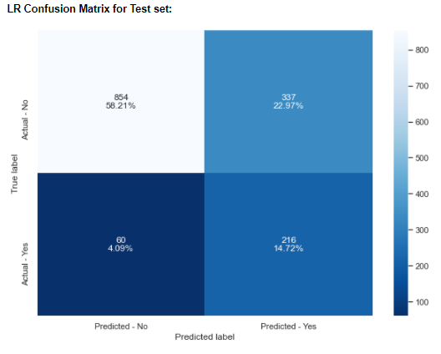
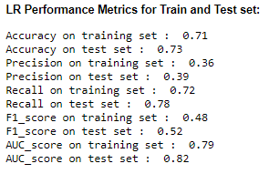
Best Optimum Model
The final best optimum model selected is simple weighted Logistic Regression with a better accuracy score of 71% on train and 73% on test set and followed by recall score of 72% on train and 78% on test set.

Slide 19
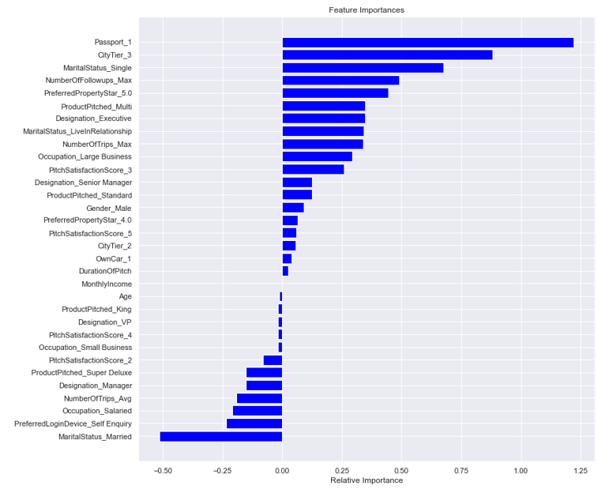
Feature Importance
Passport_1, City Tier_3, MaritalStatus_Single, NumberOfFollowups_Max, PreferredPropertyStar_5.0 are the top 5 important significant features to increase sales.
MaritalStatus_Married, PreferredLoginDevice_SelfEnquiry, Occupation_Salaried, NumberOfTrips_Avg, Designation_Manager are 5 significant features which will reduce the sales.

Slide 20
Business Insights and Recommendations
To increase sales revenue Target customers whose:
Age is less than 40 years.
Gender is Male.
Marital Status is Single and LiveInRelationship.
Occupation belongs to Large Business.
Designation belongs to Executive and Senior Manager.
Target Customer who have passport has higher chances of buying tourism package.
Target Customer who belongs to city tier 3 has higher chances of buying the tourism package.
Target Customer who prefers to stay at 5 star rating property has higher chances of buying.

Slide 21
Business Insights and Recommendations
Suggest Business to expand their business at city tier 3 in order to increase the revenue.
Suggest Business to increase the duration of sales pitch and also to increase the number of follow-ups made by sales team which will definitely generate a good amount revenue to the company.
Product Super Deluxe is having no impact to business, recommend to change product policy or offers, so that in future could help to increase sales.
Suggest business to focus on collecting more data whose occupation is free Lancers has we had only 2 records and both the customers bought the tourism package.
Suggest business to improve or attract the customers who comes in contact with company through self-enquiry. At least with 10-20% conversion rate would increase company.

Slide 22
Thank You

