Slide 1
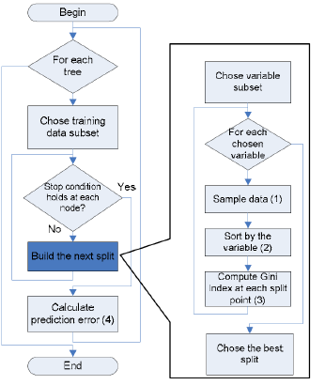
Random Forest Algorithm:

Slide 2
Testing:
Test Case Id | Test Case Name | Test Case Desc. | Test Steps |  |  | Test Case Status | Test Priority
 |  |  | Step | Expected | Actual
Register 01 | User Register | To Login into the application user must be registered | Without registration | User cannot login into the system | Registration successfully completed and user can login into the system | High | High
Login 02 | User Login into the system | To detect malicious mails user need to login into the application | If the user enter wrong username and password | Then, login fail | Display home page to the user | High | High
Upload 03 | Uploading mails | Uploading the mails into the system to detect the malicious mails | If user may upload another data | User cannot processing that data | Mails can preprocessing | High | High
Preprocessing 04 | Preprocess the mails | To view the features of the mails we can preprocess the uploaded mails | If we upload another data means, not mails | Nothing will be displayed | User can view the features of mails | High | High

Slide 3
Testing:
Feature Extraction 05 | Extract the features of mails | After view the mail features user can extract those features | If upload another data | User can view the features of mails but not related to uploaded data | extract the features of uploaded mails | High | High
Classification 06 | Classify the extracted features | User can perform the classification to analyze the mails | If upload another data | User can view the classification details as trees | User can view the classification details as trees | High | High

Slide 4
Conclusion:
Targeted Malicious Email (TME) presents a great risk for those organizations plagued by it. The impact of sensitive data loss can be severe not only to a company but also to a country.
This study aimed to demonstrate that incorporating persistent threat and recipient oriented features results in a detection capability that is superior to conventional email filtering techniques.

Slide 5
Future Enhancement:
Organizations can track features that characterize the types and amounts of email received by a particular email address.
For email with hyperlinks, we could develop features to indicate whether the domain of a link has ever been visited before.
As organization and recipient-oriented information evolves, we would evolve our techniques accordingly.

Slide 6


