Slide 1
Marena Food Ordering Web Application
By Srikanth Sarma, Praveen Raj & Pranshu Datta

Slide 2
Index
Objective
Front-End
Responsive Layout
Back-End
Databases

Slide 3
Objective
Marena Food Ordering Web Application is designed for members of the college to ease the process of food ordering from Marena by building an automated web application that lets users simply place an order on the application instead of standing in a queue to order food. Menu and food availability can be easily checked on the web application.
The data will be stored in a MongoDB management system.

Slide 4

Front-end
HTML5
CSS 3
JavaScript ES6
jQuery 3.4.1
Bootstrap 4.3.1
Vue.js 4.2.2
Popper.js v1

Slide 5
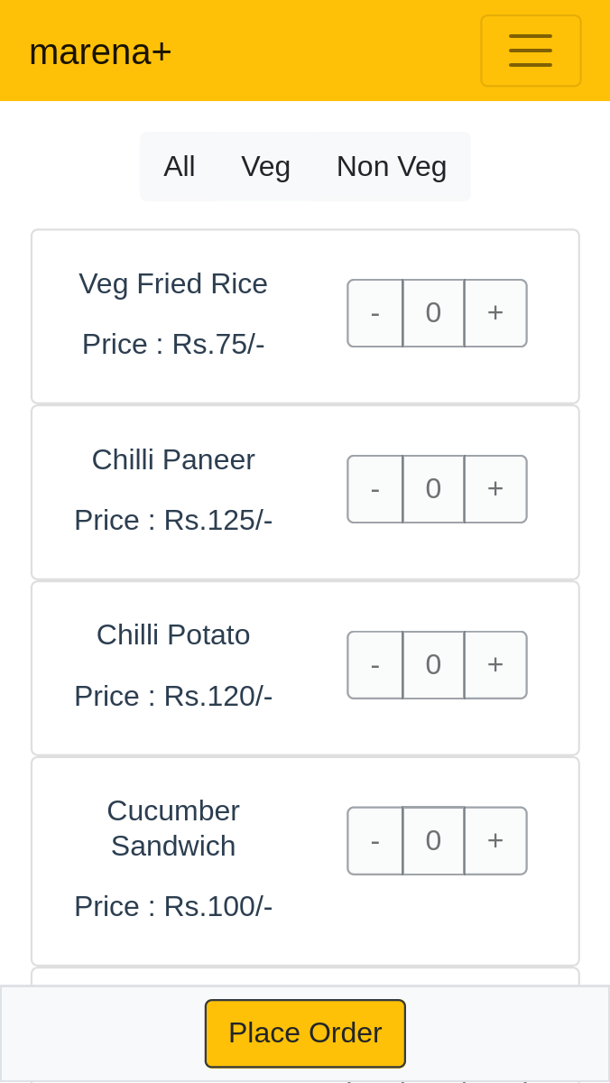
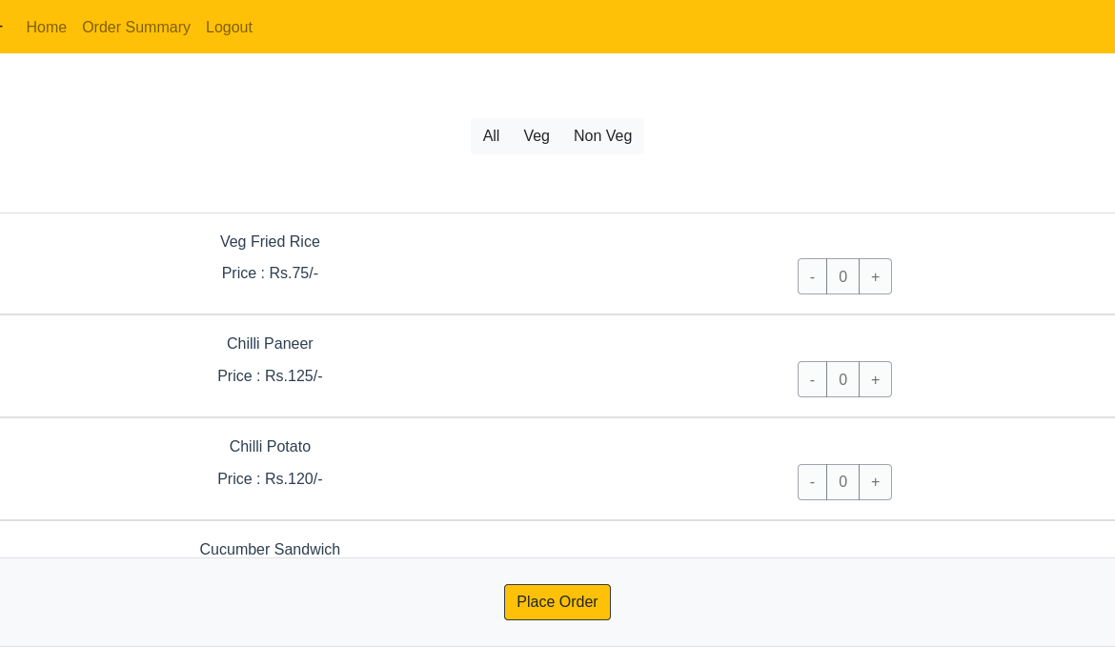
Responsive-layout

Slide 6

Back-end
Linux 7.3.10
Node.js 12.15.0
Postman 64.7.17.0
MongoDB Atlas 4.2.3
Insomnia 7.0.6
Mongoose 5.8.11
Express 4.17.1
Body-Parser 1.19.0
CORS 2.8.5

Slide 7
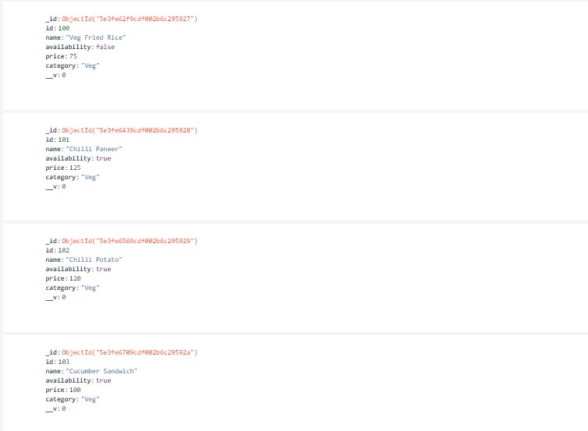
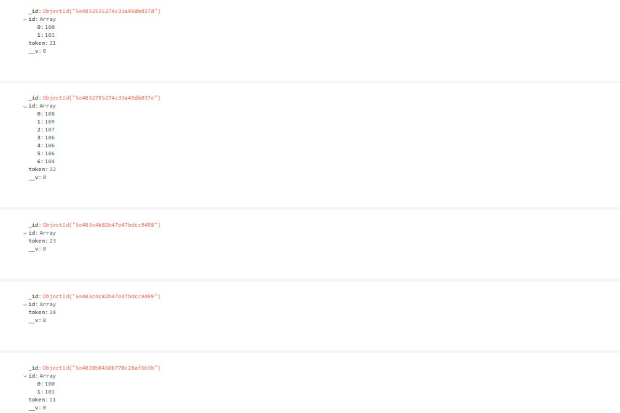
Database Collections (1/2)
Food list Collection
Order Collection

Slide 8
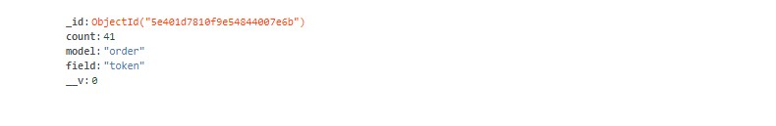
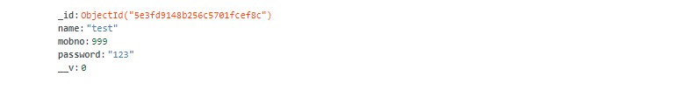
Database Collections (2/2)
Identitycounter Collection
Signup Collection

Slide 9
Thank You!

