Slide 1
Eventually Perfect Failure Detectors using ADD Channels
Srikanth Sastry and Scott M. Pike
Dept. of Computer Science
Texas A&M University, USA

Slide 2
Unsolvable Problems
Many fundamental problems unsolvable in asynchronous systems with crashes
Why? Because crashed processes are indistinguishable from slow processes
Notes:
It is a well established fact that many fundamental problems in distributed computing are unsolvable in asynchronous systems where processes are subject to crash faults.
Since, in asynchronous systems, processes can be arbitrarily slow, and messages can be arbitrarily delayed, crashed processes are indistinguishable from slow processes.
This makes crash fault detection problematic, and many fundamental impossible to solve.

Slide 3
Circumventing Impossibility
Explicit Partial Synchrony
  Provide guarantees on system parameters
  Algorithms make use of underlying system parameters.
Failure Detectors
  Provides guarantees on crash detection
  Algorithms make use of failure detector properties
Notes:
There are two approaches to circumventing this impossibility:
The first approach is to assume a stronger system model, by adopting models of communication and computation that provide certain guarantees on messages delay, process speeds, and other system parameters. Such systems are referred to as partially synchronous systems.
Algorithms designed with respect to such explicit partial synchrony are coupled to the underlying system parameters.
In many instances, these parameters are known only to system administrators and not to application developers. And in systems with multiple administrative domains, these parameters may not be known at all.
Hence, practically speaking, these algorithms either (a) cannot be designed due to lack of sufficient information about the system, or (b) are not portable across networks with different system parameters and/or values.
Alternatively, there is a second approach using what are known as failure detectors. Failure detectors can be viewed as an encapsulation the partial synchrony in a system to provide (potentially incorrect) information about process crashes in the system.
Such failure detectors can be provided by the system administrators, and algorithms can now be designed with respect to these failure detectors.

Slide 4
Failure Detectors
A distributed oracle which can be queried for (potentially unreliable) information about process crashes
Oracles can make mistakes:
  False negatives (fire, but no alarm)
  False positives (alarm, but no fire)
Notes:
FDs are distributed oracles that provide (potentially incorrect) information about process crashes.
These oracles can make two kinds of mistakes:
False negative mistakes - Like a fire alarm not going off when this is a fire.
False positive mistakes - Like a fire alarm going off when there is no fire.
Oracles and FDs are interchangeable terms

Slide 5
Two Research Avenues
Theory: Relative solvability of problems using failure detector oracles
Practice: Implementability of oracles as system services in weaker system models
Notes:
In the last 15 years, Failure detectors have have spawned two lines of research:
The first line of research is theoretical. It is the study of relative solvability of problems using failure detectors. E.g.: what’s the weakest failure detector to solve a given problem. If two problems are solvable using a given failure detector, then what is relative hardness of these problems. Can one problem be converted to another? Etc.
The second line of research is more practical. It is the actual implementation of failure detectors in various system models. Such implementations view failure detectors as a system service. The weaker the systems in which the failure detectors are implemented, the more portable and applicable the failure detector is.

Slide 6
Our Contribution
Weakest-to-date model of partial synchrony to implement the Eventually Perfect failure detector (◊P) oracle.
Notes:
We present the weakest-to-date model that is sufficient to implement the eventually perfect failure detector <>P.
Simply put, <>P is a failure detector that can make mistakes initially, by incorrectly suspecting correct processes, but can do so only finitely many times. Eventually, it stops making mistakes and gives correct information about process crashes in the system.
<>P is an important failure detector for two reasons:
It is powerful enough to solve many fundamental problems in distributed systems
It is practically implementable in real networks.
Our proposed system model is called Average Delayed/Dropped (ADD) model.

Slide 7
Significance
Most oracle implementations rely on timeout
Notes:
Our model is of significance because:

Slide 8
Eventually Perfect Failure Detector (◊P)
Strong Completeness
  Every crashed process is eventually suspected
Eventual Strong Accuracy
  Every correct process is eventually NOT suspected
◊P Eventually Stabilizes
  No false negatives
  Finitely many false positives
Notes:
<>P is a FD that eventually provides correct information about process crashes. <>P is allowed to make only finitely many mistakes.
<>P is not allowed to make any false negative mistakes. I.e. it must suspect crashed processes. This property is known as strong completeness: Every crashed process is eventually and permanently suspected by all correct processes.
<>P can make finitely many false positives. I.e. it can falsely suspect correct processes as crashed, but can do so only finitely many times. Eventually, it has to stop suspecting correct processes. This property is called eventual strong accuracy: Eventually, no correct process is suspected by any correct process.
<>P is said to be a convergent oracle because, although it can make mistakes initially, it eventually converges to a point from whereon no more mistakes are made.
Despite making such mistakes, <>P is powerful enough to solve some fundamental problems in fault tolerant distributed computing like:
Fault-tolerant consensus,
Stable leader election,
Quiescent reliable communication,
Wait-free non-blocking contention management,
Wait-free eventual weak exclusion,
Dining philosophers problem with crash-locality 1, etc.
Yet, it is practical enough to be implemented in system models that mimic real network with remarkable fidelity

Slide 9
Existing Implementations
Based on adaptive timeout mechanisms
Previous assumptions
  Message delay is (eventually) bounded
  Channels are (eventually) reliable
We implement <>P with ADD channels
  Infinitely many messages can be delayed
  Infinitely many messages can be dropped
Notes:
Most failure detectors rely on some form of timeout. Failure detectors (FD) expect correct processes to send messages within given (adaptable) duration. Quiescence of a process is grounds for suspicion.
Existing models sufficient to implement FDs provide guarantees on temporal bounds with respect to system parameters that ensure that messages arrive ‘on time’.
They assume that these temporal bounds are absolute and hold either perpetually, or eventually for all messages in the system.
However, these models assume that channels are reliable, and
There are several variations on simplifying assumptions.
These assumptions are convenient, but not practical.
Message loss is real in real systems.
Periods of asynchrony due to denial-of-service attacks, high server load, congestion etc. are unavoidable.
Our model does not assume reliable channels, and the bounds do not hold for all messages, and the bounds are not absolute.

Slide 10
Average Delayed/Dropped (ADD) Channels
Channels can be unreliable; can lose messages infinitely often.
Messages can be arbitrarily late.
Only a subset of messages have to be ‘timely’.

Slide 11
ADD Channels
(Average Delayed/Dropped)
Every message sent is either privileged or non-privileged
Non-privileged messages
  No timing or reliability guarantees
Privileged messages
  Some timing and distribution guarantees

Slide 12
Privileged Messages
There exists two unknown constants per run
  W: window size
  D: message delay
Every window of W consecutive messages contains at least one privileged message
In every sliding window W, the average delay of all privileged messages never exceeds D
Notes:
Pause and explain.
Consider a stream of messages sent on an ADD channel.
Take any W consecutive messages sent.
In this window of W consecutive messages, at least one message is privileged.
Additionally, the average delay of all privileged messages in this window never exceeds D.
To elucidate further, consider message no. 1 through message no. W. In this window of messages the above two properties hold.
Now slide the window so that we now consider message no. 2 through message no. (W+1). The above properties hold in this window as well.
Similarly, the above properties hold for any window of messages from message no. n through message no. (W+n-1)
Note that W is unknown, but we do know that there exists such a W.

Slide 13
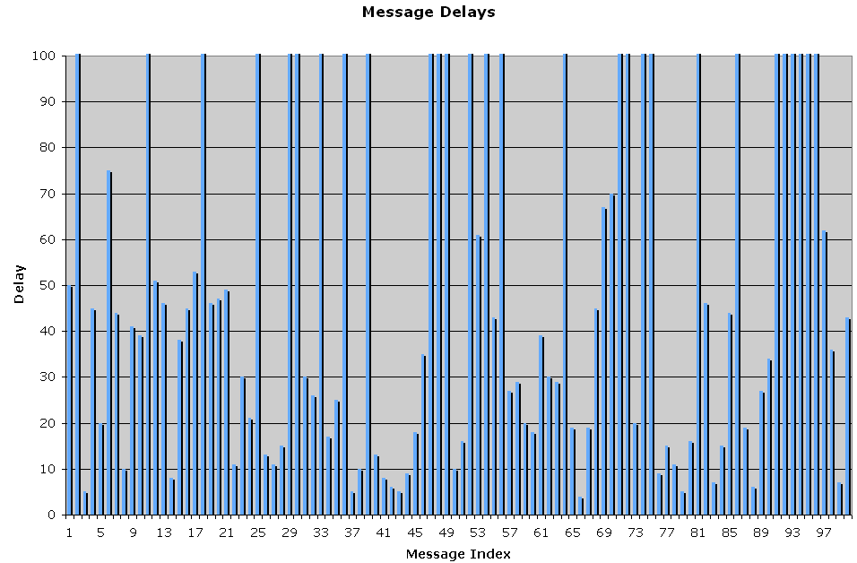
ADD Channels Illustrated
Notes:
The bar graph above shows the message delay pattern of a stream of 100 messages sent on an ADD channel.
Each bar represents a message, and the height of the bar represents the delay experienced by the corresponding message.
All the messages whose delay exceeds 100 represent dropped messages.
In the above message stream, the window size W in this illustrative example is 16.
This window of 16 messages at any given time is represented by the RED horizontal line that will slide from the first message to the 100th.
Consider the first 16 messages sent on this channel:
The bar that turn yellow are the privileged messages.
As the window (red horizontal line of length 16) slides across the messages, the privileged messages within that window turn yellow.
Note that at any given point there is at least one privileged message in the sliding window.
As the message stream continues to infinity, the above property of at least one privileged message in every window of 16 messages holds true.
The question is: How do we know that the yellow messages are indeed privileged?

Slide 14
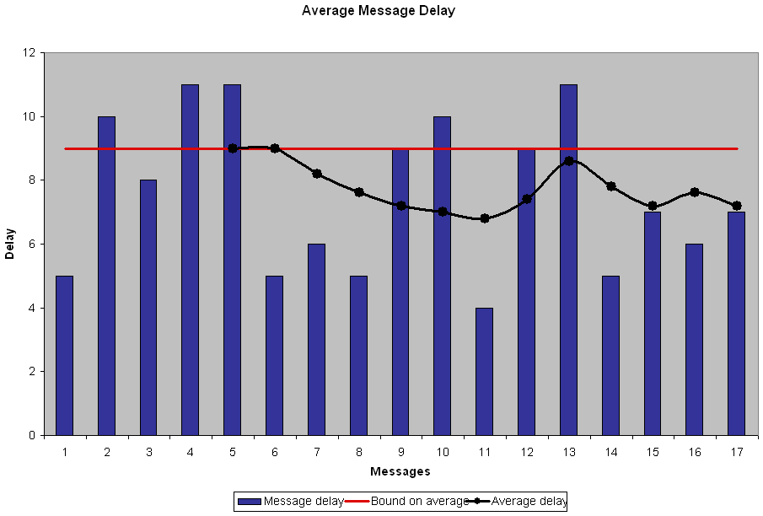
Notes:
The above chart shows why the messages that were marked yellow are indeed privileged messages.
In this graph the x-axis marks the privileged messages indexed in the order in which they appear in the message pattern in the previous slide.
The y-axis is the delay incurred by messages
The blue bars represent the privileged messages, and the height of the bar represents the message’s corresponding delay.
The red line represents the upper-bound on the average delay of messages within the sliding window of size W. In this case, the upper bound is 9 time units.
The black line represents the average delay of the privileged messages within the sliding window in which the corresponding privileged message appears first.
As you can see from the above chart, the average message delay never exceeds the red line (i.e. 9 time units).
Note that although delays incurred by some individual privilege messages exceeds the upper bound, the average delay does not.

Slide 15
Implementation Overview
Objectives
  Heartbeats are sent periodically
  Estimate the upper bound on inter-arrival time
Assumptions
  Lower bound on absolute process speed
  Local clocks
Notes:
Each process has a local <>P module consisting of heartbeat generator and heartbeat receiver.
The heartbeat generator sends heartbeats periodicaly. The heartbeat receiver monitors the heartbeats sent by other processes.
If heartbeats are sent periodically, then they are received periodically.
Upper bound on periodicity of heartbeats sent translates to an upper bound on the periodicity of heartbeats received
In order to be able to send heartbeats periodically we assume that there exists an absolute lower-bound on process speed.
In order to be able to measure the inter-arrival time, we assume existence of local clocks which can be realized by crystal oscillators and such.
Note that we do not assume that clocks are synchronized, or the existence of a global clock. We merely assume that we can measure passage of time at some bounded rate.

Slide 16
Heartbeat Generator
Bounded persistent sending patterns
  Correct processes send infinitely many heartbeats with bounded periodicity
Notes:
The Generator module sends heartbeats at regular intervals.
The bound on the periodicity is ensured by the lower-bound on the process speed, and the rate of the local clock.
Therefore, if a process is correct, then it sends infinite number of heartbeats, and is hence persistent.
Lower-bound on process speed ensures that the duration between two consecutive heartbeats is bounded.
Such a sending pattern of heartbeats is called a bounded persistent sending pattern.

Slide 17
ADD Translation
For every window of W heartbeats sent:
  At least one heartbeat is privileged
  Average delay of privileged heartbeats ≤ D
Therefore, some privileged heartbeat delay ≤ D
Periodicity bound on sending heartbeats translates into a periodicity bound on receiving heartbeats

Slide 18
Heartbeat Receiver
Adaptively estimates periodicity of receiving heartbeats
  Initial estimate on inter-arrival time
  Timeout triggers suspicion
  Each false suspicion is detectable
  Each detected false suspicion increases the estimate on inter-arrival time
  Estimate exceeds de facto bound after finitely many false positives
Notes:
The heartbeat receiver module employs an adaptive timeout mechanism to detect process crashes.
It starts with an initial estimate on inter-arrival time of the heartbeats.
If timeout expires without having received a heartbeat, the process is suspected.
If heartbeat is received from a suspected process, it implies that the estimate on inter-arrival time upper-bound was too low.
Consequently, the process taken off the suspect list, and the estimate in increased.

Slide 19
Correctness
Strong Completeness
Eventual Strong Accuracy
Notes:
Strong completeness:
If a process crashes, then it stops sending heartbeats.
Consequently, the failure detector eventually stop receiving heartbeats.
The timeout expires after the last heartbeat is received.
The process is put on the suspect list and is suspected permanently.
Eventual Strong Accuracy:
If no heartbeat arrives within the estimated upper-bound on inter-arrival time, the monitored process is suspected as having crashed.
If the process is correct, then it will send infinite number of heartbeats, hence an infinite subset of them are received.
Therefore, every false positive is detectable.
There can be only finitely many false positives before the estimate increases the de facto. upper-bound on inter-arrival time.
Hence eventually no correct process is suspected.

Slide 20
Are ADD channels real?
B
D
S
R
Channel C
Buffer
Q time/msg
L time/msg
Delay of privileged messages = D + B.L
Number of dropped messages
between two deliveries
= ⎡L/Q⎤
Notes:
Consider a sender S sending messages to a receiver R
connected by a channel C that has a message propagation delay of D time units
Let R have an input buffer of size B messages
Let the load shedding policy at R be the ‘wine policy’.
Let S send messages every Q time units
Let R process messages every L time units
Let Q < L. i.e. R is slower than S
As S sends messages, since S is faster, the buffer at R beings to fill up
After some time the buffer at R is full
When a message arrives at R when the buffer is full, then by the wine policy the new message is dropped.
However, eventually, after L time units, R processes a message thus opening up the buffer for one more message.
The next message that arrives at R gets queued into the buffer.
The subsequent messages that arrive at the buffer are dropped until R consumes another message.
In the above scenario, note that any message that is processed by R experiences the propagation delay D, and the queuing delay at the buffer given by D + B.L
These messages that are delivered at R are the privileged messages.
The messages that are dropped are non-privileged messages.
However, note that R accepts a message into the buffer ever L time units.
Therefore, the number of non-privileged messages between two privileged messages is no more than ceiling of L/Q.
Thus in every window of size ⎡L/Q⎤ + 1, there is at least one privileged message.
Hence this is modeled by an ADD channel

Slide 21
Are ADD channels real?
Wireless Sensor Networks
  Message that experience collision are non-privileged.
  Messages transmitted successfully are privileged.
  Occasional periods of heavy traffic increases collision rate. But average collision rate is bounded.
  Bounded collision rate yields message pattern modeled by ADD channels.

Slide 22
Questions?

Slide 23
Thank You
Srikanth Sastry
sastry@cs.tamu.edu

