Slide 1

Security Challenges Faced by SME’s
Computer System Security – B9IS103 – CA 2
-By Srikanth & Aniket

Slide 2
What are SME’s?
Small & Medium sized business
Hotels
Stores
Clinics
Legal offices

Slide 3
Risks faced by SME’s
Phishing
Malware
Man in Middle
Denial of Service
SQL Injection

Slide 4
Assessment Topic
Data Theft and Data Breach
Threats from Cybercriminals
Risk of non-implementation of ISO 27001:2013 standards

Slide 5
Data Theft & Data Breach
Password theft
Theft of personal files or emails
Theft of confidential information of company

Slide 6
Reasons for Data Breach
Intentional
or
unplanned
Internal
or
external

Slide 7

Reasons for Data Theft
Hackers
Ransomware
Malware
SQL Injections
DOS
MITM

Slide 8
Preventive Measures
Anti-virus
Anti-spyware
VPN
Data Encryption
Policies & guidelines

Slide 9
Limitations in implementing
Limited budget
Lack of trained cybersecurity specialists
Employee accountability

Slide 10
Risk of Cybercrime
Poor cybersecurity policies
Limited capital
7 million cyber attacks hit SME in UK in 2017
5.3 billion cost to economy
SME’s are more vulnerable to attacks

Slide 11
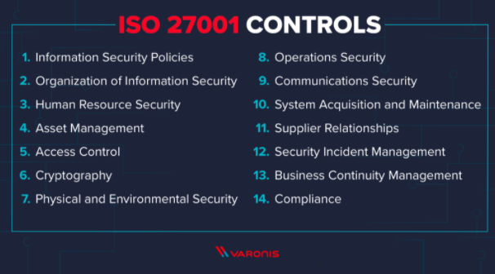
Non implementation of ISO 27001:2013 standard
Defined by Information Security Management System (ISMS)

Slide 12
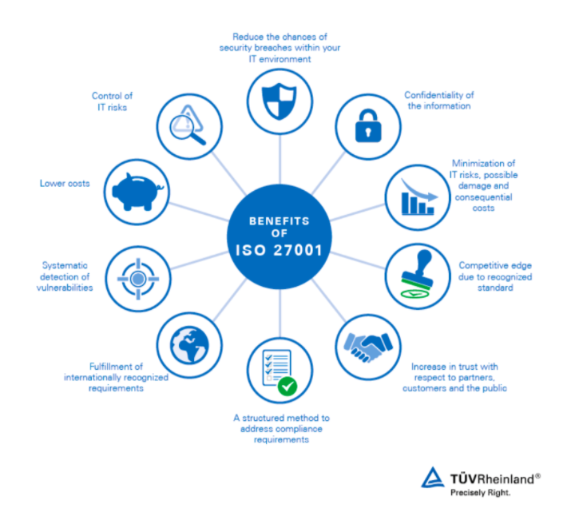
Benefits of ISO 27001

Slide 13
Conclusion
SME’s make up the majority of the market
Funds are limited
Business is run based on trust
Loss of trust means shutdown of business

