Slide 1

Data Analytics Techniques
By Srikanth Shilesh Pasam (10387794)

Slide 2
Data Warehousing

Slide 3
IT Inventory Management System
Goals
Stakeholders

Slide 4
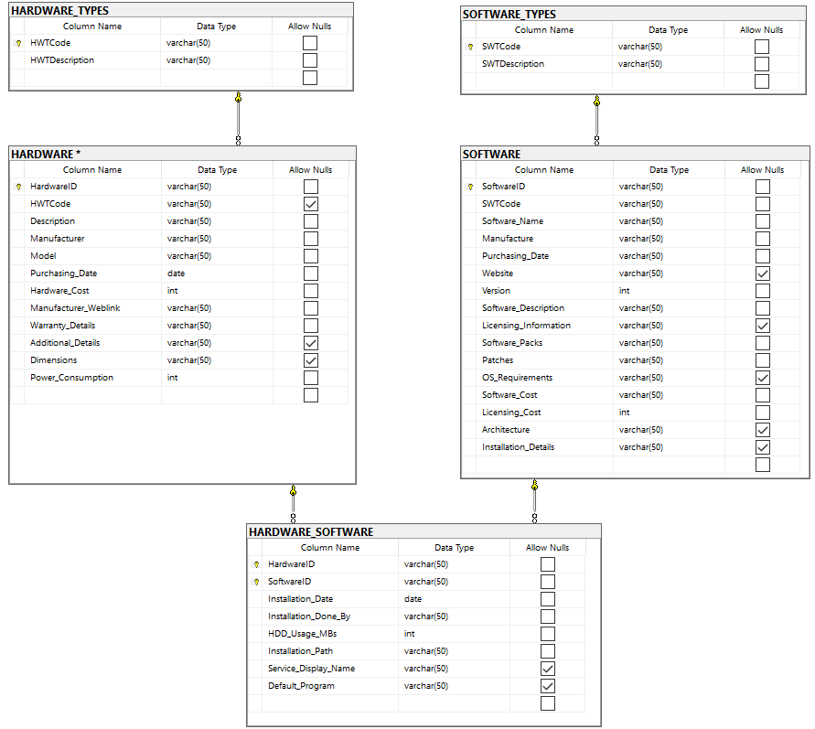
Schema/Dimensional Model

Slide 5
ETL
Extract
Transform
Load

Slide 6
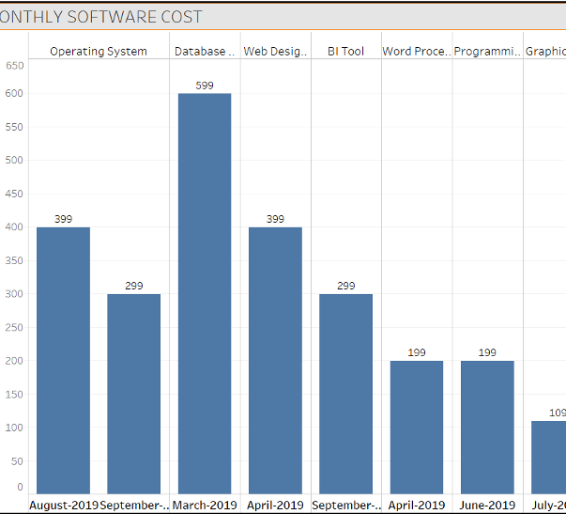
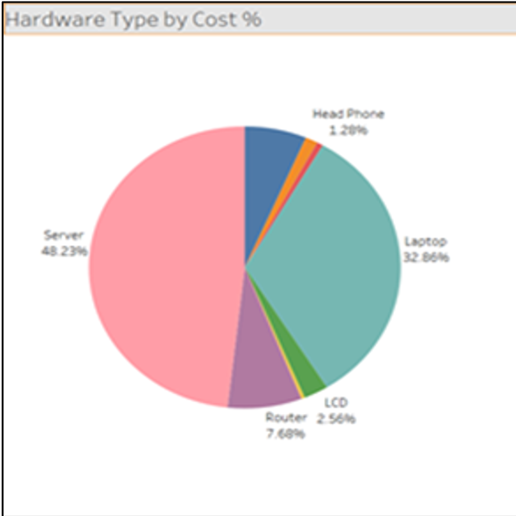
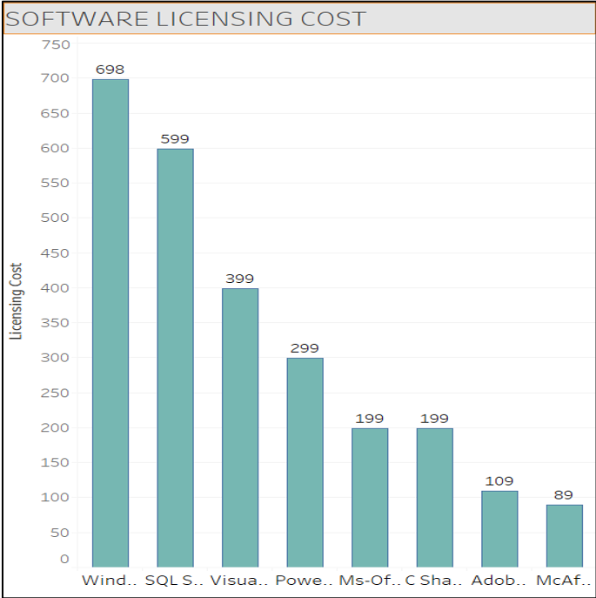
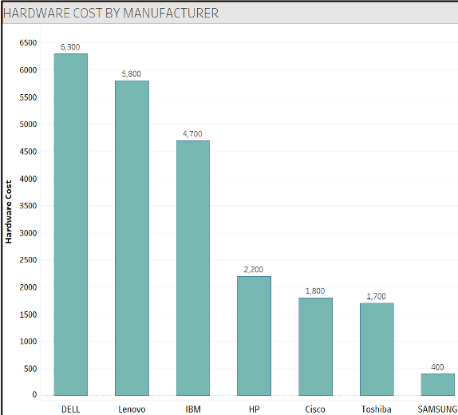
Visualization

Slide 7
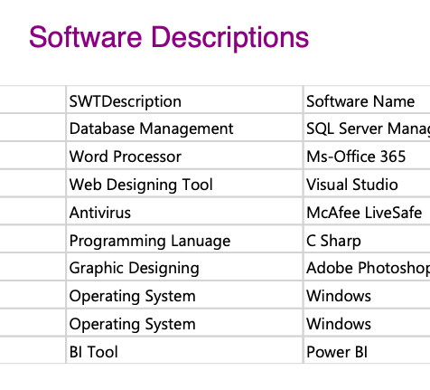
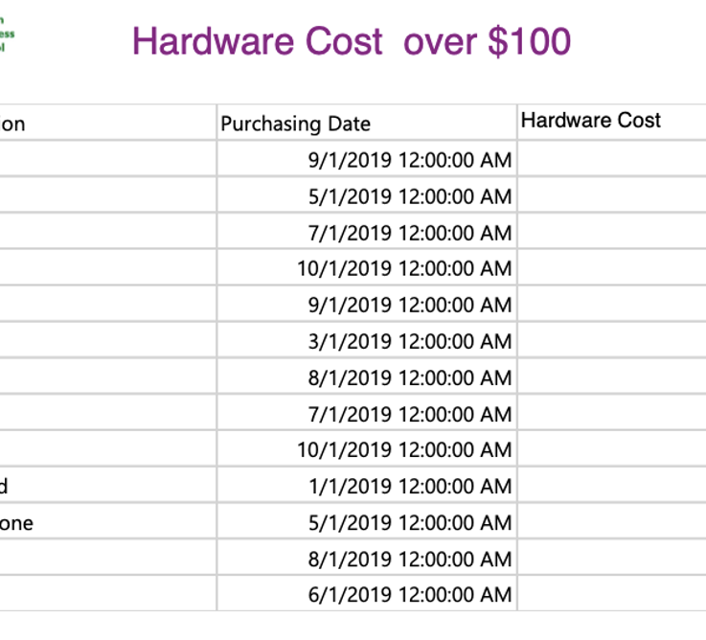
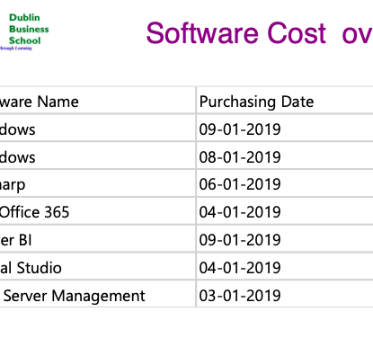
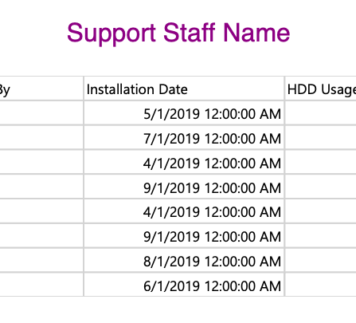
SSRS

Slide 8
Predictive Modelling using Python

Slide 9
Dataset
Variables
Cement - kg in a m3 mixture
Blast Furnace Slag - kg in a m3 mixture
Fly Ash - kg in a m3 mixture
Water - kg in a m3 mixture
Superplasticizer - kg in a m3 mixture
Coarse Aggregate - kg in a m3 mixture
Fine Aggregate - kg in a m3 mixture
Age - Day (1~365)
Concrete compressive strength (CMS)

Slide 10
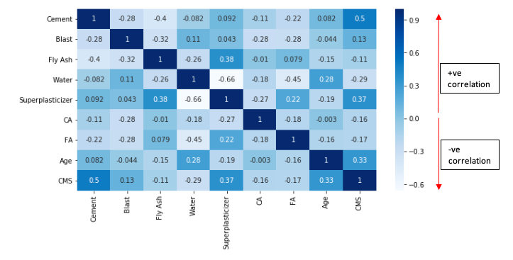
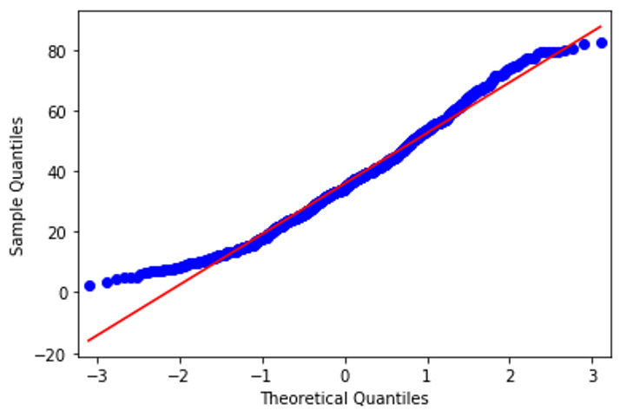
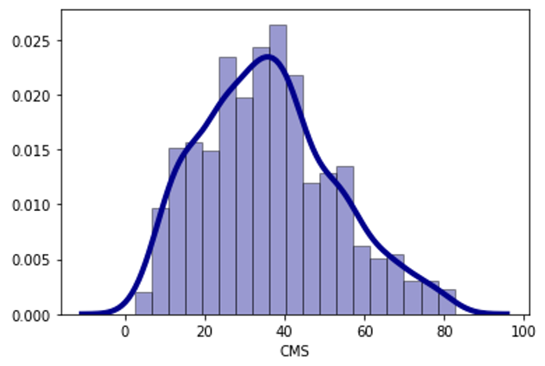
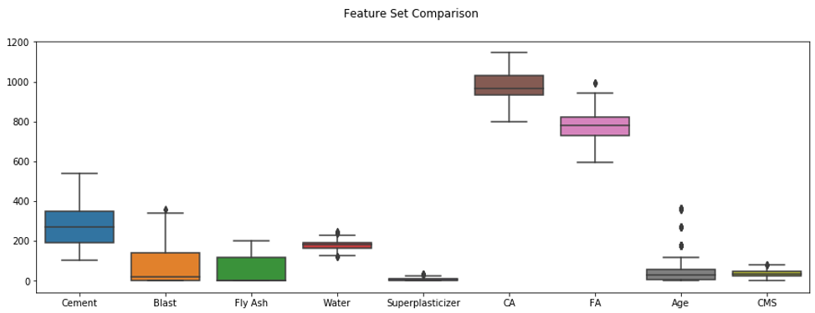
Visualizations

Slide 11
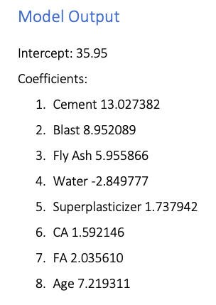
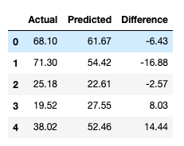
Linear Regression

Slide 12

Thank you!

