Slide 1

Enterprise Architecture
A comprehensive Enterprise Information System report on DCSL Software Limited

Slide 2
Enterprise Architecture
An enterprise architecture framework is explained as the way of creating and using enterprise architecture wherein six main components are outlined in the EA documentation model.

Slide 3
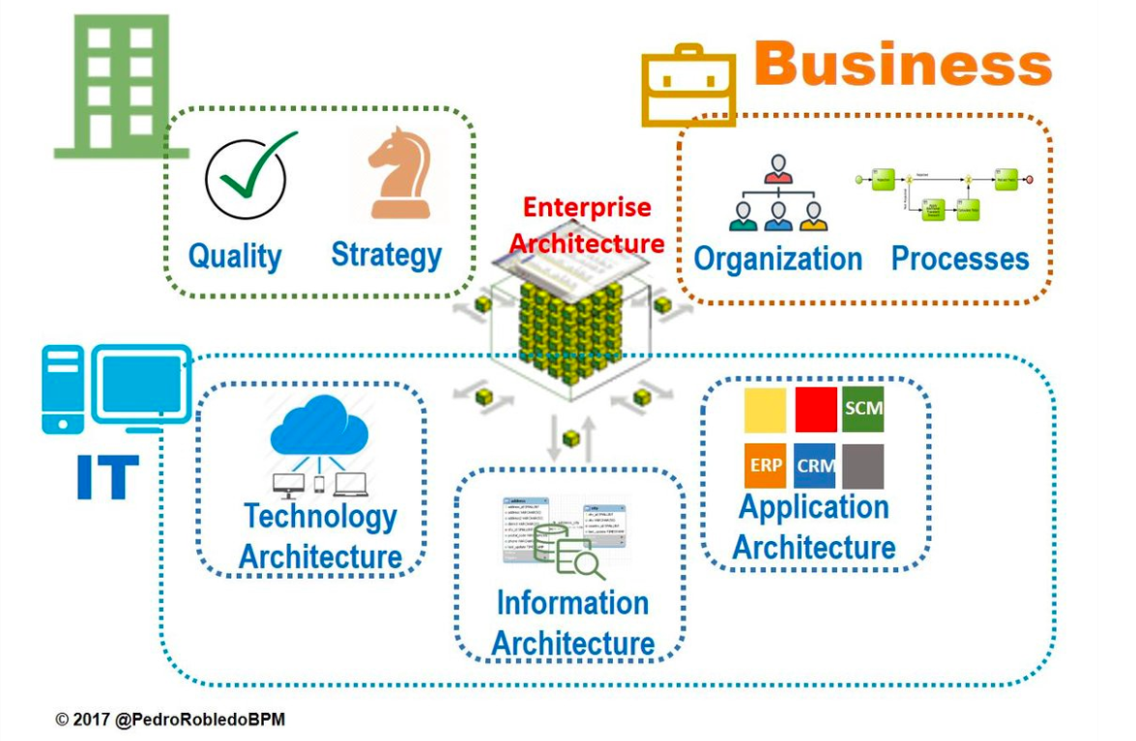
Enterprise Architecture

Slide 4
Enterprise Information System
The overall combination of computer hardware and software that a business uses to organize and run its operations.

Slide 5
Benefits of Enterprise Information System
Communicate the critical firm-wide information on the business performance to managers all across the organization quickly, so as to enable them to make better decisions and at the right time.
Reduce the cost involved in transaction processing, hardware, software, and IT support staff in a significant manner.
Improve the quality and efficiency of customer service, production and distribution by integrating the company’s internal business processes in sales, finance, production,custom logistics,etc.
Help to create a more uniform organizational culture where everyone uses similar type of processes and information to do business.

Slide 6
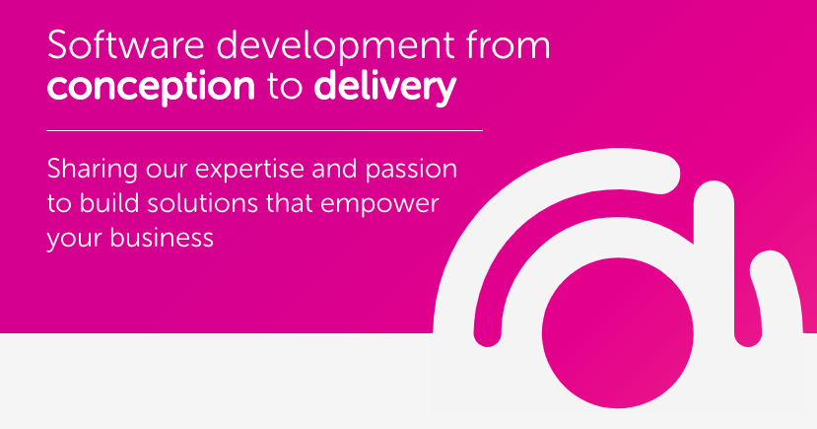
DCSL Software Limited

Slide 7
DCSL
We are DCSL Software, one of the UK’s leading bespoke software development companies with over 100 employees.
We design intelligent, cost-effective and intuitive web applications, desktop applications and mobile apps that help streamline processes for businesses as well as create new revenue streams for start-ups and established businesses alike.
We’ve been in business since 1994 and have become trusted partners through delivering software with brands like BT, Virgin Media, Lidl, WaterAid, Ikea and the NHS.

Slide 8

Enabling Technologies of DCSL Software Limited
ERP: It is one of the main enabling technology at DCSL Software which examined to play a vital role in establishing the link between the current resources and establish effective integration and flow of information exist in between distinct sections.

Slide 9
Enabling Technologies of DCSL Software Limited
CRM Systems - The use of this EIS has enabled the company to manage the customers effectively via integrating reliable processes, systems, and procedures essential for the company to collect a wide range of customer information and communicate it for commercial purposes.

Slide 10
Enabling Technologies of DCSL Software Limited
SaaS: It includes a third-party provider, software, application, and supplying capacity with the help of the internet on the basis of pay-as-you-use.

Slide 11
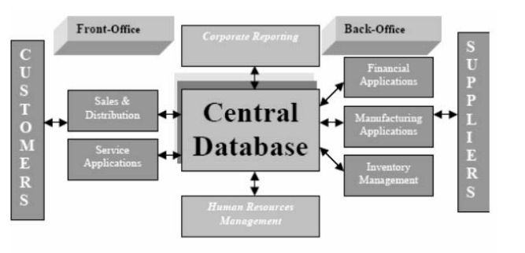
DCSL Core Diagram

Slide 12
Core Competencies of DCSL Software Limited
The company provides an end-to-end solution to customers by supporting the cloud-based application and have trusted partners to deliver high-quality services to customers.
The organizations are significantly emphasizing, delivering cohesive, complete, reusable, and highly automated platforms to provide bespoke solutions to customers.

Slide 13
Impact of EIS on DCSL
At DCSL software, the use of ERP systems is examined to bring significant transformation in the company.
Technical benefits and strategic implications.

Slide 14
Impact of EIS on DCSL
The use of the CRM system has brought a substantial transformation in the company in terms of recognizing and constructing interactional relationships with the customers.
It improves the customer touchpoints essential to optimize greater satisfaction and address the issue of fragmented data of the customer.

Slide 15
Impact of EIS on DCSL
The use of SaaS is examined to augment greater productivity.
This resulted in significant transformation in DCSL Software in terms of greater scalability, cost-effectiveness, flexibility, simplicity, and security.

Slide 16
Conclusion
Based on the findings drawn, it is concluded that in DCSL Software Limited significant focus has been made on the automation, effectiveness, and efficiency of business operations, due to which a wide range of enterprise information systems are deployed in the company.
The main enabling technologies of EISs examined to be deployed in the company are ERP, CRM systems, and SaaS.
The introduction of all these technologies has brought significant transformation in the company in terms of cost reduction, high automation, greater operational efficiency, effectiveness, bespoke solutions to customers, technical and strategic capabilities.

