Slide 1
TECHNICAL CLUB
08 December 2017

Slide 2
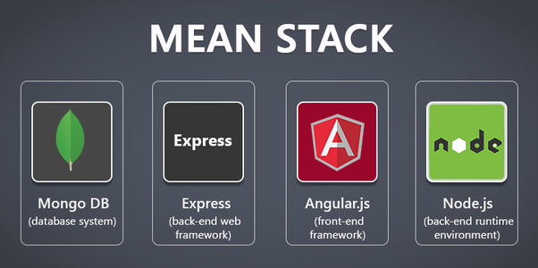
MEAN STACK

Slide 3
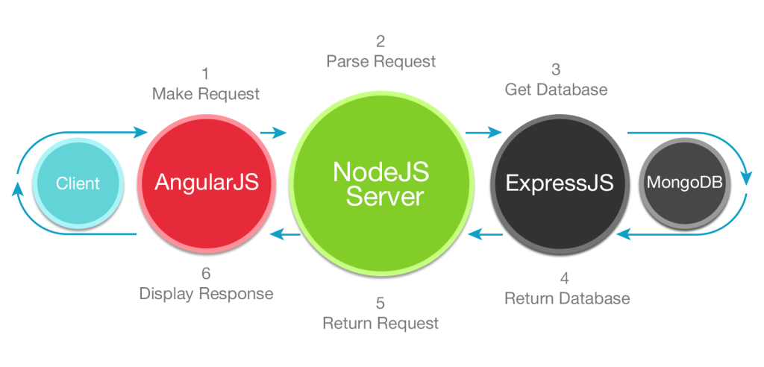

Slide 5
MOngodb

Slide 6
EXPRESS JS

Slide 7
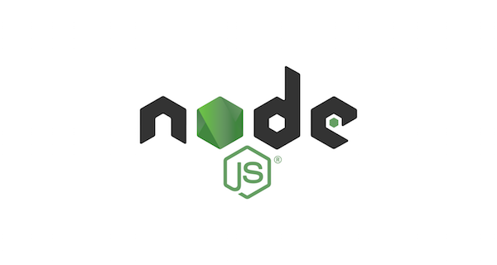

Slide 8
Features
Node.js is an open source server framework
Node.js is free
Node.js runs on various platforms (Windows, Linux, Unix, Mac OS X, etc.)
Node.js uses JavaScript on the server

Slide 9
Why Node JS?
A common task for a web server can be to open a file on the server and return the content to the client.
Here is how PHP or ASP handles a file request:
Sends the task to the computer's file system.
Waits while the file system opens and reads the file.
Returns the content to the client.
Ready to handle the next request.
Here is how Node.js handles a file request:
Sends the task to the computer's file system.
Ready to handle the next request.
When the file system has opened and read the file, the server returns the content to the client.
Node.js eliminates the waiting, and simply continues with the next request.
Node.js runs single-threaded, non-blocking, asynchronously programming, which is very memory efficient.

Slide 10
What can Node JS do?
Node.js can generate dynamic page content
Node.js can create, open, read, write, delete, and close files on the server
Node.js can collect form data
Node.js can add, delete, modify data in your database

Slide 11
What is a Node JS File?
Node.js files contain tasks that will be executed on certain events
A typical event is someone trying to access a port on the server
Node.js files must be initiated on the server before having any effect
Node.js files have extension ".js"

Slide 12
Website
The official Node.js website has installation instructions for Node.js: https://nodejs.org

Slide 13
Install Node JS

Slide 14
How to Run?
The file you have just created must be initiated by Node.js before any action can take place.
Start your command line interface, write node myfirst.js and hit enter

Slide 15
Access in the Browser!
Now, your computer works as a server!
If anyone tries to access your computer on port 8080, they will get a "Hello World!" message in return!
Start your internet browser, and type in the address: http://localhost:8080

Slide 16
What is a Module in JS?
Consider modules to be the same as JavaScript libraries.
A set of functions you want to include in your application.

Slide 17
Require a Module!
To include a module, use the require() function with the name of the module:
var http = require('http');

Slide 18
Create a SERVER
http.createServer(function (req, res) { res.writeHead(200, {'Content-Type': 'text/html'}); res.end('Hello World!'); }).listen(8080);

Slide 19
Own Modules
You can create your own modules, and easily include them in your applications.
The following example creates a module that returns a date and time object:
Example
Create a module that returns the current date and time:
exports.myDateTime = function () { return Date(); };
Use the exports keyword to make properties and methods available outside the module file.
Save the code above in a file called "myfirstmodule.js"

Slide 21
ANGULAR

