Slide 1


GenAI Decision Intelligence Accelerator for Unsecured Lending
Redefining Decision Intelligence in Digital Banking
Presented at CIO Initiative - HSBC

Slide 2
Unsecured Lending : A Decision-Oriented System
Digital lending is a sequence of policy, document, and eligibility decisions
Each stage introduces validation friction
Intelligence is fragmented across systems
Decision orchestration is rule-heavy, not adaptive
Policy reasoning
Input validation
Document extraction
Cross-verification
Eligibility computation
Explainable outcome generation
User

Slide 3
Business Problems in Digital Unsecured Lending Today
High drop-offs during KYC/document steps and repeated rework
Fragmented policy and eligibility checks
Lack of intelligent pre-underwriting guidance
Manual reviews for exceptions → inconsistent decisions
Policy interpretation scattered across documents / SMEs → slow change rollout
Fraud/quality issues because validation is reactive not proactive
Result: Quality variance, increased TAT, and delivery inefficiencies.

Slide 4
Proposed Solution – GenAI Decision Intelligence Layer
Policy Intelligence Agent
Retrieval-Augmented Generation (RAG)
Citation-enforced responses
KB freshness controls
Document Intelligence Agent
Layout-aware OCR
Structured field extraction
Confidence scoring
Validation Agent
Fuzzy matching logic
Threshold-based mismatch handling
Eligibility Engine
Configurable rule engine
Conditional approval pathways
Alternative product recommendation

Slide 5
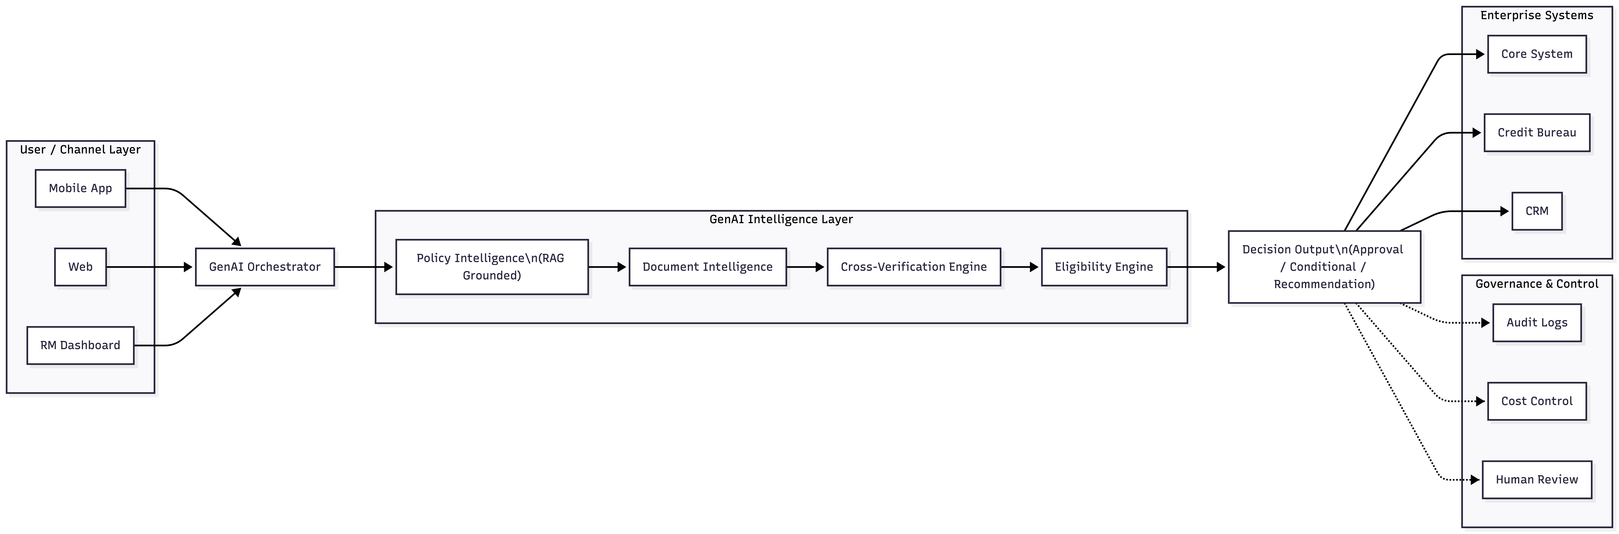
High-Level Architecture – Decision Intelligence Orchestration Layer

Slide 6
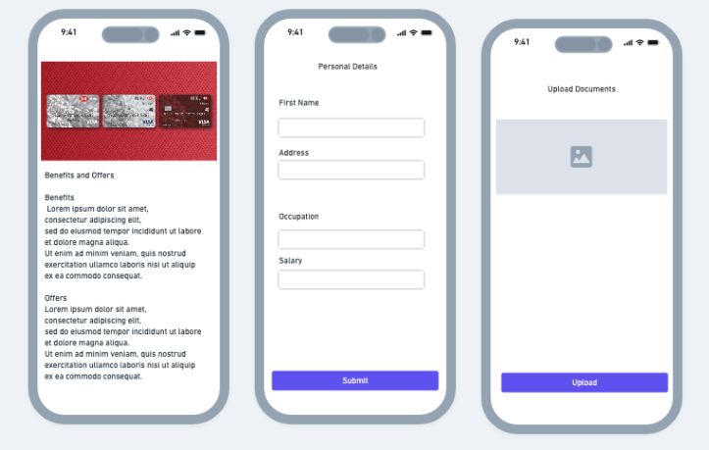
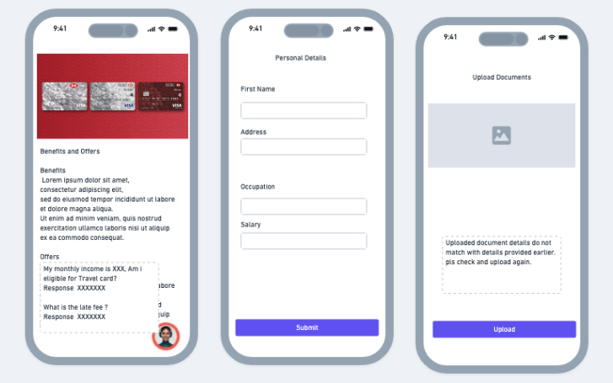
AI-Driven Workflow Transformation
Before
After
Manual document review
Policy checks done separately
Multiple clarification loops
Increased TAT
Real-time document extraction
Embedded policy reasoning
Automated cross-verification
Reduced TAT & higher conversion

Slide 7
Strategic & Operational Impact
20–40% reduction in manual validation workload
Faster onboarding cycles (15–30% improvement)
Reduced rework & drop-offs
Consistent, auditable decision outputs
Scalable across geographies & portfolios

Slide 8
ROI & Financial Impact
Cost Efficiency Impact
15–25% reduction in operational cost per application
Lower QA bandwidth consumption through structured AI validation
Revenue & Conversion Impact
5–10% improvement in onboarding completion rates
Faster “time-to-yes” leading to higher card activation and early revenue realization
Portfolio-Level Effect
Even marginal 5% efficiency improvement at scale materially impacts unsecured lending portfolio profitability
* Indicative industry benchmarks based on AI-led automation in banking operations.

Slide 9

Extensibility Across Lending Products
Primary Credit Cards
Supplementary Cards
Personal Loans
BNPL / Consumer Durable Loans
SME Working Capital

Slide 10
POC Completed (HSBC Products) – Feasibility Validation Through Prototyping
Built RAG-based policy assistant
Integrated document extraction workflow
Implemented cross-verification logic
Applied temperature discipline for compliance
Identified KB freshness & governance risks
Tested confidence-based routing
Tech Stack (Prototype)
Azure OpenAI Service
Azure Document Intelligence
Python based orchestration
Secure knowledge base integration

Slide 11
Beyond POC — Enterprise Requirements
Model abstraction layer (LLM-agnostic design)
Cost-aware routing (tiered model strategy)
Prompt version governance
Audit logging & traceability
Human-in-loop escalation triggers
Multi-region rule configuration
Latency & caching strategy

Slide 12

Thank you

