Slide 1
VL New Onboarding screens
Version 1.0

Slide 2



LOGO
LOGO
Choose My Cusine
Image
Image
Comfort Home Food
Fusion Vegan
Choose my Meal
Image
Image
Salads & Soups only
Juices & Smoothies
Next

Slide 3





LOGO
LOGO
My Profile
What is my Goal
Manage My Weight
Male
Female
Detox my Body
Have Deliciously healthy food
Age
Yrs.
Height
Ft.
In.
Weight
Kg.
Next
Next

Slide 4
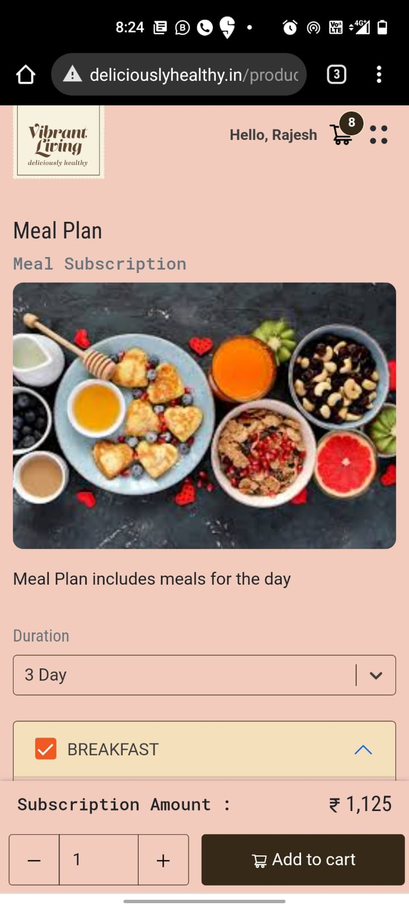
LOGO
LOGO
Sign In
Sign Up
Sign in with your mobile number and password
Sign up with your mobile number, Name password
Phone Number
Phone Number
Password
Name
Forgot password
Password
Sign in
Re type Password
New to Vibrant Living..? SIngup
Height
Forgot password
or
Sign Up
http://18.207.234.52/
Continue with Google
Having an account with Vibrant Living..? SIngin
Continue with Facebook
or
Continue with Google
Continue with Facebook

Slide 5


LOGO
LOGO
LOGO
Hi Rajesh
Hi Rajesh
Hi Rajesh
Add your address
Add your address
Add your address
Pin code
500089
500001
Enter your Pin code here to validate our services availability
Enter your Pin code here to validate our services availability
We are here to happily to serve you
Office
Home
Others
Office
Home
Others
D.no.
Oops Unfortunately our services are not available in your area, please give a call to arrange alternate delivery options
D.no.
House name / Apartment name
House name / Apartment name
+91 - 12345678901
Street name
+91 - 12345678901
Street name
Area/ Land mark
Area/ Land mark
City
City
State
State
Is your Break Fast Address is Same for Lunch and Dinner, if no please add address
Is your Break Fast Address is Same for Lunch and Dinner, if no please add address
Yes
No
Yes
No
Save Address
Save Address

Slide 6
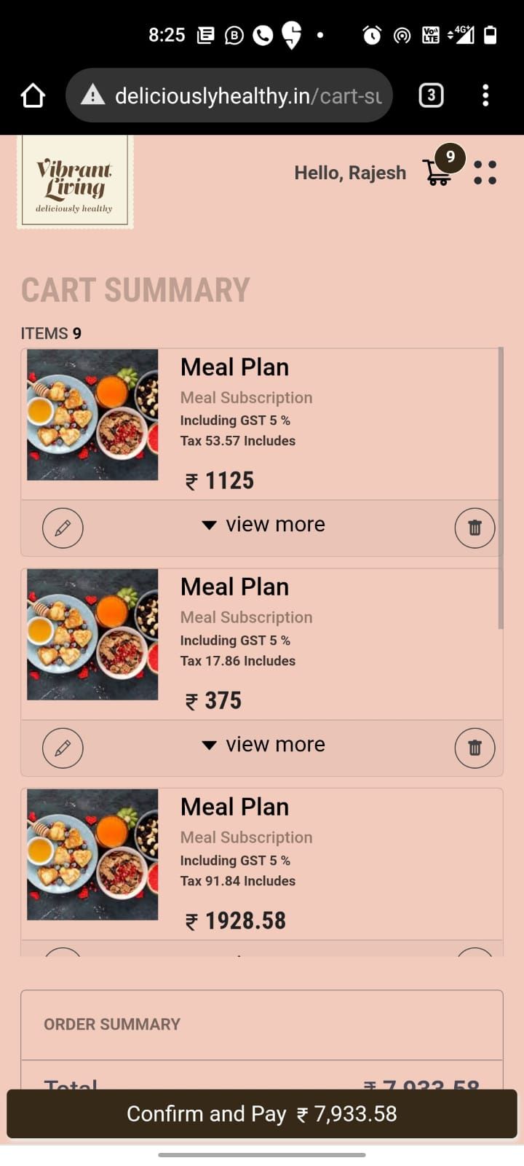
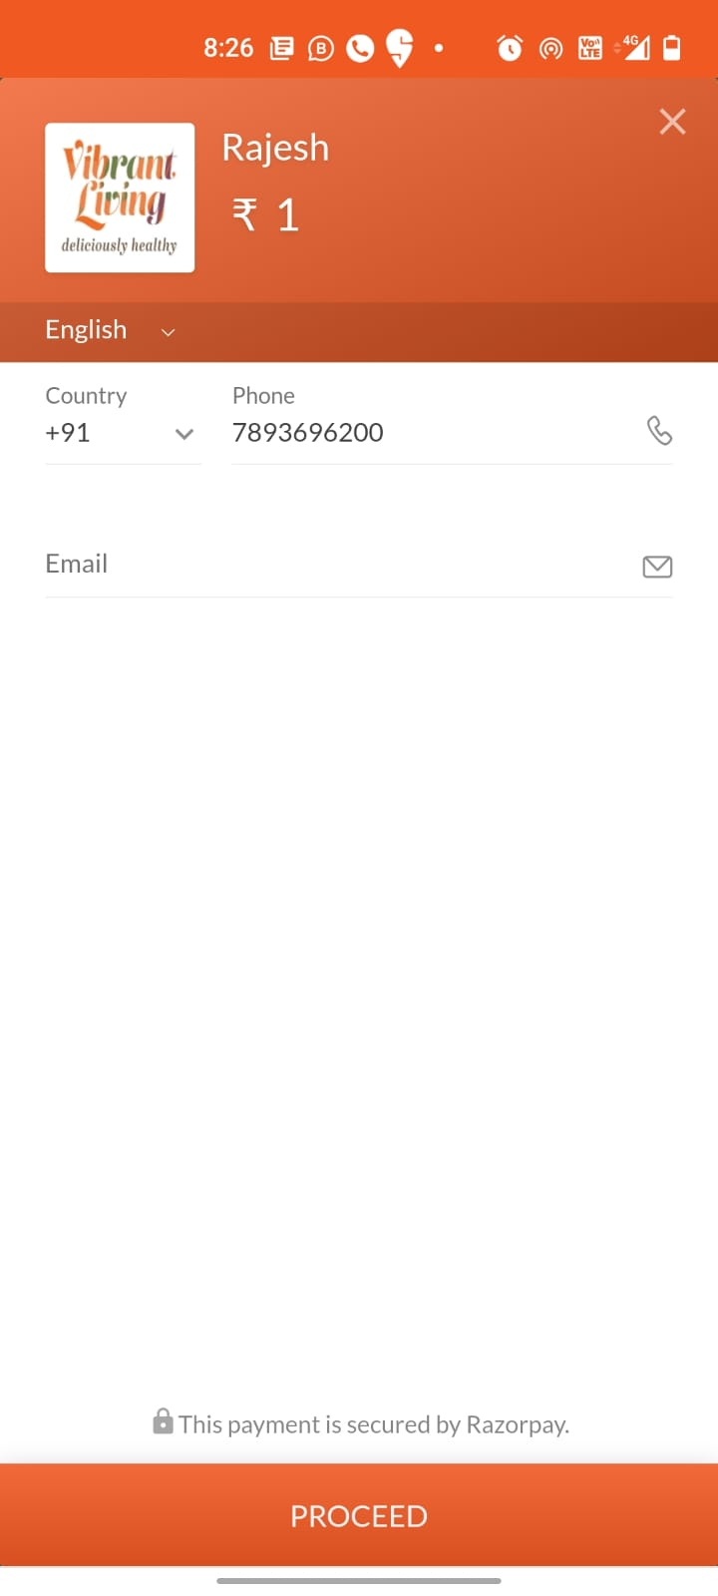
Payment, Orders screens were already developed

Slide 7
To Dos
Quantity to be added on Cart itself
Add Address State issues to be resolved
Area Code need to be printer on Consumer slip
Pin codes to mapped with Area Zones

