Slide 1
INTERNSHIP TECHNICAL PRESENTATION
Grid-Forming & Grid-Following Inverter Control,
and Dynamic Modeling of AI Data Center Load, in PSCAD
PCS average-model GFL/GFM control development — and a double-conversion UPS AI data center load model aligned with the ERCOT / Texas A&M reference architecture
PREPARED BY
DEPARTMENT
SUPERVISOR
DATE
[Your Name]
[Department, University]
[Supervisor Name]
July 23, 2026

Slide 2
INTERNSHIP ROADMAP
Two Work Streams, One PSCAD Environment
The day labels below are indicative groupings of the work — align them with your own logbook dates before presenting.
WORK STREAM A
WORK STREAM B
GFL / GFM Control Module
AI Data Center UPS Model
1
PCS average model & module interface
7
Motivation & the ERCOT / TAMU reference model
2
SRF-PLL synchronization for GFL
8
Double-conversion UPS electrical topology
3
Outer power loop, inner current loop, negative sequence
9
Rectifier (GFL) & inverter (GFM) control blocks
4
GFM control: P-f and Q-V droop
10
Bidirectional DC/DC converter & battery SOC
5
GFM control: Virtual Synchronous Machine
11
Voltage / frequency ride-through (VRT & FRT)
6
Illustrative GFL/GFM results & benchmarking
12–13
Operating modes & illustrative results
Internship Progress — Roadmap
2

Slide 3
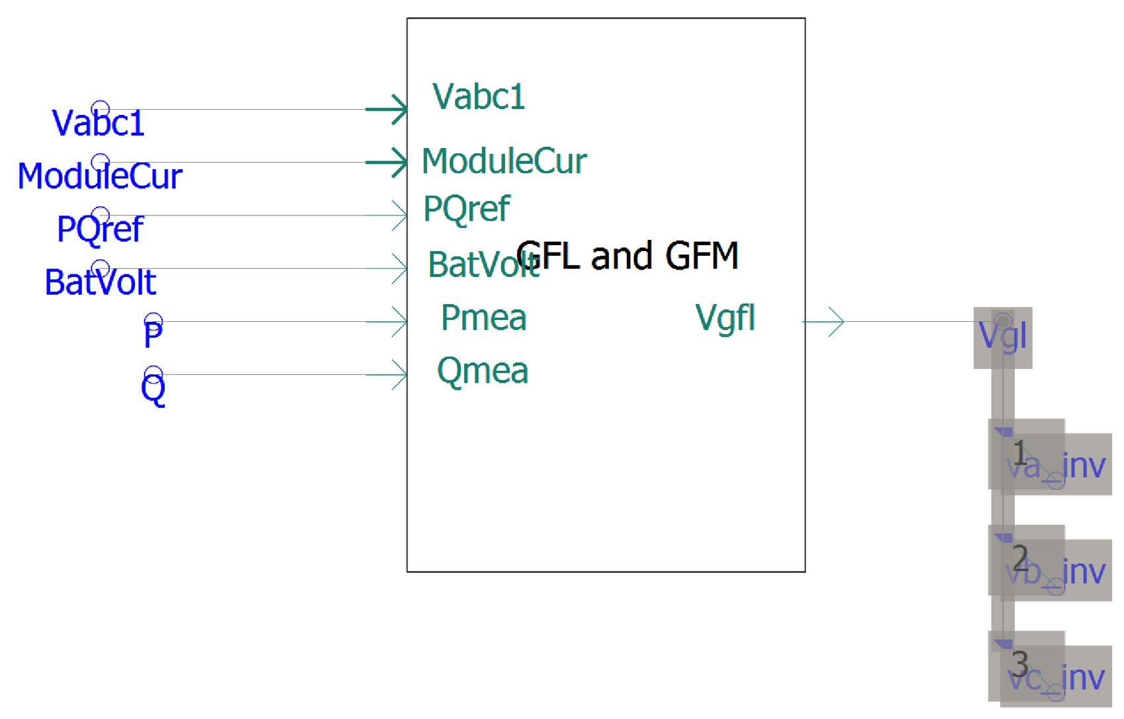
WORK STREAM A · GFL / GFM CONTROL MODULE
1
PCS Average Model & the GFL/GFM Concept
Grid-FOLLOWING (GFL)
Controlled current source. Uses a PLL to track grid phase/frequency and injects current to P/Q references. Needs a strong external voltage to synchronize to.
Grid-FORMING (GFM)
Controlled voltage source with its own internal frequency/voltage reference — like a synchronous generator's rotor. Can black-start and support weak/islanded grids via droop or VSM control.
Figure: GFL/GFM module I/O inside the PCS average model
WORK STREAM A · GFL / GFM CONTROL MODULE
3

Slide 4
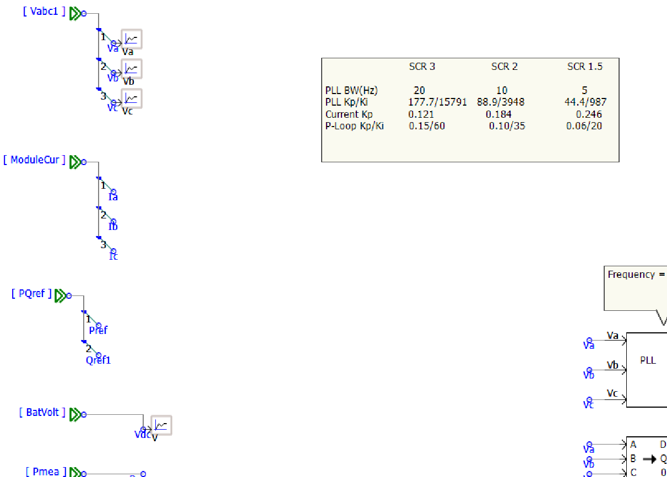
WORK STREAM A · GFL / GFM CONTROL MODULE
2
SRF-PLL Synchronization for GFL
PLL bandwidth is tuned to grid strength (SCR)
Parameter | SCR 3 | SCR 2 | SCR 1.5
PLL BW | 20 Hz | 10 Hz | 5 Hz
PLL Kp/Ki | 177.7/15791 | 88.9/3948 | 44.4/987
Current Kp | 0.121 | 0.184 | 0.246
P-loop Kp/Ki | 0.15/60 | 0.10/35 | 0.06/20
As SCR drops 3 → 1.5, PLL bandwidth is deliberately cut 4× (20→5 Hz) to stay stable on a weaker grid — current-loop and power-loop gains are retuned together, not left fixed.
Park/Clarke transform of Va, Vb, Vc into the rotating dq frame
PI controller drives the q-axis component to zero → locks the frame to the grid voltage vector
Outputs theta (angle) and omega (frequency) that every other block is built around
WORK STREAM A · GFL / GFM CONTROL MODULE
4

Slide 5
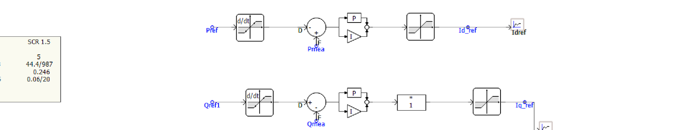
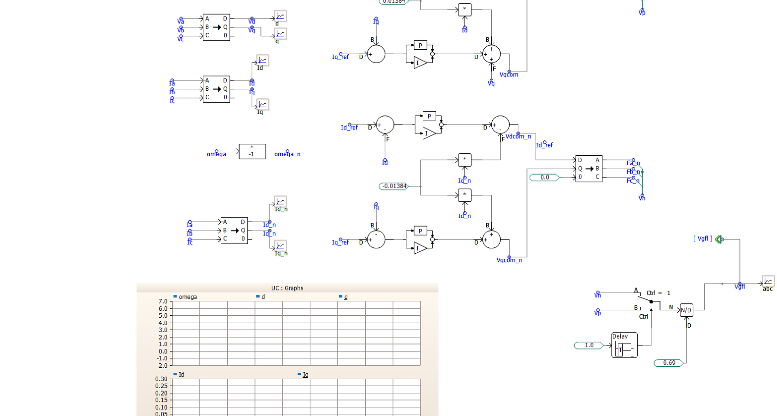
WORK STREAM A · GFL / GFM CONTROL MODULE
3
Outer Power Loop & Inner Current Loop
Outer loop:
Pref/Qref → derivative/deadband → PI vs. Pmea/Qmea → rate limiter → Idref / Iqref
Inner loop:
abc→dq0 measurement, decoupled Id/Iq PI control produces Vdcom, Vqcom
Decoupling:
0.01384 pu feed-forward gains cancel d/q cross-coupling from the rotating frame
WORK STREAM A · GFL / GFM CONTROL MODULE
5

Slide 6
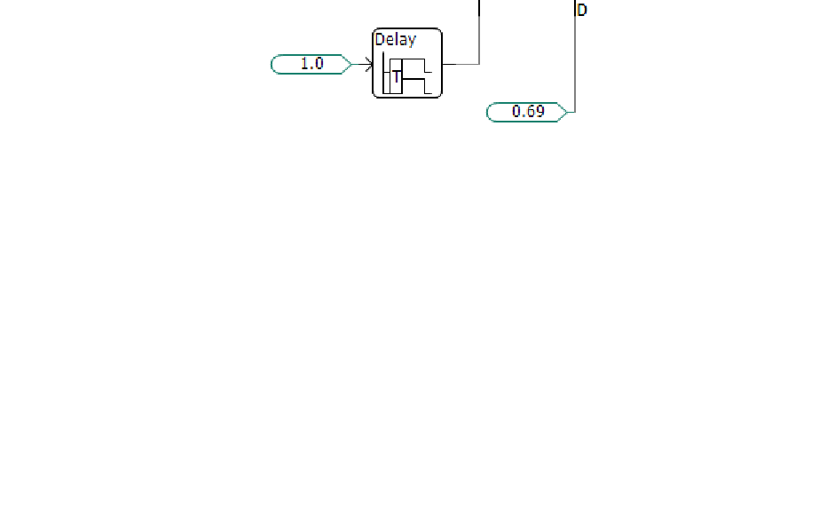
WORK STREAM A · GFL / GFM CONTROL MODULE
3
Negative-Sequence Control & Output Enable
Negative-sequence path
The entire dq current-control structure is mirrored using ω_n = −ω and a separate Id_n/Iq_n pair, so the converter can regulate negative-sequence current independently of positive-sequence current — needed for ride-through under unbalanced voltage sags rather than tripping.
Output-stage soft start
A Ctrl-driven switch, Delay block, and N/D divider assemble the dq voltage commands into the abc output Vgfl — ramping the output in cleanly on enable or mode change, rather than stepping.
WORK STREAM A · GFL / GFM CONTROL MODULE
6

Slide 7
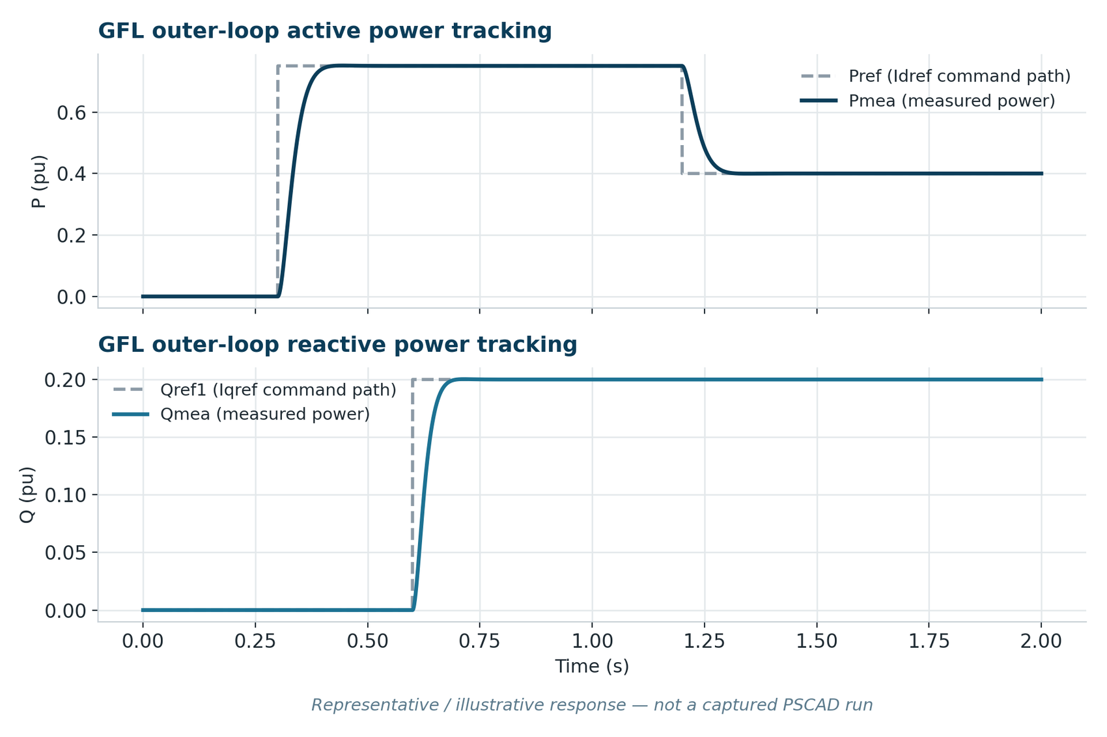
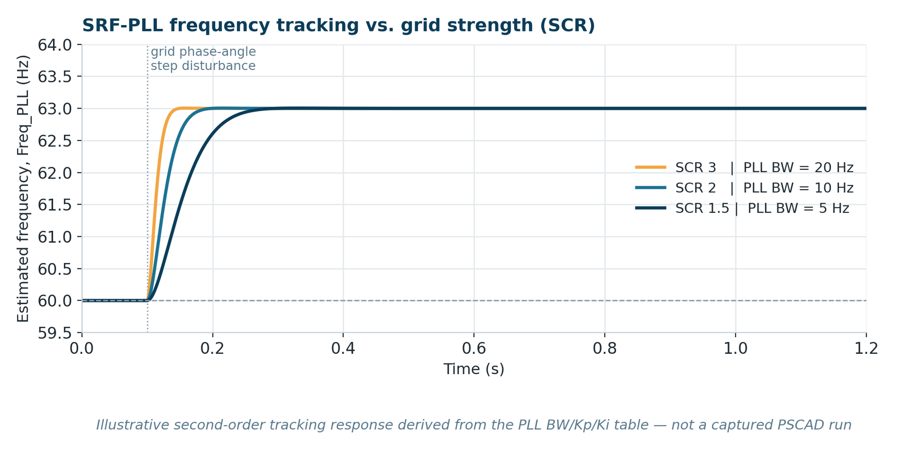
WORK STREAM A · GFL / GFM CONTROL MODULE
GFL Illustrative Results
Illustrative / expected-behavior charts derived from the control equations — the PSCAD graph frames had not yet been populated with a run. Swap in your captured Freq_PLL / Idref / Iqref traces.
WORK STREAM A · GFL / GFM CONTROL MODULE
7

Slide 8
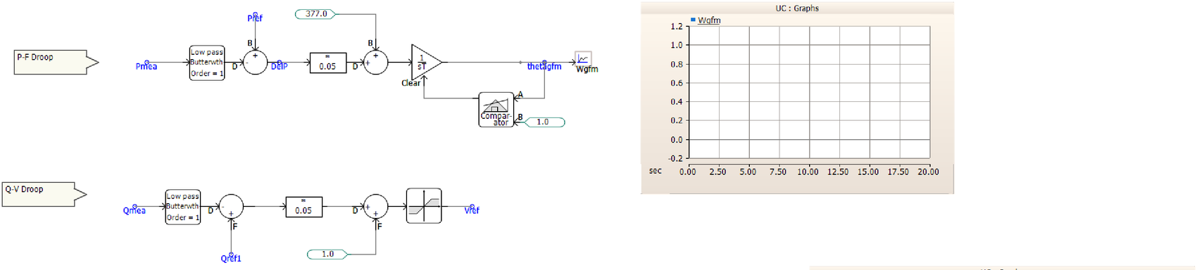
WORK STREAM A · GFL / GFM CONTROL MODULE
4
GFM Control: P-f and Q-V Droop
Reads like a generator
P-f droop mirrors a governor; Q-V droop mirrors an AVR. If Pmea > Pref, frequency droops down in proportion to the 5% gain — exactly how parallel generators (or parallel GFM inverters) share load with no communication needed.
P-f droop:
Pmea (low-pass filtered) vs. Pref, × 0.05 droop gain (5%), added to 377 rad/s nominal, integrated with Comparator/Clear angle wraparound → thetagfm
Q-V droop:
Same structure on Qmea vs. Qref1 → Vref (1.0 pu nominal, 5% gain, limiter)
WORK STREAM A · GFL / GFM CONTROL MODULE
8

Slide 9
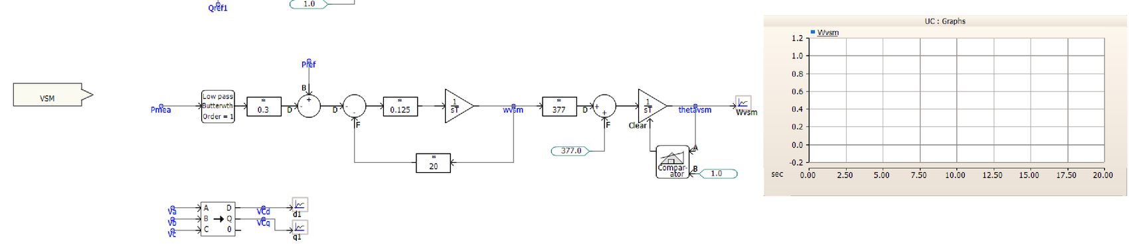
WORK STREAM A · GFL / GFM CONTROL MODULE
5
GFM Control: Virtual Synchronous Machine
Droop + inertia, not just droop
Because the swing equation carries an inertia term (2H), a sudden power imbalance changes VSM frequency gradually — a bounded rate-of-change-of-frequency (RoCoF) — rather than jumping toward the droop-implied point, while D still pulls it back to a comparable steady state.
2H · dω/dt = Pref − Pmea − D·(ω − ω₀)
0.125 gain ↔ 1/(2H) → inertia constant H ≈ 4 s
×20 feedback path ↔ damping term D = 20
Same 377 rad/s scaling + Comparator/Clear wraparound as the droop path → thetavsm
WORK STREAM A · GFL / GFM CONTROL MODULE
9

Slide 10
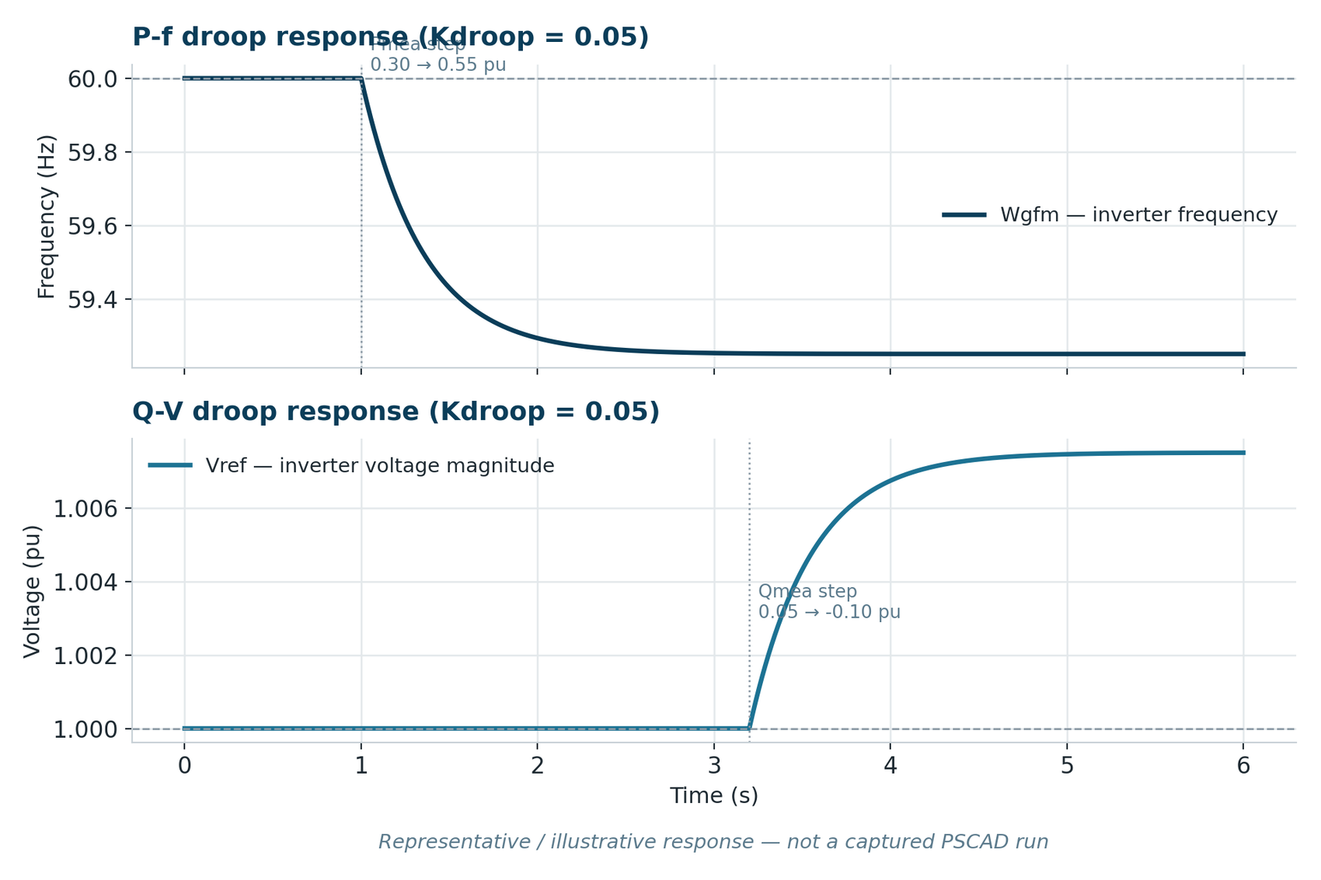
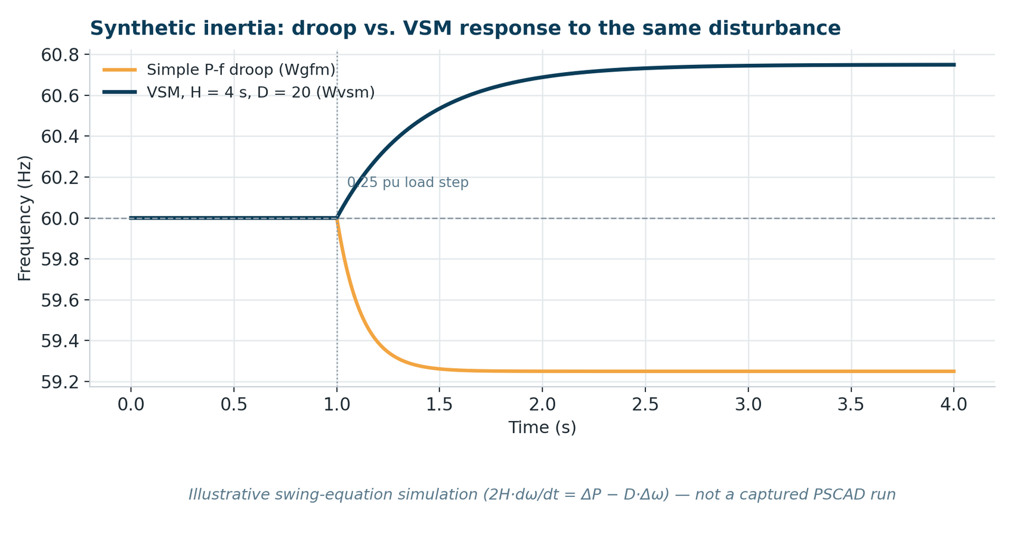
WORK STREAM A · GFL / GFM CONTROL MODULE
GFM Illustrative Results — Droop vs. VSM
Illustrative swing-equation simulation, not a captured PSCAD run — note the visibly slower initial RoCoF for VSM (H = 4 s) vs. plain droop for the same disturbance.
WORK STREAM A · GFL / GFM CONTROL MODULE
10

Slide 11
WORK STREAM B
Dynamic Modeling of AI Data Center Load
A double-conversion UPS model aligned with the ERCOT / Texas A&M reference architecture
WORK STREAM B · AI DATA CENTER UPS MODEL
11

Slide 12
WORK STREAM B · AI DATA CENTER UPS MODEL
7
Why AI Data Center Load Modeling Matters
AI data centers connect through UPS systems (rectifier, inverter, battery) with fast, nonlinear ride-through logic
Documented events show that logic can disconnect a facility — or a fleet of them at once — on a fault that wouldn't trip a conventional load
ERCOT has formalized large-load interconnection (NPRR1234 / PGRR115, ≥ 75 MW) and is moving toward requiring detailed PSCAD/EMT converter models, not generic composite loads
PRIMARY REFERENCE, WORK STREAM B
Wang, Chen, Enjeti, Lin (Texas A&M) — Yazdanpanah, Rose, Cheng, Quedan, Kansal (ERCOT), “Dynamic Modeling of AI Data Center Load in PSCAD,” TAMU–ERCOT, v1.0, April 2026.
Open-source, modular PSCAD EMT model (switching + average) of a double-conversion UPS AI data center: rectifier, inverter, bidirectional DC/DC, battery, VFD cooling, computing loads, and a centralized VRT/FRT module. Published so industry has a shared, non-proprietary starting point.
WORK STREAM B · AI DATA CENTER UPS MODEL
12

Slide 13
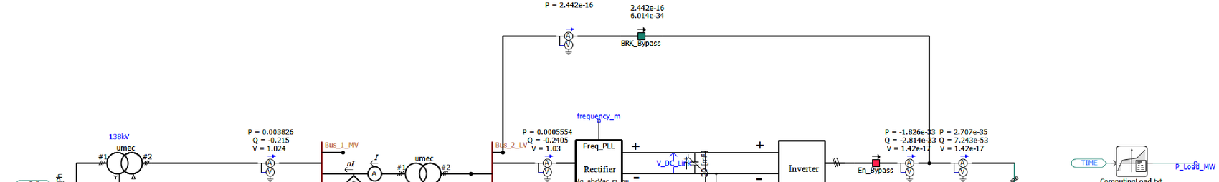
WORK STREAM B · AI DATA CENTER UPS MODEL
8
Double-Conversion UPS Electrical Topology
Bypass path
Conversion path
Load connects directly to the utility bus through BRK_Bypass — no power-electronic conversion, most efficient, used when grid voltage/frequency are healthy.
Rectifier (AC→DC) → DC link → Inverter (DC→AC) continuously regulates 480V/60Hz to the load, isolating it from most upstream disturbances. Battery sits on the DC link via a bidirectional DC/DC converter.
WORK STREAM B · AI DATA CENTER UPS MODEL
13

Slide 14
WORK STREAM B · AI DATA CENTER UPS MODEL
9
Core Conversion Blocks: Rectifier & Inverter
RECTIFIER (AC → DC)
INVERTER (DC → AC)
Grid-following converter
Grid-forming converter
3-phase, 2-level VSC; synchronizes via PLL (Freq_PLL)
dq double-loop cascade, same as Work Stream A
d-axis:
DC-link voltage (or active power during reconnection)
q-axis:
reactive power, typically Q = 0
Ramp-rate limited on take-over, trip, and reconnection
3-phase, 2-level VSC; P-f / Q-V droop, same as Work Stream A
d-axis:
AC voltage magnitude
q-axis:
reference held at 0
Forms its own voltage/frequency — the load only “sees” a disturbance if the DC link itself collapses
Adds a VDC–VAC droop: reduces AC voltage as DC link sags, protecting the DC link
WORK STREAM B · AI DATA CENTER UPS MODEL
14

Slide 15
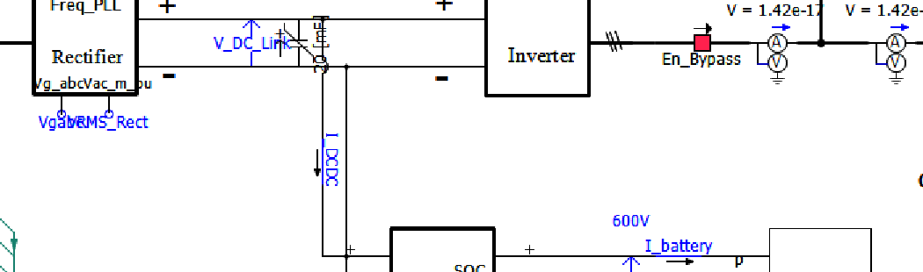
WORK STREAM B · AI DATA CENTER UPS MODEL
10
Bidirectional DC/DC Converter & Battery SOC
BUCK — charging
DC link → battery. Single-loop power control tracks a modest charging-power reference, well below the rectifier's spare capacity.
BOOST — discharging
Battery / SOC block:
Non-ideal (Thevenin-like) model — internal source + output resistance, so terminal voltage sags under discharge
SOC signal tracks remaining energy through charge/discharge cycling; essential for ride-through duration and future extensions (e.g., de-rating near SOC limits)
Battery → DC link. Single-loop DC-link-voltage control — the battery becomes the DC link's primary regulator once the rectifier can't hold it up.
WORK STREAM B · AI DATA CENTER UPS MODEL
15

Slide 16
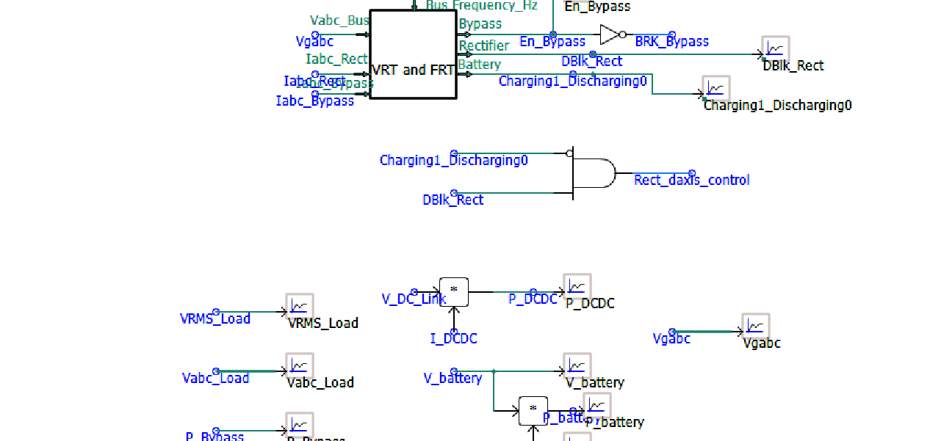
WORK STREAM B · AI DATA CENTER UPS MODEL
11
Voltage & Frequency Ride-Through (VRT/FRT)
The UPS's supervisory brain
Monitors PCC voltage/frequency, rectifier current, bypass current against multi-point ride-through curves with hold-up times
Drives 3 coordinated outputs: Bypass, DBlk_Rect, Charging1_Discharging0
Rect_daxis_control AND-gate + first-order P_Inv_Setpoint filter smooth mode transitions
Inverter is never blocked — the load never loses supply while sources negotiate
WORK STREAM B · AI DATA CENTER UPS MODEL
16

Slide 17
WORK STREAM B · AI DATA CENTER UPS MODEL
12
Three Operating Modes
Mode | Path to load | Rectifier | Battery
Bypass | Direct from utility, through BRK_Bypass | Idle / trickle-charging only | Standby or charging
Normal converter | Rectifier → DC link → Inverter | Regulates DC-link voltage (GFL) | Buck mode, charging
Battery backup | Battery → DC/DC → DC link → Inverter | Blocked / tripped | Boost mode, discharging, regulates DC link
Healthy grid → bypass (most efficient). Excursion beyond the bypass ride-through curve → normal converter mode (GFL rectifier + GFM inverter jointly regulate). Rectifier trip on a severe disturbance → battery backup keeps the DC link — and the inverter, and therefore the load — alive until the grid recovers and the rectifier reconnects on a load-like ramp.
WORK STREAM B · AI DATA CENTER UPS MODEL
17

Slide 18
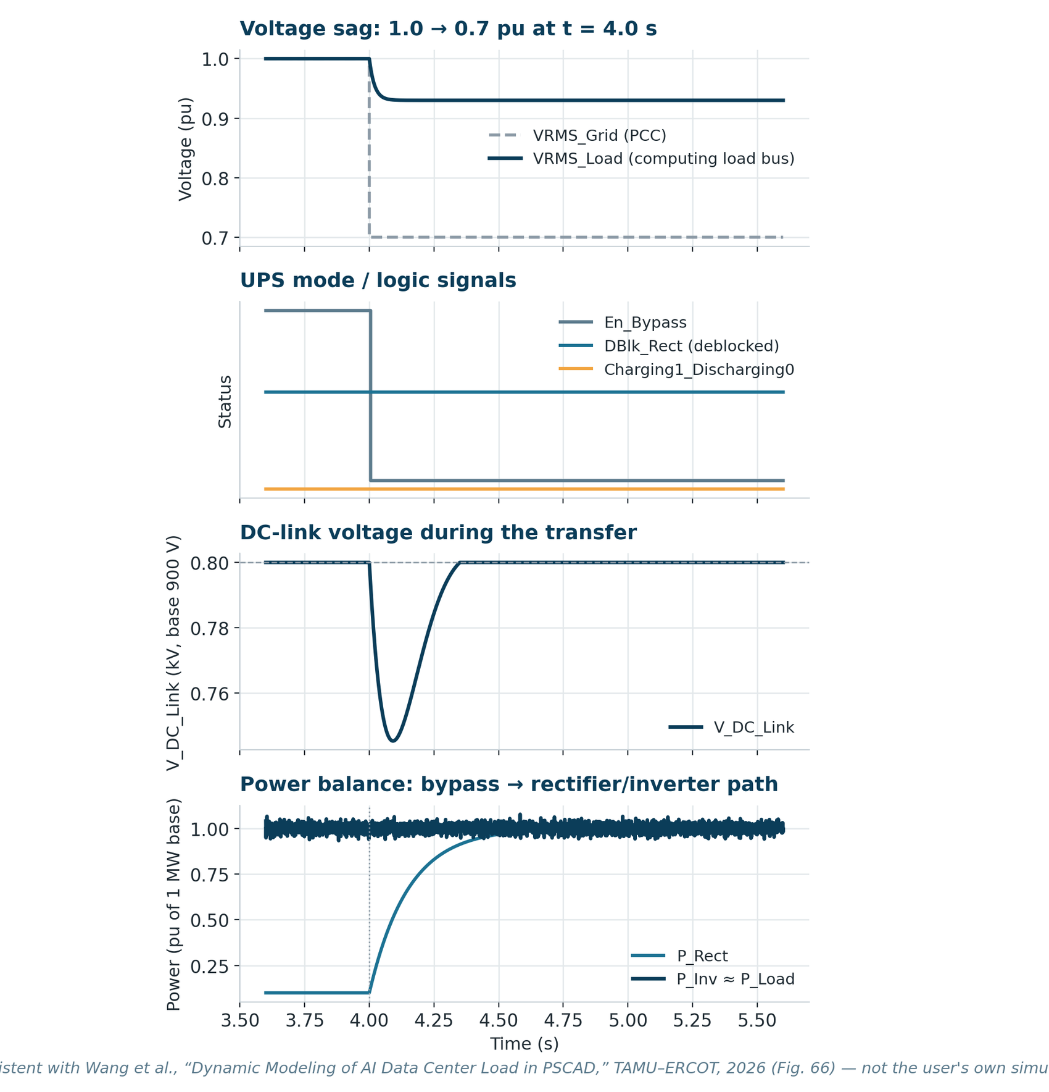
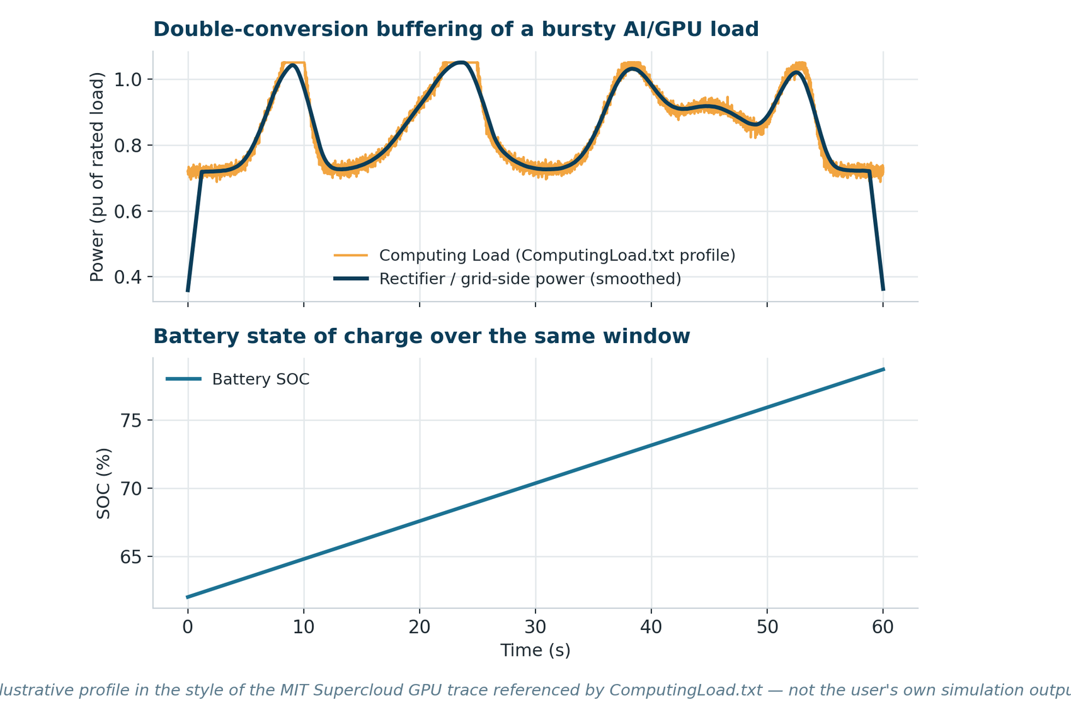
WORK STREAM B · AI DATA CENTER UPS MODEL
Illustrative Ride-Through & Load-Buffering Results
Illustrative, drawn to match the qualitative pattern reported in the ERCOT/TAMU reference (Wang et al., 2026) — not the user's own captured PSCAD run.
WORK STREAM B · AI DATA CENTER UPS MODEL
18

Slide 19
WRAP-UP
Summary of Work Completed
WORK STREAM A
WORK STREAM B
GFL/GFM module integrated into the PCS average model with a defined I/O interface
SRF-PLL synchronization tuned across 3 SCR operating points
Outer power loop + inner current loop, with decoupling and full negative-sequence control
GFM implemented two ways — P-f/Q-V droop and VSM — with reasoned RoCoF/inertia comparison
Double-conversion UPS topology reproduced from the ERCOT/TAMU reference model
Rectifier mapped to GFL control, inverter to GFM droop — direct reuse of Stream A
Bidirectional DC/DC buck/boost logic and battery/SOC block documented
Centralized VRT/FRT module and 3 operating modes documented end to end
Summary
19

Slide 20
WRAP-UP
Key Learnings & Next Steps
LEARNINGS
NEXT STEPS
PLL bandwidth is a stability lever co-tuned with grid strength, not a fixed constant
GFM's real value is giving downstream loads/buses something to synchronize to
VSM = droop + explicit inertia — bounded RoCoF during the transient
UPS ride-through is a coordinated, multi-converter behavior, not one block's job
Run the PSCAD cases; replace every illustrative chart with captured data
Validate PLL/current-loop tuning with small-signal stability margins
Multi-disturbance VSM vs. droop study — quantify RoCoF & nadir improvement
Exercise the full LVRT/HVRT curve; load the real ComputingLoad.txt profile
Key Learnings & Next Steps
20

Slide 21
Thank You
Questions & Discussion
GFL/GFM Control Module Development · AI Data Center UPS Load Modeling · PSCAD

