Slide 1

Core Applications Course
PDM191 Rev. B Life Cycle Manager Administration
Training Manual
Effective January, 1999

Slide 2
Manual History
Revision Product Version Date Supercedes
A 3.0 June, 1998 New
B 3.0 January 1999 A
Copyright 1998 Structural Dynamics Research Corporation (SDRC). All Rights Reserved. SDRC and Metaphase are registered trademarks, and Metaphase Enterprise is a trademark of Structural Dynamics Research Corporation.
Portions of the software are Property of and Copyright 1991-1996 Neuron Data, Inc. All Rights Reserved. Open Interface Elements is a trademark of and is developed and licensed by Neuron Data, Inc., Mountain View, California.
Names of other products mentioned in this manual are used for identification purposes only and may be trademarks of their companies.
All rights reserved

Slide 3
Life Cycle Manager Administration

Slide 4
Table of Contents
Chapter 1: Overview
1.1 Workflow Processes
1.2 The Life Cycle Manager
1.3 Review of OMF Concepts
Chapter 2: Calendars
2.1 Calendar Overview
2.2 Creating Calendars
2.3 Maintaining Calendars
Chapter 3: Creating Processes
3.1 Assignment Process
3.2 Distribution List Process
3.3 Review Process
3.4 Condition Process
3.5 Message Process
3.6 Life Cycle

Slide 5
Table of Contents
Chapter 4: Creating Actors
4.1 Overview
4.2 Assignees
4.3 Recipients
4.4 Reviewers
4.5 Observers
4.6 Group Assignments
Chapter 5: Editing Life Cycles
Chapter 6: Parallel Workflows
6.1 Parallel Workflows - Overview
6.2 Taskflow Process
6.3 Parallel Processes
6.4 Work Breakdown Processes
6.5 Workflow - Summary

Slide 6
Table of Contents
Chapter 7: Creating Variants of Processes
7.1 Copy
7.2 Revise
7.3 Checkout
Chapter 8: Managing Processes
8.1 Update Process
8.2 Delete Process
8.3 Update Effective Dates
8.4 View Process
8.5 Reports
Chapter 9: Managing Actors
9.1 Update Actor
9.2 Updating Reviewer Tabulation
9.3 Delete Actor Relationships
9.4 Replace Actor

Slide 7
Table of Contents
Chapter 10: Run-time Administration
10.1 Review Alternate Work
10.2 Manage Alternate Assignments
10.3 Resume Object
10.4 Aborting a Life Cycle
10.5 In Production & Baselined Processes
Appendix: Improved Advancer Controls

Slide 8
Chapter 1
Overview

Slide 9
1.0 Overview
  1.1 The Workflow Processes
  Defining and evaluating workflows
  Managing Processes
  1.2 The Life Cycle Manager:
    LCM Classes
    The Life Cycle Administration browser
    Examples
  1.3 Review of OMF Concepts
    Conditions
    Participants
    Message Groups
    Default User Groups
    Events and Notification Rules

Slide 10
1.1 Workflow Processes
Manually prepare and issue paper drawings
1
Generate tool design on drawing board
2
Receive all engineering drawings from engineering
3
Review paper drawings, generate BOM and tooling dimensions 4
Manually square up components for later processing
5
First rough machine cut of punch plate and die block
6
Heat treat punch plate and die block
7
Rough machine tool components (knock out plate and retainer)
8
Prepare programs for electrical discharge machining process
9
Complete final machining of all tooling components
10
Complete assembly of the bottom half of the tool
11
Complete machining of bottom shoe
12
Perform trail assembly of all components
13
Complete final machining of top half assembly
14
Complete final machining of bottom half assembly
15
Assemble all components
16
Complete testing of final component
17

Slide 11
Re-engineering of Workflow Process
Create 3D models and CAD part files
1
Review CAD part files
2
Create electronic tooling models and tooling paths based on the CAD data. 3
Metaphase objects enter the parallel process for review and issuance 4
Problem
Resolution
Entry Condition
Drafting Review
Issue Drawings
Entry Condition
Manuf Review
Issue Tooling
Rough
Machining 5
Final
Machining 6
Final
Review 7

Slide 12




Metal Stamping Life Cycle
1
CREATE CAD PART
Assignment Process
1
CREATE CAD PART
Assignment Process
1
CREATE CAD PART
Assignment Process
1
DRAFT REVIEW
Review Process
1
DRAFT REVIEW
Review Process
1
DRAFT REVIEW
Review Process
1
ISSUE DRWGS
Assign. Process
1
ISSUE DRWGS
Assign. Process
1
ISSUE DRWGS
Assign. Process
1000M10G01
A
1
1000M10G01
A
1
1000M10G01
A
1
1000M10G01
A
1
1000M10G01
A
1
1000M10G01
A
1
4
ENGINEERING_MAC
Parallel Process
4
ENGINEERING_MAC
Parallel Process
4
ENGINEERING_MAC
Parallel Process
1000M10G01
A
1
1000M10G01
A
1
1
MANF REVIEW
Review Process
1
ISSUE TOOLING
Assign. Process
1
MANF REVIEW
Review Process
1
ISSUE TOOLING
Assign. Process
1
MANF REVIEW
Review Process
1
ISSUE TOOLING
Assign. Process
1000M10G01
A
1
1000M10G01
A
1
1000M10G01
A
1
1000M10G01
A
1
2
CAD PART FILE
Review Process
2
CAD PART FILE
Review Process
2
CAD PART FILE
Review Process
1000M10G01
A
1
1000M10G01
A
1
5
ROUGH MACHINING
& HEAT TREATMENT
Assignment Process
5
ROUGH MACHINING
& HEAT TREATMENT
Assignment Process
5
ROUGH MACHINING
& HEAT TREATMENT
Assignment Process
1000M10G01
A
1
1000M10G01
A
1
6
FINAL MACHINING
Assignment Process
6
FINAL MACHINING
Assignment Process
3
CREATE TOOLING
Assignment Process
6
FINAL MACHINING
Assignment Process
3
CREATE TOOLING
Assignment Process
3
CREATE TOOLING
Assignment Process
1000M10G01
A
1
1000M10G01
A
1
1000M10G01
A
1
1000M10G01
A
1
7
FINALASSEMBLY
Review Process
7
FINAL ASSEMBLY
Review Process
1000M10G01
A
1
1000M10G01
A
1

Slide 13
Life Cycle Overview
Sr. Staff Eng
Design Eng
Manuf Mgr
Tool Maker
Designer
Manuf Eng
Design Eng
Designer
Sr. Staff Eng
Manuf Mgr
Sr. Designer
Tool Designer
Manuf Eng
Create 3D models and CAD part files
1
Review 3D models and CAD part files
2
Create Tooling
models & part files
3
Engineering Manfacturing Parallel Process 4
Problem
Resolution
Rough
Machining and
Heat Treatment 5
Final
Machining and
Preassembly 6
Final
Review and
Assembly 7
CNC Machinist Materials Eng
Design Eng
Machinist Assembly Specialist
Manuf Eng
Design Eng
Material Eng
Designer

Slide 14
1.2 The Life Cycle Manager
  The Life Cycle Manager (LCM) addresses the needs for workflow and data management requirements associated with:
    creating data
    releasing the appropriate data
    changing product definition information
  The overall mechanism is know within Metaphase as a Life Cycle.
  Characteristics of the Life Cycle Manager:
    Includes 10 major building blocks for building life cycles
    The 10 building blocks include 6 different kinds of processes, and the ability to do state changes and vault transfers
    Each of the processes - including Life Cycles - has both a “pass” or successful exit state and a “fail” or unsuccessful exit state

Slide 15




LCM Classes
  Life Cycles
  Defined by defining processes and states and connecting them together in a manner that models an enterprise’s business practices.
  Assignment Processes
  Used to assign work to participants. As objects proceed through the process, users are assigned a task to perform.
  Distribution List Processes
  Used to notify recipients that a significant milestone has been reached in an object’s life cycle.
  Review Processes
  Used to outline a series of actors (users/groups/roles/dynamic participants) that will review information before it is promoted to the next level. As objects proceed through the process, participants “vote” to indicate their approval or rejection of the object presented.

Slide 16




LCM Classes
  Condition Processes
  Evaluate condition objects, to provide a branching capability within life cycles.
  Message Processes
  Send a customer-specified object message to a life cycle-controlled object.
  Parallel Processes
  Composed of taskflow processes, since a single object (and its components) appears in multiple places at the same time.
  Breakdown Processes
  Composed of external life cycles, since it is the individual component objects that enter them
  Taskflow Processes
  Closely resemble life cycles, and are constructed with the same diagram-based editor (the GLE). They differ in that the Step objects that populate a taskflow do not allow State or Vault changes.

Slide 17
LCM Classes
Working
Released
As an object matures through a life cycle,
its state changes
Project10
Corporate
Similarly, as it is promoted, an object can
be transferred from one vault to another.

Slide 18



LCM Classes
  Calendars
  Define working and non-working days for a process, allowing assignments to expire and be automatically advanced.
  Process History
  Created and maintained by the Life Cycle Manager on objects in life cycles. The process history can be navigated in tree or list views.
  Routing Lists
  Created, maintained, and used by users as a means of obtaining informal comments on a work item. They are not part of a life cycle.

Slide 19
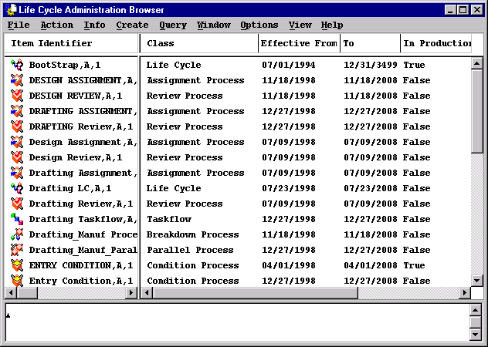
The Life Cycle Manager
  All Life Cycles and their components are created from the Life Cycle Administration Browser.
  To start the Life Cycle Browser from the Home Collection select Window → LCM Admin (as a member of LCM Admin grp)

Slide 20
Defining Life Cycles
  Life Cycles are constructed by:
  1. Defining processes and states
  2. Creating life cycles
  3. Editing life cycles to define their steps
    Associating a process with each step
    Optionally, associating state and/or vault changes with the success and failure exits of the process
    Connecting the defined steps together in a manner that models the business practices of your enterprise
S
Released
NoChange
Process
F
NoChange
Recovery
Step
  Processes may be reused as many times as necessary within a life cycle and between life cycles

Slide 21
Testing Your Life Cycle
  The following simple Life Cycle models the design, review and baselining of a product:
  1. Check to make sure the object has been moved to the MetaPen vault
  2. Do the conceptual design
  3. Review the design, if successful, transfer the object to the Corporate Vault
  4. Baseline the Object
  5. Notify the recipients that the object has been baselined
  The exceptions to the above process are:
  If the conceptual design has a problem, send it to a specialist
  If the review is not approved send the object back to the designer

Slide 22
Testing Your Life Cycle
Example
Design
Review
Notify
Recipients
S
Baseline
S
S
In MetaPen
Vault
Conceptual
Design
S
F
F
F
S
F
F
EXITLC
Specialist
S
F

Slide 23
1.3 Review of OMF Concepts
  Conditions
  Conditions are used throughout Life Cycle Manager to define and control the flow of and who participates in an object’s life cycle. Conditions:
    always evaluate to either TRUE or FALSE
    can reference attributes of one or more objects
    have a required number of arguments which depends on how the condition is being used
  Example: Assume that a drawing has an attribute of SheetSize (with US-ANSI values A, B, C, D,…). Suppose that we want to use SheetSize to determine the drawing’s life cycle. A condition expression must be written that tests the SheetSize attribute of an object and returns a TRUE or FALSE result.
  An example of such an expression is:
  ($obj.SheetSize = ‘A’) OR ($obj.SheetSize = ‘B’)
  This expression returns TRUE for small drawings.

Slide 24
Review of OMF Concepts
  Participants
  In life cycles, participants are called Actors. In OMF, three types of participants were described:
    users
    groups
    roles
  Any of these participants can be actors in life cycles. Of particular importance in life cycles are roles. Through the use of roles, the same process can be used for many different projects without redefining the human actors.
  In addition, life cycles use a fourth type of participant called a Dynamic participant. Dynamic participants are based on an attribute of an object and are used in life cycles just like any other type of participant.
  Example: Choose Create → Admin Items → Participants → Dynamic Participant to “register” $obj.Reviewers. Then, at run time, the Reviewers attribute of an object will be evaluated and the corresponding people will participate in the life cycle.

Slide 25
Review of OMF Concepts
  Message Groups
  Message Groups are used in Life Cycle Manager to determine which actions actors in a process may perform on objects, as part of their assignment. Message Groups are used:
    to simplify rule writing
    to group related messages
Query_grp
LcmRvrReadMsgGrp
Route_grp
Update_grp
LcmRvrWriteMsgGrp
CheckIn/Out_grp
Move/Trans_grp
Relate_grp
AssignToProject_grp

Slide 26
Review of OMF Concepts
  Default User Groups
  Life Cycle Manager introduces two additional default user groups:
    LCM admin grp
    LCM admin viewer grp
  Only members of the LCM admin grp have the Window → LCM Admin menu selection from the Home Collection - they can only create, edit, update, or delete life cycles and their component processes.
  Members of the LCM admin viewer grp can query for life cycles and their components from the Query menu, but they have read-only access to these objects.

Slide 27
Review of OMF Concepts
  Events and Notification Rules
  In life cycles, notification rules are used to notify the following people that certain events have occurred in the system:
    the owner of an object
    the submitter of an object to a life cycle
    a user who has a work assignment
    members of the LCM admin grp
  Example Notification Rule:
  ConditionName = ‘TRUE’ ;
  EventName = ‘AdvInvalidProcess’ ;
  RoleName = ‘LCM admin grp’ ;
  ClassName = ‘ * ‘ ;
  ChildFlag = ‘ + ‘ ;
  This notification rule ensures that members of the LCM admin grp are notified if an object cannot advance in a life cycle. It is then the task of an LCM Administrator to investigate the problem.

Slide 28
Chapter 2
Calendars

Slide 29
2.0 Calendars
  2.1 Calendar Overview
  2.2 Creating Calendars
  2.3 Maintaining Calendars
    Editing Calendars
    Updating Calendars

Slide 30
2.1 Calendar Overview
  In LCM, calendars are used to specify whether a given day is a workday or not, for a given site or organization. When associated with a Review, Assignment, or Distribution List process, due dates for individual assignments can then be computed based on a local work schedule.
  Calendars are optional; in the current release they are used only by LCM’s assignments expiration feature
  Note in particular that calendars are administrative, not user or personal tools.

Slide 31
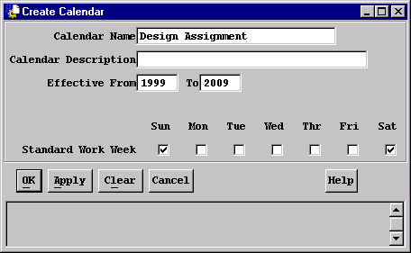
2.2 Creating Calendars
  To create a Calendar Object select Create → Calendar from the LCM Administration browser
Note that non-workdays are
“depressed” or “pushed” toggles.
Once created, the standard
workweek cannot be modified.
  The calendar is now a “template” - it contains only the standard work schedule. It is still necessary to Edit it, to define the remaining non-working days.
  The calendar will be associated with processes and life cycles when they are created or updated

Slide 32
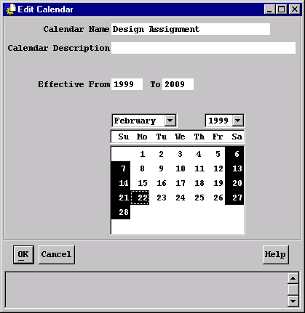
2.3 Maintaining Calendars
  Editing Calendars
  To change the state of a day from working to nonworking, either:
    double-click on a calendar object, or
    select a calendar object, and choose Action → Edit
Note again that non-workdays are
highlighted
With the left mouse button, click on
a single day to change its state, or
click-drag across a row or column to
set the state of all days in the
selection range to the inverse of the
first selected day.

Slide 33
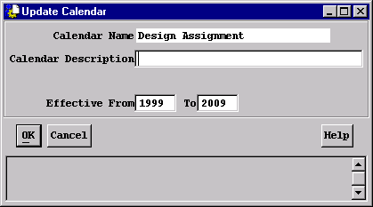
Maintaining Calendars
  Updating Calendars
  After creating a calendar, little maintenance is necessary. Two annual events which require calendar editing are:
    extending the range, in whole years, and
    specifying or updating holidays as annual schedules become known
  To extend the range or change the description, choose Info → Update Item:
  To modify the work schedule, choose Action → Edit, as before.

Slide 34
Chapter 3
Creating Processes

Slide 35
3.0 Creating Processes
3.1 Overview
3.2 Assignment Process
3.3 Distribution List Process
3.4 Review Process
3.5 Condition Process
3.6 Message Process
3.7 Life Cycle

Slide 36
3.1 Overview
  Common Process Attributes
  Life Cycles and their component processes all share the following:
    Name - this name must be unique among all processes and life cycles
    Revision - life cycles and their component processes are business items and can therefore be revised
    Description - optional
    Effective Dates - the dates between which a process is available for use
    Calendar Name - the name of an existing calendar which applies to this process or life cycle or for processes, the keyword INHERITED, which defines that a process derives a calendar from its enclosing life cycle.

Slide 37
3.2 Assignment Process
  Assignment Processes are composed of 2 components: attributes of the process itself, and identification of participants in the process.
  In an Assignment Process, actors known as Assignees are given a task to perform. The assignee’s sign-off indicates that the participant either
    Completed the task
    For some reason was unable to complete the task
      If all assignees in the process complete their work, the process “Succeeds”
      If any assignee is unable to complete the work, the process “Fails”
  These designations, Success or Failure, determine the next step that will be initiated in the Life Cycle.

Slide 38
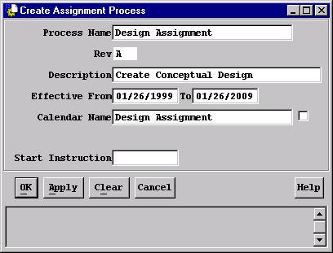
Assignment Process
  To create a new Assignment Process, choose Create → Assignment Process from the LCM Admin Browser.
  The Assignment Process has now been created, but is empty. It is still necessary to Edit it or “populate” it with participants.

Slide 39
3.2 Distribution List Process
  Distribution List Processes are composed of 2 components: attributes of the process itself, and identification of participants in the process.
  In an Distribution List Process, actors known as Recipients are notified that a significant milestone has been reached in an object’s life cycle. The recipient’s sign-off indicates that the participant:
    Acknowledged the notification
  An object advances to the next step of a life cycle without waiting for recipients to acknowledge their notifications.
  Only the Success path is taken on exit from a Distribution List Process.

Slide 40
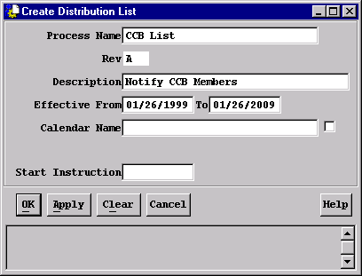
Distribution List Process
  To create a new Distribution List Process, choose Create → Distribution List from the LCM Admin Browser.
  The Distribution List Process has now been created, but is empty. It is still necessary to Edit it or “populate” it with participants.

Slide 41
3.3 Review Process
  Review Processes are composed of 2 components: attributes of the process itself, and identification of participants in the process.
  In a Review Process, actors known as Reviewers review a work item. The reviewer’s sign-off indicates:
    Approval of the work item
    Rejection of the work item
      Approvals and rejections are tabulated.
      If the ratio of approvals to rejects meets the defined tabulation specifications, the process “Succeeds”; otherwise the process “Fails”.
  These designations, Success or Failure, determine the next step for the object in the Life Cycle.

Slide 42
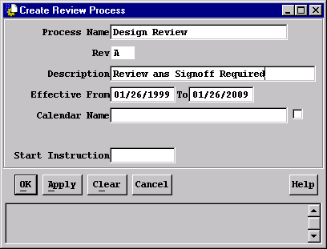
Review Process
  To create a new Review Process, choose Create → Review Process from the LCM Admin Browser.
  The Review Process has now been created, but is empty. It is still necessary to Edit it or “populate” it with participants.

Slide 43
3.4 Condition Process
  A Condition Process evaluates a Condition object, which may examine the attributes of one or more objects, and returns a Boolean (TRUE or FALSE) result. Based on the result, an object will follow one of two possible branches in a life cycle.
  Before a Condition Process can be created, the condition to evaluate must already be defined.
    When used in a Condition Process, the condition object must have two arguments. The condition might look like:
    IS_SMALL (obj, env) := ($obj.SheetSize = ‘A’)
    or ($obj.SheetSize = ‘B’) ;
    When IS_SMALL is referenced by a Condition Process, small drawings can branch to an alternate path in a Life Cycle, or can bypass steps that are required only for large drawings.
  There is one predefined Condition Process supplied, named LCM TrueCnd.

Slide 44
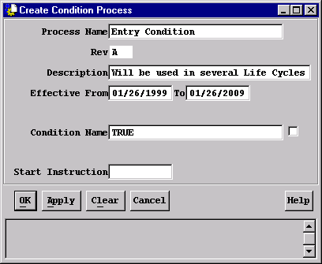
Condition Process
  To create a Condition Process, choose Create → Condition Process from the LCM Admin Browser.
  Unique Attribute:
  Condition Name - A two argument condition that has already been defined.

Slide 45
3.5 Message Process
  A Message Process is a process in which a task is executed by the system by sending a message to the object. The result of the task (success or fail) is returned to the message process.
  To create a Message Process, the message must already be defined.
  Example: An administrator could create a Message Process that causes the system to execute the BaselineObject action. This process could now be included in a life cycle, and when the step in the life cycle is executed it would attempt to baseline the object. Advancement in the life cycle is determined by the exit state argument.
  There are four predefined Message Processes:
    LCM Baseline
    LCM Export
    LCM FalseMsg
    LCM TrueMsg

Slide 46
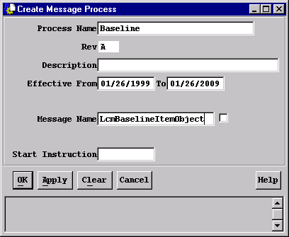
Message Process
  To create a Message Process, choose Create → Message Process from the LCM Admin Browser.
  Unique Attribute:
  Message Name - A message that has been previously defined in MODeL as like LCM AdvancerMessage.

Slide 47
3.6 Life Cycle Definition
  Life Cycles are composed of two components: Life Cycle attributes and Life Cycle Steps.
    Life Cycles define the overall series of states that an object moves through during its existence. Typically, an object begins in a work-in-process state and progresses through states which indicate formalization, production usage, change, and obsolescence.
    Life Cycles are the framework to which the rest of their component processes are related
    After creation, they are “populated” by using previously defined:
      Assignment Processes
      Distribution list Processes
      Review Processes
      Message Processes
      Condition Processes
      Life Cycles
      Parallel Process
      Breakdown Process

Slide 48
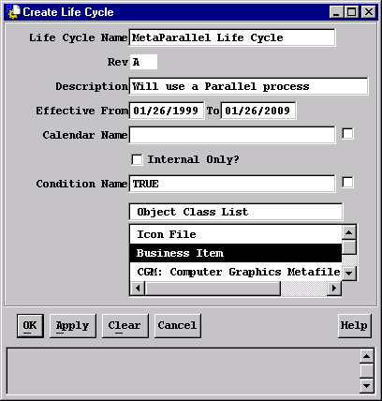
Creating The Life Cycle Object
  To create a new Life Cycle, choose Create → Life Cycle from the LCM Admin Browser.
  The Life Cycle has now been created, but is empty. It is still necessary to Edit it to define its steps.

Slide 49
Life Cycle
  Condition Name - A two argument condition which is evaluated to determine if this Life Cycle is a candidate for a given object and/or environment.
  Example: IN_DEV_PROJECT (obj, env) :=$o.ProjectName=‘DEVELOPMENT PROJECT’ and not (IS_FROZEN(o,e));
  When the IN_DEV_PROJECT condition is specified for a Life Cycle, only Business Items in the Development Project that are not frozen will be accepted by that Life Cycle.
  Internal Only? - A toggle indicating whether or not objects may be submitted directly into this Life Cycle. When TRUE, this Life Cycle may be referenced only in a Life Cycle Step, making it a nested Life Cycle
  Note that when this flag is FALSE, the keyword INHERITED may not be specified for the CalendarName attribute.

Slide 50
Life Cycle
  Object Class List - Specifies a selection list of work item classes that the Life Cycle will accept. The selected classes and any children of those classes may be submitted to the life cycle.
  Notes:
    The Object Class List attribute allows for multiple selections. It is necessary to deselect any unwanted object classes.
    For both maintenance and “business philosophy” reasons, a life cycle should not accept both business items and data items.
    When a business item is submitted to a life cycle, any attached data items are implicitly carried through the life cycle.

Slide 51
Chapter 4
Creating Actors

Slide 52
4.0 Creating Actors
4.1 Overview
4.2 Assignees
4.3 Recipients
4.4 Reviewers
4.5 Observers
4.6 Group Assignments

Slide 53
4.1 Overview
  All types of actors are relations between processes and their associated participants.
  Each type of process has its own type of actor
    Assignment Process: Assignee
    Distribution List Process: Recipient
    Review Process: Reviewer
  A participant can also be an Observer for any process type, including Life Cycles.

Slide 54
Overview
  Common Actor Attributes
  All actors share the following characteristics:
    Participant - the user, group, role, or dynamic participant to whom the task has been assigned
    Assignment - a brief description of the task that the actor has been assigned
    Message Group - the list of messages that this actor will temporarily be allowed to send to the object in the life cycle and to its attachments. LCM provides three message groups:
      LcmRvrReadMsgGrp gives access to OMF’s Query_grp (View, GetInfo_grp, QueryObj_grp, Expand_grp, Report_grp) plus LCM’s Route_grp - actions that allow navigation and display of objects
      LcmRvrWriteMsgGrp gives access to LCmRvrReadMsgGrp, plus Update_grp, CheckIn/Out_grp, Move/Trans_grp, Relate_grp, and AssignToProject_grp - actions that allow modifications to existing object data.
      LcmAssigneeMsgGrp gives access to LcmRvrWriteMsgGrp, plus the CreateRelation and DeleteRelation - actions that allow modifications to the object structure.

Slide 55
Overview
  Actor Common Attributes
  Condition Name - A four-argument condition that will be evaluated to determine if this actor should be included in this process.
    actr - the actor template object, from which additional attributes (largely applicable to reviewers) can be tested;
    hist - the current process history object, from which attributes such as process or life cycle name can be tested.
  Example: When the condition IS_SMALL is specified for a Life
  Cycle, large drawings are not accepted by that Life Cycle.
  IS_SMALL (obj, env) := ($obj.SheetSize = ‘A’)
  or ($obj.SheetSize = ‘B’)
  or
  IS_SMALL4 (obj, env, actr, hist) := IS_SMALL (obj, env) ;
  Example: With the condition IS_SMALL4 included in an actor definition, a participant excluded for large drawings in a process.

Slide 56
Overview
  Actor Common Attributes
    Expiration Interval - the length of time, in workdays, that an actor has to complete the assignment. A value of 0 indicates that the assignment does not expire.
    Expiration Action - a brief description of the task that the actor has been assigned
    Message Group - the line process-specific action that is to be taken when the assignment expires . Examples include Mark Overdue, Approve, and Reassign.
    Expire To - the name of another user to whom the assignment is given when the Expiration Action is Reassign. The due date is not recomputed for the new user.

Slide 57
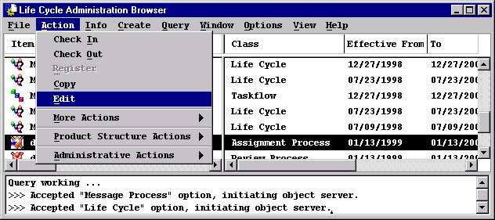
4.2 Assignees
  An Assignee is a relation object between a participant and an Assignment Process. When an Assignment Process is created, one or more assignees must be associated with the process. All participants must be defined in the database before they can be related to an assignee.
  Assignees are created by editing Assignment Processes one of the following 3 ways:
    Double-click on the assignment process
    Select the assignment process, then choose Action → Edit.

Slide 58
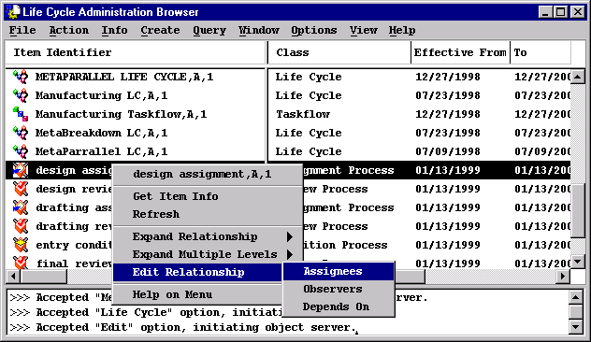
Assignees
  Click-drag on the assignment process with the right mouse button and choose Edit Relationship → Assignees
  All three methods display a Participants or Assignees browser.

Slide 59
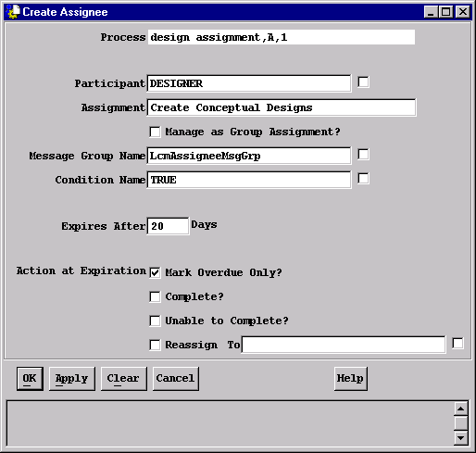
Assignees
  From the participants or Assignees browser, choose Create → Assignee, to bring up the Create Assignee dialog box.

Slide 60
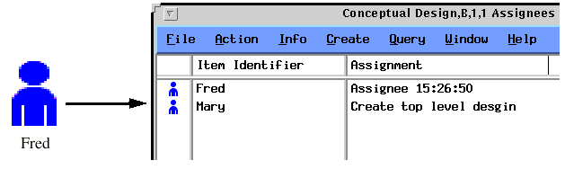

Assignees
  You can also create assignees through drag and drop. However, the Assignment will be generic in the form of Assignee (Time).
  Drag the appropriate participants to the Assignee Browser.
  Drag the participants directly onto the Assignment Process icon
Project Leader

Slide 61
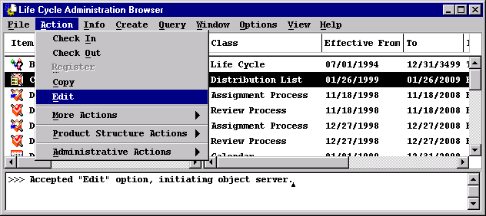
4.3 Recipients
  A Recipient is a relation object between a participant and a Distribution List Process. When a Distribution List Process is created, one or more recipients must be associated with the process. All participants must be defined in the database before they can be related to a recipient.
  Recipients are created by editing Distribution Lists one of the following 3 ways:
    Double-click on the distribution list process
    Select the distribution list process, then choose Action → Edit.

Slide 62
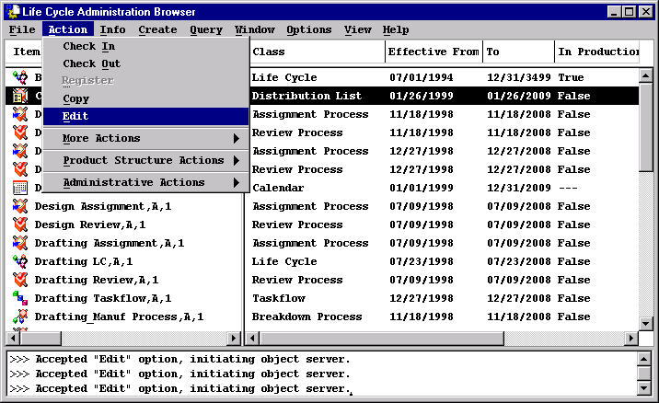
Recipients
  Click-drag on the distribution list process with the right mouse button and choose Edit Relationship → Recipients

Slide 63
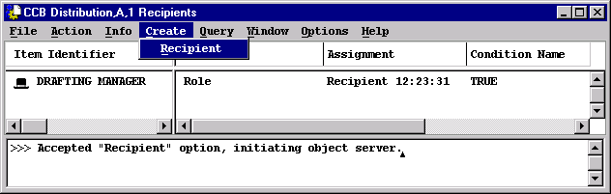
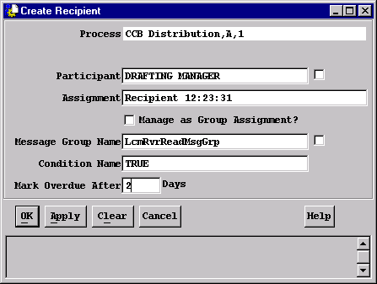
Recipients
  Click Create → Recipient, to bring up the Create Recipient dialog box

Slide 64
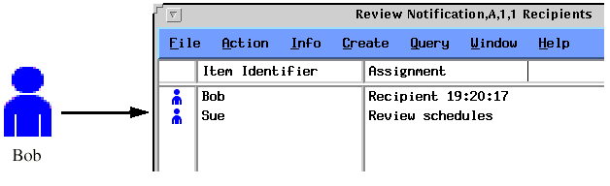
Recipients
  You can also create recipients through drag and drop. However, the Assignment will be generic in the form of Recipient (Time).
  Drag the appropriate participants to the Recipient Browser.
  Drag the participants directly onto the Distribution List Process icon
Project Leader

Slide 65
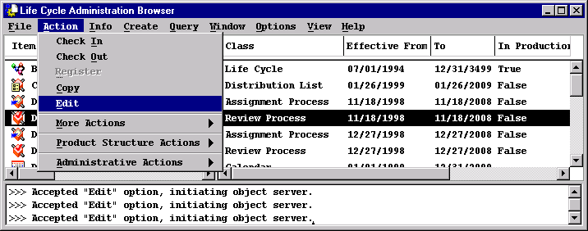
4.4 Reviewers
  A Reviewer is a relation object between a Review Process and a participant. When a Review Process is created, reviewers must then be defined for the process.
  Reviewers are created by editing Review Processes through one of the following 3 ways:
    Double-click on the review process
    Select the process, then choose Action → Edit.

Slide 66
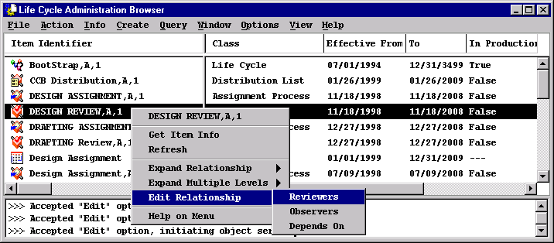
Reviewers
  Click on the process, press the right mouse button and choose Edit Relationship → Reviewers

Slide 67
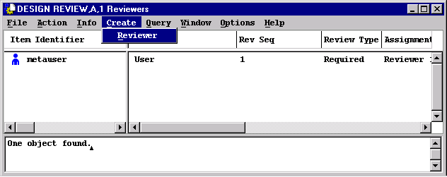
Reviewers
  All three methods display a Participants Reviewer browser.
  Click Create → Reviewer, to bring up the Create Reviewer dialog box

Slide 68
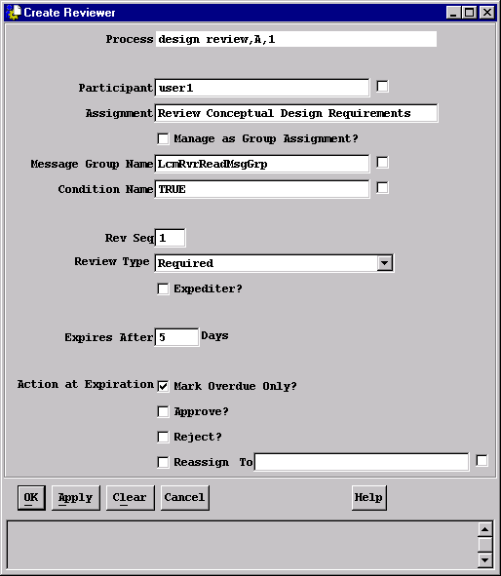
Reviewers
  Create Reviewer dialog box:

Slide 69
Reviewers
  Additional Reviewer Attributes
    Sequence - a number that determines when in the review process a reviewer will be involved. All reviewers of the same sequence will receive the work at the same time. Tabulations can be set and will apply to all reviewers at the same sequence. Sequence 0 is a special case reviewer whose duration is through out the process.
    Review Type - when reviewers receive review work in their work lists, the type of reviewer is not indicated to them.
      Required reviewers must sign off, unless the tabulation has already been determined by the signoffs of others
      Optional reviewers may sign off; their signoff will count as long as the tabulation has not already been determined
      Info-Only reviewers may register their opinions, but their signoffs may not count toward the tabulation
    Expediter? - a switch that specifies that this reviewer can expedite (either approve or reject) an object out of this process. Reviewers can only expedite on or before the sequence at which their normal review occurs.

Slide 70
Reviewers
  You can also create reviewers through drag and drop. However, the following default values will be set:
    Assignment will be generic in the form of Reviewer (Time)
    Message Group Name will be LcmRvrReadMsgGrp
    Condition Name will be TRUE
    RevSeq will be 1
    Review Type will be Required
    Expedite? Will be No
    Assignment will not

Slide 71
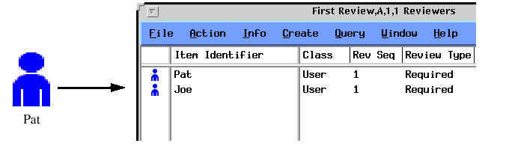
Reviewers
  Drag the appropriate participants to the Reviewers Browser.
  Drag the participants directly onto the Review Process icon
Project Leader

Slide 72
4.5 Observers
  Overview
  An Observer is a relation object between a participant and any other process class, including Life Cycles (although it makes little sense to have observers for Condition and Message Processes). Observers are “passive participants”: they can monitor an object’s status and view the comments and actions of other participants, but cannot themselves write comments or sign off on work assignments:
    Observers are always optional, but when used, participants must be defined in the database before they can be related to processes.
    Like other actors, observers can be users, groups, roles, or dynamic participants.
    An observer in a Life Cycle is defined to be an observer for every process referenced in that Life Cycle.
    An object’s submitter is always an implied observer while the object is active in a Life Cycle.

Slide 73
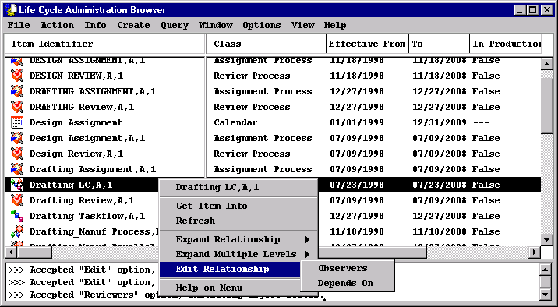
Observers
  Creating Observers
  Observers in Life Cycles are created and maintained only be selecting a Life Cycle icon, then choosing Edit Relationship → Observers from the pop-up menu. This displays a browser containing only observers.

Slide 74
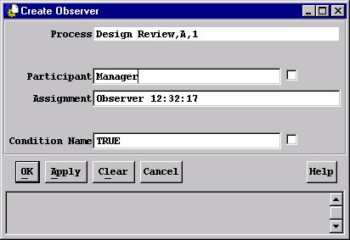
Observers
  Creating Observers
  Observers can be created for Review, Assignment, and Distribution List Processes. The Life Cycle administrator can, double-click on a process or choose Action → Edit to display a more generic “participant” browser, which includes both observers and the primary actor type for the process.
  From either resulting browser, choose Create → Observer to display the Create Observer dialog box

Slide 75
4.5 Group Assignment
  Within LCM, an Actor (Reviewer, Recipient, etc) is one of the following:
    User
    Group
    Role
    Dynamic Participant - an attribute that contains one or more
      Users
      Groups
      Roles
  Metaphase provides additional flexibility for all Actor assignments, permitting one user to act on any assignment type on behalf of a group, if allowed by the Life Cycle Administrator.

Slide 76
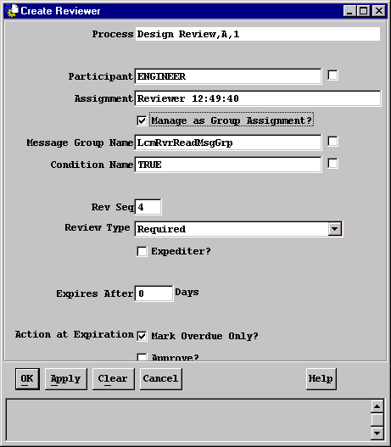
Group Assignment
  The Life Cycle Administrator specifies that this review process is to be managed with Manage As Group Assignment? toggle
  When the toggle is pushed, the following steps occur as an object enters a process containing a group assignment:
    An assignment is generated to the worklist for each user in the group
    When one user chooses the signoff action Claim, the assignment is removed from the worklists of all other group members.

Slide 77
Chapter 5
Editing Life Cycles

Slide 78
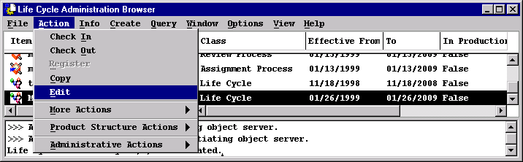
5.0 Editing Life Cycles
  Editing a Life Cycle is simply defining the Life Cycle Steps. The following rules apply:
    Two steps may not have the same name
    A Life Cycle must have only one entry point, and the editors must be able to determine its name. There must be exactly one step that is not referenced by any other step. A Life Cycle can have multiple exits.
    All steps must have an associated process for a Life Cycle to be valid.
  To create Steps for a Life Cycle, double-click on its icon or select the icon and choose Action → Edit.

Slide 79
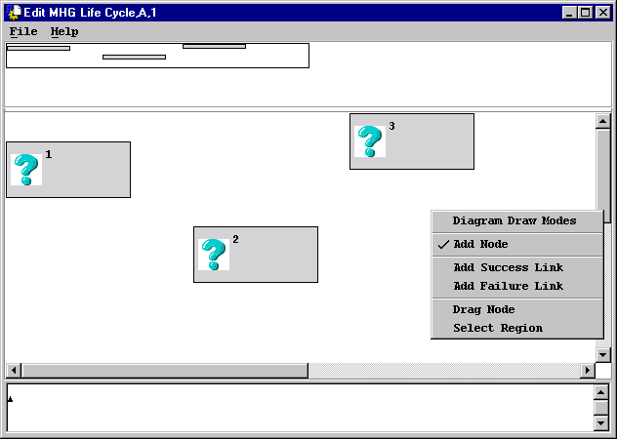
Editing Life Cycles
  Graphical Life Cycle Editor
  Step 1: Define a node for each Life Cycle step

Slide 80
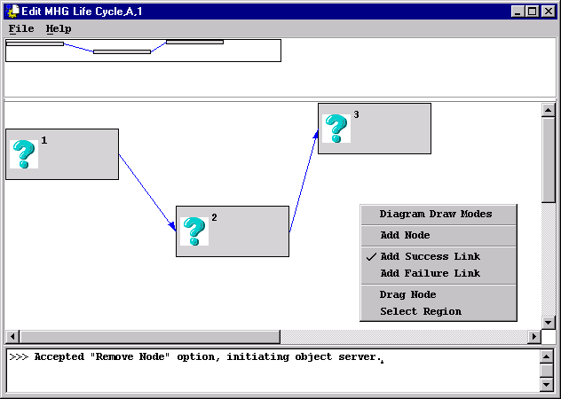
Editing Life Cycles
  Graphical Life Cycle Editor
  Step 2: Connect each step with success and failure links

Slide 81
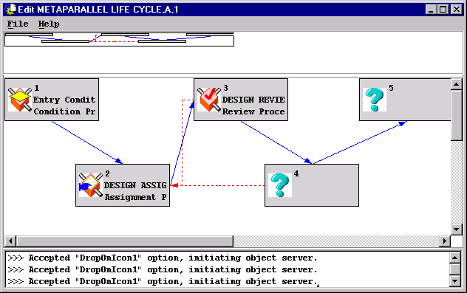
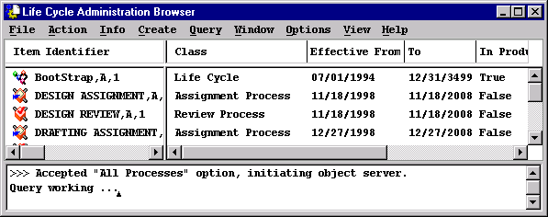
Editing Life Cycles
  Graphical Life Cycle Editor
  Step 3: Associate a process with each step

Slide 82
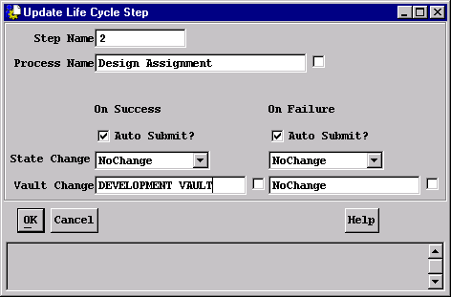
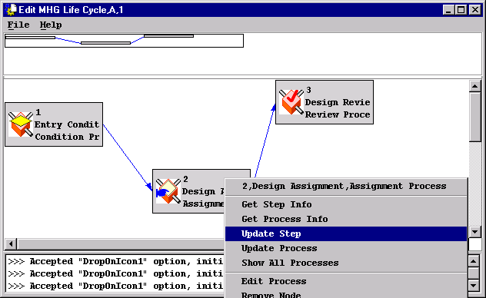
Editing Life Cycles
  Graphical Life Cycle Editor
  Step 4: Update the steps to include more meaningful step names, and add state and vault changes where needed.

Slide 83
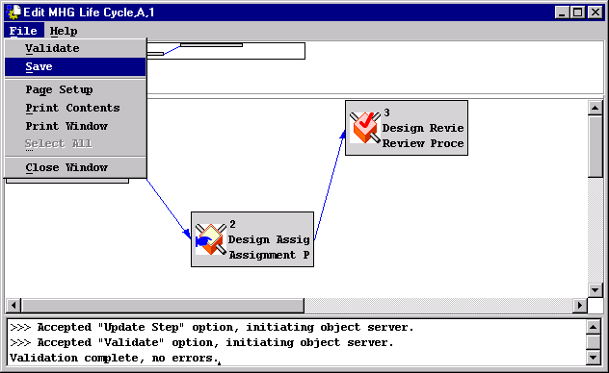
Editing Life Cycles
  Graphical Life Cycle Editor
  Step 5: Validate and Save the Life Cycle

Slide 84
Editing Life Cycles
  Graphical Life Cycle Editor - Node Actions
  The graphical life cycle editor also allows the user to perform the following actions on nodes:
  Reposition a node or group of nodes
    From the background pop-up menu, choose Drag Node or Select Region
  Remove a step
    From the node pop-up menu, choose Remove Node
    A node not yet saved is removed with its links; a node in the database is redrawn as a “shadow” node, and is deleted when the life cycle is re-saved.
  Insert new steps
    From the background pop-up menu, choose Add Node, then Add Success Link and Add Failure Link to connect it.
  Update step attributes
    Double-click on the step.

Slide 85
Editing Life Cycles
  Graphical Life Cycle Editor
  The graphical life cycle editor also allows the user to perform the following actions on links:
  Redraw a link
    From the background pop-up menu, choose Add Success Link or Add Failure Link
    Draw the new link. Because a step can have only one link of each type, the old link will be automatically removed.
  Remove a link
    From the link pop-up menu, choose Remove Link

Slide 86
Chapter 6
Parallel Workflows

Slide 87
6.0 Parallel Workflows
6.1 Parallel Workflows - Overview
6.2 Taskflow Processes
6.3 Parallel Processes
6.4 Work Breakdown Processes
6.5 Parallel Workflows - Summary

Slide 88
6.1 Parallel Workflows - Overview
  Metaphase Life Cycle Manager utilizes three process classes, to support two types of Parallel Processing, the Parallel Process, Taskflow Processes and the Work Breakdown Process.
  A fundamental problem in process design is dealing with conflicts between branches: what happens when branches call for conflicting state changes or simultaneous vault changes? Metaphase addresses this with the Taskflow Process. These Taskflow Processes do not allow state or vault changes.
  A single object structure can be in multiple Taskflows simultaneously; its progress is “monitored” by a Parallel Process.
  When a component of a complex object needs to enter independent (external) life cycles of their own, Metaphase uses the Work Breakdown Process. These external life cycles do allow state and vault changes. However, the component can only be in one of the branches of the Breakdown Process at a given time

Slide 89
Parallel Workflows - Overview
  The three process types, plus the existing life cycle object class, are interrelated as follows:
Parallel
Breakdown
Taskflows
Life Cycles
    Parallel processes are composed of taskflow processes, since a single object ( and its components) appears in multiple places at the same time.
    Breakdown processes are composed of external life cycles, since it is the individual component objects that enter them.

Slide 90





Parallel Process (Example)
engineering
change
drawing
An Engineering Change that contains
a drawing and a specification is advanced to a
parallel process
spec
Drafting Taskflow
Manufacturing Taskflow

Slide 91
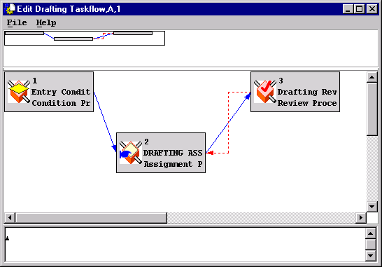
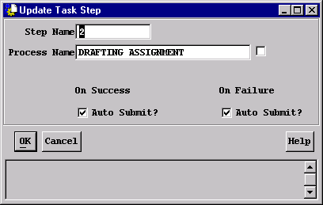
6.2 Taskflow Processes
  Taskflow processes closely resemble life cycles, and are constructed with the same diagram-based editor (the GLE). They differ in that the Process Steps that define a taskflow do not allow State or Vault changes.
  Each step in a taskflow may contain any other process type, except a life cycle, and Taskflows may be nested.

Slide 92
6.3 Parallel Processes
  After taskflows are defined, they are used to populate parallel processes; in effect, a parallel process is a “monitor” for the branches that comprise it.
    Each taskflow branch is associated with a condition, so that a subset of the available branches may be taken for any given object.
    Each branch must complete successfully in order for the parallel process to complete successfully. Any failed branch will cause the parallel process to fail and take its alternate exit path.
    In the even a branch fails, the remaining branches can be allowed to complete, or forced to terminate immediately as well.
    If no branch condition fires, the parallel process is considered optional. The behavior in this case is controlled by advancer conditions, described later.

Slide 93
Parallel Processes
  Conditions used to determine whether or not to involve a taskflow process have only one argument, the parent (WorkItem) object. This is appropriate since it is that object that will enter the various branches of the parallel process.
  Create the condition object with the following argument:
  CondName (itemObj ) := expression;

Slide 94
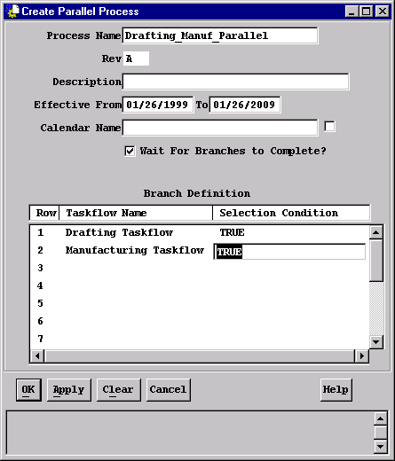
Parallel Processes
  Parallel processes are created by choosing Create → Parallel Process from the Life Cycle Administrator’s browser.

Slide 95
6.4 Breakdown (Example)
engineering
change
Engineering Change that contains
a drawing and a specification is advanced
to a Breakdown process.
drawing
spec
Drafting Life Cycle
Manufacturing Life Cycle

Slide 96
Work Breakdown Processes
  Work breakdown processes provide a mechanism for the components of a complex object to be processed independently of the parent Work Item.
    The objects that enter the branches of a breakdown process are “semi-dependent” objects; this, a breakdown process is composed of external life cycles - life cycles into which the component objects could be submitted directly.
    Within their separate life cycles, the component objects may be promoted from one state to another, and may be moved to new vaults.
    In addition to a condition, each branch also specifies a Priority and Relationship that controls the breakdown of the component objects.
    Like parallel processes, the breakdown process “monitors” the progress of objects in the branch life cycles. All branches must terminate successfully for the breakdown process to succeed. If any branch fails, the breakdown process fails.
    If no branch condition fires, the process is considered optional.

Slide 97
Work Breakdown Processes
  Conditions used to determine whether or not to invoke a life cycle for a component of a compound object have three arguments:
    The parent Work Item ( the “left” object)
    The relation object
    The child Work Item ( the “right” object)
  This is appropriate since it is the objects on the right side of each relationship that will enter the various branches of the work breakdown process.
  Create the condition object with the following argument:
  CondName (itemObj, relObj, rhsObj ) := expression;
  The following example will illustrate this concept:
  IS_DESIGN_DOC(itemObj,relObj,rshObj):=$rhsObj.Class=‘DesDoc

Slide 98


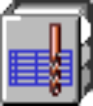
Work Breakdown Processes
  DESIGN PART
  Document
Depends On
  $rhsObj.Class=DesignDoc
  METAPART
  Document
  IN_DEV_PROJECT
  (item obj selected)
  MFG PART
  Document
  $rhsObj.Class=Manufacturing
  Planning Document
Depends On
IN_DEV_PROJECT(o,e):$o.ProjectName=‘DEVELOPMENT PROJECT’ and not (IS_FROZEN(o,e));
IS_DESIGN_DOC(itemObj,relObj,rhsObj):=$rhsObj.Class=‘DesDoc’;
IS_MANUF_DOC(itemObj,relObj,rhsObj):=$rhsObj.Class=‘MfPlDoc’;

Slide 99
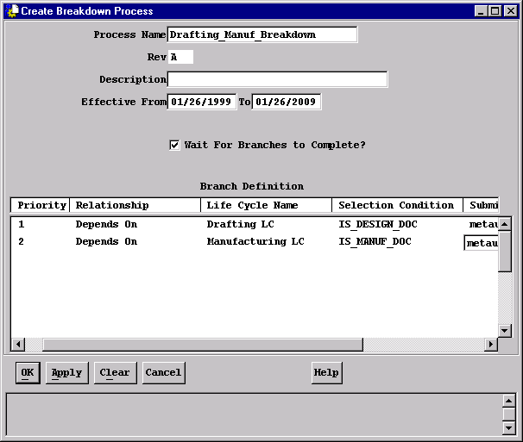
Work Breakdown Processes
  After creating and editing the life cycles that the individual objects will enter, create the breakdown process:

Slide 100
Work Breakdown Processes
  Additional features of work breakdown processes:
    Similar to parallel processes, the Wait for Branches to Complete? Toggle specifies whether the first branch failure causes the breakdown process to terminate immediately or not.
    Each value for Priority must be unique.
    The combination of Relationship and Selection Condition must be unique. This ensures that a given object may be submitted to only one life cycle.
    The Submitter entry in the dialog window can be a User, Role, or Dynamic Participant on whose behalf the object enters the (external) life cycle.
    The Relationship, Life Cycle Name, Selection Condition, and Submitter fields are all listable.

Slide 101
6.5 Workflow - Summary
  Parallel and breakdown processes are still components of a top-level life cycle. Users continue to Submit objects into such life cycles, perform their assignments, and Signoff exactly as before.
  It is possible to freely intermix parallel and breakdown processes and nested life cycles to create very complex workflows. The History options are compatible with these compound process types.
  Observers can be defined for all the process types, giving view-only access to objects in those processes.

Slide 102
Chapter 7
Creating Variants of Processes

Slide 103
7.0 Creating Variants of Processes
7.1 Copy
7.2 Revise
7.3 Checkout

Slide 104
7.0 Creating Variants of Processes
7.1 Copy
7.2 Revise
7.3 Checkout
These OMF actions allow the administrator to:
  Make a new copy from an existing process or life cycle
  Retain all attributes of the original process
  Retain all assigned participants or life cycle steps
Each action differs primarily in how the new object is named, and in how it is related to its predecessor.

Slide 105
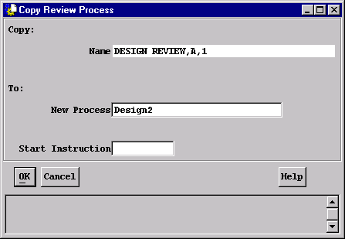
7.1 Copy
  When you Copy a process:
    Gives the copy a new name - its primary identifier
    Resets the revision and sequence to initial values, typically “A” and “1”
  Use copy when you need to create a new working process from an existing process or Life Cycle. Because the name is changes, the new object is almost completely unrelated to its predecessor.
  Select the Process or Life Cycle and choose Action → Copy; enter a name for the new process.

Slide 106
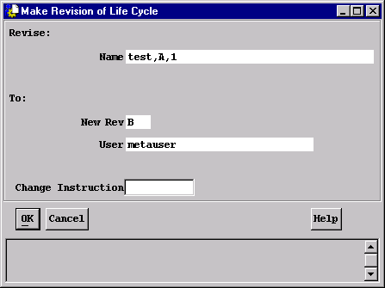
7.2 Revise
  When you Revise a process:
    Retains the same name as the original
    Increment the revision and Reinitialize the sequence
  Use Revise when your intention is to replace an existing process with a new revision. The revised process will immediately be marked as superseded so that further modifications can not be made.
  Select the Process or Life Cycle and choose Action → More Actions → Revise

Slide 107
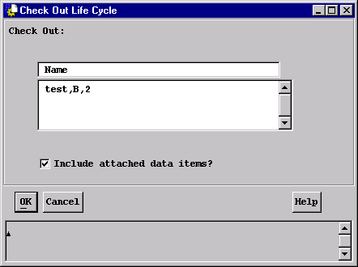
7.3 CheckOut
  When you Check Out a process, you:
    Retain the same name and revision as the original
    Increment the sequence
    Lock the predecessor process or life cycle
  Use CheckOut to create a working sequence of an existing process or life cycle. The predecessor item will be marked as superseded so that no further modifications are permitted.
  Select the Process or Life Cycle and choose Action → Check Out

Slide 108
Chapter 8
Managing Processes

Slide 109
8.0 Creating Variants of Processes
8.1 Update Process
8.2 Delete Process
8.3 Update Effective Dates
8.4 View Process
8.5 Reports

Slide 110
8.1 Update Process
  Provided a process is not frozen or superseded, the following may be changed by updating the process:
  All:
    Description
    Effective From/To Dates
    Calendar Name
    In Production? Toggle
  Condition Process:
    Condition Name
  Message Process:
    Message Name
  Life Cycle:
    Condition Name
    Internal Only? Toggle
    Object Class List

Slide 111
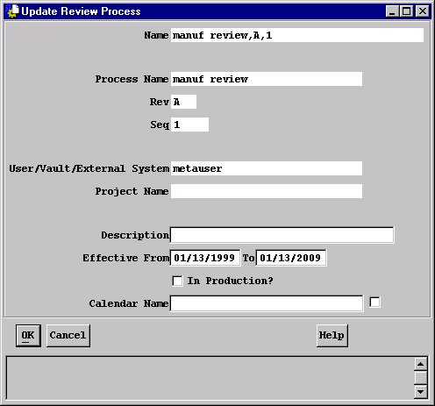
Update Process
  To update these attributes of any process, select the process and choose Info → Update Item.

Slide 112
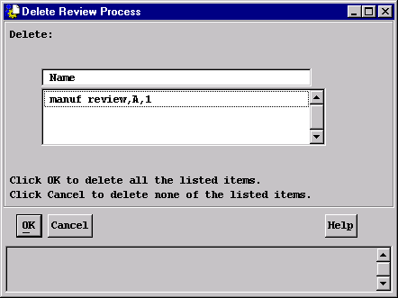
8.2 Delete Process
  Deleting a process or Life Cycle removes that definition from the database:
    A process or life cycle can be deleted if it is not frozen or superseded
    A process can only be deleted if it is not in use by a life cycle
    If the process or life cycle is still effective, or is official, a warning message will be displayed before deletion is allowed to proceed.
    To delete processes and life cycles, select all of the life cycles and processes to be deleted and choose Actions → More Actions → Delete Item

Slide 113
8.3 Update Effective Dates
  Once a process has been baselined (frozen) , only the Effective Dates of the process can still be updated. This is accomplished through the Update Effective Dates action.
  Once frozen, effective dates of all variants must not overlap. Update Effective dates validates dates so this can not happen. Gaps are permitted, and are sometimes necessary.
  Example: current plans call for the “Electrical Design” process, rev C, to be effective through next June 30, to be replaced by rev D on July 1. If it becomes necessary to make rev D effective on June 1:
    first, update the effective to date of rev C to May 31;
    then, update the effective from date of rev D to June 1.
  Life Cycle Manager will not permit the second step first if both revisions are baselined.

Slide 114
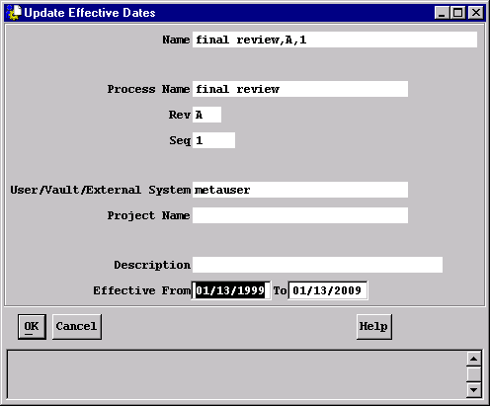
Update Effective Dates
  To update the Effective Dates of any process, select the process and choose Info → Update Effective Dates.
  All fields except Effective From/To are display-only.

Slide 115
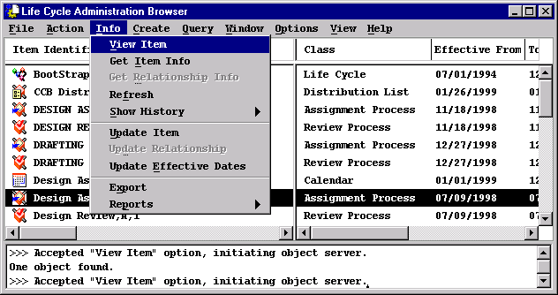
8.4 View Process
  Viewing a process means looking at the actors associated with that process in a read-only browser. You can view a process by:
  Double clicking on the process
  Selecting the process Info-> View Item

Slide 116
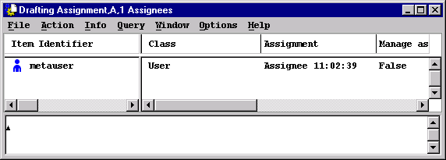
View Process
Resulting Browser window:

Slide 117
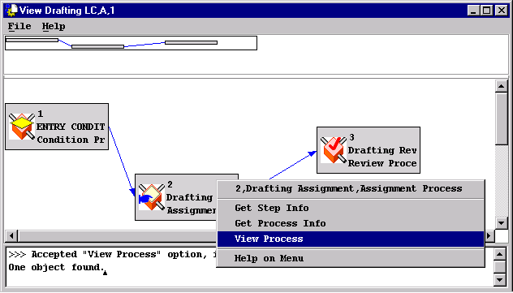
Viewing a Life Cycle
  Viewing a life cycle means looking at the process steps associated
  with that life cycle in a read-only browser. You can view a life cycle by:
  Selecting the life cycle icon and click on Info-> View Item
You can also view a process from the View Life Cycle browser window by
putting the cursor on a node, pressing the right mouse button and selecting View Process.

Slide 118
8.5 Reports
  Life Cycle Manager has two general categories of reports:
    information about life cycles and processes
    information about objects in life cycles
  From a selected life cycle or process, a report can be generated which contains its attributes, along with the step definitions of a life cycle or the actors associated with a process. To generate this type of report, select the desired life cycle or process and choose Info → Reports → Item Info.
  To see any objects that are currently in the life cycle or individual process, select the Report LCM Activity option on the dialog window.
  To see an overall summary of process usage, select the Report Metrics option. Metrics include the number of PASS outcomes, the number of FAIL outcomes, and the average elapsed time in the process.

Slide 119
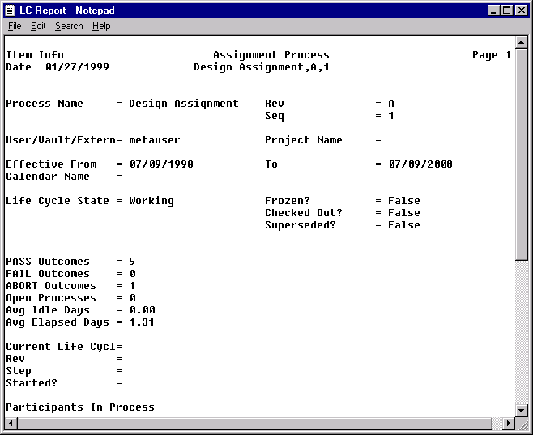
Process-Centered Report

Slide 120
Reports
  Object-centered report
  From a selected work item, the second type of report extends OMF’s standard Item Info report to include the object’s life cycle history. In the previous example of an assignment process report, the area at the bottom of the page shows that there is an object currently in the assignment process. The next example shows how to obtain more information about this specific object.
  To generate this report, select the desired object and choose Info → Reports → Item Info. From the report dialog window, select Process History from the Relationship list.

Slide 121

Object-Centered report
  Dialog Window

Slide 122

Object Centered Report

Slide 123
Chapter 9
Managing Actors

Slide 124
9.0 Managing Actors
9.1 Update Actors
9.2 Update Reviewer Tabulation
9.3 Delete Actor Relationships
9.4 Replace Actors

Slide 125
9.1 Update Actors
  Provided a process is not frozen or superseded, the following may be changed by updating the actors:
  All:
    Assignment
    Message Group Name
    Condition Name
    Expiration attributes
  Reviewers:
    Review Sequence
    Review Type
    Expediter?
  An actor can only be updated if the process can be updated
  To update any actor, select the actor from the actors (Assignees/Recipients/Reviewers/Observers) browser and choose Info → Update Relationship or double-click on the actor

Slide 126


Update Actors
Browser Window
Dialog Window

Slide 127

9.2 Update Reviewer Tabulation
  This function allows the administrator to define the number of reviewers required to approve an object in the Review Process. Also, an object can be forced to wait until all required reviewers have reviewed, even if the process outcome can be determined earlier.
  To update the tabulation parameters for a review sequence, select any reviewer in the desired sequence from the Reviewers browser and choose Action → Update Tabulation

Slide 128

Update Reviewer Tabulation
  Dialog window for Updating Reviewer Tabulation

Slide 129
Update Reviewer Tabulation
  How can one person act on behalf of a group? Some LCM administrators assume that the following tabulation parameters are appropriate:
    Reviewers Needed to Approve - One
    Wait for All Required Reviewers - No
  This has the desired outcome only if the first person to sign off Approves the item; but if the first person Rejects the item, the tabulation parameters are not met - there are still users who can approve the item.
  The proper tabulation parameters are as shown in the preceding dialog:
    Reviewers Needed to Approve - None
    Wait for All Required reviewers - No
  If the first person to sign off Rejects the object, it will proceed to the next step of the life cycle with an exit status of fail.
  If the first person to sign off Approves the object, it will proceed to the next sequence or to the next step with an exit status of pass
  Therefore, the first person to sign off acts on behalf of the entire group

Slide 130


9.3 Delete Actor Relationships
  Deleting an actor removes the actor relationship between a participant and the assignment, review, or distribution list process or life cycle; it does not delete the actual participant from the database.
  An actor can only be deleted if the process can be deleted
  To delete an actor from a process, select the actor in the actors (Assignees/Recipients/Reviewers/Observers) browser and choose Action → Delete Relationship
Browser Window
Dialog Window

Slide 131

Replace Actors
  Once a process has been baselined (frozen), individual users can be changed by using Replace. With Replace:
  Users can only be replaced on a one-for-one basis. If an actor is a group or a role, then the people associated with the group or role can be changed within OMF.
  No other attributes of the actor, such as the work assignment, can be changed
  To delete an actor, select the actor in the actors (Assignees/Recipients/Reviewers/Observers) browser and choose Action → Delete Relationship

Slide 132
Chapter 10
Runtime Administration

Slide 133
10.0 Runtime Administration
10.1 Review Alternate Work
10.1 Manage Alternate Assignments
10.2 Resume Object
10.3 Aborting a Life Cycle
10.4 In Production & Baselined Processes

Slide 134

10.1 Review Alternate Work
  It is possible for an administrator to view the worklist of another user. The primary use of this capability is to reassign work to someone else.
  To view another user’s work, the administrator selects Window → LCM Worklists → Review Alternate Work
  Enter the desired user in the Alternate Worklist dialog and click OK
  From the resulting browser, the administrator may reassign work to another user by choosing Signoff → ReAssign, or may modify the assignment parameters with Signoff → Manage Assignment.

Slide 135

10.2 Manage Alternate Assignments
  Life Cycle Administrators can also change some of a work assignment’s parameters after the assignment is activated. To do so, choose Signoff → Manage
  The Due Date may be set to “today” or later
  A Reminder Date may be cleared, or set to any date between “today” and the Due Date. There is no default value for Reminder Date.
  The Action at Expiration toggles are appropriate for the type of assignment being modified.

Slide 136
10.3 Resume Object
  Normally, an object in a life cycle advances from one step to another without user intervention. However, in some cases an object may pause at the beginning of a process. This can be caused by:
    The AutoSubmit flag is set to OFF in the Life Cycle definition
    An error has occurred during an objects advancement
  It is expected that the administrator will resume the object when the error is corrected or an appropriate time interval has passed.
  To locate paused objects, specify a value of FALSE for the Started? Attribute on the query dialog
  To Resume a paused object, select the object and choose Action → More Actions → Resume
  The administrator may optionally add comments if desired
  If the object was paused because of an error, the error will be indicated in the Comments field

Slide 137

Resume Object

Slide 138

10.4 Aborting a Life Cycle
  Aborting a Life Cycle
  Metaphase provides the capability to prematurely terminate a life cycle. The Abort action allows a Life Cycle Administrator to immediately close all active work assignments for a process and all process history structures in a life cycle.
  The Abort action is implemented as an option on the Action menu of the Process History Browser. The Abort action is applicable only to top-level cycles.

Slide 139
10.5 In Production & Baselined Processes
  Effects on Life Cycle
  Metaphase recognizes three different levels of control for life cycles:
    Prototype
    Pilot
    Production
  Prototype:
  Life cycles and processes are created in prototype mode
  Life cycles and processes are not baselined and do not have the In Production flag set
  Only the owner of the life cycle may submit objects to the life cycle
  All valid, effective variants of a process at any level can be referenced by a prototype life cycle
  Priority is given to the latest effective variant of a process
  Prototype processes and life cycles can be modified

Slide 140

In Production/Baselined Processes
  To move to the next level, Pilot, life cycles and processes must be updated, to set the InProduction flag. Select the process or life cycle and choose Info → Update Item
  A helpful hint is to select the life cycle icon, then select Info-> View Item. Use the Get Process Info option from the node pop-up menu to verify that the In Production flag was set.

Slide 141
In Production/Baselined Processes
  Pilot:
  Life cycles and processes have the In Production flag set but are not baselined
  Anyone may submit objects to the life cycle, subject to rules and life cycle conditions
  A pilot Life Cycle can reference only effective processes that have the In Production flag set or are baselined
  Priority is given to the latest effective variant of a process with the In Production flag set or that is baselined
  Pilot processes and life cycles can be modified or taken out of production
  To move to the next level, production, life cycles and processes must be baselined. Baselining automatically sets the In Production flag if it is not already set.

Slide 142
In Production/Baselined Processes
  Production:
  Life cycles and processes are baselined
  Anyone may submit objects to the life cycle, subject to rules and life cycle conditions
  A production Life Cycle can reference only effective processes that are baselined
  Production processes and life cycles can not be modified

Slide 143
In Production/Baselined Processes
  Baselining a process or life cycle freezes the process or life cycle in the database. Once frozen, the process or life cycle cannot be changed or deleted; it can only be viewed, copied, checked out, or revised.
  Baselining affects the effective start date of the current process or life cycle as follows
  If the process doesn’t have a predecessor, its start date is the later of:
    The process’s current effective start date
    Today
  If the process has a predecessor, the start date is the latest of:
    The process’s current effective start date
    One day after the predecessor’s start date
    Tomorrow
  Finally, if the process or life cycle has a predecessor, the predecessor’s end date is reset to one day before the current process’s start date.

Slide 144
In Production/Baselined Processes
  In this manner, LCM ensures that
    consecutive revisions of a baselined process do not have overlapping effective dates
    processes are not made effective retroactively
  After Baselining, the only attributes of a process that can be modified are the Effective From/To dates.

Slide 145
Appendix A

Slide 146
Improved Advancer Controls
  Although the LCM advancer has successfully addressed the needs of many customers in its short lifetime, sites have requested changes or alternatives to its fundamental algorithms
  Metaphase has responded by implementing seven new conditions, which influence various facets of the advancer. Each condition object evaluates at runtime to TRUE or FALSE, using attributes of a Work Assignment (“Signature”) object, Process object, WorkItem object, and/or the Rule environment.
  As part of this feature, LCM may more frequently place an object in a “Suspended” status in a process. This status sets the Started? Attribute to FALSE for the work item; in addition, the advancer adds comments to the process history for the object

Slide 147
Improved Advancer Controls
  Zero Process Participants
  A process that contains Actor templates (definitions), but for which no condition evaluates to TRUE at runtime, will continue. Metaphase 2.3 allows a site to tailor the exit state of such a process with the following condition:
  lcm_zero_sigs_allowed ( procObj, itemObj, env )
    When TRUE (the default value), a Work Item that enters such a process will proceed on the Success path to the next step and process;
    When FALSE, the Work Item will proceed to the next step along the Failure path.

Slide 148
Improved Advancer Controls
  Zero Process Branches
  In a similar manner, compound processes - parallel processes and work breakdown processes - will be considered to be in error if they contain no branches. Objects entering this type of empty process will be suspended.
  If branches are defined, but no branch evaluates to TRUE at runtime, the following Condition controls process exit and object advancement:
  lcm_zero_branches_allowed (procObj, itemObj, env)
    When TRUE (the default value), a Work Item that enters such a process will proceed on the Success path to the next step and process;
    When FALSE, the Work Item will proceed to the next step along the Failure path.

Slide 149
Improved Advancer Controls
  Zero Required Reviewers in a Review Sequence
  Through the evaluation of conditions as applied to reviewers in a review process, it is also possible for a Review Sequence to contain no required reviewers. In this case, Metaphase simply waited for the first Optional or Info-Only Reviewer to act before triggering tabulation.
  Starting with Metaphase 2.3, this behavior will change, such that a Review Sequence containing only Optional and Info-Only Reviewers will be terminated. The state of such a termination is controlled by the following new Condition:
  lcm_zero_req_reviewers_allowed ( procObj, itemObj, env )
    When TRUE (the default value), a Review Sequence will terminate in the PASS state, allowing the Work Item to proceed to the next Sequence;
    When FALSE, the Review Sequence will terminate in the FAIL state, terminating the Review Process with a FAIL value as well.

Slide 150
Improved Advancer Controls
  Retaining Unused Work Assignments
  Through Metaphase 2.2, when a Work Item exited from a Review or Assignment Process, all “unused” assignments - those in which an Actor had neither written comments nor taken a signoff action - were discarded. Sites have requested the capability to retain all such Signatures as part of object history, even those that contain no additional historical information.
  To enable this mode of operation, the following Conditions are provided:
  lcm_retain_active_sigs ( ActvSig, env )
  lcm_retain_passive_sigs ( PasvSig, env )
  Active Signature objects are work assignments for Reviewers, Assignees, Advisors, and Recipients - users who are expected to play an active role in the life cycle of a Work Item.
  Passive Signature objects are the pseudo-assignments for Submitters and Observers, whose involvement is limited to writing comments.

Slide 151
Improved Advancer Controls
  Retaining Unused Work Assignments
  Active Signature objects are controlled by lcm_retain_active_sigs as follows:
    When TRUE, Reviewer, Assignee, Recipient, and Advisor assignments that were not signed off and for which no comments were written are retained as part of the Work Item’s history;
    When FALSE ( the default value), unused active assignments are discarded at process termination.
  Passive Signature objects are separately controlled with the lcm_retain_passive_sigs condition. TRUE and FALSE have the same meaning as above, but the default value for the condition is TRUE for Submitter assignments and FALSE for Observer assignments.

Slide 152
Improved Advancer Controls
  Claiming Individual Work Assignments
  The Group Assignment Flexibility feature provides the capability for a user to act on behalf of a group; doing so requires that the user choose the new worklist Signoff action, Claim.
  LCM may also be configured so that individual assignments must also be Claimed; to do so, modify the following new Condition:
  lcm_claim_work_allowed ( ActvSig, env )
    When TRUE (the default value), individual work assignments must also be claimed;
    When FALSE, individual work assignments may be acted on without first claiming them.
  The user impact of this feature is described in more detail in the Worklist Changes section.

Slide 153
Improved Advancer Controls
  Signing Off on Locked Work Items
  Concurrent engineering requires that as many people as practical be able to work on an object simultaneously. Work on an object is serialized when one user locks the object by checking it out. Through Metaphase 2.2, interlocking an object has had no effect on another user’s Signoff action.
  Metaphase 2.3 changes this behavior, and allows sites to control whether or not such signoff actions are allowed by evaluating the following condition:
  lcm_superceded_signof_allowed ( itemObj, sigObj, env )
    When TRUE (the default value), users will be warned when an object is checked out by another user, and given the opportunity to cancel their signoff action;
    When FALSE, signoff actions on checked out objets are prohibited unless the object is checked out to the user taking the signoff action.

Slide 154
Appendix B

Slide 155
LCM Class Hierarchy
  Process Classes:
BusItem
BusImLcm
Process
Legend by Pattern
AsgProc
ABSTRACT
CndProc
INSTANTIABLE
DLstProc
LifeCyc
MsgProc
RLstProc
RevProc

Slide 156
LCM Class Hierarchy
  Actor Classes:
Relation
Actor
Legend by Pattern
Advisor
ABSTRACT
Assignee
Recipent
INSTANTIABLE
Assignee
Recipent

Slide 157
LCM Class Hierarchy
  Sig Classes:
Relation
Sig
*
ActvSig
Legend by Pattern
AsgSig
ABSTRACT
AvrSig
INSTANTIABLE
RcpSig
RevSig
PasvSig
*
*
New at 2.2
ObrSig
*
SbrSig
*

Slide 158
LCM Class Hierarchy
  Miscellaneous Classes:
Relation
BusSetR
LC Proc
Legend by Pattern
PrcHsR
ABSTRACT
PrhStr
*
INSTANTIABLE
PdmItem
Admin
DYNAMIC
Calendar
*
New at 2.2
LCStep
ProcHist

Slide 159


Metaphase 3.0 LCM Administration Training Manual PDM191lcma Revision B

