Slide 1

Core Applications Course
PDM191 Rev. C Product Structure Manager Usage
Training Manual
Effective April, 1999

Slide 2
Manual History
Revision Product Version Date Supercedes
A 3.0 June, 1998 New
B 3.0 January, 1999 A
C 3.1 April, 1999 B
Copyright 1998 Structural Dynamics Research Corporation (SDRC). All Rights Reserved. SDRC and Metaphase are registered trademarks, and Metaphase Enterprise is a trademark of Structural Dynamics Research Corporation.
Portions of the software are Property of and Copyright 1991-1996 Neuron Data, Inc. All Rights Reserved. Open Interface Elements is a trademark of and is developed and licensed by Neuron Data, Inc., Mountain View, California.
Names of other products mentioned in this manual are used for identification purposes only and may be trademarks of their companies.
All rights reserved

Slide 3
Product Structure Manager

Slide 4
Table of Contents
Chapter 1: Introduction to Product Structure Manager
1.1 Overview
1.2 Part Masters and Parts
1.3 Product Structure
Chapter 2: Creating and Managing Parts
2.1 Part Characteristics
2.2 Copying and Revising
2.3 Creating Suppliers
Chapter 3: Product Structures
3.1 Building Product Structures
3.2 Updating Product Structures
3.3 Displaying Product Structures
Chapter 4 PSM Reports

Slide 5
Chapter 1
Introduction to Product Structure Manager

Slide 6
1.0 Intro to Product Structure Manager
  1.1 Overview
  1.2 Part Masters and Parts
  1.3 Product Structures

Slide 7

1.1 Overview
SDRC
Car
Steering
Frame
Body
Engine
Drive
Suspension
System
Assembly
Train
Steering
Belts
Ball
Rack &
Pinion
Front
Trans-
mission
Differential
Shifting
Assembly
Drive
Rear
Component
Joints
Wheels
Shaft
Wheels

Slide 8

Overview
16
Drawing
Drive
Train
Rear Wheel Model
Trans-
mission
Differ-
ential
Shifting
Assembly
Drive
Shaft
Rear
Wheels
NC Code
Quality Plan
Specifications

Slide 9
Overview
Product Structure Manager (PSM)
  Manages definition data from a product perspective
  Allows you to create, view, and manipulate product structure information in a graphical manner

Slide 10
Overview
The basic features of the Product Structure Manager module include the capabilities to:
  Create parts
  Set part attributes
  Create product structures
  Create suppliers
  Query and navigate product structures
  Compare product structures using reports
  Relate parts to other OMF - managed items

Slide 11
Overview
Product Structure Model
Master
Car
Rev A
Revision
Rear
Wheel
Assembly
Engine
Rev A
Rev A
Axle
Rear
Wheel
Rev A
Rev A
Rev B
Rev C
Revision Relation
Structure Relation

Slide 12


1.2 Part Masters and Parts
Part Masters have the following characteristics:
  Represent the parts that an enterprise manufactures or uses
  Can be viewed as a general description of a part
  Can represent an assortment of product items
  Represent a particular form, fit and function
Assembly Master
Component Master

Slide 13
Parts Characteristics
Parts have the following characteristics:
  Represent a revisioned instance of a part number
  Derive Part Number and Nomenclature from the Part Master
  Defines its own specific attributes
  Reflect interchangeability with other revisions of its Part Master

Slide 14
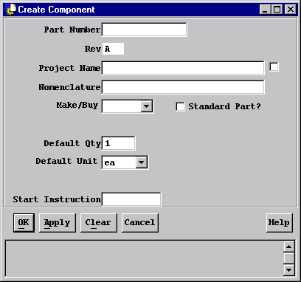
Creating Components
The attributes that apply to Components are as follows:
Default Qty and Default Unit attributes are used as “seed” values for building assemblies

Slide 15

Component
PSM supports two types of parts:
Components
Assemblies
A component has the following attributes:
Component
    Is not composed of other constituent parts
    Derives part Number and Nomenclature from its Part Master
Component Master - Component relationship
ps - 21
A
ps - 21
has
ps - 21
B

Slide 16
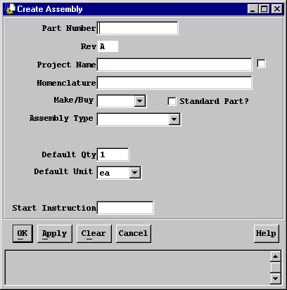
Creating Assemblies
The attributes that apply to Assemblies are as follows:

Slide 17


Assembly
An assembly has the following properties:
Assembly
    Is composed of other assemblies and/or components
    Derives Part Number and Nomenclature from its Part Master
    Has an additional attribute of Separable or Inseparable
      Separable - Can be disassembled
      Inseparable - Can not be disassembled without causing damage to any of it’s parts
Assembly Master - Assembly relationship
ps - 21
A
ps - 21
has
ps - 21
B

Slide 18


1.3 Product Structures
A Product Structure is a division of parts into assemblies and components creating a hierarchical relationship
You create product structures with the following steps:
1. Create (define part attributes) the parts of the product
2. Relate the parts to each other
3. Optionally, relate the parts to documents and suppliers
Comp2
A
1
Assm2
A
1
uses
Comp3
A
1
uses
Comp1
A
1
Assm1
A
1
Assm1
812345678
isFor
supBy

Slide 19
Chapter 2
Creating and Managing Parts

Slide 20
Creating and Managing Parts
  2.1 Creating Parts
  2.2 Copying and Revising
  2.3 Creating Suppliers

Slide 21
Creating Parts
Three ways to create parts:
  Create
  Copy
  Revise
  Part Masters are created automatically when you Create or Copy a part
  To create a part select:
  Create → Product Structure Classes → Assembly/Component

Slide 22
2.1 Creating Parts
  Above dialog is the same for both Assembly and Component with the exception of the Assembly Type field
  Assembly Type is the separable or inseparable attribute
  Part Number and Nomenclature are required fields

Slide 23
2.2 Copying and Revising
Copy
  Creates a new part
  Retains all attributes except:
    part number
    nomenclature
  New part master is also created
  Revise
  Creates a copy of an existing part
  Only attribute that is different is revision
  Uses the same Part Master
  Note: A part must be frozen before it can be revised

Slide 24
2.3 Creating Suppliers
Suppliers
  Organizations which sell parts to an enterprise
  Can be related to Part Masters to reflect where the part is coming from when denoted as a Buy item

Slide 25
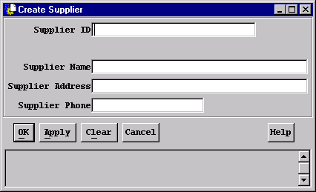
Creating Suppliers
  To create a supplier choose Create → Product Structure Classes → Supplier
  Fill in the appropriate fields, Supplier ID being the only required field.

Slide 26
Chapter 3
Product Structures

Slide 27
3.0 Product Structures
3.1 Building Product Structures
3.2 Updating Product Structures
3.3 Displaying Product Structures

Slide 28
3.1 Building Product Structures
  Three ways to build Product Structures:
  1. Drop Part onto Assembly icon:
Component
Assembly
Assembly
Assembly

Slide 29
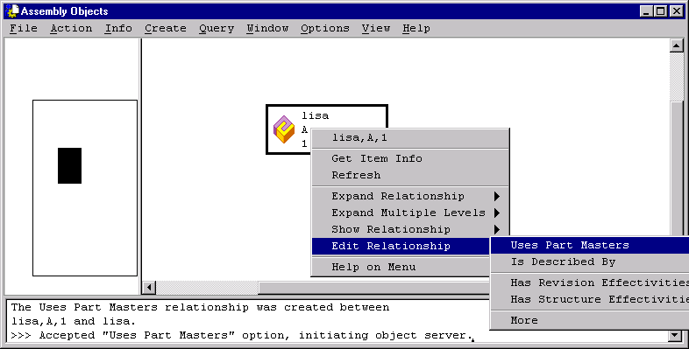
Building Product Structures
  2. Using an Edit Relationship Browser →

Slide 30
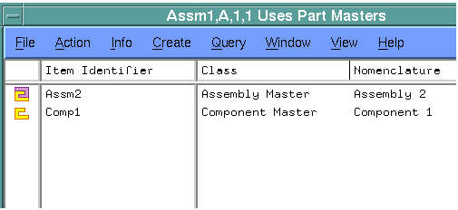
Building Product Structures
  Drop part onto Edit Relationship Browser
Component

Slide 31
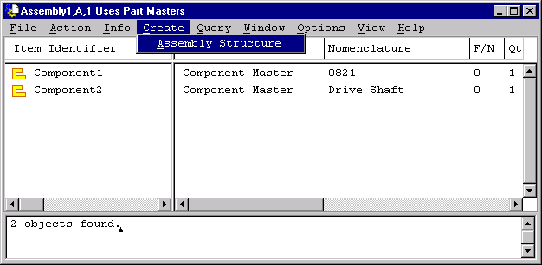
Building Product Structures
  3. From the Assembly Edit Relationship Browser select:
  Create → Assembly Structure
  Dialog will be presented requesting part number
  Note: All three scenarios may be used by selecting either the assembly, the component or the associated master

Slide 32
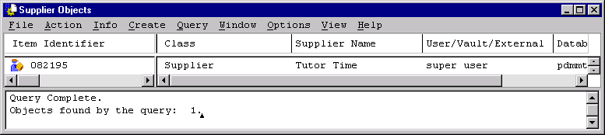
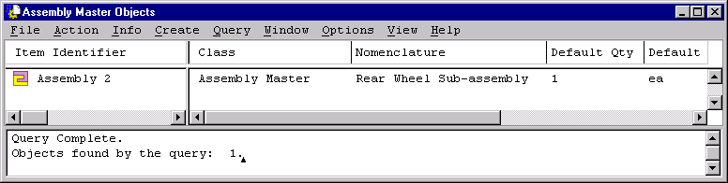
Building Product Structures
  Three ways to include Suppliers:
  1. Drop Supplier onto Assembly Master icon:
  OR
  Drop A Master onto Supplier icon:

Slide 33
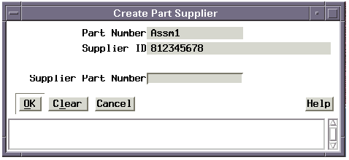
Building Product Structures
  Dialog is presented requesting the Supplier’s part number

Slide 34
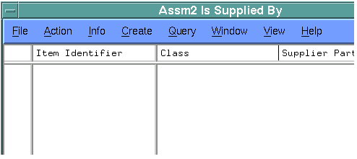
Building Product Structures
  3. Select Part Master and open an Edit Relationship Browser
  Drop Supplier onto Browser
Supplier
  Again dialog requesting Supplier part number is presented

Slide 35

Building Product Structures
  Including Other Items
  For Part revisions:
Component
Document
  Most objects dropped on an icon will have a default relationship built (e.g. Document dropped on a Part defaults to the Part “is described by”)
Comp1
B
1
Owners Manual
A
desBy

Slide 36
Building Product Structure
Part-to-Document (PartDoc) Relations
  Relations can not be created nor can they be deleted once a part item has been frozen.
  When a document is revised and part is not frozen, relations will be carried over from the previous document revision.
  When a part is revised, relations will be carried over from the previous part revision.
  When a part is frozen, all documents related to the part via the PartDoc elation are also frozen (and consequently, all attached data items).

Slide 37
Building Product Structure
In a Product Structure, the following attributes are stored on the relationship and are placement specific.
  F/N - Find Number
    Differentiates between multiple occurrences of a Part Master in an assembly (e.g. balloon numbers). This attribute is required
  Qty - Quantity
    Designates the quantity of this instance of the Part Master in an assembly
  Remark
    An open description field related to this instance of the Part Master in an assembly
  Reference Designators
    Differentiates between the separate occurrences of a part when a quantity greater than one is specified
  This allows for a different definition of these attributes each time the part is included in the Product Structure.

Slide 38
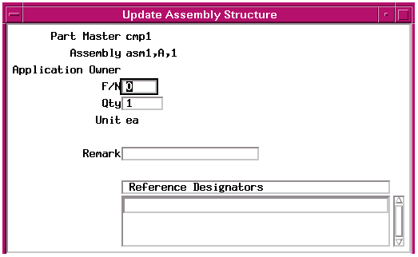
3.2 Updating Product Structure
Attributes for the structure may be updated by:
  Select assembly: Edit Relationship → Uses Part Master
  Highlight part to change and select: Info → UpdateRelationship

Slide 39
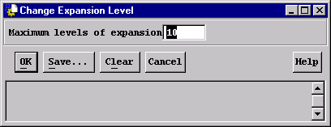
3.3 Displaying Product Structure
Product Structures are displayed with either:
  Tree View
  Indented List View
  How Product Structures are displayed utilizes the following:
  Expansion Level
  Configuration Context
  To set the Expansion level select: Options → Change Preferences → Expansion Level

Slide 40
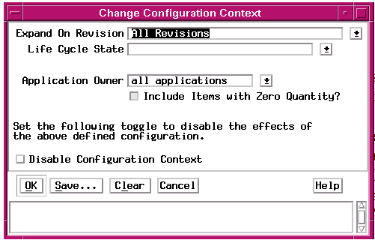
Displaying Product Structures
  To set the Configuration Context select: Options → Change Preferences → Configuration Context

Slide 41
Displaying Product Structure
Choices for Expand on Revision are:
  All Revisions
  Last Revision with State
  For Life Cycle State:
  Working
  Released
  For Application Owner:
  All Applications

Slide 42
Displaying Product Structures
  Expand Relationship → Is For Item Master
Assm1
A
1
Assm1
isFor
  Expand Relationship --> Uses Part Masters
Assm2
Assm1
A
1
uses
Comp1

Slide 43
Displaying Product Structures
  Expand Relationship → Uses Part
Assm2
A
1
Assm1
A
1
Comp1
A
1
uses
Comp1
B
1
  Configuration Context is set to All Revisions

Slide 44
Displaying Product Structures
  Expand Multiple Levels → Uses Part
Comp2
A
1
Assm2
A
1
uses
Comp3
A
1
Assm1
A
1
Comp1
A
1
uses
Comp1
B
1
  Expand Multiple Levels --> Is Used By Assemblies
Comp2
A
1
Assm2
A
1
Assm1
A
1
useBy
useBy
  Configuration Context is set to All Revisions
  Expansion Level is set to 2

Slide 45
Displaying Product Structures
Advanced topics - Relationships
ItemRev
Assm1
IsFor
PartSupp
Assm2
Crank
Handles
supBy
AssmStrc
uses
Comp1
A
1
Comp1
Assm1
A
1
has
Comp1
B
1
Owners
Manual
A
PartDoc
desBy
ItemRev
Assm2
A
1
AsRevRev
AsRevRev
uses
Assm1
A
1
Comp1
B
1
useBy
INSTANTIABLE
DYNAMIC
Legend

Slide 46
Chapter 4
PSM Reports

Slide 47
4.0 PSM Reports
  PSM generates 5 out-of-the-box reports
  Supplied with PSM module - Modified with the Toolkit
  The reports are:
  Parts List
  BOM
  Where Used
  Compare Assembly
  Detect Recursion

Slide 48
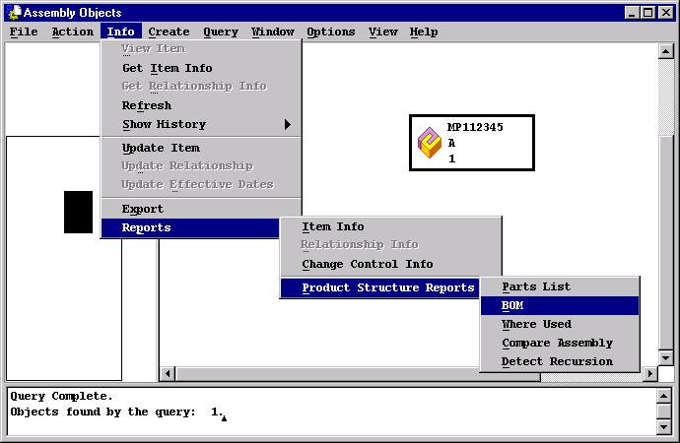
PSM Reports
  To create a report select Info → Reports → Product Structure Reports

Slide 49
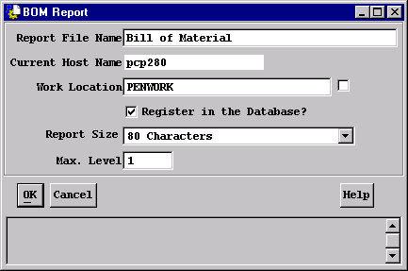
PSM Reports
  Reports:
  Can be printed to a file and registered in the database if desired
  Have a different dialog box related to the type of report
  The following is an example of the Parts List dialog box:
  The report size can be 80 or 132 characters per line:

Slide 50
Appendix A
PSM Standard Classes

Slide 51
PSM Standard Classes
  PSM classes appear in the object class hierarchy as follows:
OwnedItm
ProdBI
Relation
GenDoc
ItemRev
ItemMstr
StrucBI
StRevRev
PartMstr
AssmMstr
Part
AsRevRev
Assembly
Structur
CmpnMstr
Cmponet
AssmStrc
PartDoc
ABSTRACT
INSTANTIABLE
DYNAMIC
PartSupp
Legend

Slide 52


Metaphase 3.1 Product Structure Manager Usage Training Manual PDM191psm Revision C

