Slide 1
PFM (Part Family Manager)

Slide 2

Contents:
Introduction to Part Family Manager (PFM)
1.1 Overview
Part Families and Characteristics.
Family Hierarchy
Maintaining Part Families
Using Part Families

Slide 3
Overview
    Part Family Manager (PFM) provides:
      A “classification” system which promotes reuse of standard and existing parts
      A capability to group parts by design or function allowing users to quickly locate and use existing parts
    PSM and APC manage parts and structures - PFM manages part characteristics information
    PFM eliminates the cost of redesigning, restocking, and inventorying

Slide 4
Overview
Two Major advantages that PFM offers:
      Organization of parts into Part Families
      Concept of managing part characteristics

Slide 5
Overview
    Part Family
    A collection of parts that have a similar design or function
    Standard Parts
      frequently used by the enterprise
      characteristics are defined by
        company standards
        vendor catalogs
        published in industrial standards
    Designed Parts
    Manufactured by the enterprise for the final product

Slide 6

Sharing information using an enterprise tool to support the product team
Purchasing
Manufacturing
Engineering
PFM is an additional tool which allows users to quickly access this shared information

Slide 7
Part Families and Characteristics
Using PFM, your enterprise groups parts that have a similar design or function into a part family.
Your enterprise might create a family called Flat Washers and define the family as having these characteristics. The PFM administrator assigns parts to the family and enters the part values for each defined family characteristic. For part characteristics that have associated units (for example, outer diameter size), you can specify the units in which to display the part (for example, millimeters).

Slide 8
Family Hierarchy
Your enterprise can organize families into family hierarchies. In a hierarchy, a family is a descendant of another family and inherits its characteristics. For example, your enterprise might create a family called Washers that consists of subfamilies called Flat Washers and Lock Washers . Flat Washers and Lock Washers are descendants of the Washers family.
A family that has subfamilies is called a branch family; the Washers family is a branch family. Branch families do not have parts; they are used to build hierarchies.
A family that has no subfamilies is called a leaf family; the Flat Washers and Lock Washers families are leaf families. Unlike branch families, leaf families contain actual parts.

Slide 9


  Branch Family
  A part family that has sub-families
  Leaf Family
    A family that has no additional
    sub-families Parts are added to these
    families

Slide 10



Branch Family
Standard
ANSI Std
DIN 4001
Bolts
DIN 433 Washers
Leaf Family
Flat Washers
Lock Washers

Slide 11
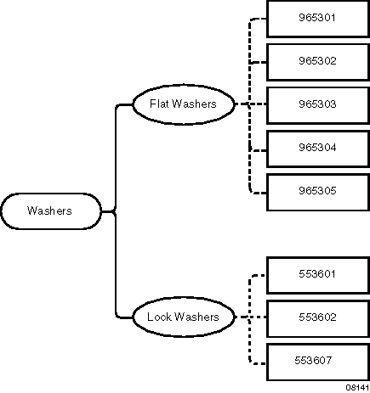

Slide 12
Maintaining Part Families
Assigning Parts to Leaf Families.
Removing Parts from Leaf Families.
Updating Part Values for Family Characteristics.
Managing Changes.
Controlling Access to Family Revisions.

Slide 13
Using Part Families
Using PFM you can locate parts that meet your specifications, both custom-designed parts and standard parts (parts your enterprise manufactures or purchases from a vendor). You locate the parts by navigating the family hierarchy and searching for the parts in a family.
Navigating Family Hierarchy.
Searching Families for Parts.

Slide 14
Navigating Family Hierarchy
Navigating a family hierarchy is the process of searching a database to locate a family of parts.

Slide 15
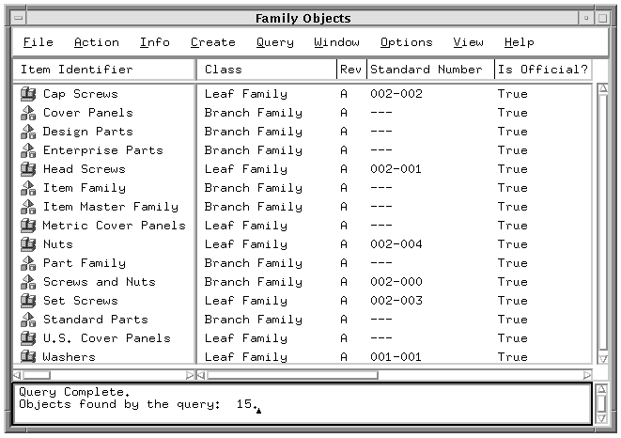

Slide 16
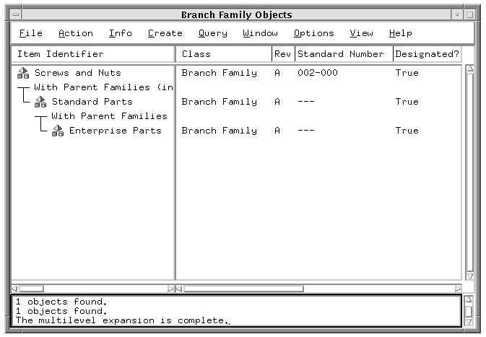

Slide 17
Searching Families for Parts
You can search a family for all parts or for all parts whose characteristics match your search criteria.

Slide 18
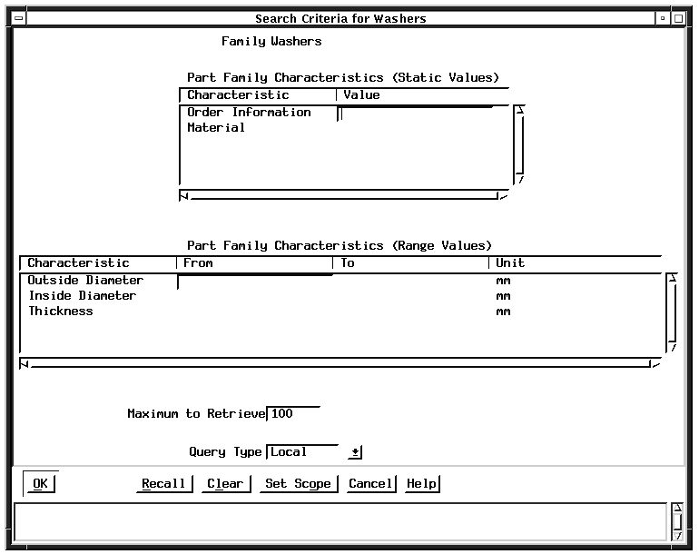

Slide 19
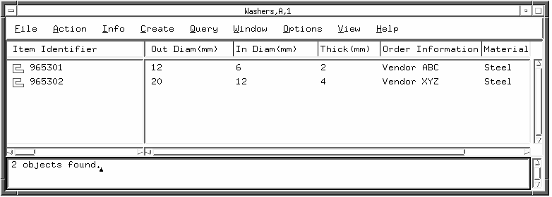

Slide 20
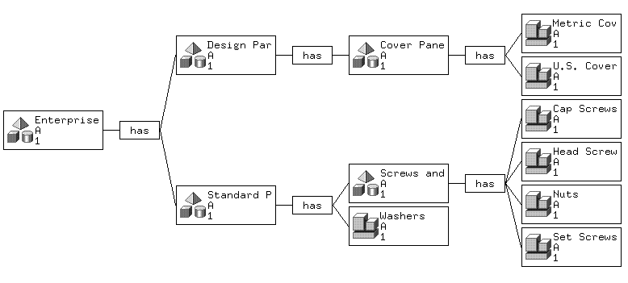

Slide 21
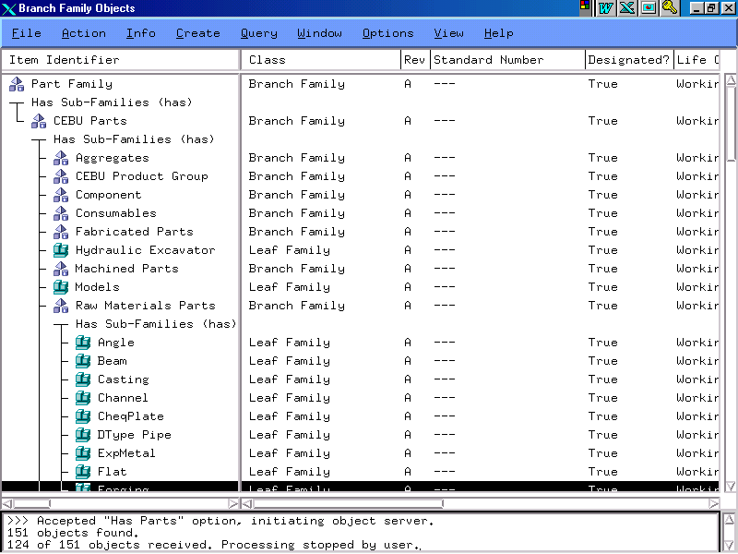

Slide 22
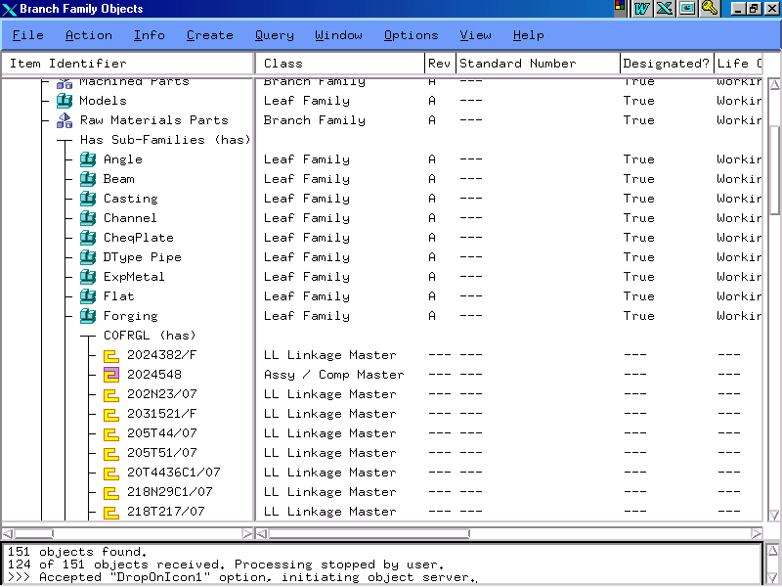

Slide 23
Thank You

