Slide 1
Title
Application Developed for ERC
By DPDS-JSR
Date: 09 Feb 2022

Slide 2
Projects Milestone
Sr. No | Project/Functionality | Environment
1 | Enhancements in iProc System | Production
2 | Enhancements in Online Material Requisition System | Production
3 | Development of Vehicle dispatch process | Production
4 | Development of IDT Dashboard | Production
5 | Development of ERC Dashboard | QA

Slide 3
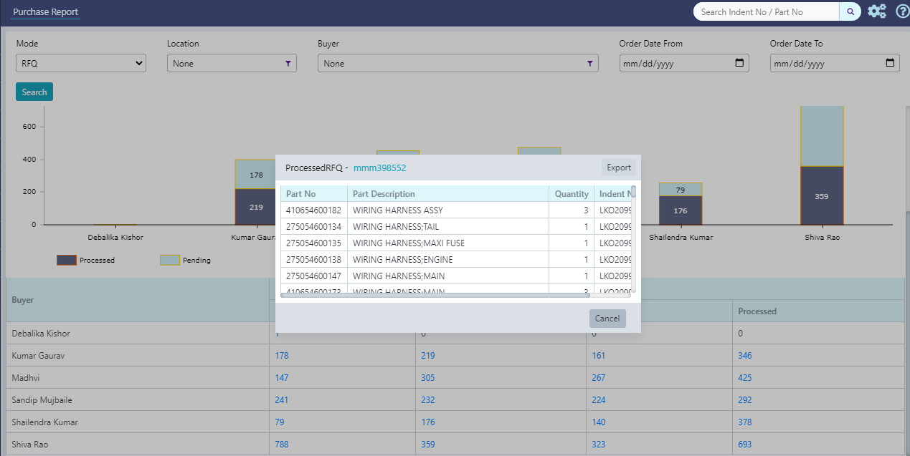
Enhancements in IProc system for ERC-JSR
Activities
Statistics
Business Benefits
Integration of Chassis registration process.
Implementation of procurement and inter-plant STO approval process.
Enhancements in Quality inspection process and part closure process.
Part validation and Part details Modification facilities.
Provide robust data analytics options
No of Indent : 1146
No of Part : 12284
No of Ordered Qty : 8819
Start date : 01-Sep-2020
Date Range : 01-Apr-2021 to 22-Feb-2022
No of Issues : 1962
No of Issues Closure: 1785
Generating scope for successor business processes in this system.
Optimized process cycle-time.
Robust analytical report provide vision for process optimization.
Authorization on data, reduces the dependency and increases the productivity time.
Sample Analytical Reports
Implementation
ERC – Jamshedpur and Lucknow
An executive discipline to drive proto manufacturing excellence

Slide 4
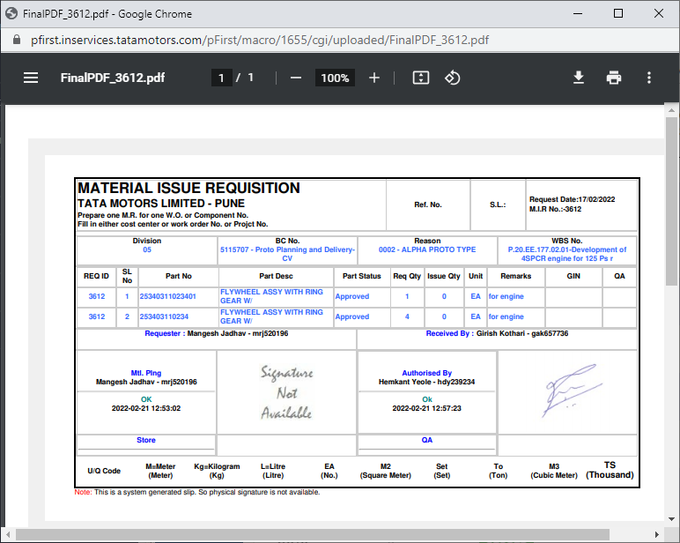
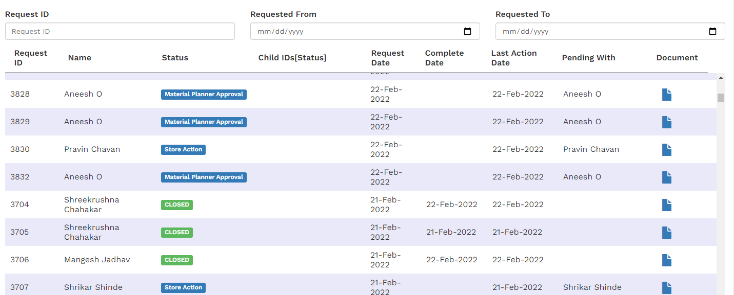
Enhancements in Online Material Requisition System
Activities
Statistics
Business Benefits
Enhanced with online approval process.
Implementation of request splitting methodology for faster closure.
Snapshot view provided for audit made easy
No of Issues :2226
Start date : 19-Jul-2021
Date Range : 19-Jul-2021 to 22-Feb-2022
No of Raisers: 57
No of Issues Closure: 1775
Optimized process cycle-time.
Detailed data view in one page.
Authorization on data, reduces the dependency and increases the productivity time.
Implementation
Advance Engineering - Pune
A flexible indent process for optimized cycle time.

Slide 5
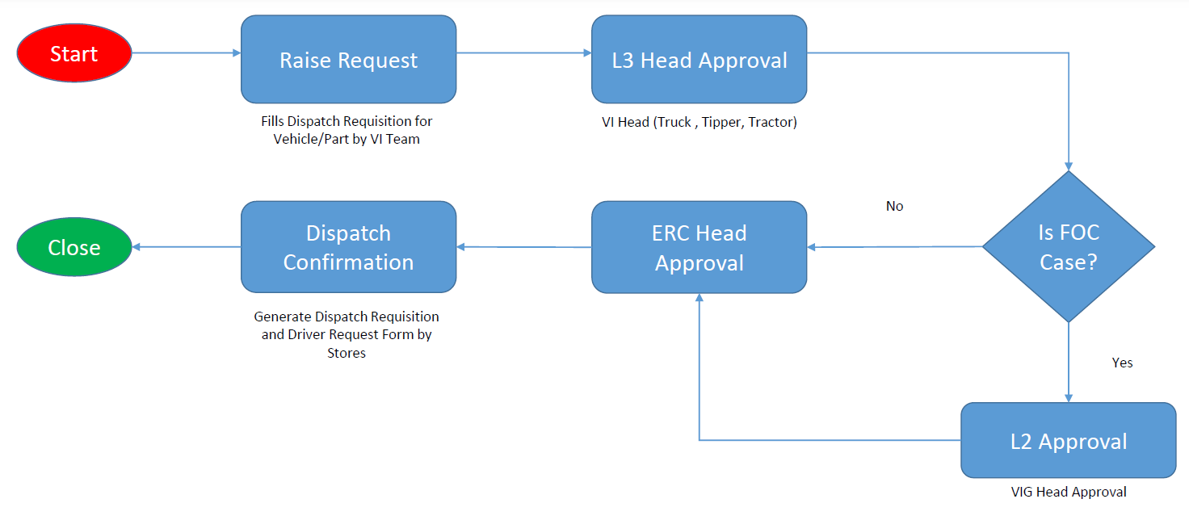
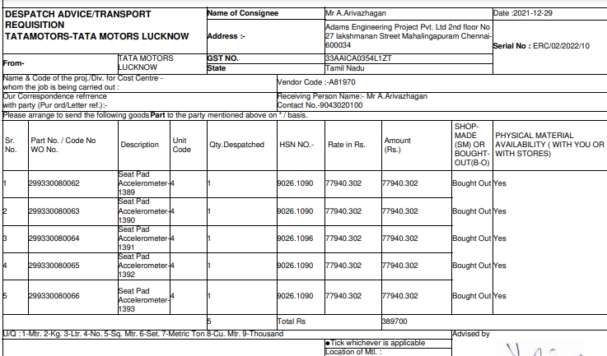
Development of Vehicle dispatch process
Activities
Statistics
Business Benefits
5 Steps common workflow Implemented for all plant.
For vehicle and part dispatch, access and behavior changes dynamically.
Dynamic Approval structure defined as per raiser location.
No of Issues :74
Start date : 20-Dec-2021
Date Range : 20-Dec-2021 to 22-Feb-2022
No of Issues Closure: 8
Workflow based approach reduces process time.
Common data snap for part and vehicle.
Easy maintenance of data.
Implementation
ERC – Jamshedpur and Lucknow
A simple, common process to optimize the approval cycle time

Slide 6
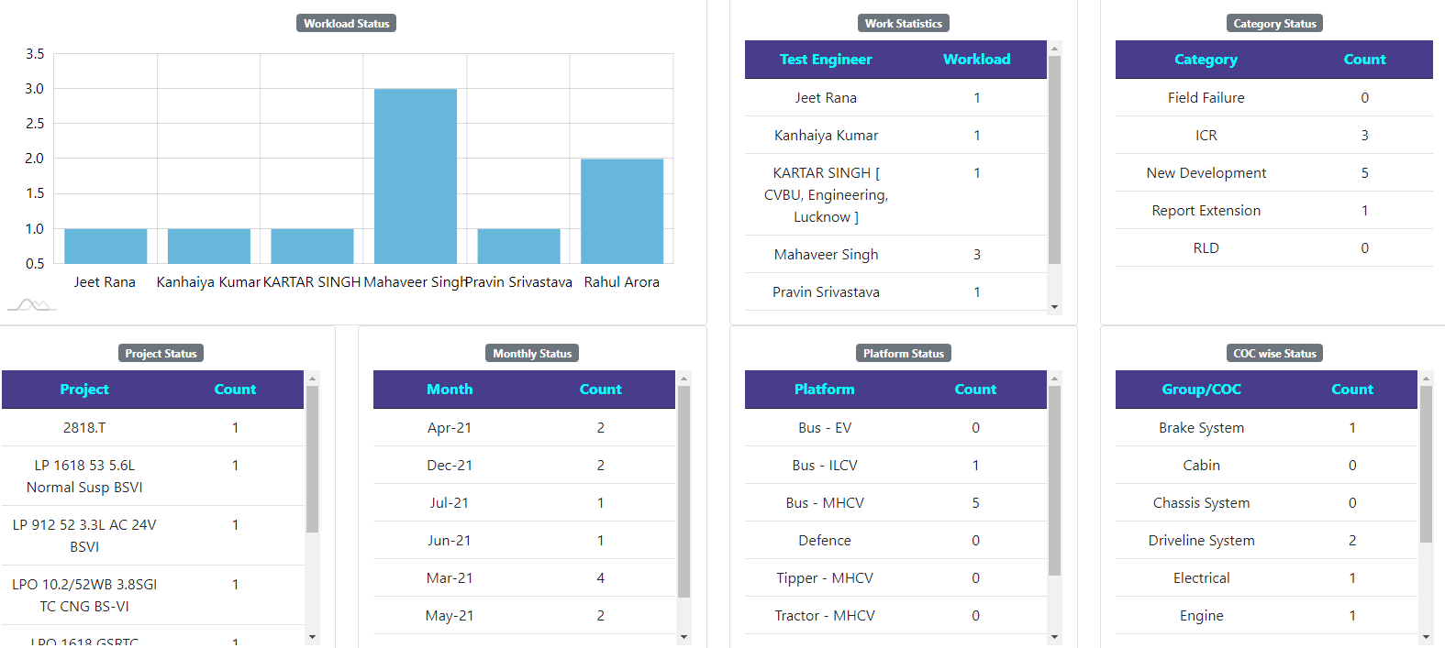
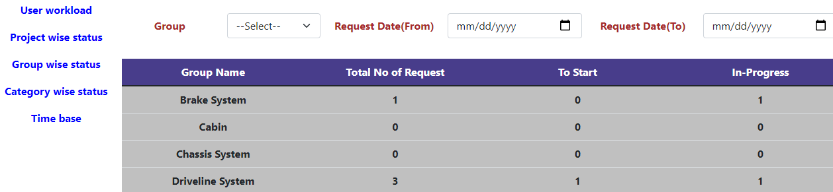
Development of IDT Dashboard
Activities
Statistics
Business Benefits
Recording meta test entities to analyze the activities, status, plans and trends.
Single window for update, view and analyze.
No of Issues :20
Start date : 22-Jan-2022
Date Range : 22-Jan-2022 to 22-Feb-2022
No of Issues Closure: 2
Performance on data representation is technical advancement.
Robust Data Analytics.
Very flexible process for integration with any system.
Easy enhancement and maintenance approach.
Implementation
ERC – Lucknow
A flexible online solution for IDT process

Slide 7
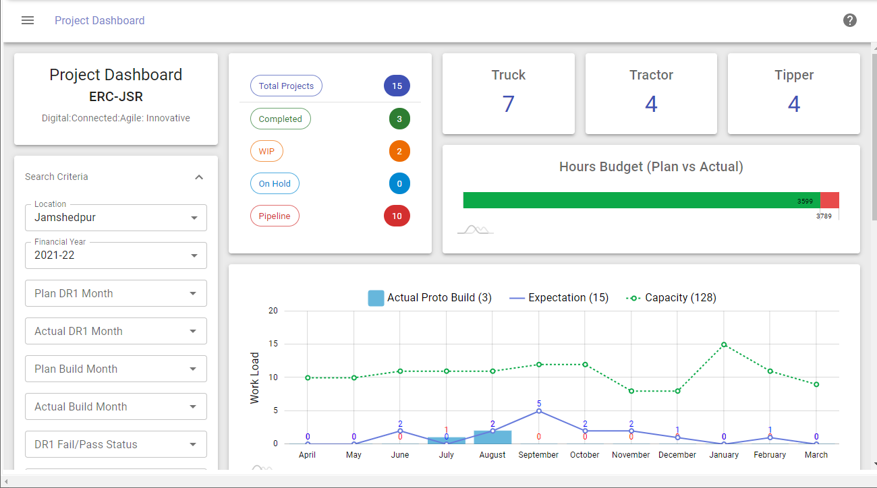
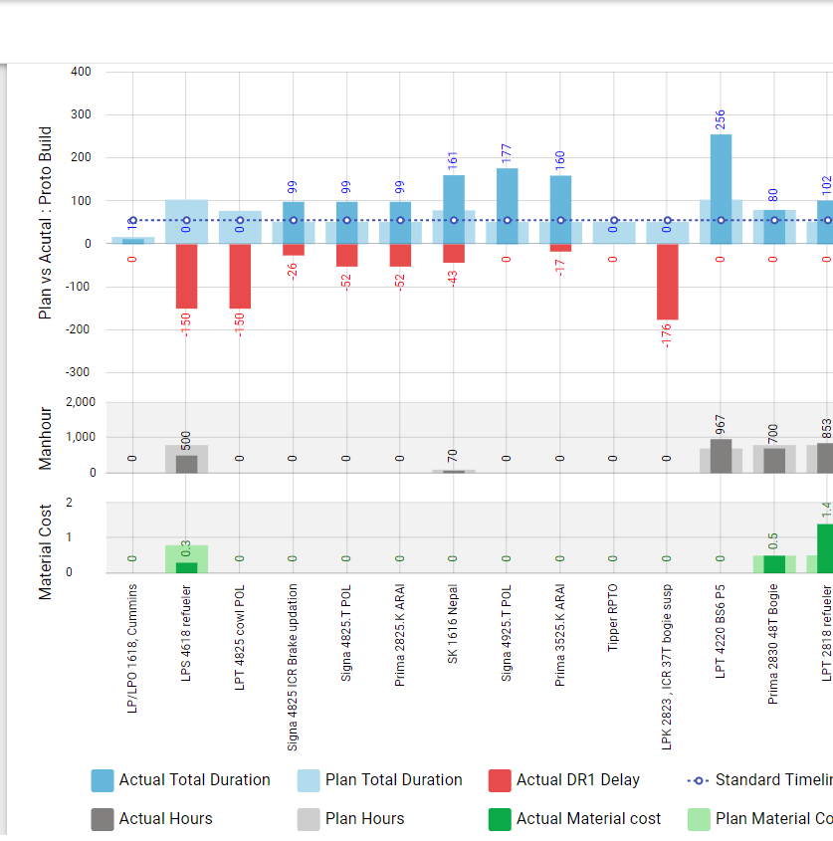
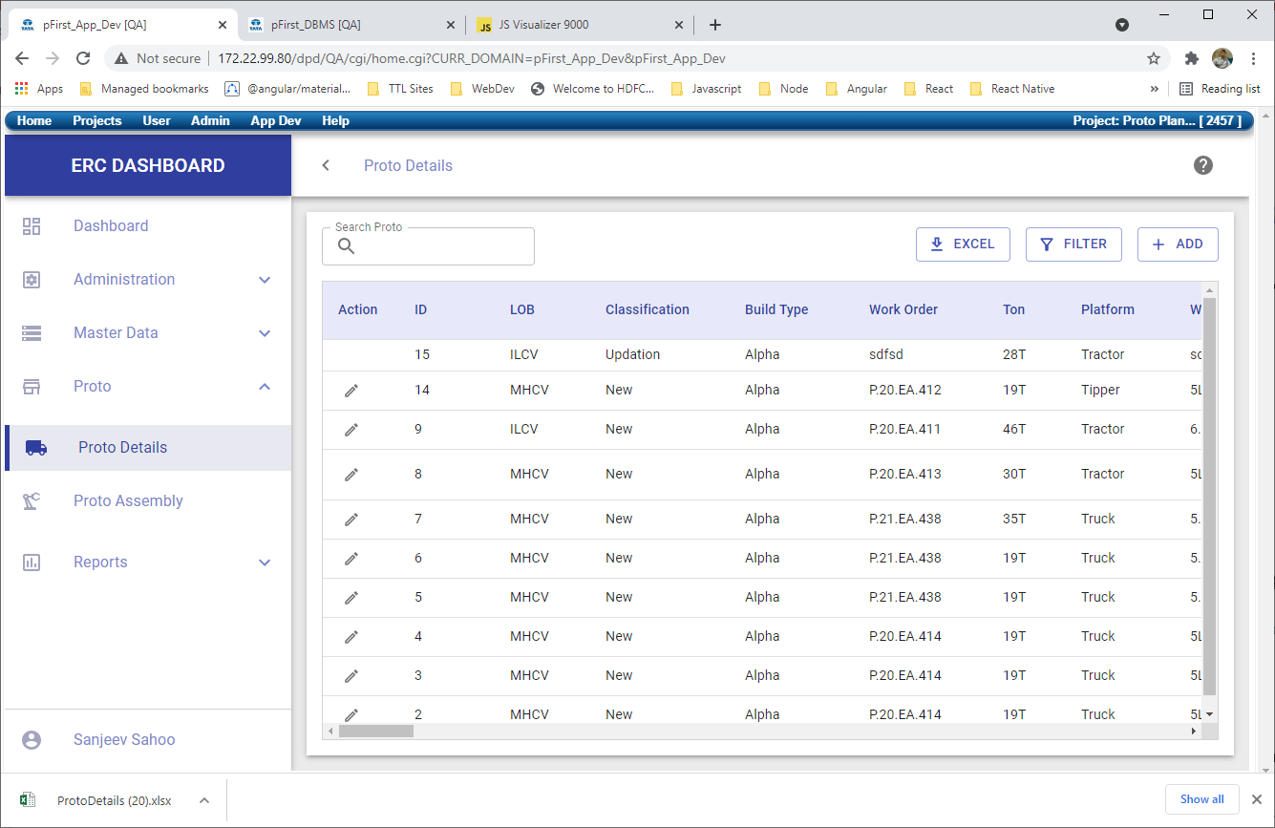
Development of ERC Dashboard for ERC- JSR
Business Benefits
ERC Dashboard will be pfirst based system that will replace the current excel based reports in ERC
Online dashboard for Top Level Management.
Dashboard for respective Agency (Like Proto, Planning, etc.) to Track respective Performance Indicators.
Interlinking with difference system to reduce manual effort.
Better data analysis with readily available Dashboards (like, Project Dashboard, Assembly Dashboard, Proto Planning Dashboard, QA Dashboards etc.)
Implementation
Under Development
Will be used in ERC Jamshedpur initially.
Full visibility on proto building process in a single window

