Slide 1
Digital Product Development Annual Report FY22-23 ERC-PO by Srikant Bhattacharjee

Slide 2
Index
S No. | Initiative | Slide No
1 | Process Improvement (pFirst based process digitization for improving the process ) | 3-6
2 | Digital Manufacturing Implementation ( Digital Manufacturing initiatives across TML ) | 7-8
3 | OJT/IDP/Cross Skilling (Actions on Skill Gaps improvement identified) | 9-10
4 | New Technologies- Innovation/POC/Tech Paper/KM (AI/ML, New Tools & Technologies ) | 11-12
5 | MUVC –9 blocker movement (In Moving up value chain advance productivity and initiatives across ERC ) | 13-14
6 | Digitization in Vehicle Program and Project Management ( Tools & Technologies for Gen3NPI processes) | 15-16
7 | Business Growth- One Team with our Customers (in ERC and TML) | 17-18

Slide 3
Process Improvement
(pFirst based process digitization for improving the process )

Slide 4
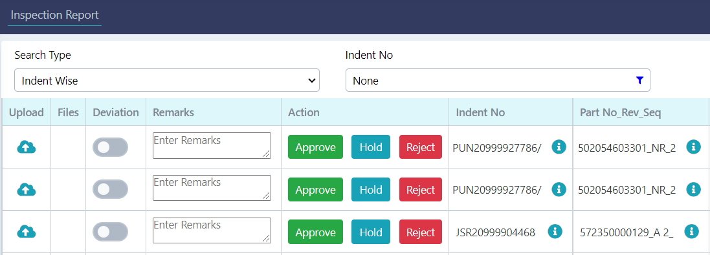
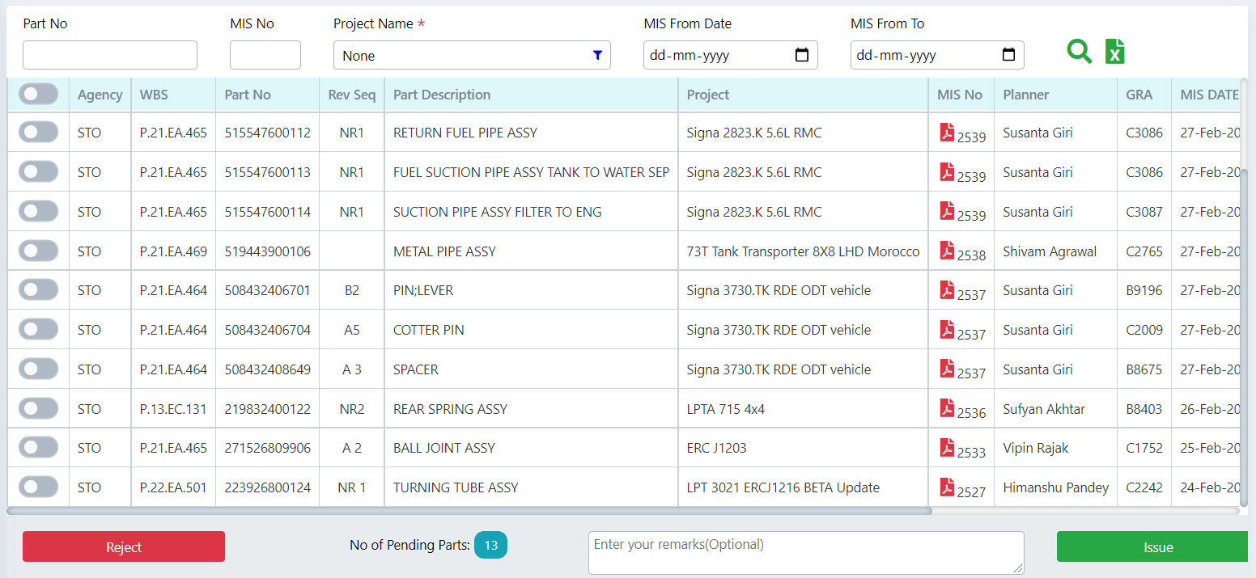
i-Proc System
End to end process implemented for proto part management.
Optimized the intra-departmental process like fabrication workflow, in-house collection workflow, MIS implementation, parting booking mechanism.
Agency wise tracking with respective indicators.
Interlinking with other system to reduce manual effort.
Implementation of Chassis No generation process enables the scope of implementing vehicle handover process.
Business Benefits
The online process has been completely implemented for JSR and LKO part process with linkage with other application for better data visibility and analysis.
Scopes provided to get several formatted export file for restricted data sharing purpose.
Time optimization per request achieved.
From Apr22 to till date, 1019 indent and 16933 parts have been registered.
Implementation
ERC Jamshedpur, Lucknow
Process Improvement

Slide 5
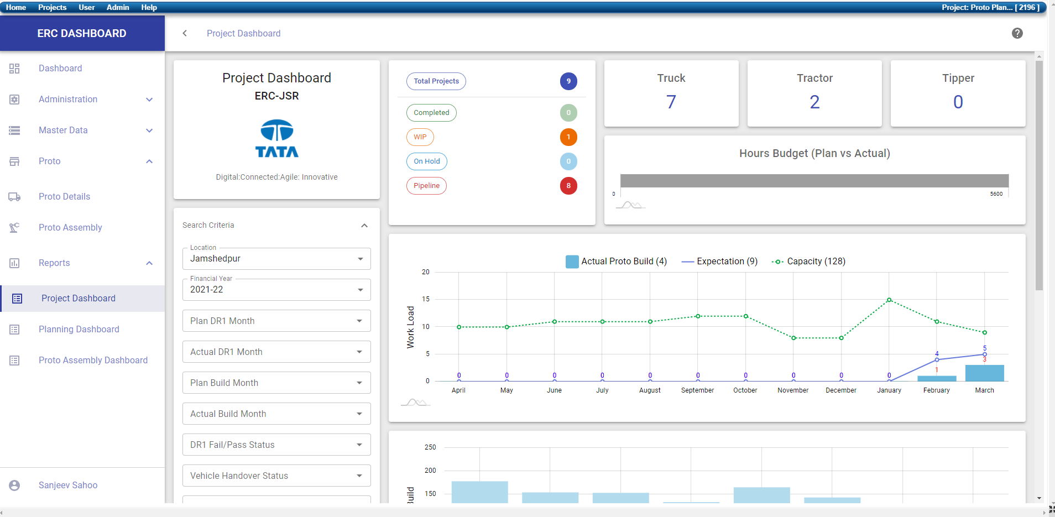
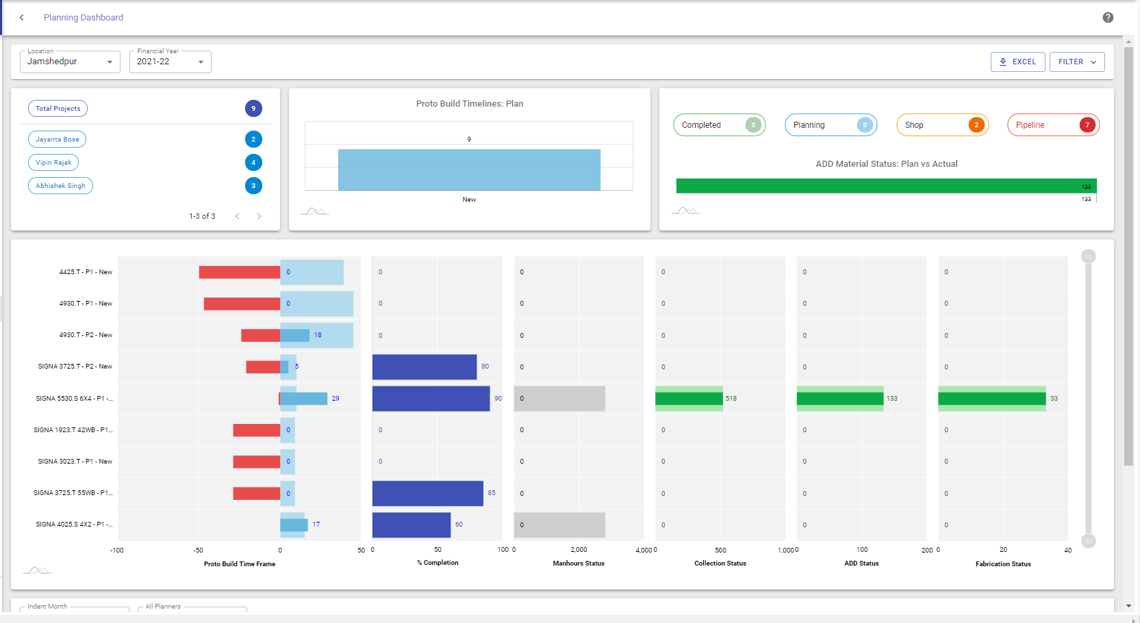
ERC Dashboard Digitization
Online dashboard for Top Level Management.
Dashboard for respective Agency (Like Proto, Planning, etc.) to Track respective Performance Indicators.
Interlinking with difference system to reduce manual effort.
Better data analysis with readily available Dashboards (like, Project Dashboard, Assembly Dashboard, Proto Planning Dashboard, QA Dashboards etc.)
Business Benefits
The current process is that, the ERC dashboard is being generated using the Excel (macros). The relevant Data is being feed into excel sheets and Dashboard is being refreshed as required.
The excel file is in shared location and individual users do the required changes for their respective vehicle models.
we would save 15 minutes per request
Since there will be approx. 576 requests per quarter, we expect to save 144 hrs per quarter
Proto Planning Dashboard
Implementation
ERC Jamshedpur
Project Dashboard
Process Improvement

Slide 6
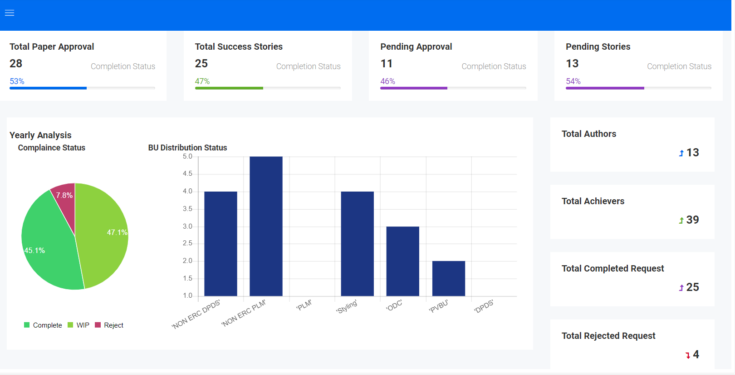
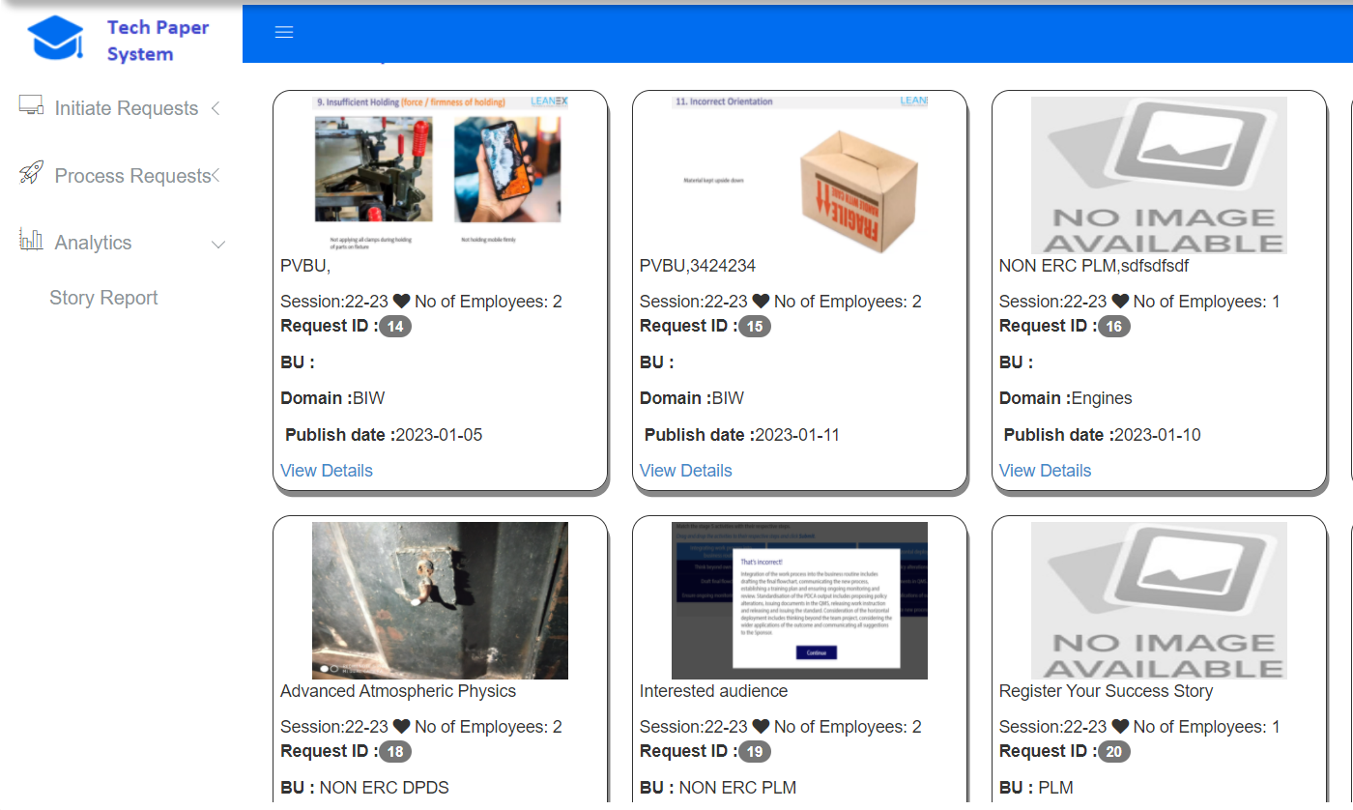
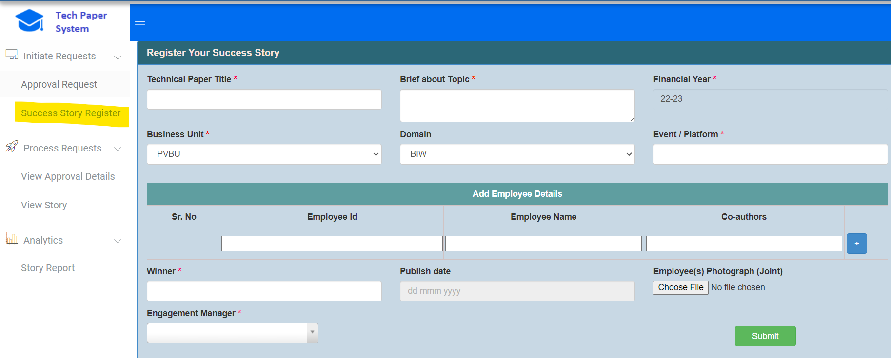
PMO Applications
Introduced technical paper system for PMO usability.
An Application can cater multiple services, related to technical papers.
Visual Analytics on captured data suggest PMO on future decisions.
Business Benefits
The online process has been implemented for all TTL employee.
Open to implement new services and relate with existing
Designed for process optimization and easy accessibility.
Implementation
ERC Jamshedpur, Lucknow
Process Improvement

Slide 7
Digital Manufacturing Implementation
( Digital Manufacturing initiatives across TML )

Slide 8
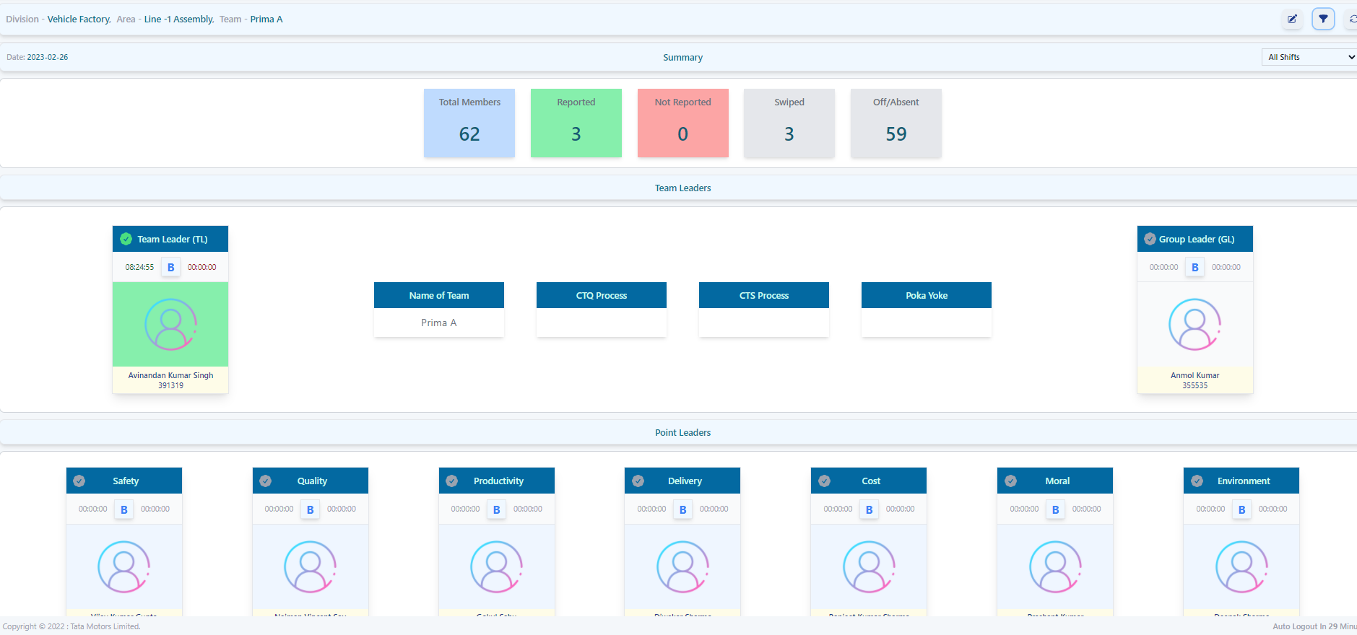
ESDT Portal
In the current practice SDT Team captures all the data in excel sheet, the relevant document are captured in excel, printed and then used across SDT Team. The eSDT Portal is digitization of the process to capture all these in a central repository.
Through this online process, we can capture the relevant data in a centralized system and can be accessible from anywhere inside the TATA Motors network.
Business Benefits
Improve accountability & Ownership
More Empowerment and decision making in day to day functioning
Less Supervision by operator traceability mechanism
Develop understanding and maturity of Team Leader in the connected platform
Alignment with Industry 4.0 initiatives & requirements
Implementation
TML Jamshedpur
Process Improvement

Slide 9
OJT/IDP/Cross Skilling
(Actions on Skill Gaps improvement identified across ERC )

Slide 10
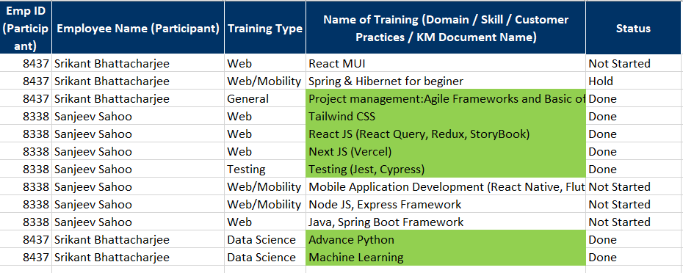
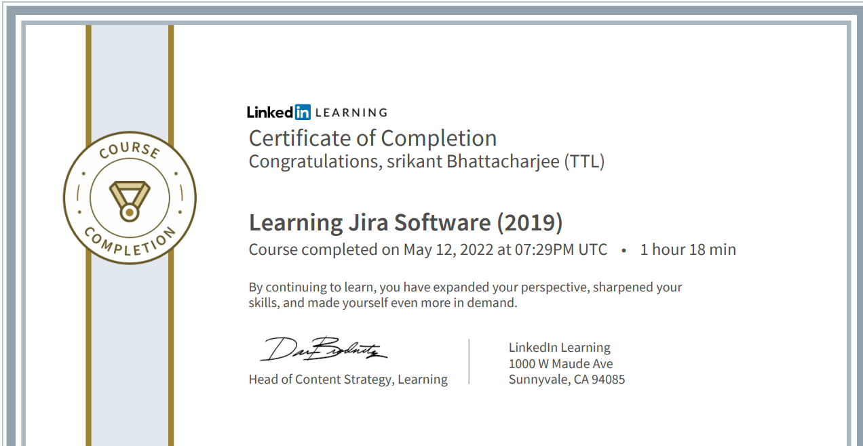
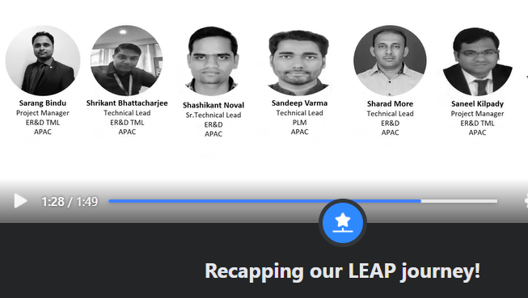
OJT/IDP/Cross Skilling
IDP achieve on “Tailwind CSS”, ”Python Django framework” and “Mongo DB”, with consumption of 123.75 hrs.
OJT and Training on several applications done , with mentioned statistics.
Cross Skilling: Attended “Preditictive Analysis with Tata Neuron “ training.
Cross Skilling: Attended “Presentation Skill” by Tata Technologies Ltd.
Business Benefits
Team has capable enough on frontend and backend development with E1 level
User training on new enhancements increases the productivity among user and new ideas generated for future development.
OJT given to new developer, helps to increase the productivity.
Implementation
ERC JSR
Actions on Skill Gaps improvement identified

Slide 11
New Technologies- Innovation/POC/Tech Paper/KM
(AI/ML, New Tools & Technologies )

Slide 12
Innovation/POC/Tech Paper/KM-KS
Global KS Session : “Tailwind CSS”
Local KS: “Tailwind CSS”, “Mongo DB”, “Django Rest Framework”.
KM : “Mongo DB”, “Django Rest Framework”, “Tailwind CSS”.
Technical Paper : Online Incident Investigation Process is in progress.
Business Benefits
New learning open scopes for new areas like Data warehousing, mobility and Machine Learning.
Standard process and approach through CAD
Implementation
ERC JSR
Talent Fungebility (Domain/Subdomain)

Slide 13
MUVC –9 blocker movement
(In Moving up value chain advance productivity and initiatives across ERC )

Slide 14
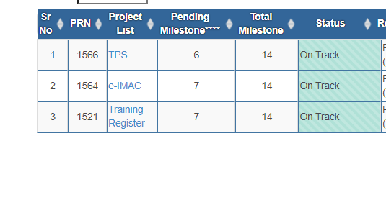
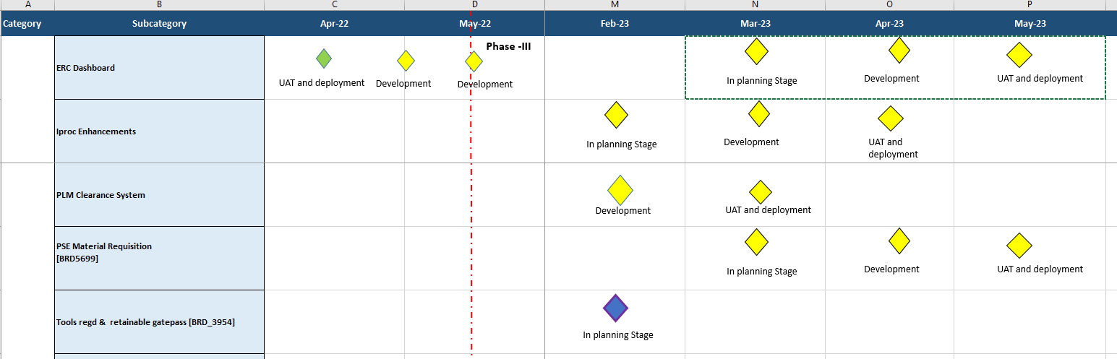
MUVC –9 blocker movement
Current Status productivity applications.
Upcoming applications with business prospect.
MUVC Status and actives.
1) Application support
3) pFirst Application development
5) Software Development Life Cycle
6) Access Control
Business Benefits
Regular enhancements and supports to maintain customer delight
New application development using new technologies will increase the technical as well as economical productivity.
Mostly worked on Y1 and Y2 in MUVC blocks, which increase the business in future.
Y2->
3) Portal applications design and architecture
--------------------------------------
Y1->
1) Requirements Management
2) End User Tech support
3) Technical Documentation
4) User Manual
5) End User Training
Implementation
ERC JSR
Activity: Project Planning, development, Maintenance, Support.

Slide 15
Digitization in Vehicle Program and Project Management
(KBE & Design Automation tools for improving the productivity )

Slide 16
Project and resource Management
iProc – Fulfill all departmental requirements and supports/suggested for the betterment of the application.
PAR – Automate the accessibility of application and enhance the analytical report and additional workflow for PLM clearance is in process
TPS – Technical Paper related data capture and automate the approval process.
ERC Dashboard – Implementation of Vehicle Assembly process.
Business Benefits
Agile methodology followed for better Project & resource management .
Existing tools are being used business benefit.
Optimised the processes, and improve the productivity.
Implementation
ERC JSR
Supported Applications: iProc System, ERC Dashboard, PLM ID and Access Request, Online Material Requisition, Despatch Advice, TPS

Slide 17
Business Growth- One Team with our Customers
(CVP updates in CV/PV & EV in TML)

Slide 18
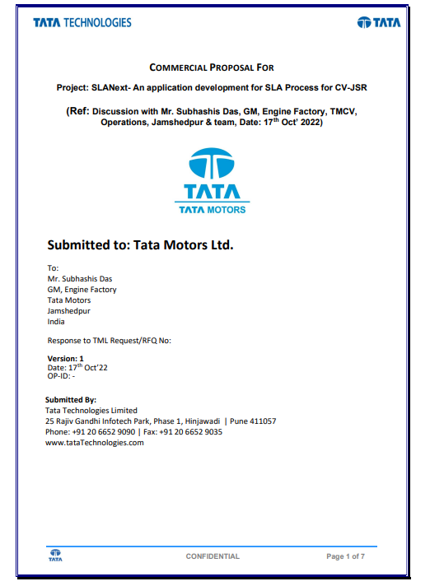
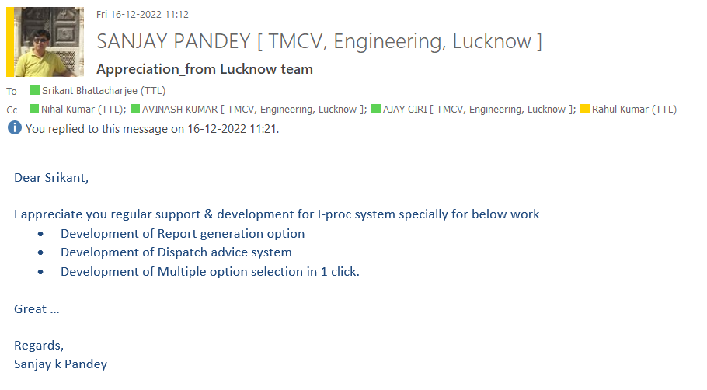
Business Growth- One Team with our Customers
Customer appreciation.
Upcoming applications with business prospect.
Business Benefits
Added business with same resource.
Optimize the processes for reduction support time and manage the resources for customers delight.
Implementation
ERC JSR
.

Slide 19
Title
Thank You

