Slide 1
Front End – Using CSS Preprocessor SASS
Project Name
NoSql with Mongo DB
-
Project Number
LoB
Industry
Domain
Functional
Tool
[Document Category - General / Customer Specific / Confidential]
Document Type (From the list on left)
Author
Author email
Document version | 1
Keywords
EnD
Automotive
Web Application
General
Lesson Learnt
Srikant Bhattacharjee
Srikant.bhattacharjee@tatatechnologies.com
.

Slide 3
Contents
Overview
Pros and Cons of NoSQL
Types and Tools
Mongo DB
Advantages, Uses
Installation
Mongo DB Fundamentals
References

Slide 4
Overview
What is NoSQL?
A NoSQL database provides a mechanism for storage and retrieval of data that is modeled in means other than the tabular relations used in relational databases. NoSQL systems are also sometimes called Not only SQL to emphasize that they may support SQL-like query languages. NoSQL databases are increasingly used in big data and real-time web applications.
The data structures used by NoSQL databases are key–value pair, wide column, graph, or documents, which are different from relational databases and which makes some operations faster in NoSQL.
When should NoSQL be used?
When a huge amount of data needs to be stored and retrieved.
The relationship between the data you store is not that important
The data changes over time and is not structured.
Support of Constraints and Joins is not required at the database level.
The data is growing continuously and you need to scale the database regularly to handle the data.

Slide 5
Pros and Cons of NoSQL
Pros: The main advantages are high scalability and high availability.
High scalability – NoSQL databases use sharding for horizontal scaling. Partitioning of data and placing it on multiple machines in such a way that the order of the data is preserved is sharding. Vertical scaling means adding more resources to the existing machine whereas horizontal scaling means adding more machines to handle the data.
High availability – Auto replication feature in NoSQL databases makes it highly available because in case of any failure data replicates itself to the previous consistent state.
Cons:
Narrow focus – NoSQL databases have a very narrow focus as it is mainly designed for storage but it provides very little functionality.
Open-source – NoSQL is open-source database. There is no reliable standard for NoSQL yet.
Backup – Backup is a great weak point for some NoSQL databases .

Slide 6
Type and Tools
Types of NoSQL database:
Graph Databases
Neo4j
Key value store
Redis
Tabular
Hbase
Document-based
MongoDB

Slide 7
Mongo DB
MongoDB is a source-available cross-platform document-oriented database program. Classified as a NoSQL database program, MongoDB uses JSON-like documents with optional schemas.
MongoDB is available under General Public license for free, and it is also available under Commercial license from the manufacturer.
The following table shows the relationship of RDBMS terminology with MongoDB.
RDBMS | MongoDB
Database | Database
Table | Collection
Tuple/Row | Document
column | Field
Table Join | Embedded Documents
Primary Key | Primary Key (Default key _id provided by MongoDB itself)
Database Server and Client
mysqld/Oracle | mongod
mysql/sqlplus | mongo

Slide 8
Advantages, Uses
Advantages over RDBMS
Big Data
Content Management and Delivery
Mobile and Social Infrastructure
User Data Management
Data Hub
Where to Use
Schema less − MongoDB is a document database in which one collection holds different documents. Number of fields, content and size of the document can differ from one document to another.
Structure of a single object is clear.
No complex joins.
Deep query-ability. MongoDB supports dynamic queries on documents using a document-based query language that's nearly as powerful as SQL.
Tuning.
Ease of scale-out − MongoDB is easy to scale.
Conversion/mapping of application objects to database objects not needed.
Uses internal memory for storing the (windowed) working set, enabling faster access of data.

Slide 9
Installation
There are two edition in Mongo DB server, Such as “Enterprise” and “Community”.
Additionaly MongoDB Atlas is a hosted MongoDB service option in the cloud which requires no installation overhead and offers a free tier to get started
Ways to install Mongo DB in Windows
Download and Run the MongoDB Community .msi installer.
Install MongoDB Compass(wizard).
Install mongosh: The MongoDB Shell, mongosh, is a fully functional JavaScript and Node.js 16.x REPL environment for interacting with MongoDB deployments. You can use the MongoDB Shell to test queries and operations directly with your database.
Open a new Command Interpreter and enter mongosh.exe to connect to MongoDB OR Start DB compass
NOTE: The MongoDB service starts upon successful installation with windows service, if not, manually start the MongoDB instance from the following path <install directory>\bin\mongod.cfg.
NOTE: Be sure to add the path to your mongosh.exe binary to your PATH environment variable during installation.

Slide 10
Mongo DB Fundamentals: Database , Collection
Purpose | Syntax
To Create Database: | use DATABASE_NAME
To Use Database: | switch to db DATABASE_NAME
To show all Databases: | show dbs
To drop Database: | db.dropDatabase()
Create a collection: | db.createCollection(name)
Show All collectios: | db.createCollection()
delete a collection | db.<collection-name>.drop()

Slide 11
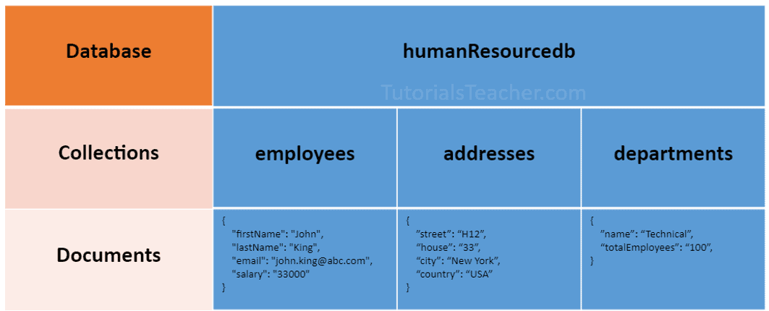
Mongo DB Fundamentals: Data Model Design
Mongo DB provides two types of data models:
1) Embedded Data Model
All the related data in a single document, it is also known as de-normalized data model.
Data Pattern→{
_id:
, Emp_ID: "10025AE336"
Personal_details:{
First_Name: "Radhika",
Last_Name: "Sharma",
Date_Of_Birth: "1995-09-26"
}
}
2) Normalized Data Model
sub documents in the original document, using references.
Data Pattern→
Employee:{
_id: <ObjectId101>
, Emp_ID: "10025AE336"
}
Personal_details:{
First_Name: "Radhika",
Last_Name: "Sharma",
Date_Of_Birth: "1995-09-26"
}

Slide 12
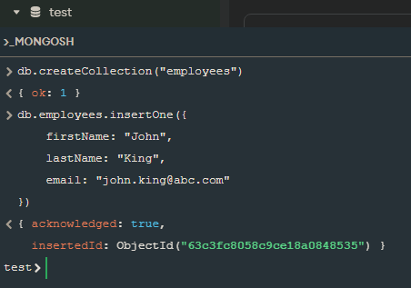
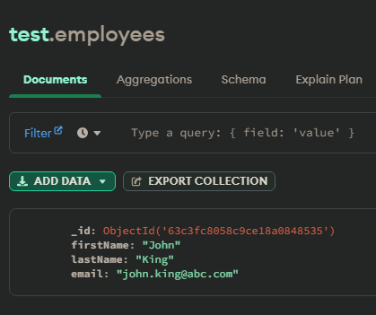
Mongo DB Fundamentals: Insert Document
Mongo DB provides the following methods to insert documents into a collection:
InsertOne() - Inserts a single document into a collection.

Slide 13
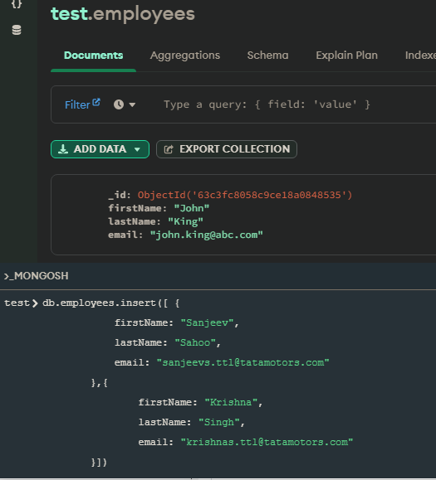
Mongo DB Fundamentals: Document
insert() - Inserts one or more documents into a collection.
InsertMany() - Insert multiple documents into a collection.

Slide 14
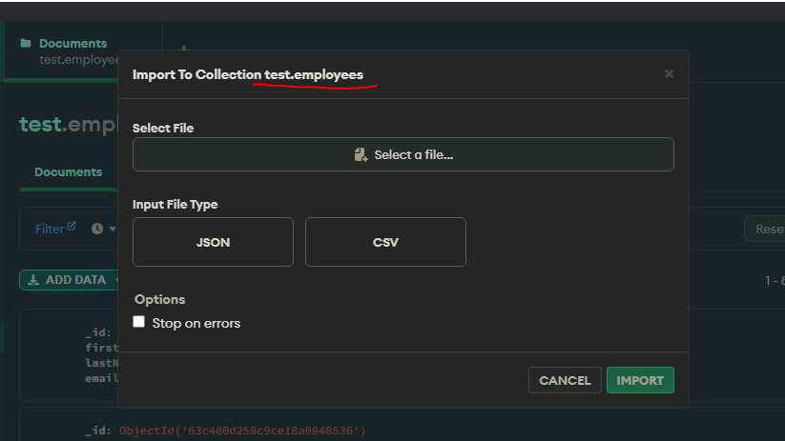
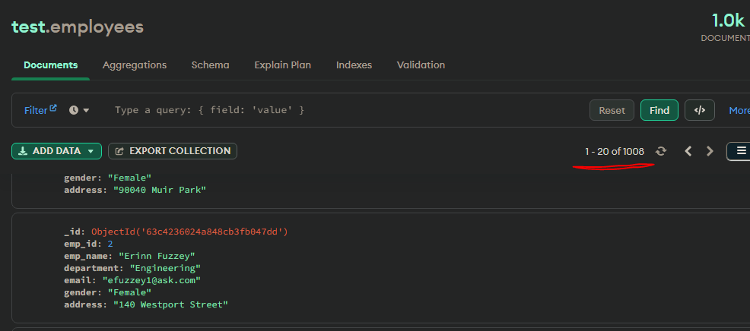
Mongo DB Fundamentals: Import Data in Document
MongoDB Compass can import data into a collection from either a JSON or CSV file.

Slide 15
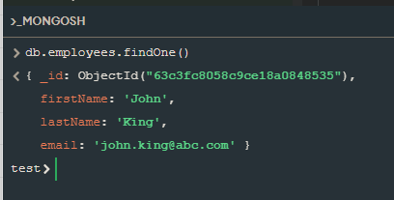
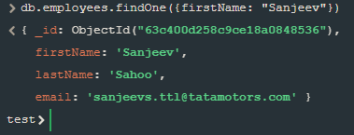
Mongo DB Fundamentals: Query Document
MongoDB provides two methods for finding documents from a collection.
findOne() - returns a the first document that matched with the specified criteria

Slide 16
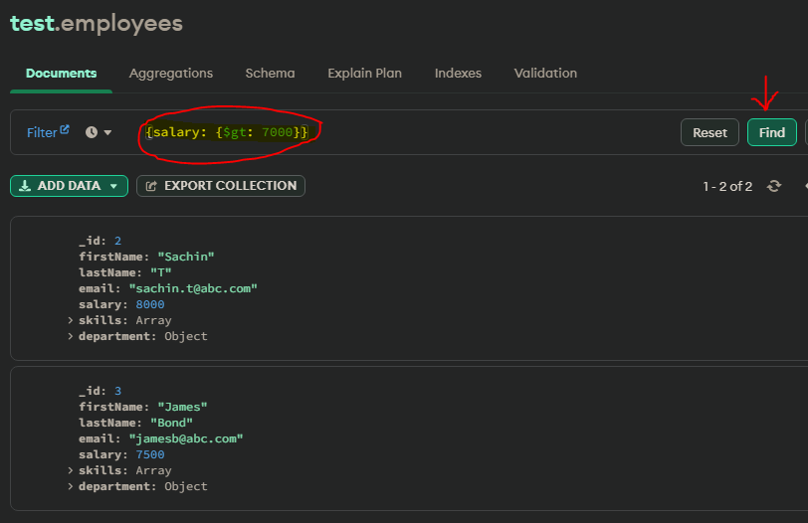
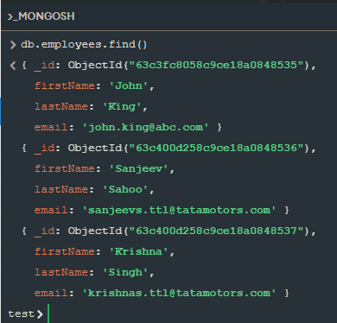
Mongo DB Fundamentals: Query Document & Projection
find() - returns a cursor to the selected documents that matched with the specified criteria.

Slide 17
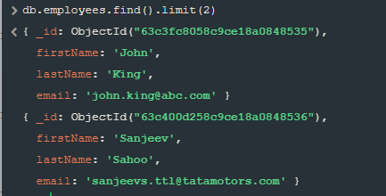
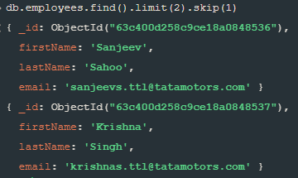
Mongo DB Fundamentals: Query Document & Limit Records
The method accepts one number type argument, which is the number of documents that you want to be displayed.
Use skip() to skip the number of documents

Slide 18

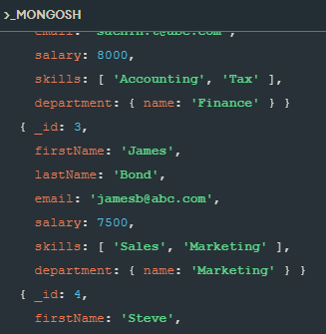
Mongo DB Fundamentals: Query Document & Sorting Records
To sort documents in MongoDB, you need to use sort() method. The method accepts a document containing a list of fields along with their sorting order. To specify sorting order 1 and -1 are used. 1 is used for ascending order while -1 is used for descending order.

Slide 19

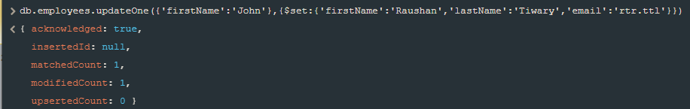
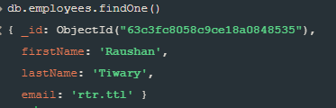
Mongo DB Fundamentals: Update Document
MongoDB's update() methods are used to update document into a collection.
The update() method updates the values in the existing document.

Slide 20
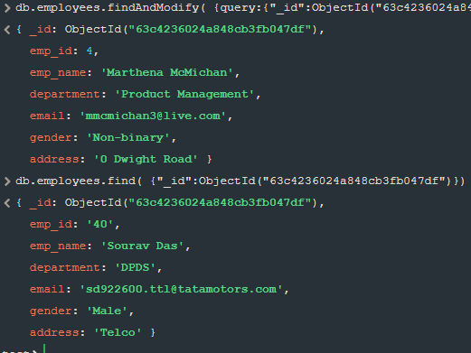
Mongo DB Fundamentals: Update Document
The findOneAndUpdate() method updates the values in the existing document.
db.employees.findAndModify( {query:{"_id":ObjectId("63c4236024a848cb3fb047df")},update:{"emp_id":"40","emp_name":"Sourav Das", "department":"DPDS", "email":"sd922600.ttl@tatamotors.com", "gender":"Male", "address":"Telco"},upsert: true} )

Slide 21
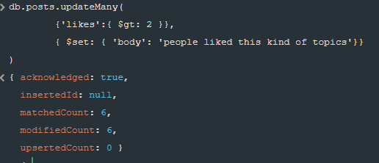
Mongo DB Fundamentals: Update Document
The updateMany() method updates all the documents that matches the given filter.

Slide 22
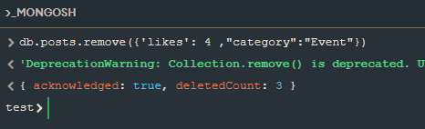
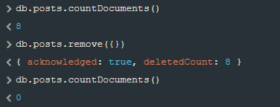
Mongo DB Fundamentals: Delete Document
MongoDB's remove() method is used to remove a document from the collection. remove() method accepts two parameters. One is deletion criteria and second is justOne flag.
deletion criteria − (Optional) deletion criteria according to documents will be removed.
justOne − (Optional) if set to true or 1, then remove only one document.

Slide 23
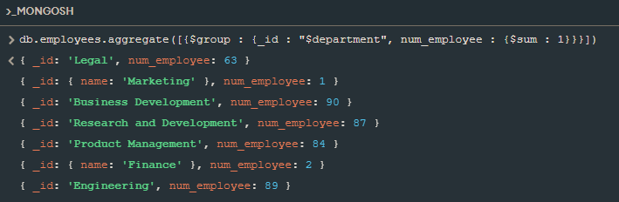
Mongo DB Fundamentals: Aggregation
Aggregations operations process data records and return computed results. Aggregation operations group values from multiple documents together, and can perform a variety of operations on the grouped data to return a single result. In SQL count(*) and with group by is an equivalent of MongoDB aggregation.

Slide 24
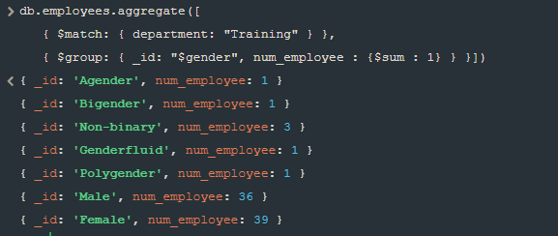
Mongo DB Fundamentals: Aggregation Pipeline Concept
The aggregation pipeline is a framework for data aggregation modeled on the concept of data processing pipelines. Documents enter a multi-stage pipeline that transforms the documents into aggregated results.

Slide 25
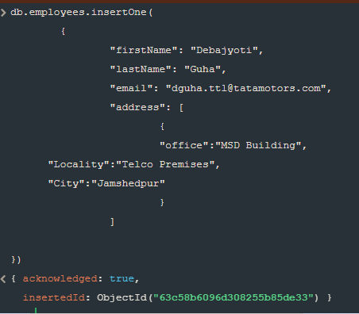
Mongo DB Fundamentals: Relationships
Relationships in MongoDB represent how various documents are logically related to each other. Relationships can be modeled via Embedded and Referenced approaches. Such relationships can be either 1:1, 1:N, N:1 or N:N.
Let us consider the case of storing addresses for users. So, one user can have multiple addresses making this a 1:N relationship.
Embedded Relationships:

Slide 26
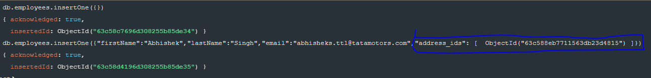
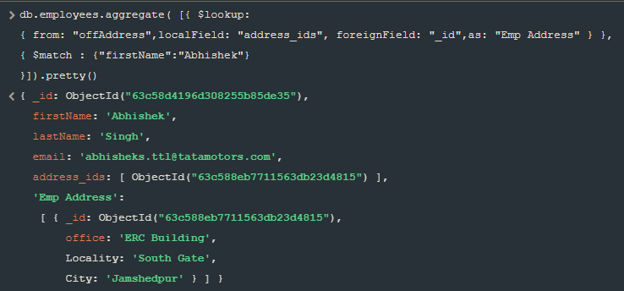
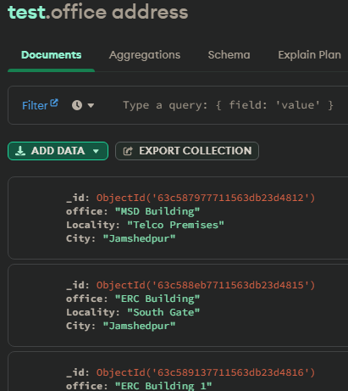
Mongo DB Fundamentals: Relationships
var addresses = db.address.find({"_id":{"$in":result["address_ids"]}})
Referenced Relationships: This is the approach of designing normalized relationship.

Slide 27
References
https://www.mongodb.com/docs/manual/
https://www.tutorialspoint.com/mongodb/index.htm
https://www.geeksforgeeks.org/mongodb-an-introduction/
https://www.educba.com/mongodb-relationships/

Slide 28


For further information about Tata Technologies and what we can do to help you create better products for your customers, simply check out our website www.tatatechnologies.com
© Copyright 2016 Tata Technologies. All rights reserved. All other trademarks are trademarks of their respective owners.

