Slide 1
Jithendra Yenugula 2017300 Srikar Paida 2017336 Nalam Abhinay 2017154 Chaitanya Alladi 2017315
Heart Beat Monitor using Arduino

Slide 2
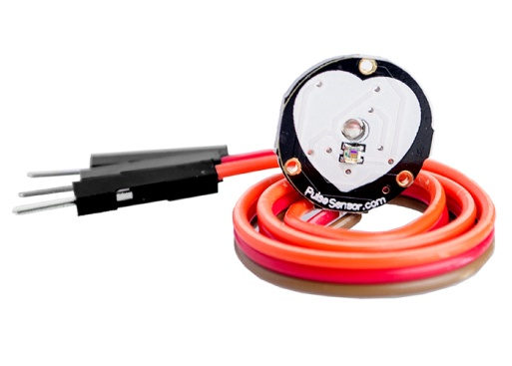
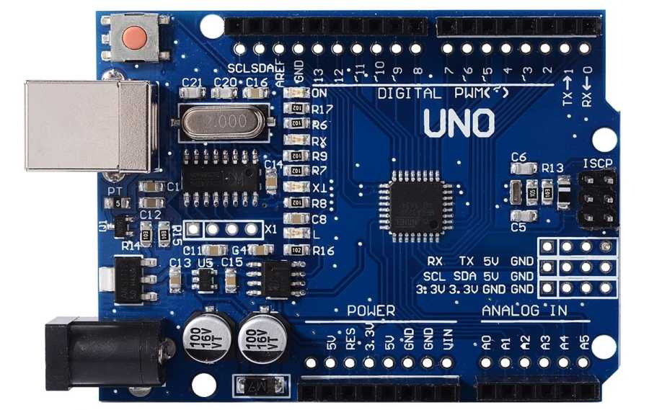

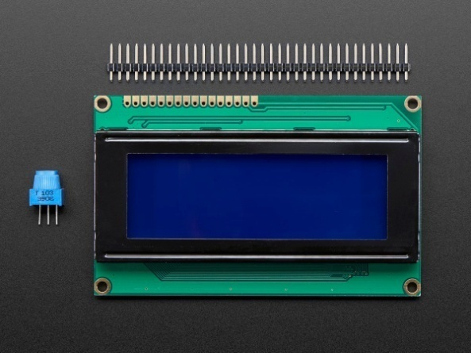

Components:
20x4 LCD Display
Ardunio UNO
Heart beat Sensor
Connecting wires
Variable resistors
Push Button

Slide 3
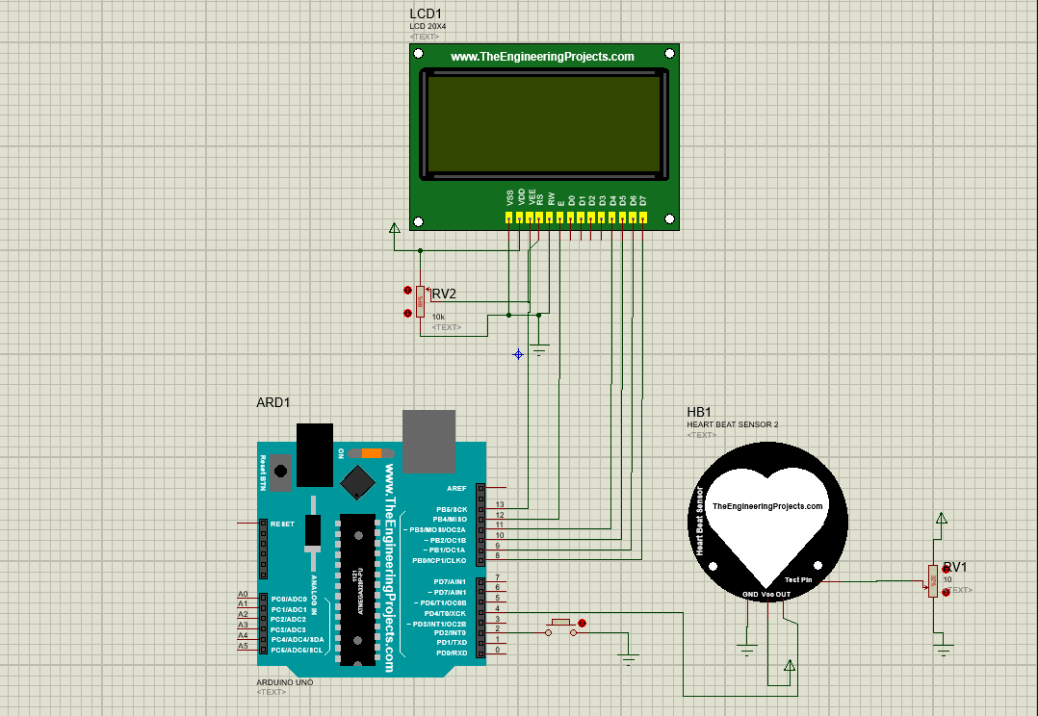
Circuit in Proteus

Slide 4
The Heart Beat Sensor
We have four pins on it.
We can change How fast or slow heart is beating by changing the voltage at TestPin.
TestPin voltage must vary between 0 to 5.
So, when we apply 1V then Heart Beat will be Fast and when will you apply 4V then it will be very slow.
OUT Pin will give us the Heart Beats, so when there’s a beat OUT will be HIGH otherwise LOW.

Slide 5
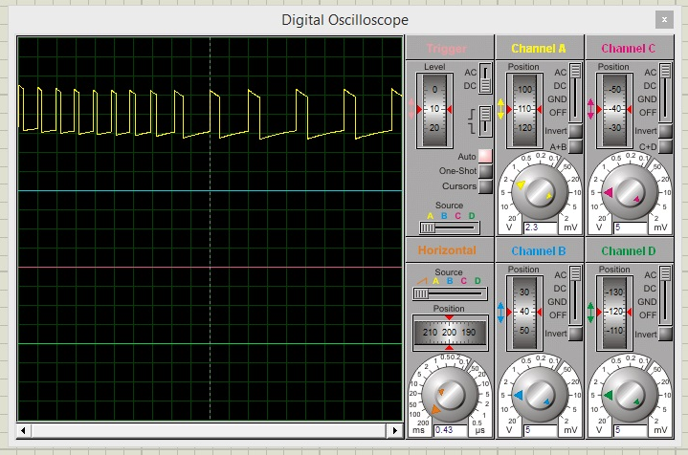

Slide 6
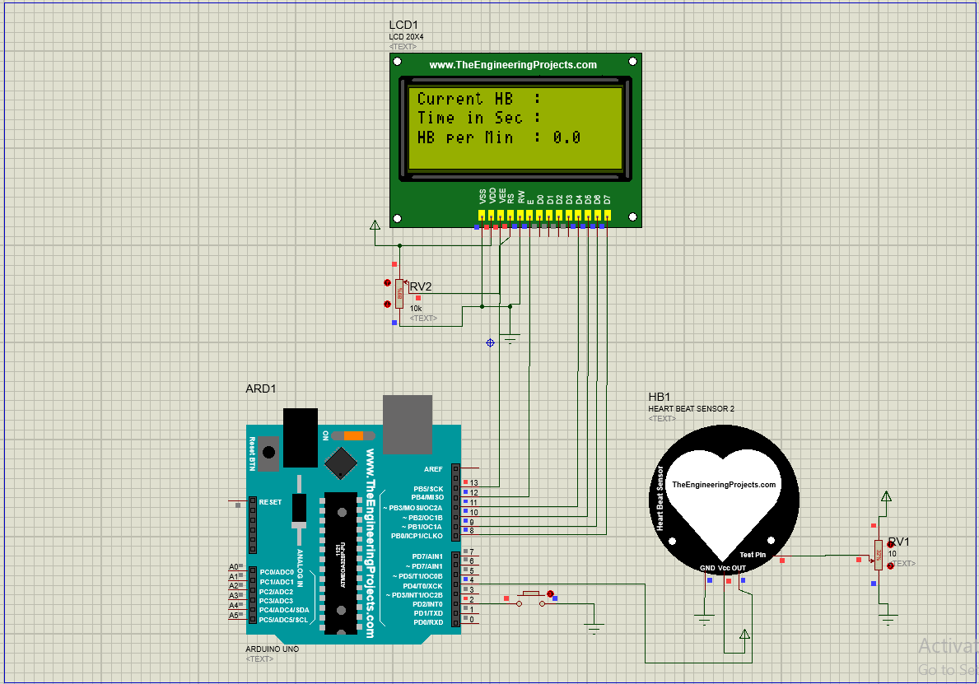
When executed

Slide 7
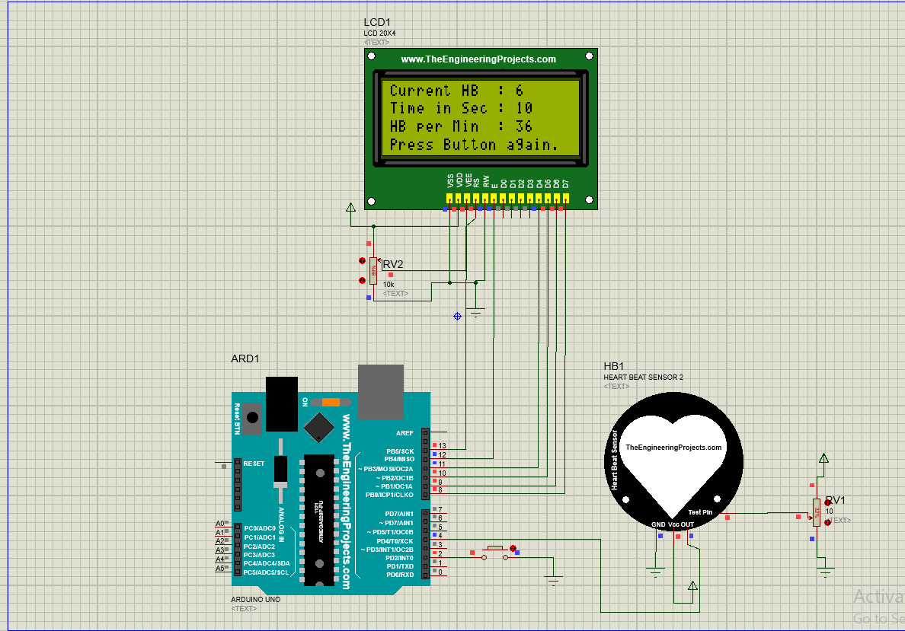
When Push button pressed (for R1)

Slide 8
In this code, We have used a TimerOne Library which creates an interrupt after every 1sec.
On each interrupt, it executes timerIsr() function, in which I have placed a check that whenever this interrupt will call we will increment TimeinSec variable.
So, when TimeinSec will become equal to 10 then We are simply multiplying it with 6 and updating it on the LCD.
Value of Heart Beat can be changed from the variable resistor connected with Heart Beat Sensor.

Slide 9
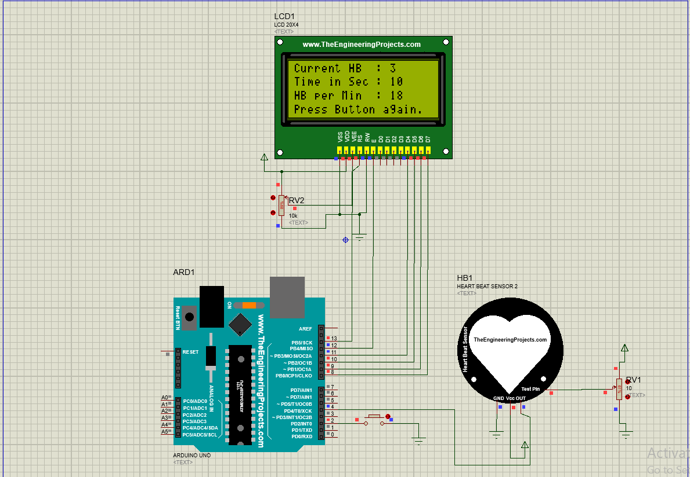
For R2

Slide 10
END

