Slide 1

Smart Grid
Energy Forecasting
Machine Learning Mini Project
An ML-based system to forecast electricity demand, detect risky peaks, and support grid-planning decisions through a prediction API and dashboard.
24 hr
0–100
FastAPI
Forecast
Risk score
API
Team Roll Numbers & Names
2510030006 – N Srikar
2510030246 – M Sri Charan
2510030147 – U Yogendra
2510030008 – G Pranav

Slide 2
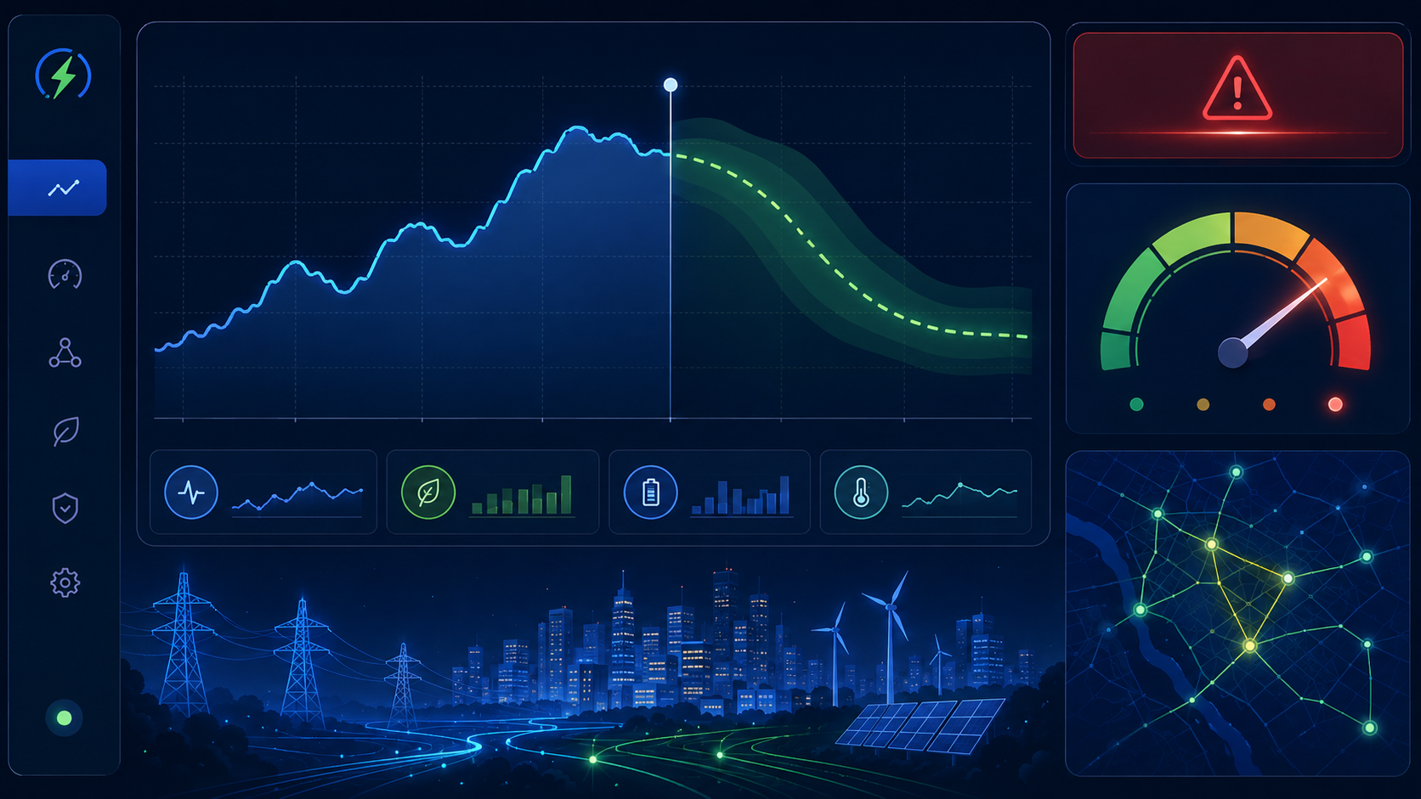
Problem Statement
Smart grids need accurate short-term energy forecasts to avoid overload and wastage.
Electricity demand is not constant. It changes every hour based on weather, time, weekday/weekend behavior, holidays, and previous consumption patterns. Manual estimation can miss sudden peaks and hidden relationships in data.
Demand uncertainty
Energy wastage
Late response
Sudden spikes during evenings or hot weather can create overload risk.
Over-generation increases operational cost and resource waste.
Without early alerts, operators react only after demand becomes critical.
Project need: Build a forecasting system that predicts upcoming electricity demand, classifies demand risk, and gives simple decision-support outputs before peak periods occur.

Slide 3
Objectives
Focused goals for the project implementation
1. Forecast demand
2. Classify grid risk
Predict next-hour and next-24-hour electricity demand using historical and weather-based features.
Convert predicted demand into Low, Normal, High, or Critical levels for easy understanding.
3. Detect peak conditions
4. Compare ML models
Generate alerts when predicted demand crosses dynamic threshold or rises too quickly.
Train linear and tree-based models, evaluate them, and select the best performer.
5. Explain predictions
6. Build working app
Show important factors such as hour, temperature, weekday and previous demand.
Expose predictions through FastAPI and present them in an interactive dashboard.
Unique additions: What-if simulator + Grid Stress Score + Similar-day comparison.

Slide 4
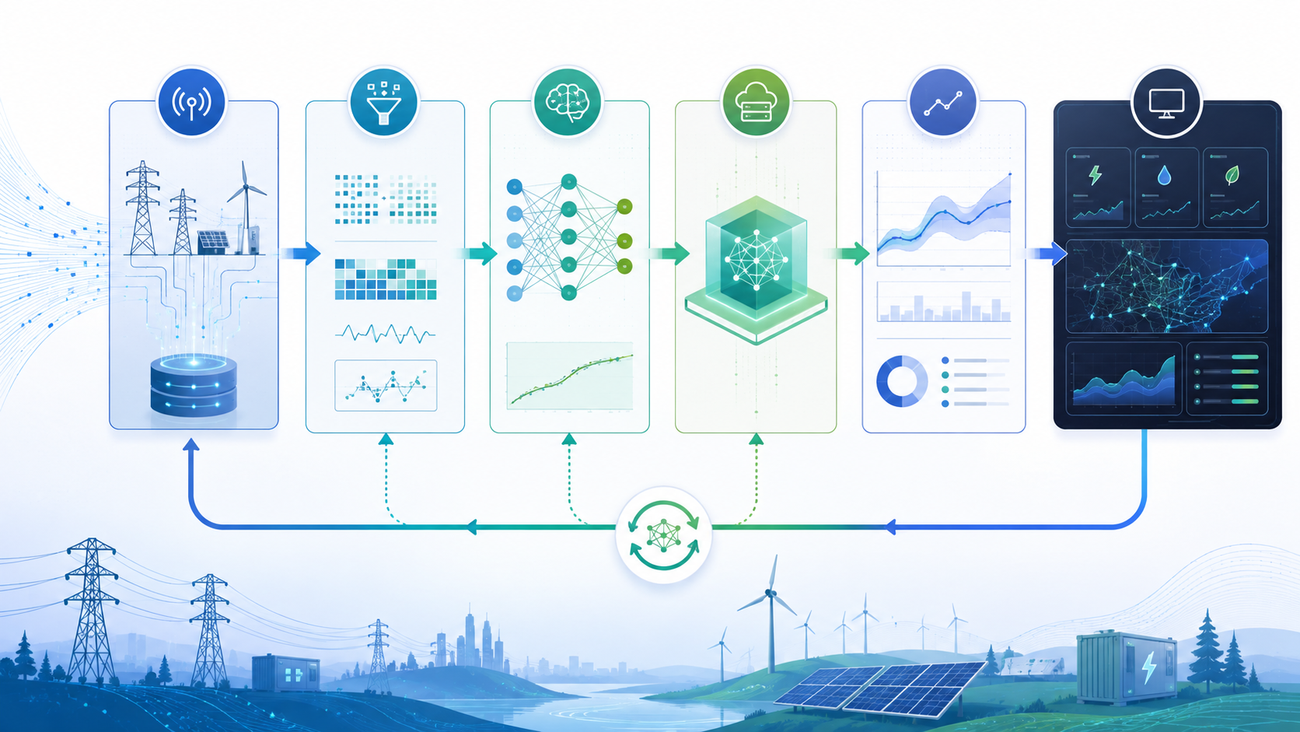
Technology Stack
Tools selected for each stage of the ML lifecycle
Data Processing
Python, Pandas, NumPy for cleaning, transformation and feature generation.
Machine Learning
Scikit-learn models, Random Forest, Gradient Boosting, XGBoost; Joblib for model saving.
Backend Service
FastAPI, Pydantic validation, Uvicorn server and REST endpoints.
Dashboard & Storage
React + Recharts for UI; SQLite/PostgreSQL for prediction history.
Optional tracking: MLflow can store model versions, parameters, metrics and artifacts.

Slide 5
Expected Outcome
Final deliverables after implementation
The final output will be a working ML prototype that takes grid/weather inputs, predicts electricity demand, classifies risk, and presents alerts and charts to the user.
Forecast Output
Risk Output
Numerical demand prediction for next hour and 24-hour demand curve.
Demand category, peak alert and Grid Stress Score from 0 to 100.
ML Output
App Output
Best model selection based on MAE, RMSE, MAPE and R².
FastAPI endpoint, dashboard graphs and stored prediction history.
Example demo: Enter timestamp, temperature, humidity and previous demand → system predicts demand → shows High/Critical alert, main reason and forecast chart.

Slide 6
Project Modules
Clean module-wise breakdown for development
1. Data Module
2. Preprocessing
3. Feature Engineering
4. Model Training
5. Prediction App
Collect/load dataset with timestamp, energy demand, temperature, humidity and holiday/weekend indicators.
Handle missing values, duplicates, outliers, data types and timestamp conversion.
Create hour, day, month, lag demand, rolling average and peak-hour features.
Train Linear Regression, Random Forest, Gradient Boosting and XGBoost; tune parameters.
FastAPI endpoints, dashboard, alerts, stress score and prediction-history storage.
Extra logic inside Prediction App: What-if simulator, similar-day comparison and actual-vs-predicted chart.

Slide 7

Project Plan
Timeline / Implementation plan
Task 1
Task 2
Task 3
Task 4
Finalize dataset, understand columns, clean data, perform EDA and draw demand trend graphs.
Create time-based, lag and rolling features; train baseline Linear/Ridge Regression models.
Train Random Forest, Gradient Boosting and XGBoost; compare metrics and build alerts/stress score.
Develop FastAPI + dashboard, connect prediction history, test demo flow and prepare report/PPT.
Final deliverable: trained forecasting model + API + dashboard + evaluation results + implementation report.

