Slide 1
USGS Earthquake Visualization Project
Sai Srikar Reddy
University of Missouri – Columbia

Slide 2
Dataset & Objectives
• Source: USGS GeoJSON Earthquake Feed (2.5+ magnitude)
• Objective: Visualize global earthquake patterns in time and space
• Identify co-occurrence of seismic events across regions
• Understand frequency, magnitude, and inter-regional relationships

Slide 3
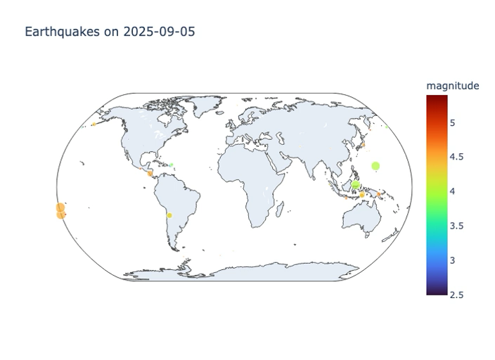
Frame from temporal animation showing earthquakes.
Color represents magnitude, and bubble size represents depth.

Slide 4
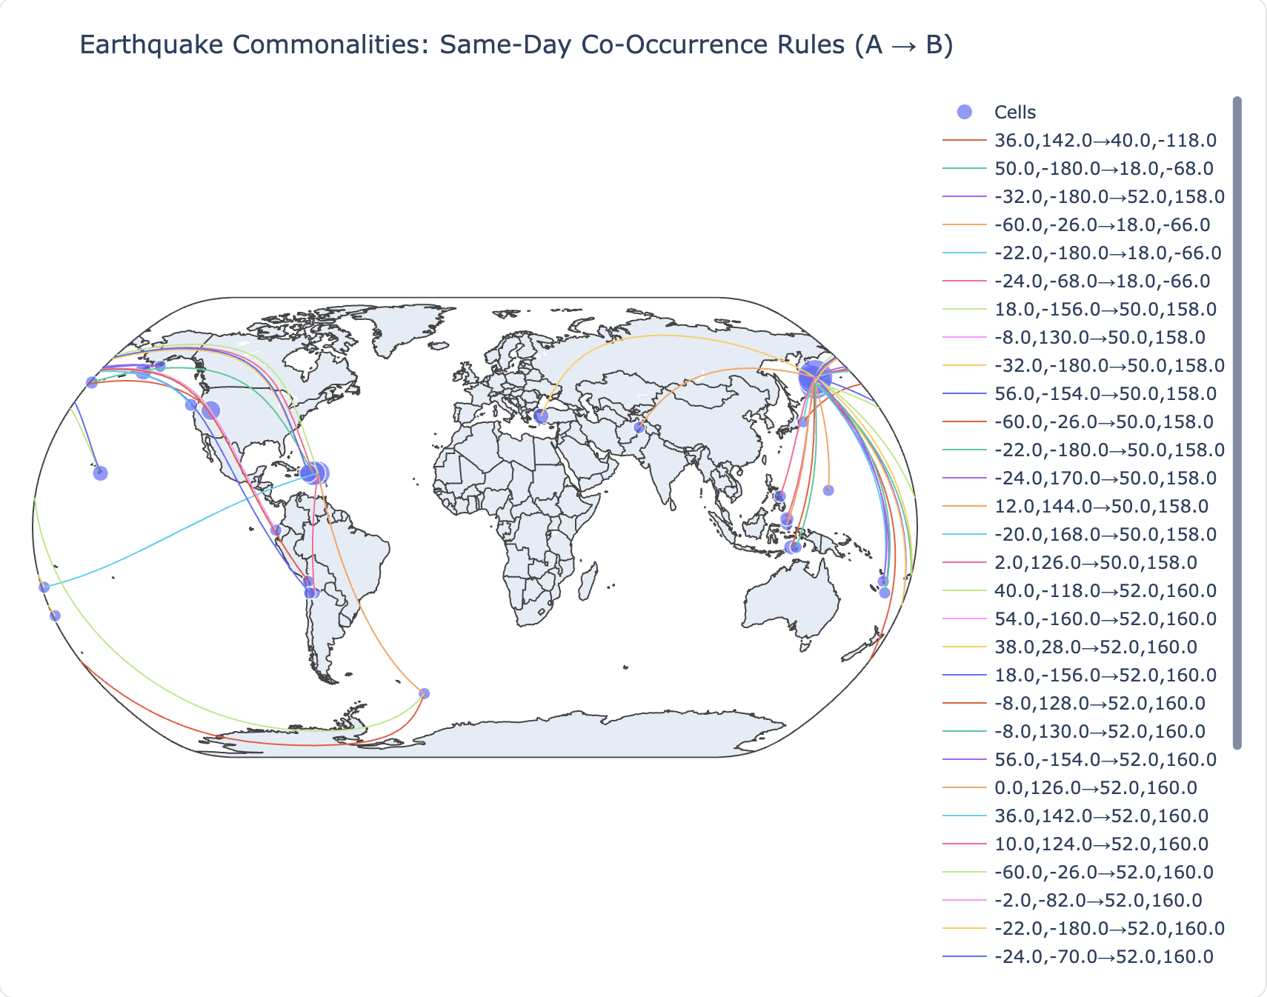
This world map shows grid cells that frequently experience earthquakes on the same day.
Arcs represent A → B rules with high confidence, revealing regions that shake together.

Slide 5
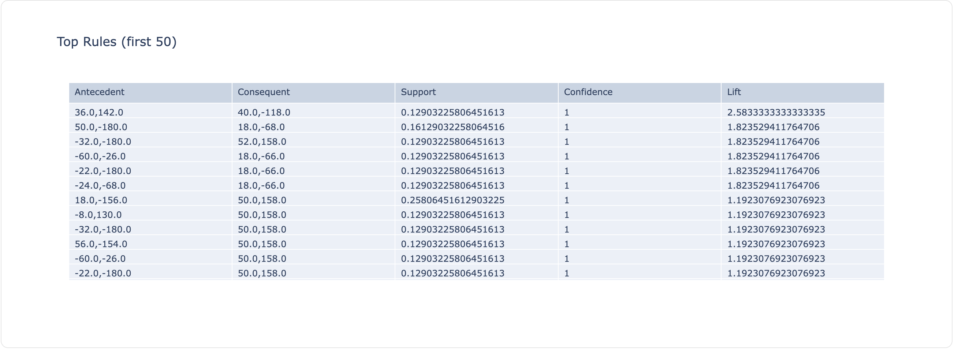
Table summarizing strongest co‑occurrence pairs:
• Support – frequency of A & B together
• Confidence – probability of B given A
• Lift – strength of relationship beyond randomness.

Slide 6

Insights
• Found regions that frequently co‑shake, suggesting tectonic connections
• High‑lift pairs identify inter‑linked fault zones

