Slide 1
Invoice Approval:
approval limits by role
REVIEWER WALKTHROUGH
One feature, taken from specification to a reviewed pull request, with the evidence around it.
Python · FastAPI
Spec Kit
Claude Code
pytest
mutmut
Playwright
Reviewer edition · Version 1.0 · 30 October 2026
Notes:
Start here. This deck explains the whole project in five parts: the feature, the architecture, how AI was used, the proof, and how to check it yourself.

Slide 2
The assignment, and what was delivered
OVERVIEW
The ask
The feature
The outcome
Add role-based approval limits to a small invoice approval service, and take it from specification to a reviewed pull request with the evidence around it: tests, mutation scores, a browser test, a review with a verdict on every finding, and a log of every AI interaction.
A Manager may approve up to 50,000.00. A Director may approve up to 500,000.00. Above that, two different approvers are needed and the second must be a Director. A refused attempt returns a clear reason and changes nothing.
177 unit tests and 1 browser test pass. Mutation score rose from 63.9% to 100%. 11 review findings each have a verdict. Every AI interaction is logged with 27 fixed keys.
Stack: Python 3.13 · FastAPI · pytest · mutmut 3.8 · Playwright · Spec Kit · Claude Code (Sonnet 5.5)
The original demo is ASP.NET Core. With no .NET SDK available and Python as the requirement, the backend was ported to FastAPI with the same layering, endpoints and web UI, and the 7 original tests were kept green before any feature work.
Invoice Approval · Approval limits by role
2
Notes:
State the three things: the ask, the feature, the outcome. Mention the port from C# to Python once and move on.

Slide 3
Results at a glance
OVERVIEW
177
100%
1
Backend tests pass
Mutation score
Browser test passes
63 policy, 62 service, 36 API, 16 repository contract
132 of 132 mutants killed; the baseline was 63.9% (23 of 36)
Manager is refused on an over-limit invoice, the reason is shown, the invoice stays pending
11
27
5
Review findings
Keys on every log line
Project agents
6 fixed, 3 dismissed with a reason, 2 deferred and tracked
Prompt, tools, sub-agents, AI suggestion, human decision, verification, status
spec-writer, implementer, test-reviewer, pr-reviewer, mutation-analyst
Invoice Approval · Approval limits by role
3
Notes:
Every number on this slide can be re-run; the commands are on the 'Check it yourself' slide.

Slide 4
The feature
01
What the rules are, the decisions behind them, and the life of an invoice.

Slide 5
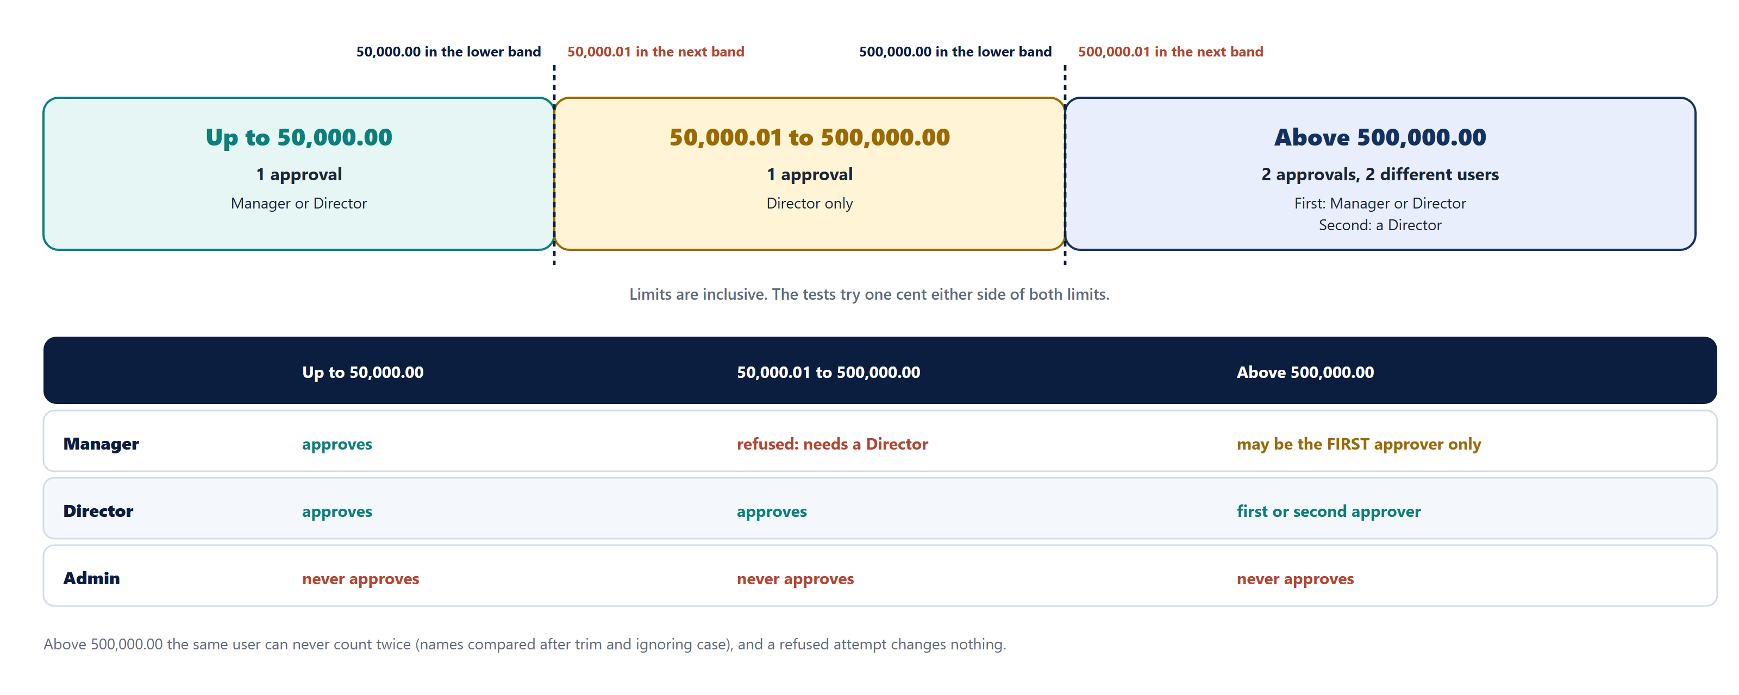
Who may approve what
THE FEATURE
Invoice Approval · Approval limits by role
5
Notes:
Read the three bands left to right. The dashed lines are the two limits; the cent either side is tested. Then the table: Manager first approver only above 500,000; Director any; Admin never.

Slide 6
Decisions made, and why
THE FEATURE
1
Limits are inclusive
2
First approver above 500,000
3
"The same user"
50,000.00 is allowed for a Manager; 50,000.01 needs a Director. Same at 500,000. Tests try one cent either side.
A Manager or a Director. Only the second approver is constrained: it must be a Director.
The same account after trimming spaces and ignoring case, so Dir.One and dir.one are one person.
4
Admin cannot approve
5
A refusal is not a Reject
6
Nothing changes on refusal
Admin keeps reject and delete, never approval. The old Approver role became Manager.
"Rejected attempt" means an approval the rules refuse: 403 with a reason, nothing written. The Reject button is unchanged.
Every check runs before the first change, so there is no half-done state to clean up.
Invoice Approval · Approval limits by role
6
Notes:
These are the specification's clarifications; each became a test.

Slide 7
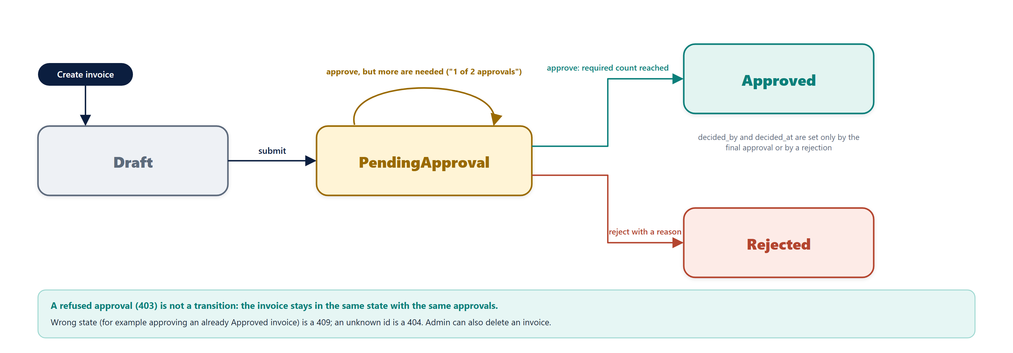
The life of an invoice
THE FEATURE
Invoice Approval · Approval limits by role
7
Notes:
Draft, Pending, then Approved or Rejected. A refused approval is not a transition. Only the final approval sets decided_by and decided_at.

Slide 8
Architecture
02
Where each responsibility lives, how one request flows, and the design principles behind it.

Slide 9
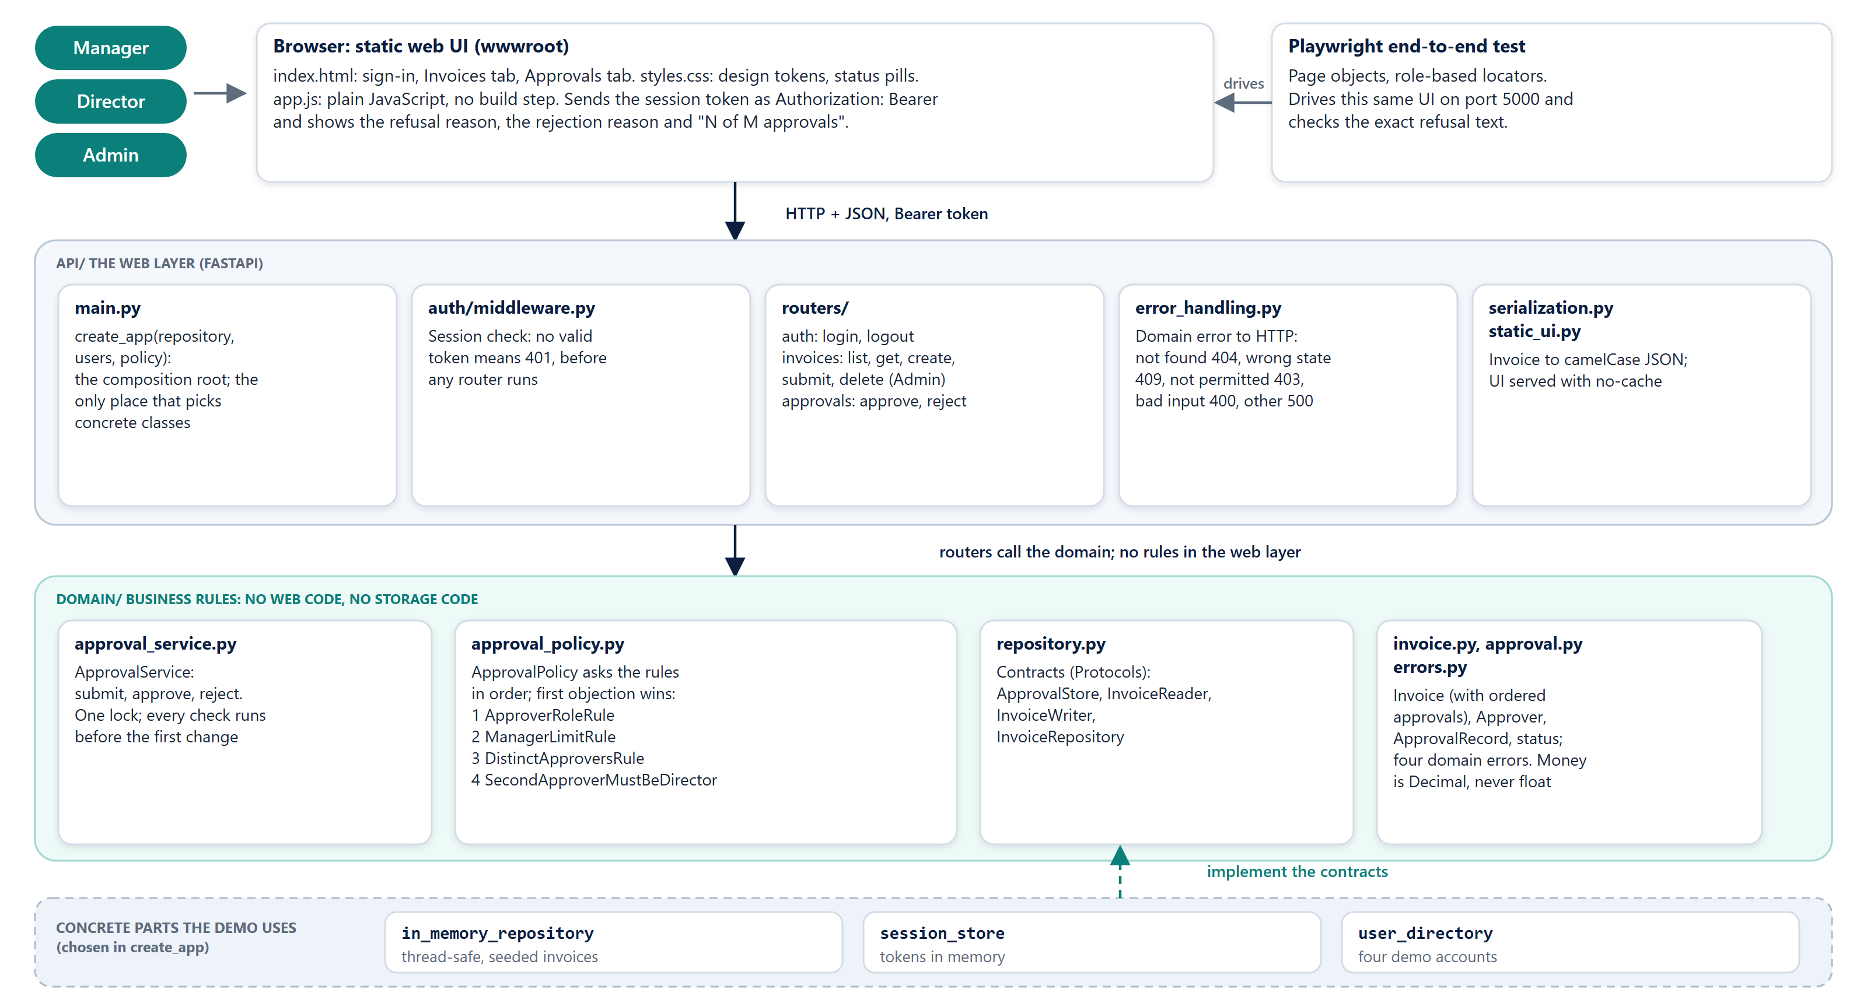
System architecture
ARCHITECTURE
Invoice Approval · Approval limits by role
9
Notes:
Top to bottom: the browser, the web layer, the domain. The domain has no web or storage code. create_app is the only place that chooses concrete classes.

Slide 10
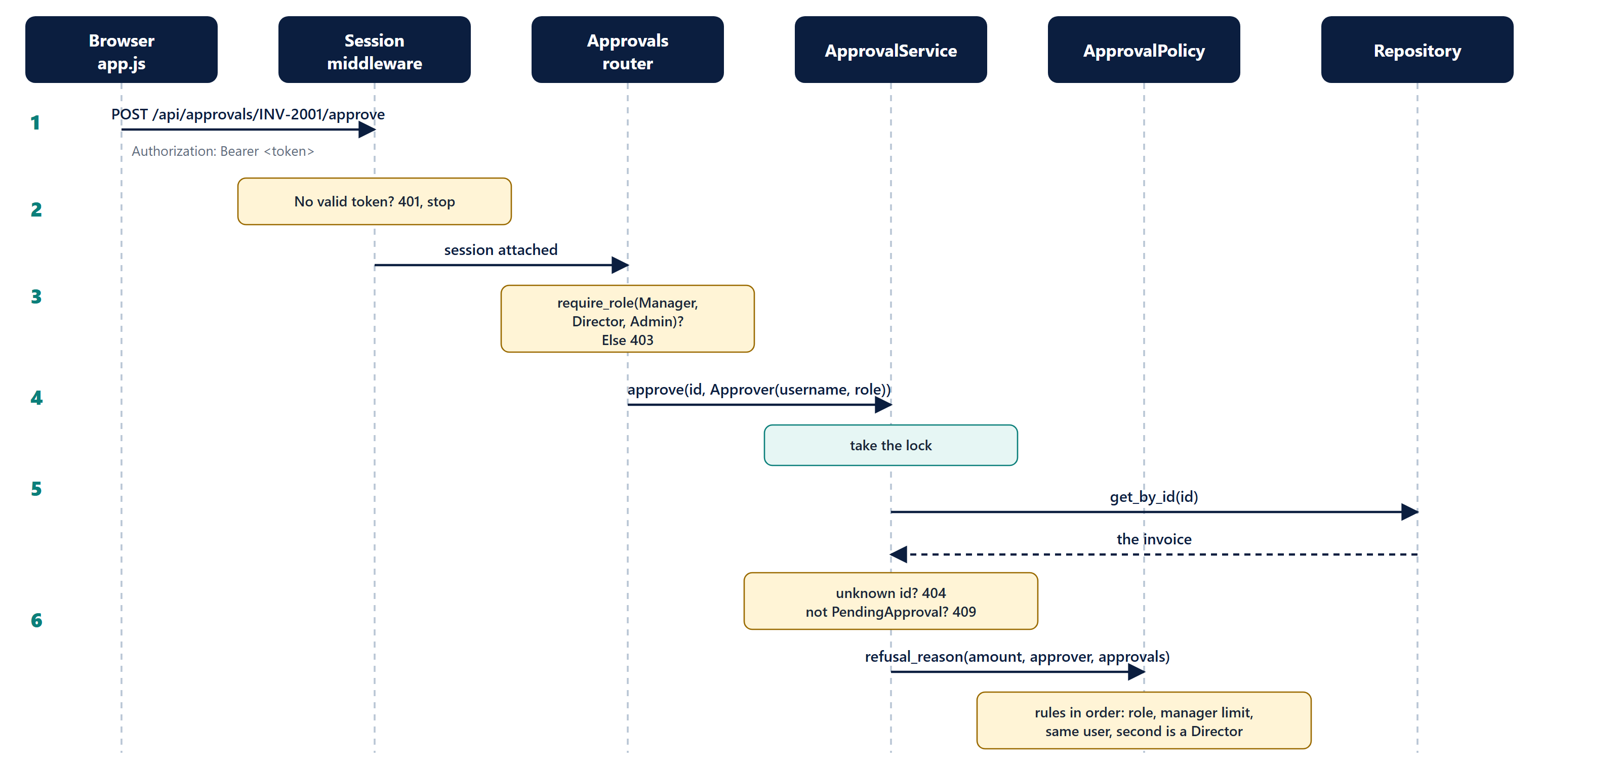
One approval request: the checks
ARCHITECTURE
Invoice Approval · Approval limits by role
10
The session is checked first (401), then the role (403), then the service takes a lock, loads the invoice (404, 409) and asks the policy.
Notes:
Follow the numbered steps down. Nothing has been changed yet at this point.

Slide 11
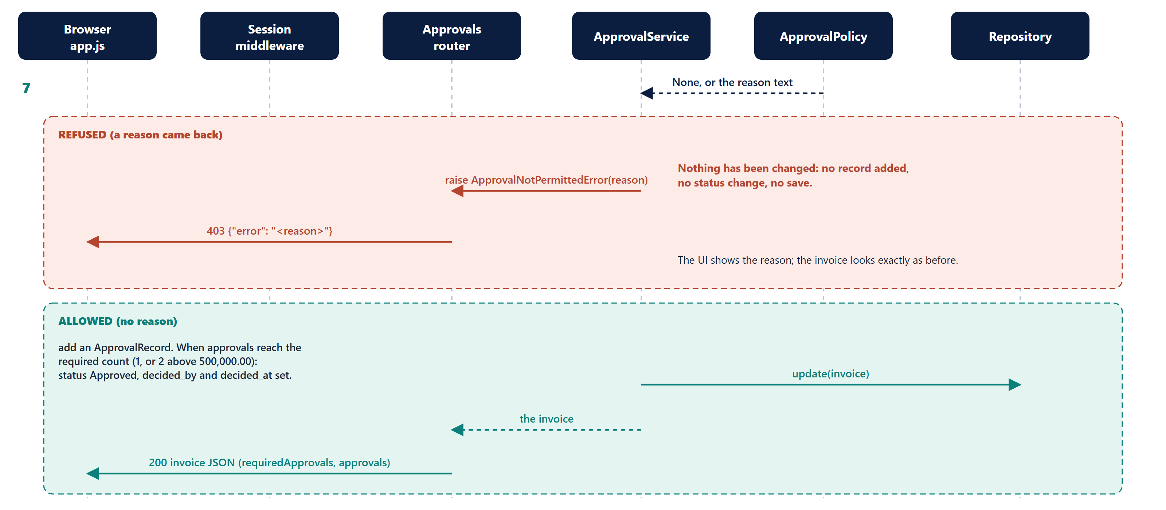
One approval request: refused or allowed
ARCHITECTURE
Invoice Approval · Approval limits by role
11
Notes:
The red box is the refusal path: the exception is raised before anything is written. The green box is the success path.

Slide 12
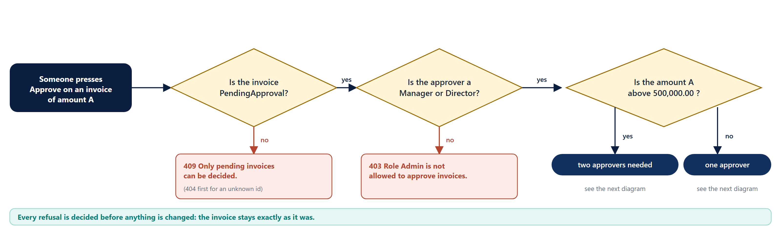
The approval rules: three gates
ARCHITECTURE
Rules run in a fixed order: state, role, Manager limit, same user, second must be a Director.
The first objection wins and its text is the reason shown to the user.
Each red box is a real message from the code and is asserted word for word in a test.
Invoice Approval · Approval limits by role
12
Notes:
The same flow as the code in approval_policy.py. Each rule is its own small class.

Slide 13
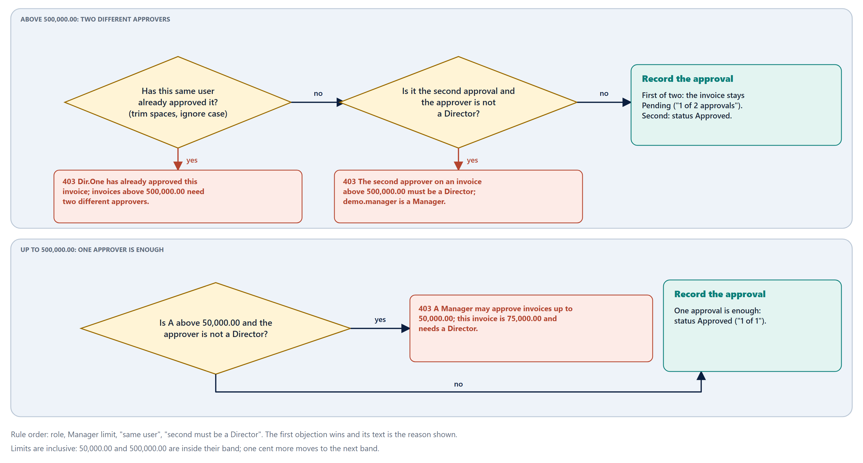
The approval rules: one approver or two
ARCHITECTURE
Invoice Approval · Approval limits by role
13
Notes:
Above 500,000 the same-user and second-must-be-a-Director rules apply; up to 500,000 only the Manager limit does.

Slide 14
Design: the SOLID principles, with proof
ARCHITECTURE
Principle
What changed
Proof
Single responsibility
main.py was split into wiring, error mapping and the session check; each approval rule is its own class.
Each file has one job; every rule class has its own tests.
Open / closed
Four rule classes plus an ApprovalPolicy that asks them in order; limits are data. A new rule is a new class.
test_a_new_rule_plugs_into_the_policy_without_changing_the_existing_rules
Liskov substitution
One contract test suite runs against the fake repository and the real one.
test_repository_contract.py (16 tests)
Interface segregation
The approval service needs two operations, so it takes an ApprovalStore, not the six-method repository.
test_the_service_works_with_a_store_that_offers_only_find_and_save
Dependency inversion
The service takes a policy and a clock as arguments; login uses a UserDirectory; create_app accepts replacements.
Tests inject a stub policy, a fixed clock and a one-user directory.
Behaviour did not change: all 134 earlier tests passed unchanged, 43 were added, and mutation stayed at 100%.
Invoice Approval · Approval limits by role
14
Notes:
Detail: docs/guides/19-solid-design.md

Slide 15
Key design decisions
ARCHITECTURE
Decision
Choice
Why
Money
Decimal, never float
Exact comparison at 50,000.00 and 50,000.01.
Refusal signal
ApprovalNotPermittedError mapped to 403
Distinct from 409 (wrong state), 404 and 400 (bad input).
No partial writes
Check first, then change
The in-memory repository returns the live object, so changing first would leak state.
Atomic approvals
One lock in ApprovalService
Two clicks by one user could both pass the duplicate check (finding F1).
Same user
strip().casefold()
Stops Dir.One versus dir.one slipping through.
Amount input
gt=0, max_digits=14, decimal_places=2
Rejects 1e999999, NaN and sub-cent values (findings F2, F3).
Unexpected errors
500 with no detail
Only DomainValidationError maps to 400 (finding F5).
Invoice Approval · Approval limits by role
15
Notes:
Full table: docs/guides/03-architecture-and-design.md

Slide 16
Built with AI, in the open
03
The context file, agents, skills, hooks, the specification and the commit plan, and how each one shows up as evidence.

Slide 17
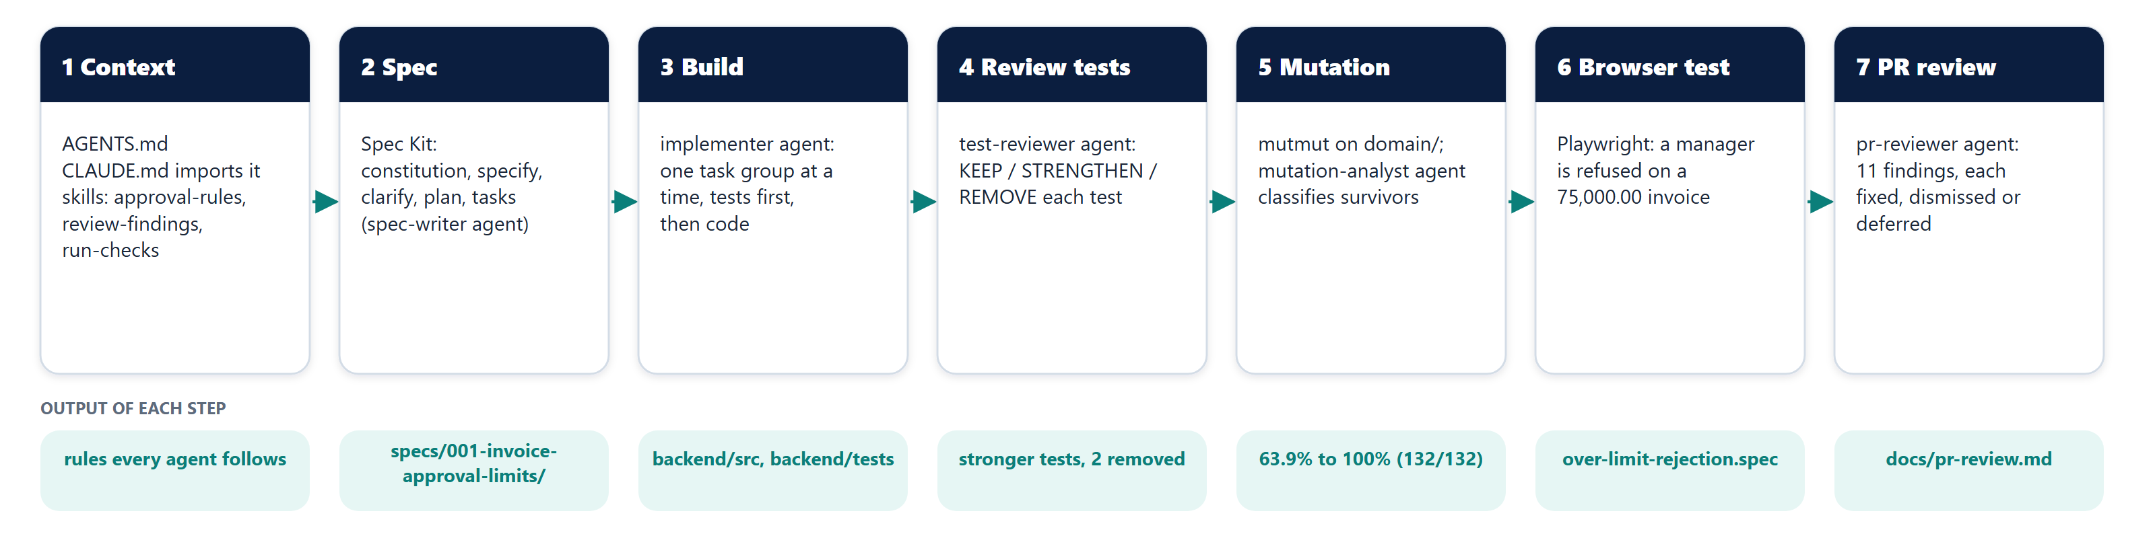
The workflow, from context to reviewed PR
AI IN THE LIFECYCLE
Each step leaves evidence in the repository: rules, specification, code and tests, stronger tests, scores, a browser test, a reviewed PR.
Agents are read-only wherever they judge work (test-reviewer, pr-reviewer, mutation-analyst); only spec-writer and implementer may write.
Invoice Approval · Approval limits by role
17
Notes:
The seven steps left to right, with the output of each underneath.

Slide 18
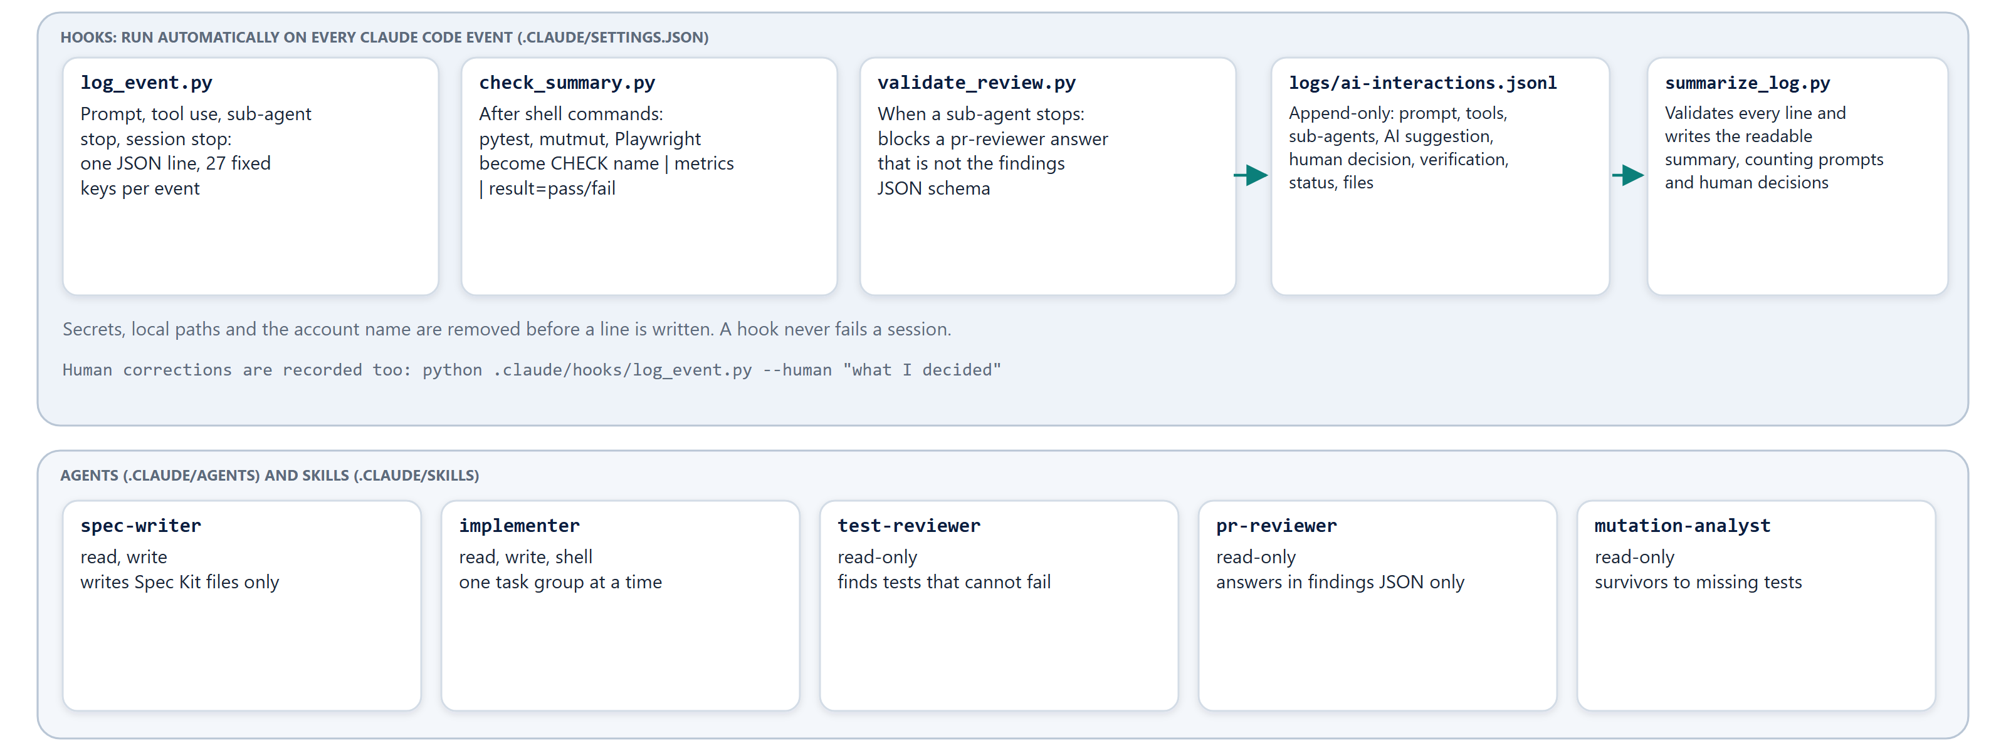
Hooks write the log; agents do the work
AI IN THE LIFECYCLE
Invoice Approval · Approval limits by role
18
Notes:
Hooks run automatically on every event and write the log. The lower lane lists the five agents.

Slide 19
Context matters: AGENTS.md
AI IN THE LIFECYCLE
Same prompt, two agents
What AGENTS.md holds
The approval rules table with inclusive limits; layering (rules only in domain/); the exact commands for tests, mutation and the browser test; review expectations (one verdict per finding); a Never list.
Aspect
Without
With AGENTS.md
Boundaries
Whole units: 49,999 / 50,001
One cent: 50,000.00 / .01
Same user
Same name only
Trimmed, case-folded
Why a file, not a prompt
Admin
Not mentioned
Never approves
It is read at the start of every session and by every sub-agent, so each step starts from the same rules without repeating them.
Test command
"Find it in the build files"
The real commands
Findings
Fix, decline or ask
Fixed, dismissed or deferred
One run per arm, and AGENTS.md contains part of the answer by design: read it as an illustration, not a benchmark.
Invoice Approval · Approval limits by role
19
Notes:
Experiment details: ASSIGNMENT.md section 7

Slide 20
Agents and skills, and what each one caught
AI IN THE LIFECYCLE
Role
Access
Job
What it produced here
spec-writer
read, write
Writes Spec Kit files only
Spec with 7 clarifications, plan, research, data model, contract, 25 tasks
implementer
read, write, shell
One task group at a time, tests first
Single-approver limits, then the two-approver rule
test-reviewer
read-only
Finds tests that cannot fail
Weak state tests, 2 duplicates, a fake that hid missing saves, 14 missing cases
mutation-analyst
read-only
Classifies surviving mutants
16 survivors, all missing tests (none equivalent); the tests to add
pr-reviewer
read-only
Answers only in the findings JSON format
11 findings, two reproduced against the running code
Skills
loaded on demand
approval-rules, review-findings, run-checks
One source for the rules, the verdict vocabulary and the exact check commands
Invoice Approval · Approval limits by role
20
Notes:
Files: .claude/agents and .claude/skills

Slide 21
Hooks and the interaction log
AI IN THE LIFECYCLE
log_event.py
check_summary.py
validate_review.py
Runs on prompt, tool use, sub-agent stop and session stop. Appends one JSON line with 27 fixed keys. Redacts secrets, local paths and the account name.
Runs after shell commands. Turns pytest, mutmut and Playwright output into CHECK name | metrics | result=pass/fail so every run is comparable.
Runs when a sub-agent stops. Blocks a pr-reviewer answer that is not the findings JSON schema.
The 27 keys of every line in logs/ai-interactions.jsonl
id, timestamp, session, stage, event, agent, agent_name, agent_type, ai_tool, model, mode, related_ids, parent_task, context, request, summary, skills_used, subagents_used, mcp_tools_used, tools_used, suggestion, human_decision, action_verification, limitation, status, artifacts, source
A prompt gets an id; every later action carries it in parent_task, so each edit, command and check traces back to the request that caused it. python scripts/summarize_log.py validates every line and writes the readable summary.
Invoice Approval · Approval limits by role
21
Notes:
Detail: docs/guides/10-ai-workflow-guide.md

Slide 22
Spec Kit: the specification comes first
AI IN THE LIFECYCLE
1
Constitution
2
Specify
3
Clarify
4
Plan
5
Tasks
6 principles: rules in the domain, test-first with negative cases, boundaries both sides, refusals explain themselves.
3 user stories with acceptance scenarios and the exact feature text.
7 questions answered in writing: inclusive limits, first approver, same user, Admin.
Plan, research, data model and the approvals API contract.
T001 to T025 in 5 phases; tests before code for each story.
›
›
›
›
What is in the folder
spec.md plan.md research.md data-model.md quickstart.md tasks.md
contracts/approvals-api.md checklists/requirements.md .specify/memory/constitution.md
Honest note
Spec Kit was installed with specify init; the spec, plan and tasks follow its templates and were written by the assistant directly rather than by running the /speckit-* commands one by one.
Invoice Approval · Approval limits by role
22
Notes:
Files: specs/001-invoice-approval-limits/ and .specify/

Slide 23
Built in small steps: the commit plan
AI IN THE LIFECYCLE
#
Commit
Why it stands alone
1
Port backend from ASP.NET Core to Python/FastAPI (behaviour-identical)
No .NET SDK; keeps the 7 original tests green before any feature
2
Add AGENTS.md rules, skills, sub-agents and AI-interaction logging hooks
The context every later step relies on
3
Add Spec Kit specification, plan and tasks for approval limits
The agreed behaviour, before code
4
Enforce Manager and Director approval limits
Single-approver rules, tests first
5
Require two distinct approvers, second a Director, above 500,000
Approvals list, duplicate-user and second-approver rules
6
Add Playwright test for a refused over-limit approval and approval progress in the UI
The browser-level proof
7
Fix PR review findings
Atomic approvals, amount validation, narrower 400 mapping, strict tests
Invoice Approval · Approval limits by role
23
Notes:
Source: ASSIGNMENT.md section 5

Slide 24
Proof that it works
04
Test layers, the two negative rules, mutation scores, the browser test and the pull-request review.

Slide 25
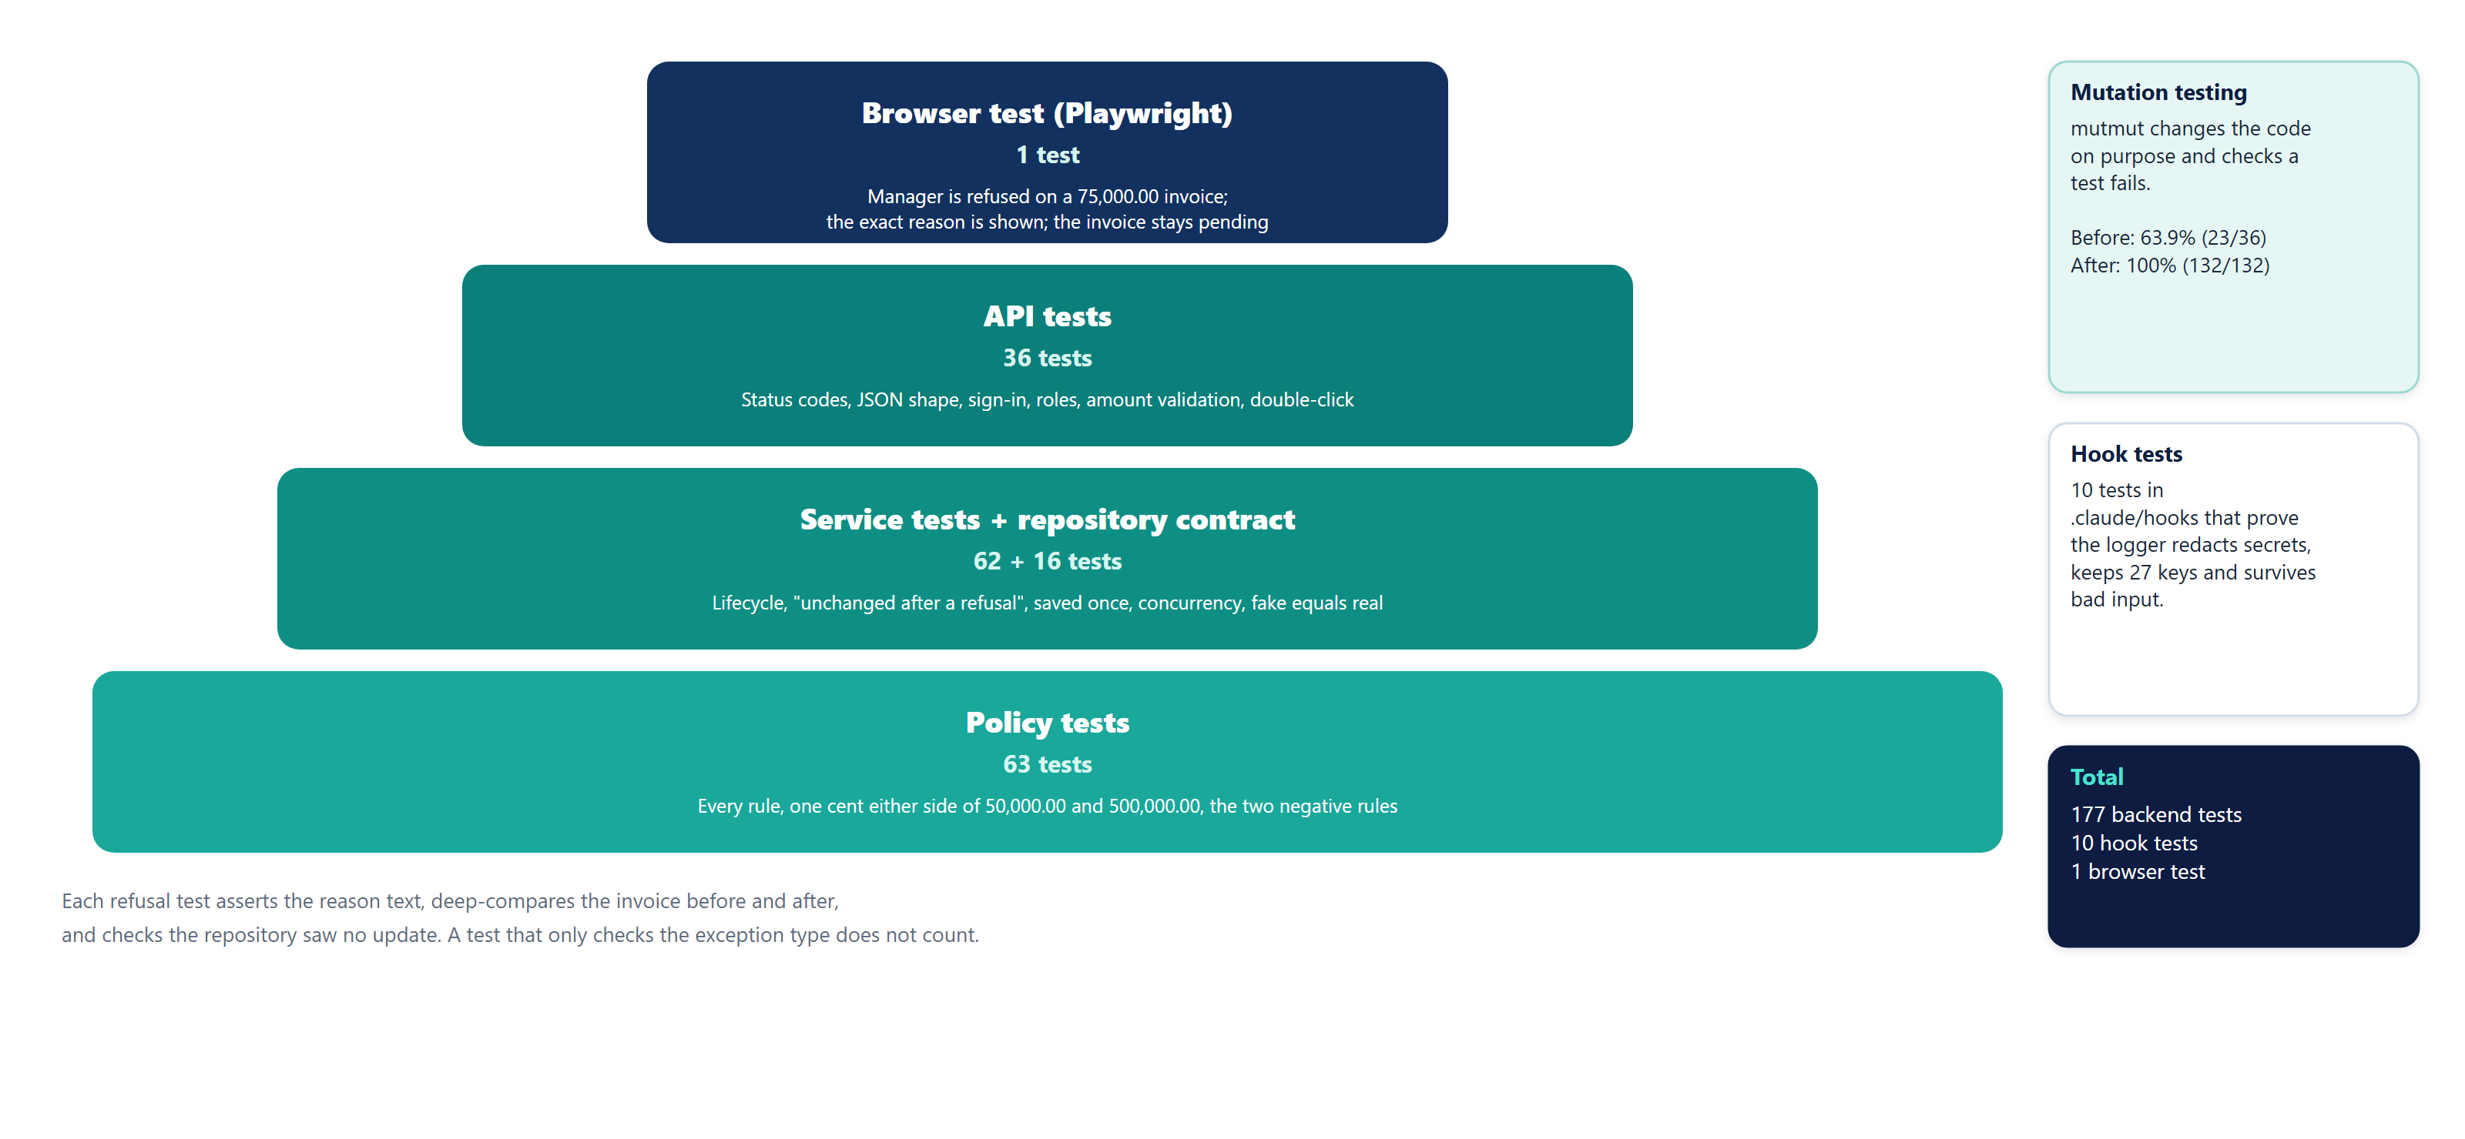
The test layers
PROOF
Invoice Approval · Approval limits by role
25
Notes:
Policy tests at the base, API tests above, one browser test at the top. Mutation testing judges the unit tests; hook tests protect the logger.

Slide 26
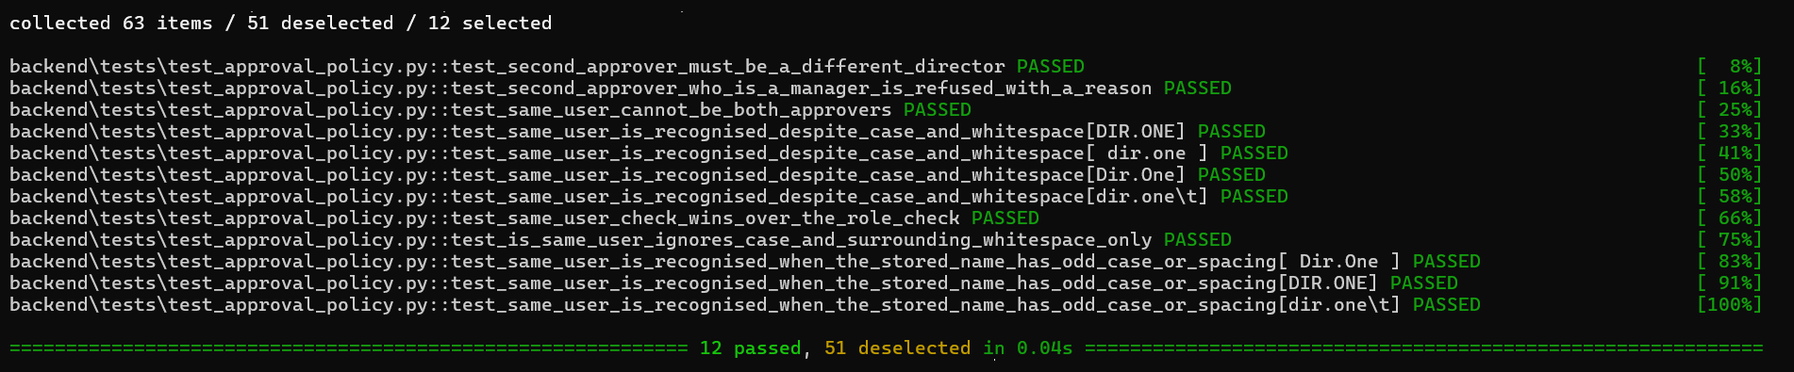
The two negative rules, tested properly
PROOF
Same user twice is refused
A Manager cannot be the second approver
A refusal changes nothing
Including Dir.One versus dir.one , with the duplicate on the new or the stored side.
Each test compares a deep copy before and after, asserts the exact reason text, and checks the repository saw no update.
Above 500,000 a Manager may only be first; a Director must give the second approval.
Invoice Approval · Approval limits by role
26
Notes:
Command: python -m pytest backend/tests/test_approval_policy.py -v -k "same_user or second_approver"

Slide 27
Mutation testing: from 63.9% to 100%
PROOF
Baseline
63.9%
Final mutation run
ported code, 7 tests: 23 of 36
132 / 132
First pass
81.2%
feature + 75 tests: 69 of 85
Killed: 132 Survived: 0
Timeout: 0 Other: 0
Mutation score: 100.0%
After
100%
134 tests: 86 of 86
After SOLID refactor
100%
132 of 132
The mutant count rises from 36 to 132 because the scope grew (new rule files), so compare the kill rate, not the counts.
Mutation testing measured the domain unit tests only; the API tests are not in the run.
A mutant that survives means a change to the code went unnoticed by every test.
16 survivors after the first pass were all missing tests: a fake that never saved, unasserted timestamps and messages.
The refactor left one survivor (99.2%): a > that an earlier rule had been hiding. A boundary test per rule closed it.
Invoice Approval · Approval limits by role
27
Notes:
Tool: mutmut 3.8 on the domain package (WSL). Reports: docs/mutation/

Slide 28
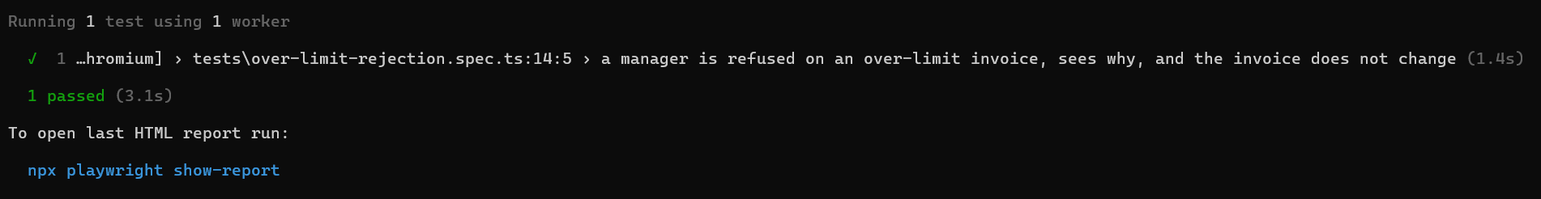
Browser test: one refusal, end to end
PROOF
cd e2e; npx playwright test --headed; cd ..
What the test does
How it is written
Signs in as demo.manager, creates its own 75,000.00 invoice, submits it, presses Approve on the Approvals tab, and expects the exact text A Manager may approve invoices up to 50,000.00; this invoice is 75,000.00 and needs a Director. The invoice must stay Pending Approval in both the list and the table. It then deletes the invoice, so the server is left as it was.
Page objects (LoginPage, InvoicesPage, ApprovalsPage) and role-based locators (getByRole, getByLabel); no CSS or XPath selectors.
Invoice Approval · Approval limits by role
28
Notes:
Command: cd e2e && npx playwright test --headed

Slide 29
Reviewing the PR: 11 findings, each with a verdict
PROOF
6
Finding
Verdict
How it was settled
F1 (high) approvals not atomic
fixed
Lock around submit/approve/reject; threaded tests fail without it
fixed
F2 (high) 1e999999 breaks the list
fixed
Amount validated at the API; invalid input never stored
F4 float() loses precision
dismissed
Input now bounded; every limit round-trips exactly to the cent
3
F9 roles matched exactly
dismissed
Roles come from the server; failing closed is intended and pinned by a test
F7 no two-Director UI test
deferred
Tracked as T024; the flow is covered at API level
dismissed
F11 tokens never expire
deferred
Pre-existing demo auth; tracked as T025
2
deferred
The test-reviewer pass raised 14 further gaps in the tests themselves; all were acted on or consciously declined (see the report).
Invoice Approval · Approval limits by role
29
Notes:
Full table with reasons: docs/pr-review.md

Slide 30
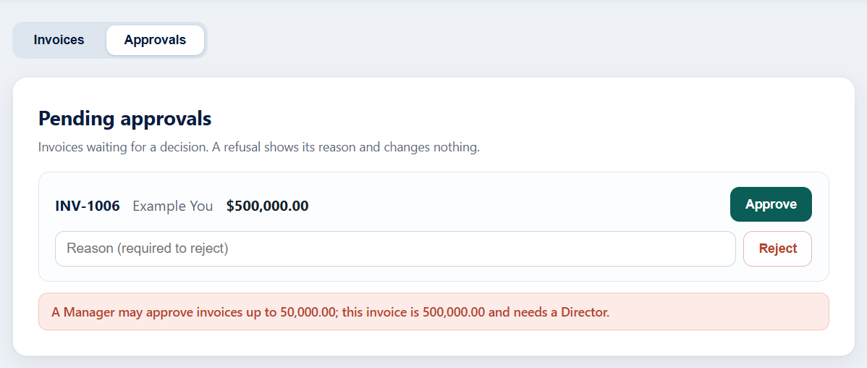
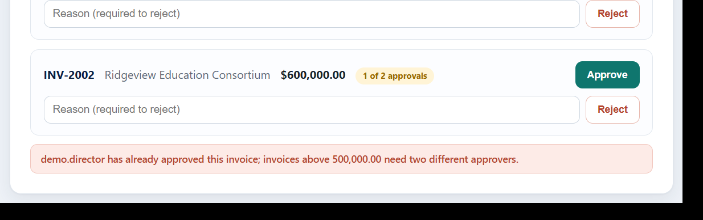
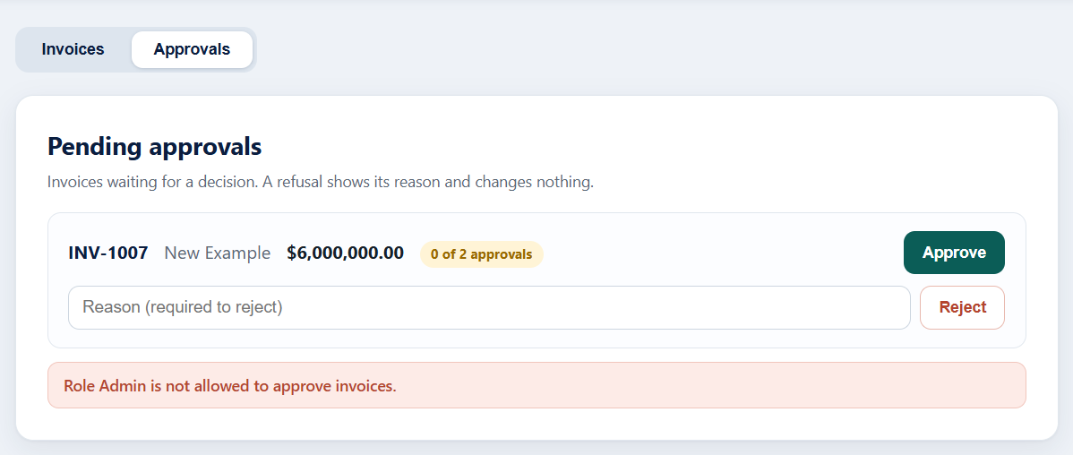
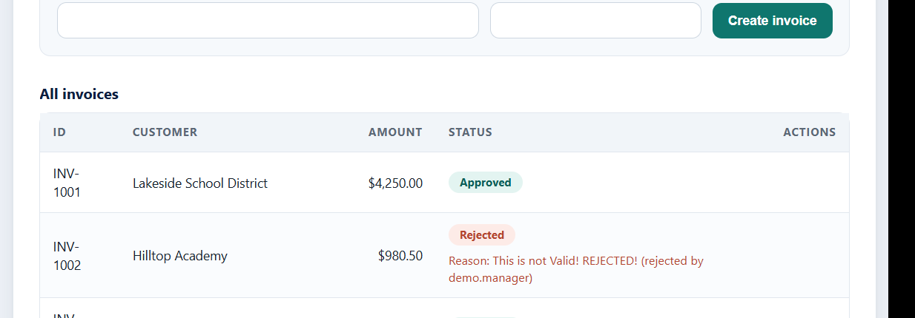
The application in action
PROOF
A Manager is refused above 50,000.00, with the reason
The same Director cannot approve twice above 500,000.00
Admin may look, but can never approve
A rejection shows who rejected it and why
Invoice Approval · Approval limits by role
30

Slide 31
For the reviewer
05
Where every hand-in item lives, how to check it yourself in minutes, and what is honestly left open.

Slide 32
Hand-in checklist: where each item is
FOR THE REVIEWER
#
Item
Where to look
Status
1
Pull request, 3 or more standalone commits
Commit plan in ASSIGNMENT.md section 5 (7 commits)
Made by the author
2
Updated AGENTS.md
AGENTS.md; imported by CLAUDE.md
In the repository
3
Spec files
specs/001-invoice-approval-limits/, .specify/
In the repository
4
Unit tests incl. both negative rules
backend/tests/ (177 tests)
Passing
5
One Playwright test: rejected over-limit approval
e2e/tests/over-limit-rejection.spec.ts
Passing
6
Mutation scores before and after, as text
ASSIGNMENT.md section 3; docs/mutation/*.txt
63.9% to 100%
7
PR description with a verdict on every finding
docs/pr-review.md (11 findings)
Ready to paste
8
Log of all AI interaction
logs/ai-interactions.jsonl and its summary
Validated
9
ASSIGNMENT.md with write-up and video link
ASSIGNMENT.md
Link added after recording
10
8 to 10 minute demo video
Recorded and linked by the author
Made by the author
Invoice Approval · Approval limits by role
32
Notes:
Details: docs/guides/16-submission-checklist.md

Slide 33
Check it yourself in five minutes
FOR THE REVIEWER
1
Install
pip install -e "backend[dev]"
once
2
Unit tests
python -m pytest backend/tests -q
177 passed
3
Run the app
python -m uvicorn invoice_app.api.main:app --app-dir backend/src --port 5000
http://localhost:5000
4
Browser test
cd e2e; npm install; npx playwright install chromium; npm test
1 passed
5
Mutation
wsl -d Ubuntu-22.04 -- bash scripts/run_mutation.sh check
100.0% in about 13 s
6
AI log
python scripts/summarize_log.py
validates every line
Demo accounts (local only): demo.manager, demo.director, demo.director2, demo.admin. Password ChangeMe123!. Try INV-2001 (75,000.00) and INV-2002 (600,000.00).
Invoice Approval · Approval limits by role
33
Notes:
Windows PowerShell; the mutation run needs WSL (Ubuntu).

Slide 34
Honest limits and what is still open
FOR THE REVIEWER
Limits of the evidence
Deferred, with tracking
Mutation testing covered the domain unit tests only. The AGENTS.md experiment was one run per arm. Early planning and the port were logged as reconstructed, not captured live. Sub-agents ran as general-purpose agents reading the agent files in the session that created them.
T024 a second Playwright spec for the two-Director flow, with a reset endpoint so UI tests that change data are repeatable. T025 session expiry and constant-time password comparison.
Left to the author
Not production
Create the pull request from the commit plan, record and link the 8 to 10 minute video, and paste the link into ASSIGNMENT.md.
Sign-in is a demo: in-memory sessions, no expiry, no throttling. The store is in memory. Both are documented and outside this feature.
Invoice Approval · Approval limits by role
34

Slide 35
Everything here can be re-run
Documentation: 23 PDF documents in docs/pdf/
Slides: docs/presentations/ (this deck and the UI walkthrough)
Rules of record: specs/001-invoice-approval-limits/spec.md
Evidence: ASSIGNMENT.md, docs/pr-review.md, docs/mutation/, logs/
Notes:
Close by pointing at the five folders. Invite the reviewer to run the unit tests first.

