Slide 1
The application,
screen by screen
USER INTERFACE WALKTHROUGH
Real screenshots of the running app: what each screen shows and which rule it proves.
Sign-in
Invoices
Approvals
Refusals
Evidence
Screen-by-screen edition · Version 1.0 · 30 October 2026
Notes:
This deck follows one realistic session: sign in, look at the invoices, try to approve, get refused, and finish an approval.

Slide 2
Four accounts, three roles
BEFORE YOU START
Account
Role
Can approve
Also can
demo.manager
Manager
Invoices up to 50,000.00
Create, submit, reject
demo.director
Director
Up to 500,000.00 alone; above that as first or second approver
Create, submit, reject
demo.director2
Director
The same as demo.director: a second, different person
Create, submit, reject
demo.admin
Admin
Nothing: Admin never approves
Create, submit, reject, delete
Password for all four: ChangeMe123! (local demo only).
INV-2001 · 75,000.00
INV-2002 · 600,000.00
Needs one Director. A Manager is refused.
Needs two different approvers, the second a Director.
Invoice Approval · Approval limits by role
2

Slide 3
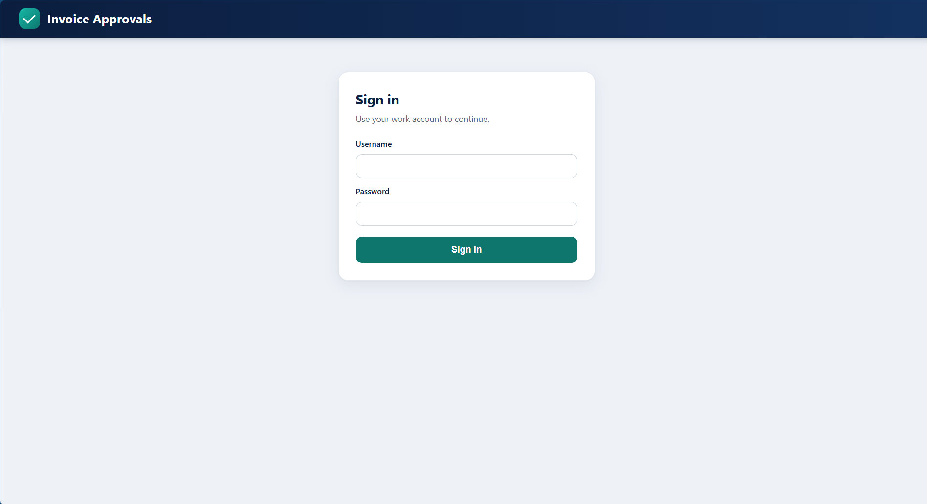
The sign-in screen
SIGN-IN
Not signed in
What you see
Only a sign-in card is shown; there is no Sign out button and no invoice data.
Every part of the app is behind sign-in: the server answers 401 to anything else.
Username and password; one button.
What it proves
Nothing is visible before sign-in, and the page does not pretend you are signed in (a bug where Sign out showed here was found and fixed).
Invoice Approval · Approval limits by role
3
Notes:
The first screen. Point out there is no Sign out button and no data.

Slide 4
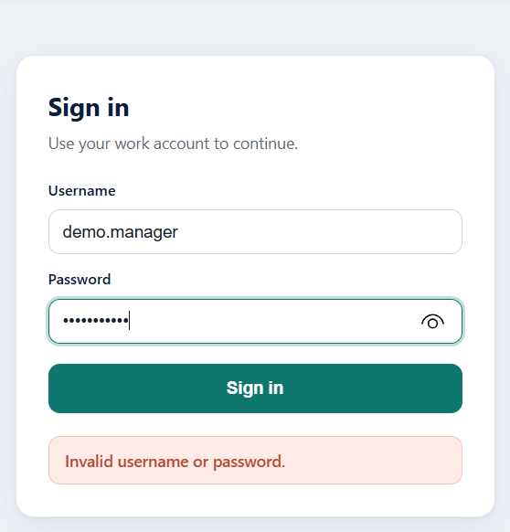
A wrong password is refused
SIGN-IN
Not signed in
What you see
The message Invalid username or password. appears in a red notice under the button.
It does not say which of the two was wrong.
The password field is masked.
What it proves
Sign-in failures are generic by design, so the form cannot be used to find out which usernames exist.
Invoice Approval · Approval limits by role
4

Slide 5
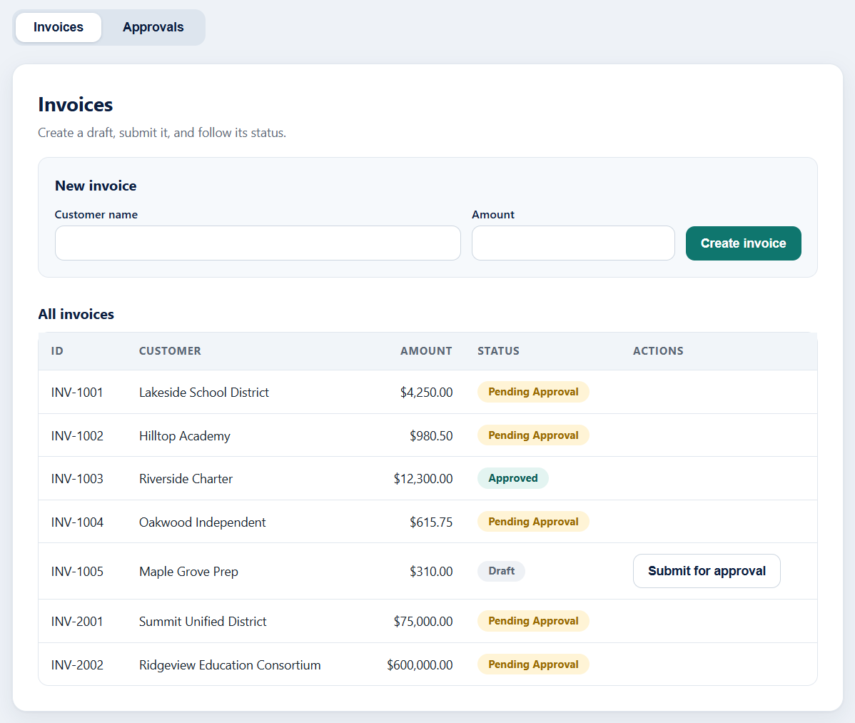
The Invoices tab
INVOICES
Signed in as demo.manager (Manager)
What you see
A New invoice form (customer name, amount) and the All invoices table.
Status pills: Pending Approval (amber), Approved (teal), Draft (grey), Rejected (red).
A Draft invoice has a Submit for approval button.
INV-2001 (75,000.00) and INV-2002 (600,000.00) are the invoices built to try the rules.
What it proves
The seed data covers every status, so each rule can be tried without creating anything first.
Invoice Approval · Approval limits by role
5

Slide 6
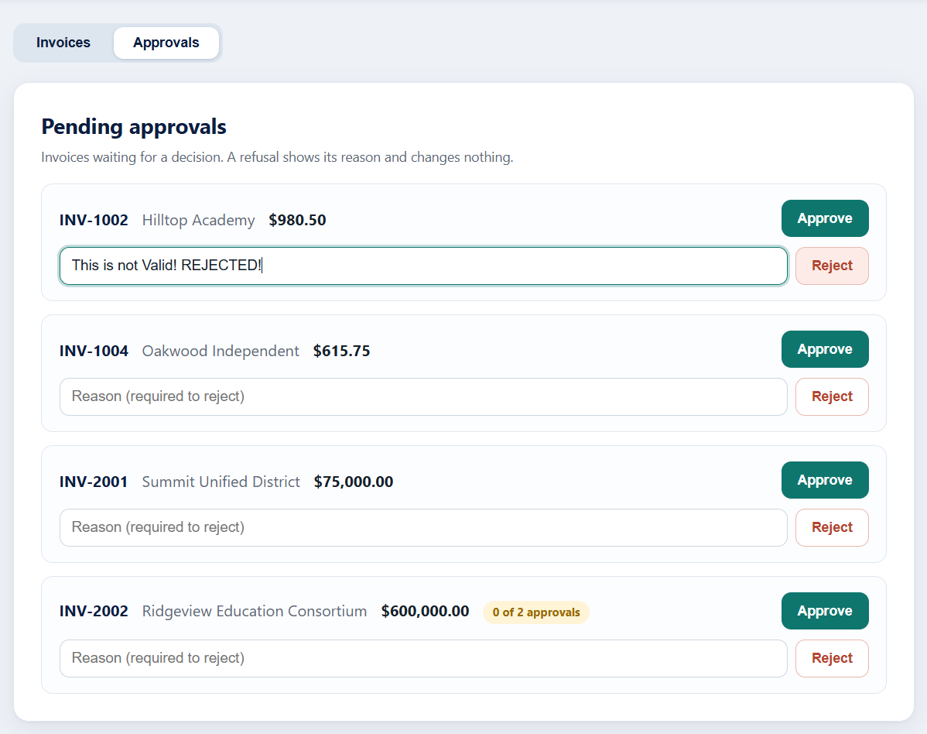
Rejecting needs a reason
APPROVALS
Signed in as demo.manager (Manager)
What you see
The Approvals tab lists every invoice waiting for a decision.
Each card has Approve, a reason box and Reject.
A reason has been typed for INV-1002.
INV-2002 shows 0 of 2 approvals: it needs two people.
What it proves
Reject is a different action from a refused approval: it ends the invoice, and it requires a reason that is stored and shown later.
Invoice Approval · Approval limits by role
6

Slide 7
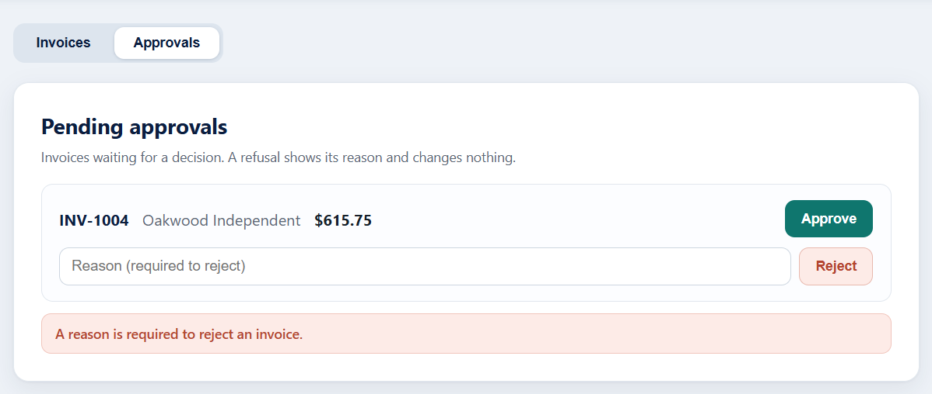
Reject without a reason is refused
APPROVALS
Signed in as demo.director2 (Director)
What you see
Reject was pressed with the reason box empty.
A red notice says A reason is required to reject an invoice.
INV-1004 is still in the list: nothing was changed.
What it proves
A missing reason is bad input (HTTP 400). It is caught before the invoice is touched.
Invoice Approval · Approval limits by role
7

Slide 8
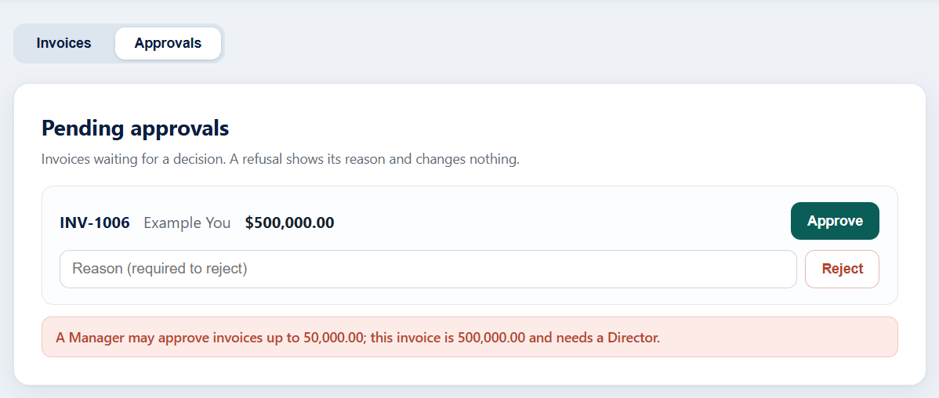
A Manager is refused above 50,000.00
THE RULES
Signed in as demo.manager (Manager)
What you see
Approve was pressed on INV-1006, 500,000.00.
The reason is shown in full: A Manager may approve invoices up to 50,000.00; this invoice is 500,000.00 and needs a Director.
The invoice is still waiting; the Approve button is still there.
What it proves
The limit is enforced by role, the user is told exactly why, and a refusal changes nothing. This is the screen the browser test checks.
Invoice Approval · Approval limits by role
8
Notes:
This is the key screen of the assignment: the refusal reason and the unchanged invoice.

Slide 9
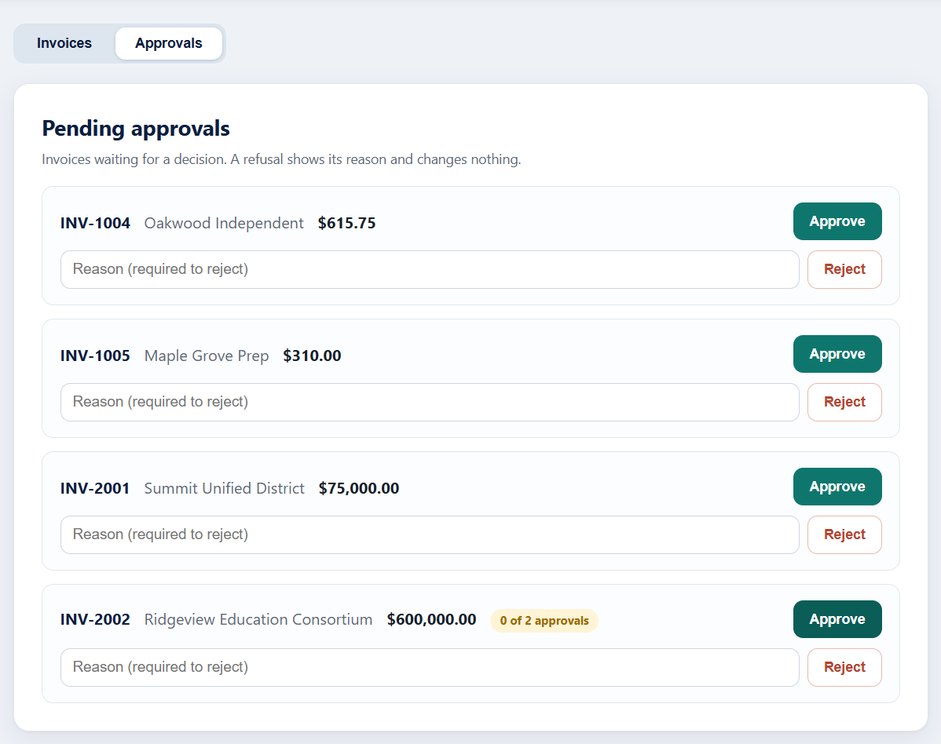
A Director sees the larger invoices
THE RULES
Signed in as demo.director (Director)
What you see
The same list, signed in as a Director.
INV-2001 (75,000.00) can be approved here; INV-2002 is still 0 of 2 approvals.
The header shows who is signed in and their role.
What it proves
Between 50,000.01 and 500,000.00 one Director is enough. Above 500,000.00 the first approval only moves the counter.
Invoice Approval · Approval limits by role
9

Slide 10
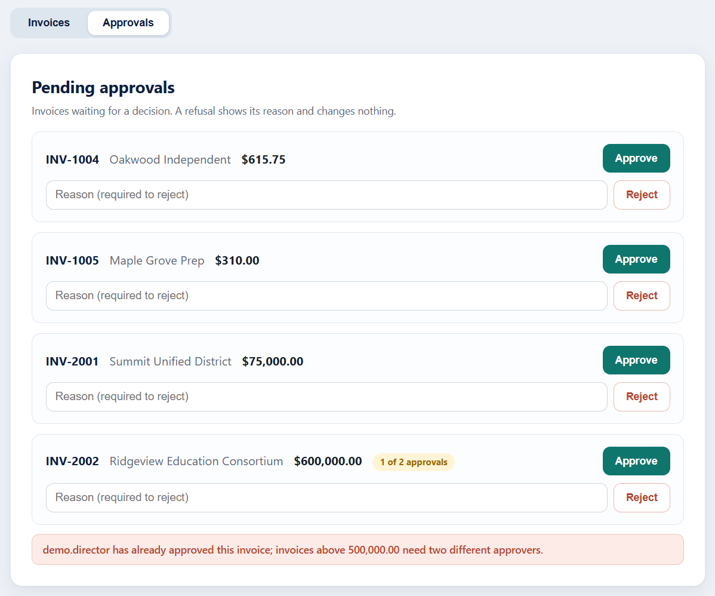
The same Director cannot approve twice
THE RULES
Signed in as demo.director (Director)
What you see
INV-2002 now shows 1 of 2 approvals: this Director approved once.
Approving again gives: demo.director has already approved this invoice; invoices above 500,000.00 need two different approvers.
INV-2001, already approved, has left the list.
What it proves
The first negative rule: the same user never counts as both approvers, and the refused second attempt changes nothing.
Invoice Approval · Approval limits by role
10

Slide 11
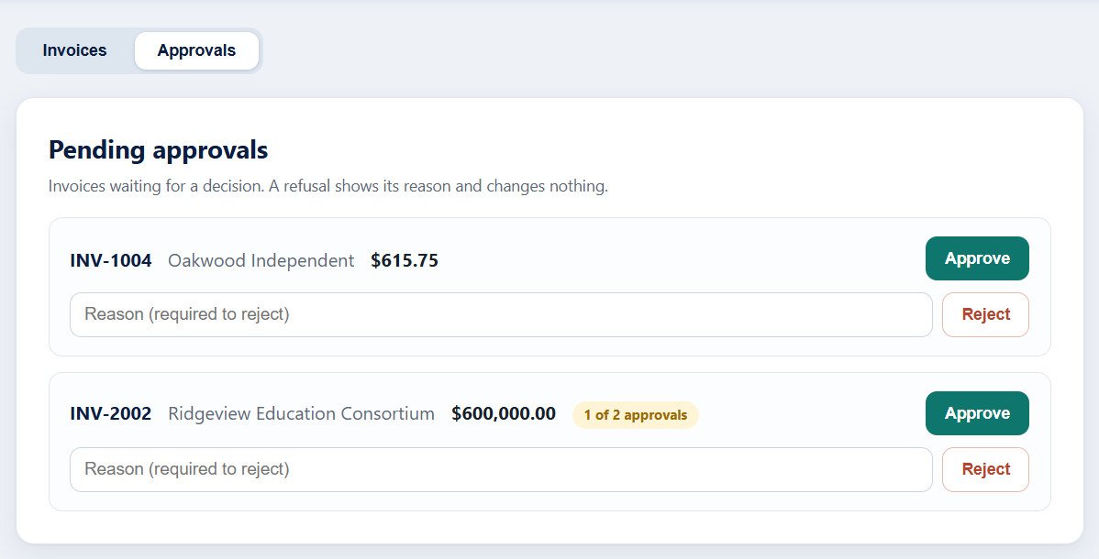
A second, different Director takes over
THE RULES
Signed in as demo.director2 (Director)
What you see
After signing out and in as demo.director2, INV-2002 still reads 1 of 2 approvals.
The first approval was kept; it is waiting for a different Director.
The message from the previous screen is gone: it is cleared on sign-out and sign-in.
What it proves
The invoice has been waiting in a valid state, not lost or half-written.
Invoice Approval · Approval limits by role
11

Slide 12
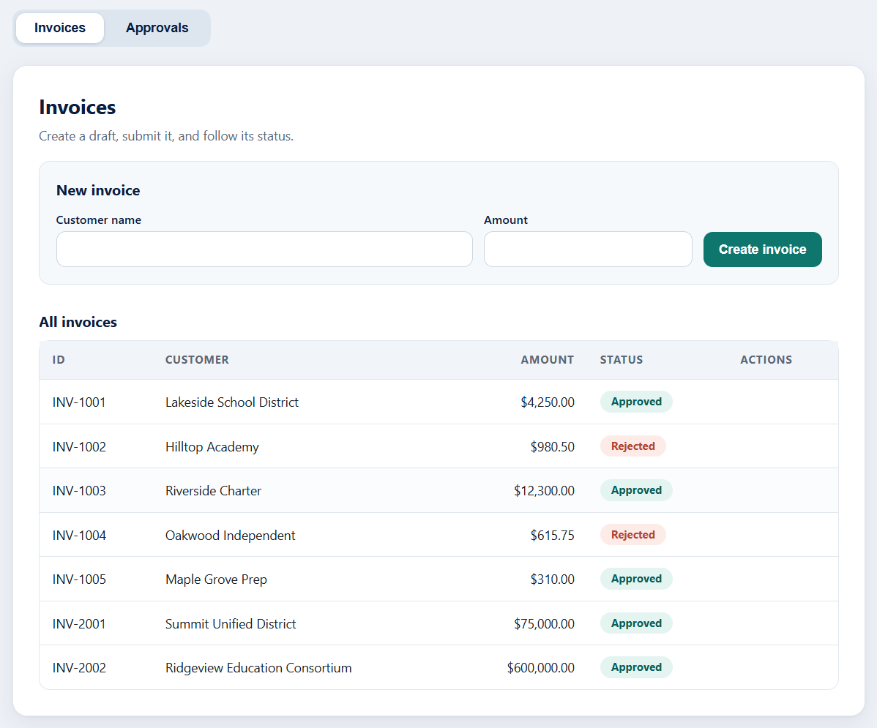
Two approvals complete the invoice
THE RULES
Signed in as demo.director2 (Director)
What you see
On the Invoices tab INV-2002 is now Approved.
Rejected invoices carry a red Rejected pill.
Nothing is left in a half-approved state.
What it proves
Above 500,000.00 the invoice becomes Approved only when two different users, the second a Director, have approved.
Invoice Approval · Approval limits by role
12

Slide 13
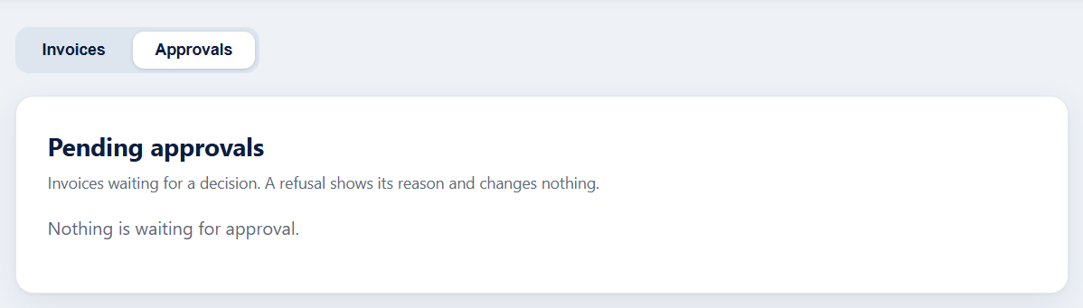
Admin has nothing to approve
THE RULES
Signed in as demo.admin (Admin)
What you see
The Approvals tab shows Nothing is waiting for approval. once every invoice has a decision.
An empty list is a normal state with its own message.
What it proves
Every pending invoice went through the rules; the queue is empty and nothing is stuck.
Invoice Approval · Approval limits by role
13

Slide 14
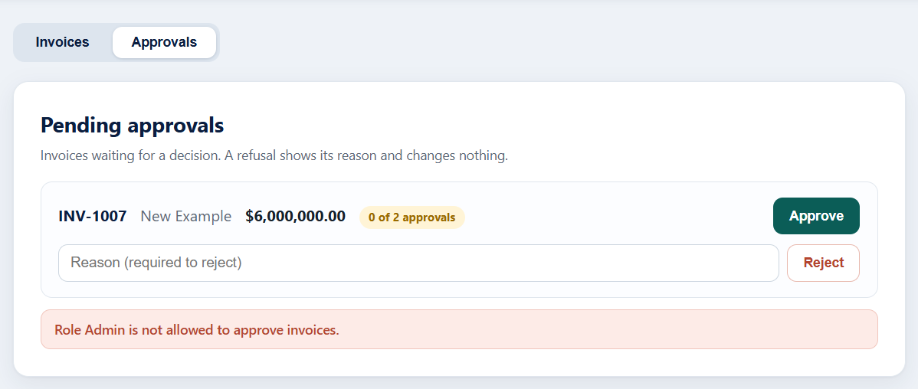
Admin may look, but not approve
THE RULES
Signed in as demo.admin (Admin)
What you see
INV-1007 (6,000,000.00) is waiting, 0 of 2 approvals.
Approve was pressed as Admin: Role Admin is not allowed to approve invoices.
The invoice is unchanged.
What it proves
Admin can reject and delete but never approve. The role check comes first, before any amount rule.
Invoice Approval · Approval limits by role
14

Slide 15
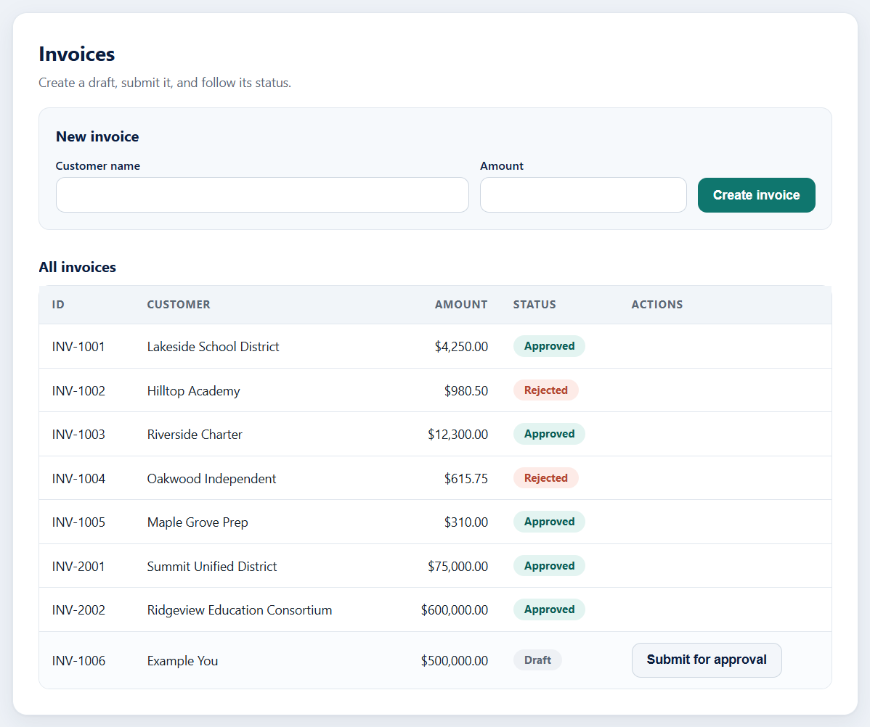
Creating a draft invoice
INVOICES
Signed in as demo.admin (Admin)
What you see
A new invoice INV-1006 for 500,000.00 appears as Draft.
It has a Submit for approval button; it is not in anyone's approval queue yet.
Amounts are checked on the server: zero, negative, sub-cent and huge values are rejected.
What it proves
An invoice moves Draft, then Pending, then Approved or Rejected. Amounts are exact decimals, never floating point.
Invoice Approval · Approval limits by role
15

Slide 16
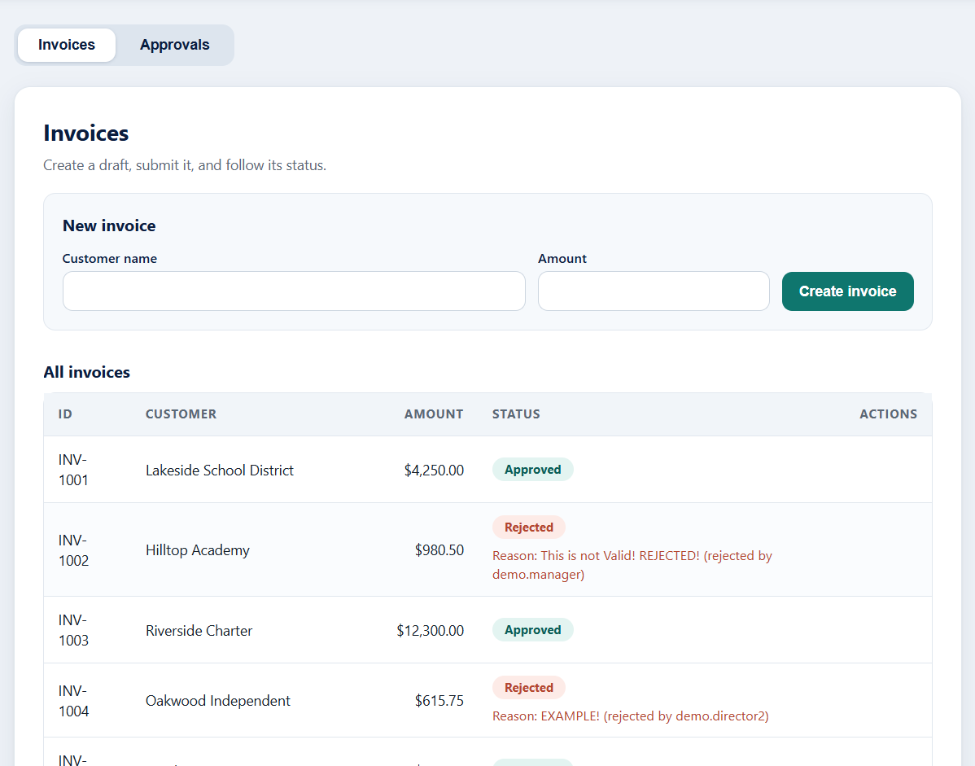
Rejection reasons stay visible
INVOICES
Signed in as demo.director (Director)
What you see
Rejected invoices show the reason under the pill: Reason: … (rejected by demo.manager).
Anyone who opens the Invoices tab can see who rejected an invoice and why.
What it proves
A rejection is accountable: the decider and the reason are stored with the invoice and shown to everyone.
Invoice Approval · Approval limits by role
16

Slide 17
Unit tests: 177 passed
EVIDENCE
python -m pytest backend/tests -q
What ran
What they prove
One warning
63 policy tests, 62 service tests, 36 API tests and 16 repository-contract tests.
Every rule and boundary, the two negative rules, and that a refusal leaves the invoice unchanged.
A third-party deprecation notice about the test client; it does not affect the result.
Invoice Approval · Approval limits by role
17

Slide 18
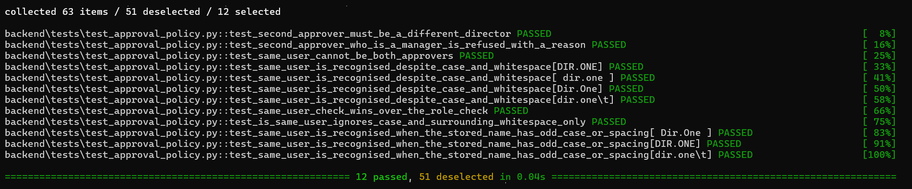
The two negative rules, run on their own
EVIDENCE
python -m pytest backend/tests/test_approval_policy.py -v -k "same_user or second_approver"
Same user twice
Manager as second approver
12 passed
Refused, including Dir.One, dir.one and tab or space padding.
Refused with a reason above 500,000.00.
51 other tests were skipped by the filter; this view is only the two rules.
Invoice Approval · Approval limits by role
18

Slide 19
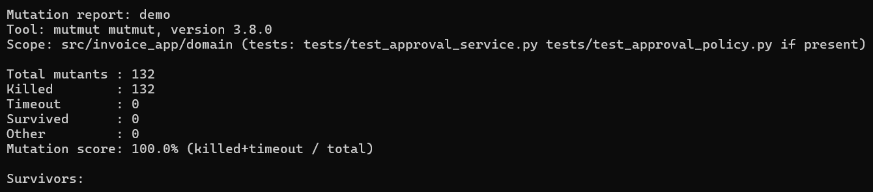
Mutation testing: 100%
EVIDENCE
wsl -d Ubuntu-22.04 -- bash scripts/run_mutation.sh demo
What it does
The result
Why it matters
Changes the domain code 132 different ways, one at a time, and runs the tests.
132 killed, 0 survived: the tests noticed every change.
A high line-coverage number does not say whether tests can fail; this does.
Invoice Approval · Approval limits by role
19

Slide 20
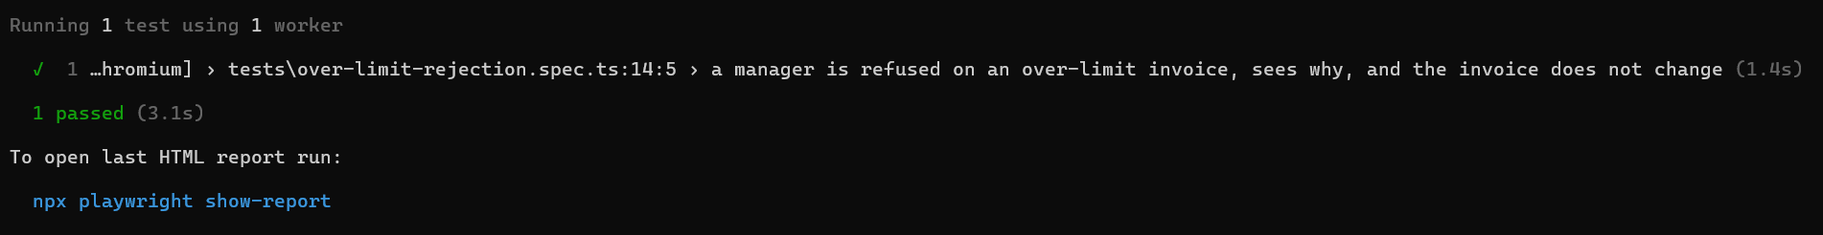
Browser test: 1 passed
EVIDENCE
cd e2e; npx playwright test --headed; cd ..
What it does
What it checks
Clean up
Drives the real UI as a Manager and tries to approve an over-limit invoice.
The exact refusal reason, and that the invoice stays Pending Approval.
The test creates its own invoice and removes it, so it can run again and again.
Invoice Approval · Approval limits by role
20

Slide 21
Every screen, and the rule it proves
SUMMARY
Screen
Rule or behaviour proven
Sign-in and wrong password
Everything is behind sign-in; failures are generic.
Reject with and without a reason
A reason is required, stored and shown with who rejected.
Manager refused on 500,000.00
Role limits are enforced with a clear reason; nothing changes.
Same Director refused on INV-2002
The same user never counts twice above 500,000.00.
Second Director completes INV-2002
Two different approvers, the second a Director, are required.
Admin refused
Admin can reject and delete but never approve.
Draft and Submit
Invoices move Draft, Pending, then Approved or Rejected.
Test, mutation and browser output
177 tests, 100% mutation score and 1 browser test, all repeatable.
Invoice Approval · Approval limits by role
21

Slide 22
Try it yourself
Start the app: python -m uvicorn invoice_app.api.main:app --app-dir backend/src --port 5000
Open http://localhost:5000 and sign in as demo.manager
Approve INV-2001 and read the refusal, then try again as demo.director
Approve INV-2002 as demo.director, then as demo.director2
Notes:
Invite the viewer to follow the same path on their own machine.

