Slide 1
Zomato Bangalore Restaurants Analysis Project

Slide 2
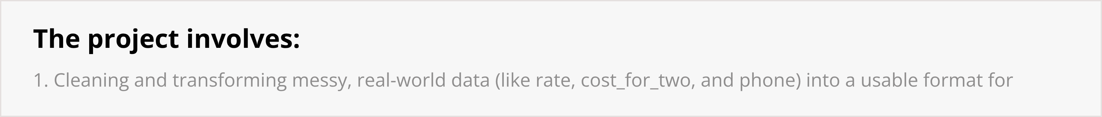
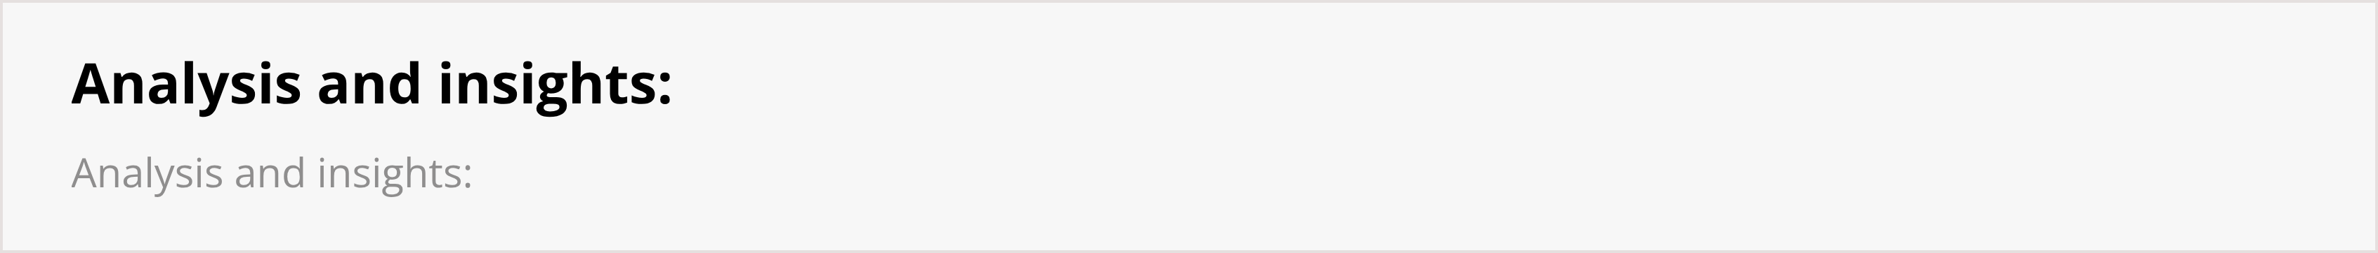
Problem Statement:
"To perform a comprehensive Exploratory Data Analysis (EDA) on the Zomato Bangalore restaurant dataset to identify the key factors that define the city's food market landscape.

Slide 3
The project involves:
1. Cleaning and transforming messy, real-world data (like rate, cost_for_two, and phone) into a usable format for analysis.
  Analyzing distributions and trends to understand restaurant density, popular types, and rating patterns.
  Deriving insights on the relationships between variables like location, cost, online presence, and customer ratings to build a complete profile of the market."

Slide 4
Analysis and insights:

Slide 5
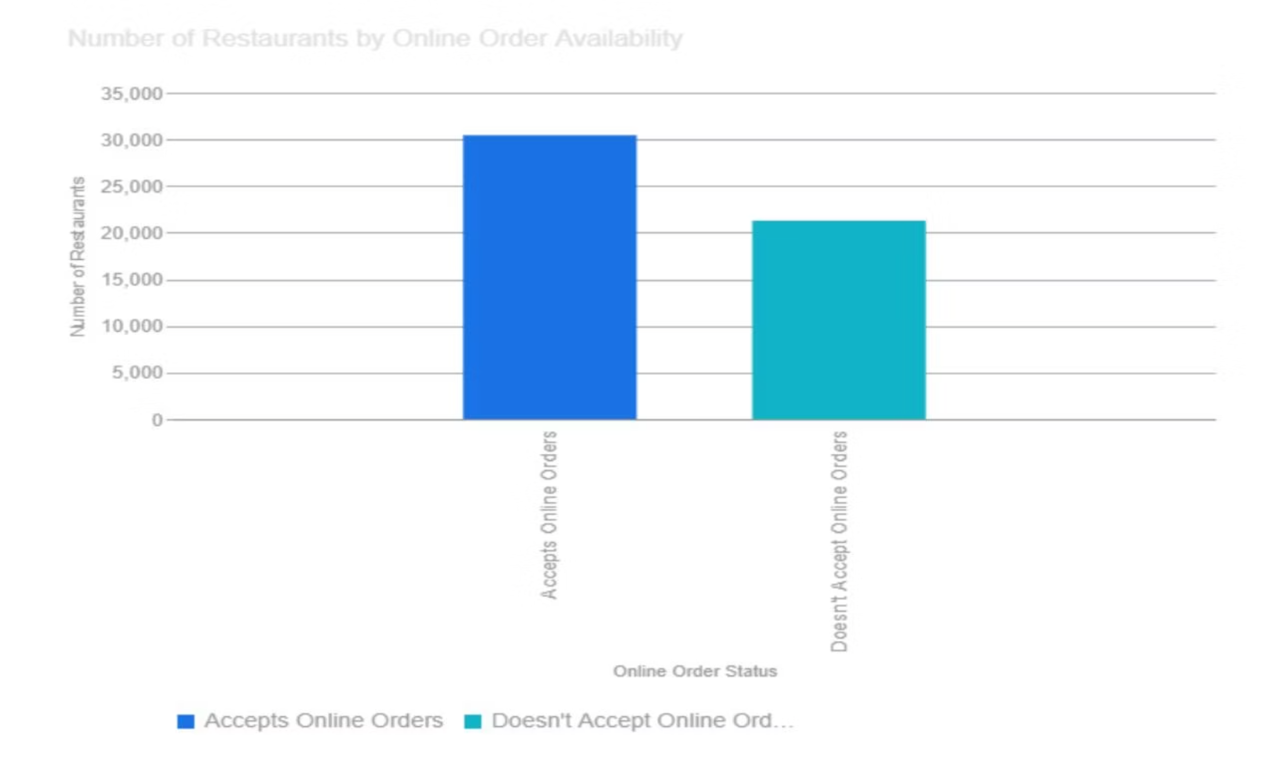
1. How Online Ordering Affects Restaurant Count and Rating
Insight: You found that while 30,444 restaurants accept online orders compared to 21,273 that don't, the impact on the average rating is minimal. Restaurants with online ordering have a slightly higher average rating (3.72) than those without (3.66). This suggests that while online availability is a huge part of the business (more restaurants have it than don't), it isn't a significant factor in what customers perceive as the quality of the restaurant.

Slide 6
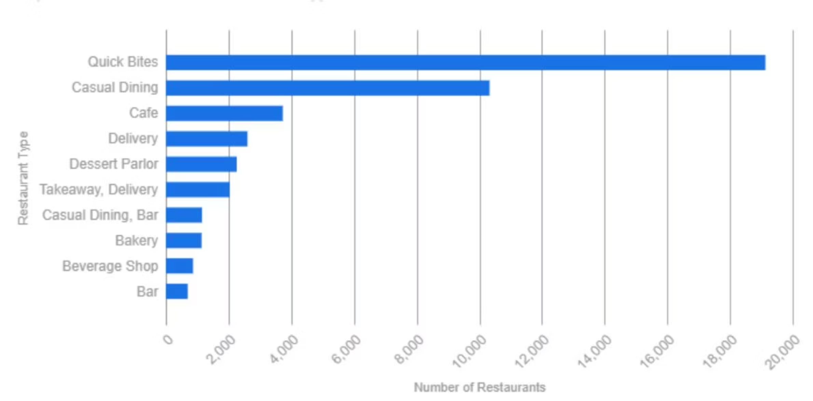
2. Top 10 Most Common Restaurant Types
Insight: The Bangalore food scene is overwhelmingly dominated by "Quick Bites" (19,132) and "Casual Dining" (10,330). These two categories alone represent a massive portion of all restaurants. This indicates a strong market demand for convenience, speed, and informal dining experiences over more formal or niche categories.

Slide 7
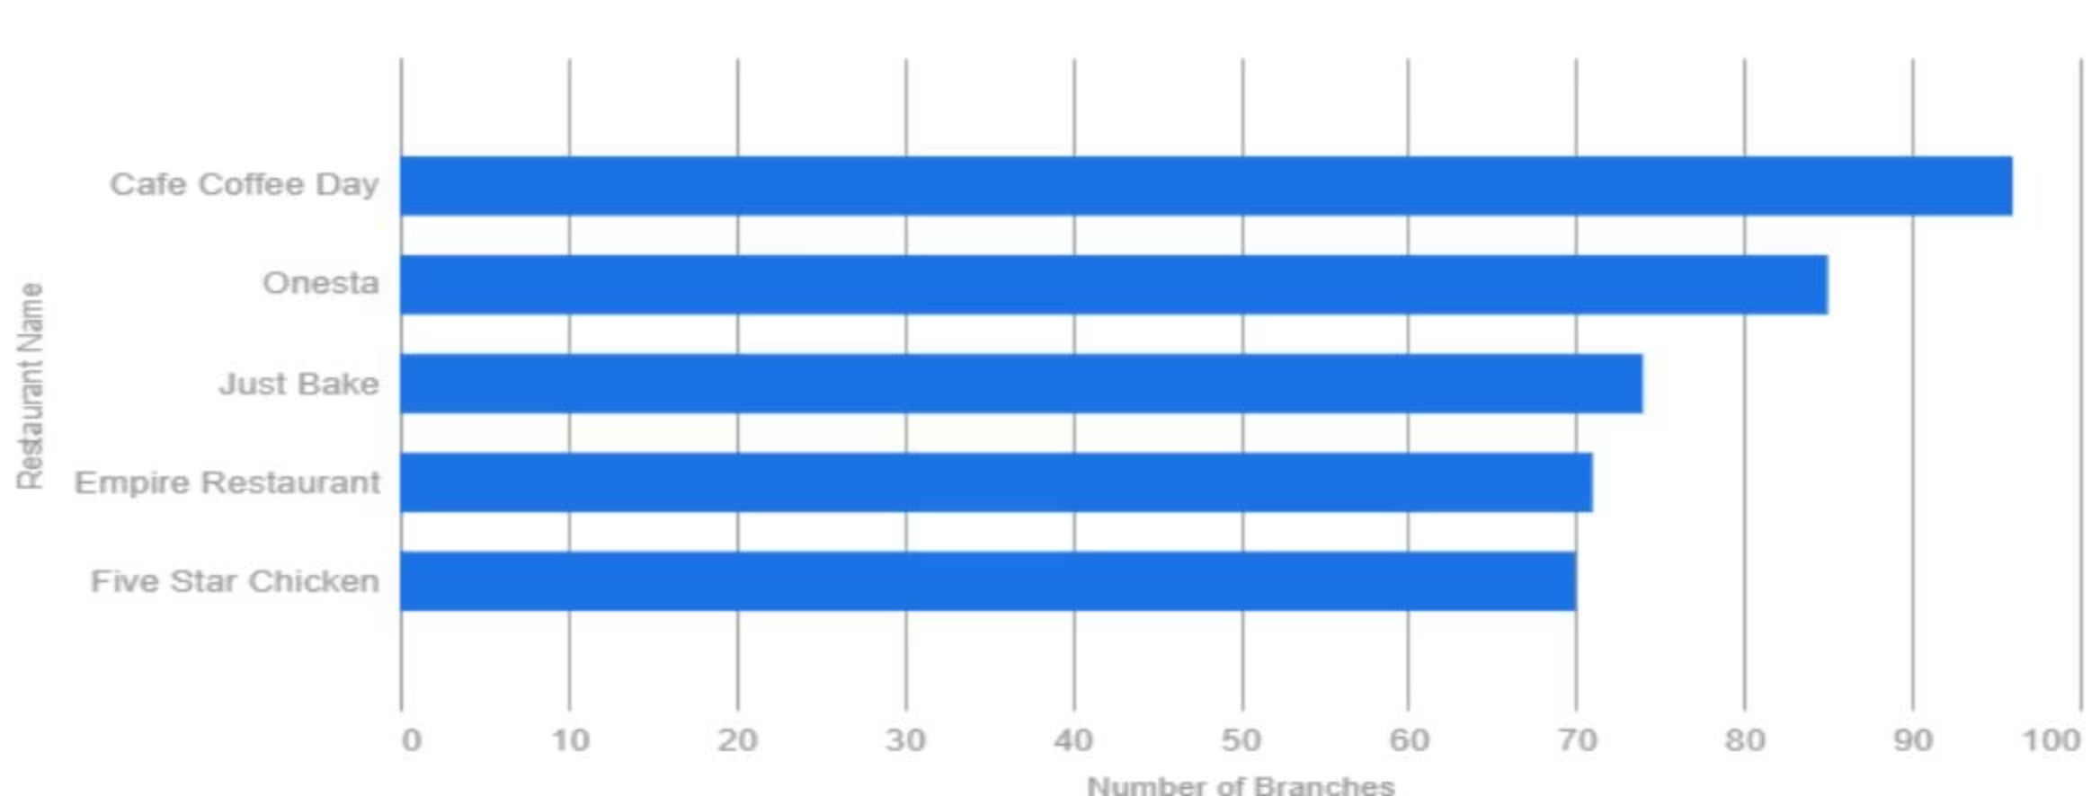
3. Restaurant Chains with the Most Branches
Insight: The market shows significant saturation from large chains. "Cafe Coffee Day" (96 branches) and "Onesta" (85 branches) lead the pack. This highlights the power of brand recognition and scalability, with cafe chains, pizza places, and bakeries being the most successful at expanding across the city.

Slide 8
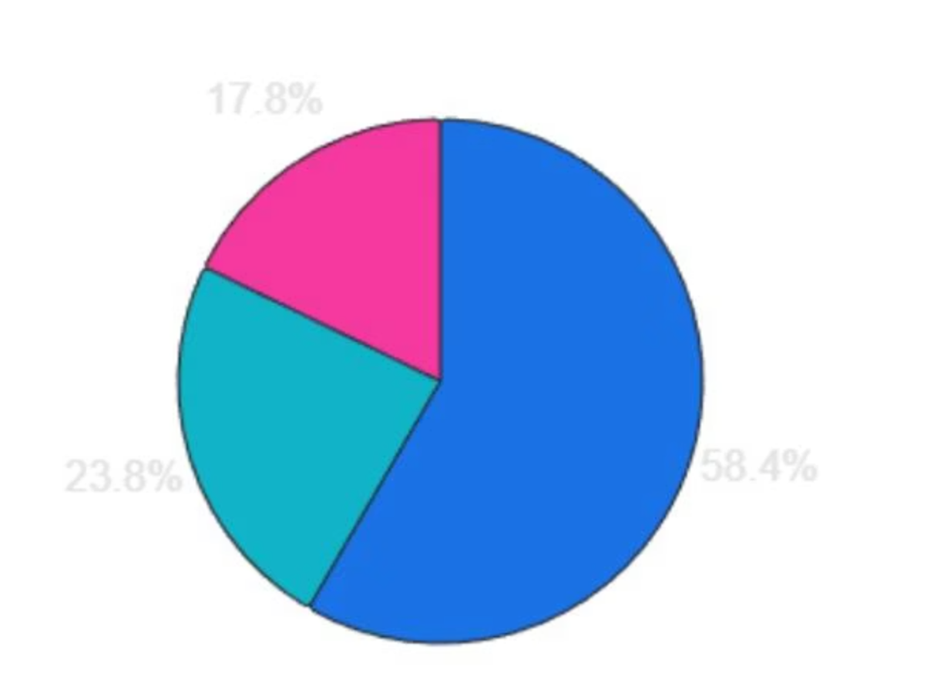
4. Distribution of Restaurant Ratings
Insight: The vast majority of restaurants in Bangalore fall into the 3.0 to 4.0 "Average" rating bracket, accounting for 30,192 establishments. A much smaller, but still significant, group of 9,216 restaurants achieve a "High" rating (above 4.0). This shows a classic distribution where most businesses are considered "average," and achieving a high rating is considerably more difficult.

