Slide 1
Automatic Road Extraction from Satellite Image
Group 10
Ishan Arora (IIT2017501)
Vikrant Singh (IIT2017502)
Srikar Anand (IIT2017504)
Akshay Gupta (IIT2017505)
Naman Deept (IIT2017507)

Slide 2
Abstract
This paper presents the project titled ”Automatic Road Extraction from Satellite Image” which aims to extract Road networks from Satellite images of the ground. This is more challenging compare to roadextraction from the aerial images because satellite images are more noisy and comparatively of the lower resolution than the aerial images. Variety of the network structures with different number of the epochs or iteration times are used to train the model and to determine the model with best network structure so that results can be obtained with more accuracy.

Slide 3
Introduction
Road network detection is the process of detecting and extracting the road network from high resolution satellite images. It is essential for many applications like map generation and updating. To do this road network detection, resolution of satellite images plays an important role. If experts try to label the road pixels manually, it will take more time and will lead to errors. Hence an automatic method is proposed here.
Satellite images consist of the various parts of the earth and various other planet and stars which are taken through the use of the satellites. Satellite images provides the details about various natural and man-made features of the earth. These help in the various fields of studies like astronomy, agriculture, geology, etc. These are also used in google maps which help in finding and locating the different paths and locations. Road extraction from these images is one of the most important application as it can be of great help for the map, tourists,cabs, etc

Slide 4
Main Base Paper
Paper 1:
The base paper which has been used by us for the implementation of this project titled as Automatic Road Extraction from Satellite Image is Volodymyr Mnih and Geoffrey E. Hinton, ”Learning to Detect Roads in High-Resolution Aerial Images”, Department of Computer Science, University of Toronto, 6 King’s College Rd., Toronto, Ontario, M5S 3G4, Canada, 2013.

Slide 5
Methodology:
Learning using Patch based labels
The inputs are a set of satellite images provided and these maps to corresponding binary image which is the expected output for those provided satellite images. These satellite images can either be of the form of RGB or grayscale ,the corresponding mapped image is of the same size of the image. In our training image folder we have two folder the corresponding maps are provided as same image file name but in different folders named "groundtruth" and "images".

Slide 6
Methodology (Contd..)
At training time we are presented with N map and aerial image patch pairs. We train the neural network by minimizing the total cross entropy between ground truth and predicted map patches
We pretrain the neural network f using the procedure of Hinton and Salakhutdinov, which makes use of Restricted Boltzmann Machines (RBMs)
Since our neural network has real-valued inputs and logistic hidden units, in order to apply RBM-based pretraining, we use an RBM with Gaussian visible and binary hidden units
We train an RBM on the PCA representations of aerial image patches by approximately minimizing Contrastive Divergence using stochastic gradient descent with momentum
Once the RBM was trained, we initialized the weight matrix W1 and bias vector b1 from Equation 4 with the RBM weights w and b

Slide 7
Methodology (Contd..)
The neural network is trained using stochastic gradient descent to minimize cross entropy between the ground truth map patches and the predictions
We do not use pre-training when training, as this did not improve performance
As with training of the neural network f, we randomly rotate each training case before it is processed in order to remove a bias towards roads in some orientations
We train a convolutional neural network to predict small noise-free patches of natural images given larger patches that had noise added to them
Since our post-processing procedure repeatedly applies a local filter at fixed intervals over a larger image, it can be seen as a type of convolutional neural network where the convolution is followed by subsampling

Slide 8
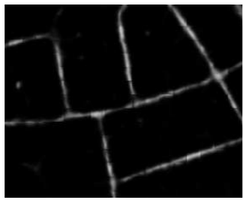
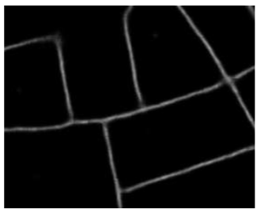
Methodology (Contd..)
Figure 1(b) shows the result of applying the post-processing procedure to the predictions from Figure 1(a). The process clearly removes disconnected blotches, fills in the gaps in the roads, and generally improves the quality of the predictions. While we do not do so in this paper, the post-processing procedure can be applied repeatedly, with each application receiving the predictions made by the previous application as input. This process propagates confident predictions along the predicted road network
Figure 1(a)
Figure 1(b)

Slide 9
Proposed Network:
We propose modeling the observed map distribution using neural networks. Neural networks are particularly better suited to aerial or satellite image labeling tasks because they offer several distinct advantages. Most importantly, neural networks have been shown to work particularly well on perceptual tasks with large amounts of labeled data .The main advantage is the ease with which the neural networks workings can be parrallelized in the GPU cores this makes it much efficient to be worked with the large datasets and it yields results with more accuracy and precision.
"CNNs" or Convolutional Neural Networks are generalized versions of multi-layers perceptrons which are best networks used in the field of computer vision and image processing, image segmentation.The basic fundamental mathematical operation involved in this is mathematical convolution

Slide 10
Network Implementation and post processing
The proposed network is implemented in the Keras platform with TensorFlow backend
We tried running the data based on training models, and the corresponding weights were obtained
For every input satellite image we get the corresponding CSV output of the image (comma separated value) first value is given as i-x-y where i is the image number x and y are the coordinates based on the patch size as 16, and the second value is the intensity value
Thus we obtained the desire output image reading that CSV file and making that image using PIL in python.
The size of the patch is “16*16” ,So our implementation goes as copying the first value of the pixel i.e a multiple of 16 into a non multiple value which are present in the same grid.

Slide 11
Reference Paper
Paper 2:
One of the reference paper which has been used in the implementation of this project titled as Automatic Road Extraction from Satellite Image is M. Mokhtarzade, M.J. Valadan Zoej, “Road detection from high-resolution satellite images using artificial neural networks”, K.N. Toosi University of Technology, Geodesy and Geomatics Faculty, No. 1364, Mirdamad Cross, Valiasr St., Tehran 19967-15433, Iran, International Journal of Applied Earth Observation and Geoinformation 9 (2007) 32–40.

Slide 12
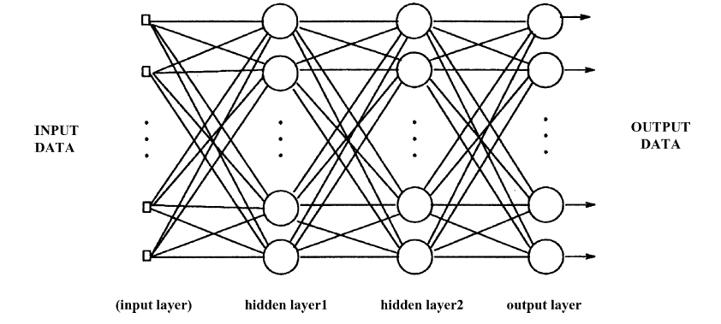
Artificial Neural Network (ANN)
Artificial Neural Networks (ANN) are made up of simple processing units called neurodes.
The task of neurodes is to:
Receive the input from neighbors
Compute the output
Send the computed output to its neighbors
Neurodes are comprised of three types of layers:
Input layer
Hidden layer
Output layer
The typical neural network is shown in the Fig 2.
Fig 2: A typical neural network

Slide 13
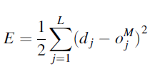
Artificial Neural Network (ANN): Continued ...
The two main stages in the Artificial Neural Networks are:
Learning or Training
Recalling
Learning or Training is the process of changing or modifying the connection weights using the proper dataset so that the neural network could fulfill the particular task, for example extraction of roads here.
One of the most common learning algorithm used in this paper is back - propagation which is the iterative gradient algorithm used to minimize the error.
The error function for the back - propagation is:
“L” is number of neurodes in output layer
“d_{j}” is the desired output
“o_{j}” is current response of neurode j in output layer

Slide 14
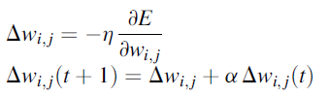
Artificial Neural Network (ANN): Continued ...
In the iterative method, the updates in weights are done as follows:
“w_{ij}” is weight parameter
“η” is the learning rate
“α” is the momentum factor which can take the values between 0 and 1
“t” is the iteration number
Recalling is the trained network which can be used for the purpose of interpolation and extrapolation, i.e. in this step the neural network functions on the basis of its training.

Slide 15
Methodologies
As a case study, a part of an RGB Ikonos image with the size of 550 550 pixels from Kish Island in Iran is chosen and enhanced with linear function
500 road and 500 background pixels are chosen as training set to be used in learning stage
A BNN with one hidden layer, which is self-programmed in Delphi, is implemented
The output layers consists of one neurode, 1 for road and 0 for background pixels
When the trained network is performed on entire pixels, a 2D matrix of the same size as input image is obtained, being called output matrix
An adaptive strategy is used to avoid trail and error learning rate and momentum assignment
In this method both parameters are adjusted downwards as half after some training intervals if the overall training error has increased and upward 1.2 times if the overall error has decreased. Therefore, the initial learning rate and momentum are not crucial to the success of training stage
Also, training speed is increased because the learning rate is adjusted to the highest value that does not cause instability

Slide 16
Methodologies (Contd..)
Addition of the multiplication of correspondent values in whole binary image and output matrix produces a value that can be considered as road detection correctness coefficient (RCC) when divided to the road pixel number
When the binary image is inversed, background detection correctness coefficient (BCC) can be obtained in a similar method as well
The third parameter is root mean square error (RMSE)
Overall accuracy is actually the percentage of correctly classified pixels to all available pixels in entire image
In continuation, each input vector type is evaluated in a distinctive section

Slide 17
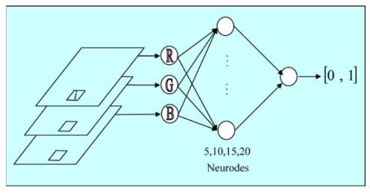
Methodologies (Contd..)
Spectral Values as input parameters
In this section spectral information for each pixel is simply entered to the network as its input parameters after normalizing the RGB values between 0 and 1.
Thus, three neurodes are designed in input layer in charge of receiving spectral values for each pixel in the entire image
The network, with five hidden neurodes, is very unstable in the sense that functionality of networks is highly dependent on initial weight assignment and that the results vary in multiple implementations
In this case classification problem does not seem so complex since the results are quite the same for different networks
Fig 3 : Network structure when spectral
values form input parameters.

Slide 18
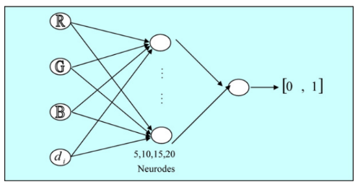
Methodologies (Contd..)
2. Including input parameters with normalized distance
In this section the normalized distance of each pixel to the road mean point in the spectral space is added to the input parameters
Distance parameter is calculated for each pixel as below:
d_{i} = (1/441.673)*[(R_{m}-R_{i})² + (G_{m}-G_{i})² + (B_{m}-B_{i})² ]^{½}
R_{m},G_{m},B_{m} are the mean values of pixels in the training set
441.673 is the maximum imaginable distance in the spectral space
Fig 4 : Network structure when distance
parameter is added to input parameters

Slide 19
Methodologies (Contd..)
3. Participating neighbor pixels in input parameters:
Normalized spectral information in a 3 x3 window around each pixel is extracted as 9 RGB values to form input parameters in that order
Since homogeneity is a characteristic that can be recognized with respect to neighbor pixels, spectral information of all pixels in the designed window participates in input vector generation
As roads are presented like homogeneous areas in high-resolution satellite images, participating neighbor pixels in input parameters enables the network to extinguish road pixels more efficiently, causing the RCC parameter to improve
4. Spatial information and normalized distance as input parameters
Normalized distances of all nine pixels in the mentioned window to the mean vector of road pixels are added to the input parameters of the previous stage
Thus, the input layer consists of 9 RGB and finally 9 normalized distances to the road mean vector that means 36 neurodes are designed in this layer
Although the input layer enlargement can make training stage more time- consuming, this problem is compensated to some extent by decrease in requested hidden layer size and iteration time

Slide 20
Reference Paper
Paper 3:
One of the reference paper which has been used in the implementation of this project titled as Automatic Road Extraction from Satellite Image is Jose Hormese , Dr. C Saravanan, ”Automated Road Extraction From High Resolution Satellite Images”, National Institute of Durgapur , International Conference on Emerging Trends in Engineering, Science and Technology (ICETEST - 2015).

Slide 21
Methodologies:
Vectorization Approach to Road Extraction
A novel automatic road network detection approach based on the combination of segmentation and vectorization is explained, which includes three main steps:
the image is segmented to roughly identify the road network regions
the decision making and continuity procedure to correctly detect the roads
the Vectorization step to identify the line segments or curved segments which represent the roads segment

Slide 22
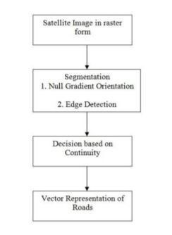
These steps can be explained using the following flow diagram as shown:
Fig 5: Automated Road Extraction Flow Diagram

Slide 23
1.Image Segmentation
Segmentation refers to the process of partitioning a digital image into multiple segments.
The goal of segmentation is to simplify and/or change the representation of an image into something that is more meaningful and easier to analyze.
Image segmentation is typically used to locate objects and boundaries (lines, curves, etc.) in images.
The result of image segmentation is a set of segments that collectively cover the entire image, or a set of contours extracted from the image (see edge detection).
Each of the pixels in a region is similar with respect to some characteristic or computed property, such as color, intensity, or texture.
Adjacent regions are significantly different with respect to the same characteristics.

Slide 24


2.Null Gradient Orientation
The gradient of function of two variables can be defined as:
The gradient for the function of N variables will be:
The description of the above equations is as follows:
FX = gradient(F) where F is a vector returns 1D numerical gradient of F.
FX corresponds to ∂F/∂x.
FY corresponds to ∂F/∂y.
Spacing between points in all the directions is assumed to be one.
[FX,FY,FZ,...] = gradient(F) where F has N dimensions.

Slide 25
Null Gradient Orientation (Continued…)
Spacing between values in F can be controlled in two ways:
Single spacing value “h” which specifies spacing between points in all direction.
N spacing values (h1,h2,...) which species spacing for each dimension of F.
The property of road is that it has continuity in one direction.
Gradient is represented as tensor.
Eigen transformations are performed on this tensor and then those pixels are selected for which at-least one eigen value should have a minimum value.
This eigen vector which is corresponding to the minimum eigen value will give the direction of road.

Slide 26
3. Edge Detection
Edge detection is a fundamental tool in image processing and computer vision, particularly in the areas of feature detection and feature extraction, which aim at identifying points in a digital image at which the image brightness changes sharply or more formally has discontinuities.
The edge detection algorithm being employed is the Canny Edge Detection Algorithm which consists of multi stages.
The algorithm runs in 5 separate steps:
Smoothing: Blurring of the image to remove noise.
Finding gradients: The edges should be marked where the gradients of the image has large magnitudes.
Non-maximum suppression: Only local maxima should be marked as edges.
Double thresholding: Potential edges are determined by thresholding.
Edge tracking by hysteresis: Final edges are determined by suppressing all edges that are not connected to a very certain (strong) edge.

Slide 27
4. Decision Making based on Continuity
A lot of edges are proved not to be roads through the procedure of edge detection.
Therefore road following or tracking is one of the most important steps in road detection.
The major goal of road tracking is to eliminate roadlike but non-road pixels.
Hough Transforms are being used to perform this step.
In automated analysis of digital images, a sub-problem often arises of detecting simple shapes, such as straight lines, circles or ellipses.
Due to imperfections in either the image data or the edge detector, there may be missing points or pixels on the desired curves as well as spatial deviations between the ideal line/circle/ellipse and the noisy edge points as they are obtained from the edge detector.
The purpose of the Hough transform is to address this problem by making it possible to perform groupings of edge points into object candidates by performing an explicit voting procedure over a set of parameterized image objects.

Slide 28
5. Vector Representation of Roads
Vector graphics is the use of geometrical primitives such as points, lines, curves, and shapes or polygon(s), which are all based on mathematical equations, to represent images in computer graphics.
Vector graphics files store the lines, shapes and colours that make up an image as mathematical formulae.
A vector graphics program uses these mathematical formulae to construct the screen image, building the best quality image possible, given the screen resolution.
The mathematical formulae determine where the dots that make up the image should be placed for the best results when displaying the image.
Since these formulae can produce an image scalable to any size and detail, the quality of the image is limited only by the resolution of the display, and the file size of vector data generating the image stays the same.
Printing the image to paper will usually give a sharper, higher resolution output than printing it to the screen but can use exactly the same vector data file.

Slide 29
References:
[1] Volodymyr Mnih and Geoffrey E. Hinton, ”Learning to Detect Roads in High-Resolution Aerial Images”, Department of Computer Science, University of Toronto, 6 King’s College Rd., Toronto, Ontario, M5S 3G4, Canada, 2013
[2] M. Mokhtarzade and M.J. Valadan Zoej, ”Road detection from high-resolution satel-lite images using artificial neural networks”, International Journal of Applied EarthObservation and Geoinformation, 2007 32-40.
[3] Jose Hormese , Dr. C Saravanan, ”Automated Road Extraction From High Reso-lution Satellite Images”, National Institute of Durgapur , International Conferenceon Emerging Trends in Engineering, Science and Technology (ICETEST - 2015).

