Slide 1



SMART INDIA HACKATHON 2026
  Problem Statement ID - SIH26167
  Problem Statement Title - SatQuery AI - An Interactive Vision-Language Assistant for Multimodal Remote Sensing Image Analysis through Text Queries
  Theme - Space Technology
  PS Category - Software
  Team ID - NIL
  Team Name – Midnight Syntax

Slide 2
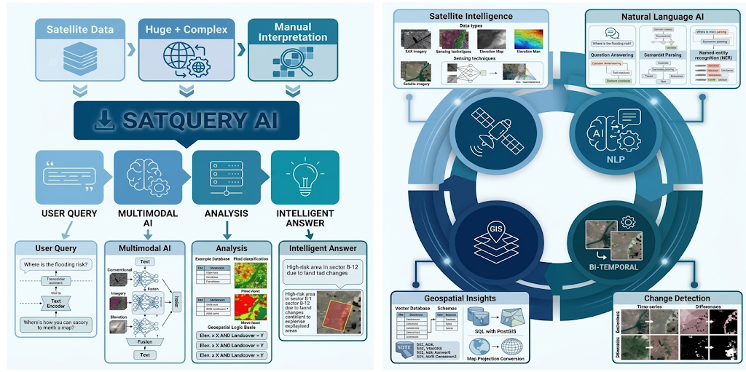
SatQuery AI - An Interactive Vision-Language Assistant for Multimodal Remote Sensing Image Analysis through Text Queries
Midnight
Syntax
@SIH Idea submission- Template
2

Slide 3
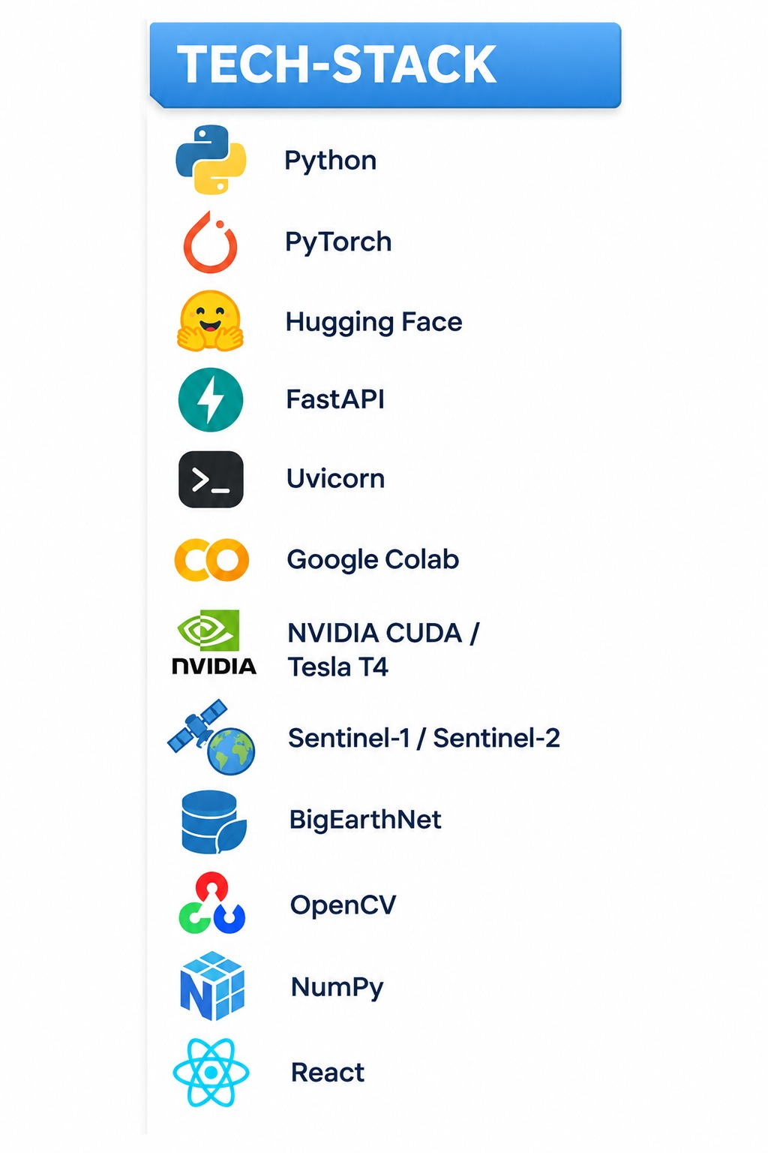
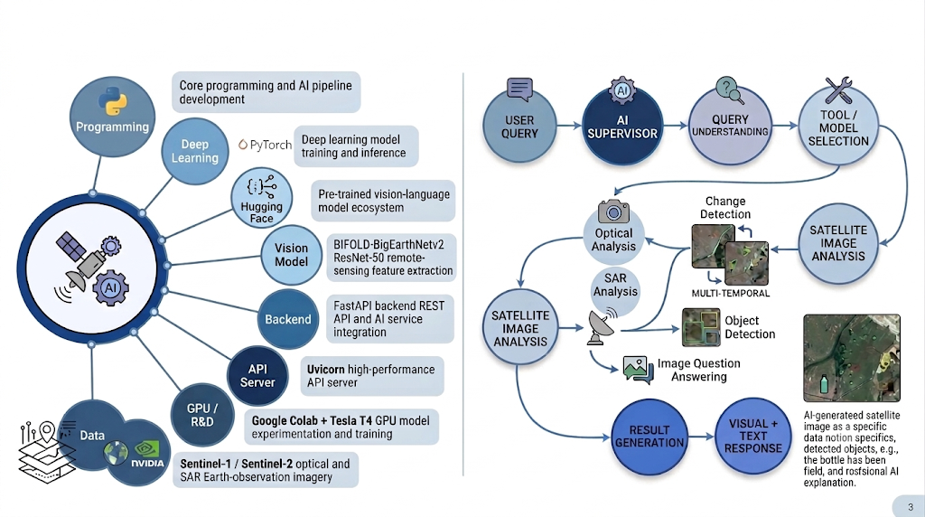
TECHNICAL APPROACH
Midnight
Syntax
@SIH Idea submission- Template
3

Slide 4
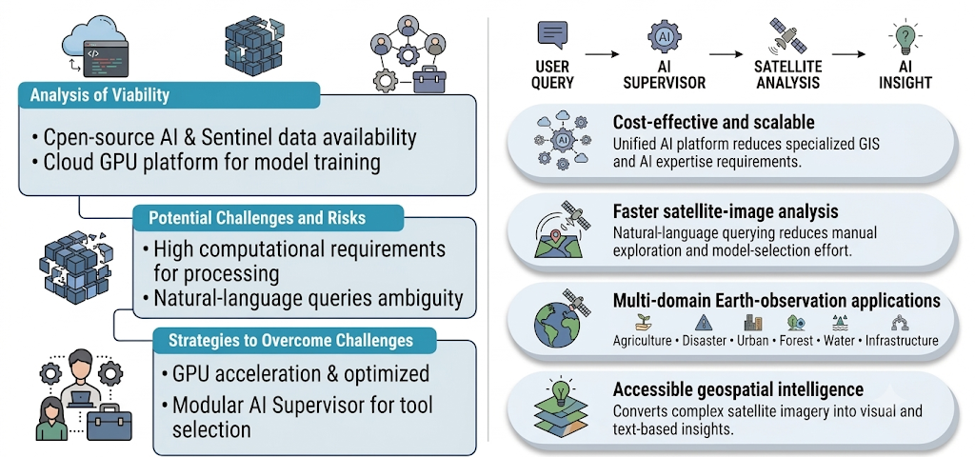
FEASIBILITY AND VIABILITY
Midnight
Syntax
@SIH Idea submission- Template
4

Slide 5
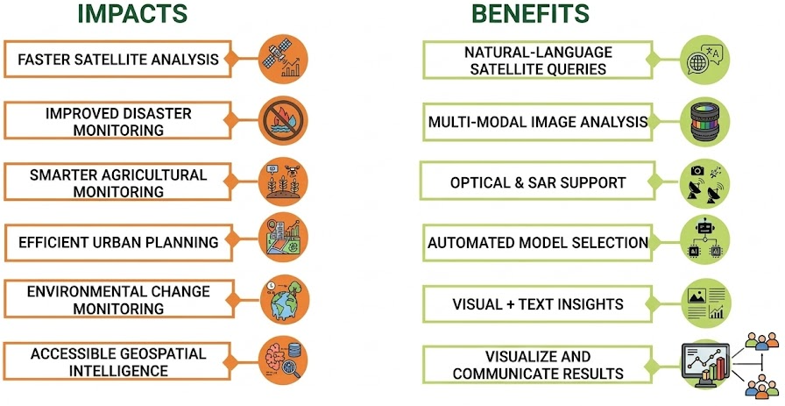
IMPACT AND BENEFITS
Midnight
Syntax
@SIH Idea submission- Template
5

Slide 6
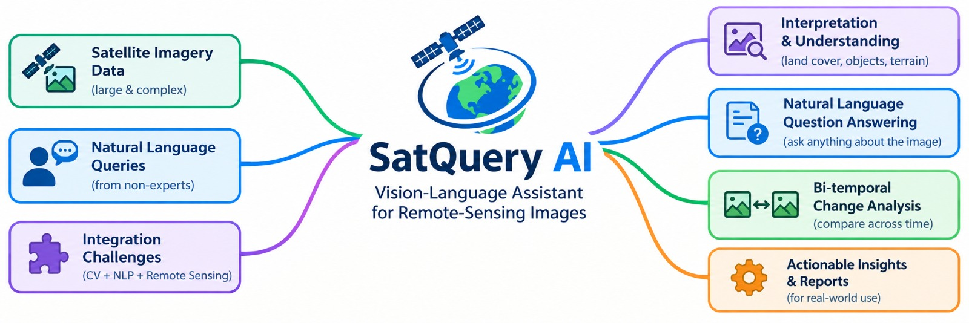
RESEARCH AND REFERENCES
Midnight
Syntax
PROJECT REPOSITORIES
Backend: https://github.com/shiva181-bit/SatQuery_1
Frontend: https://github.com/nandakishore939143-tech/SIH_frontend_ms
BACKEND SETUP — GOOGLE COLAB
Mount Drive & verify GPU
Load BLIP-2 model + LoRA weights
Launch FastAPI :8000, start tunnel
Verify /health endpoint
FRONTEND SETUP — WIN / VS CODE
Update .env with tunnel URL
Run backend & frontend servers
Open localhost:5173 & log in
LIVE DEMO FLOW
Login
Analyze
Upload image
Pose queries
@SIH Idea submission- Template
6

