Slide 1

RoadBlocks
Srikar Balmuri
Maneesh Boddu

Slide 2
Contents
Problem Statement
UML Diagram
Homepage UI
Game Page UI
Testing
Tools
Challenges

Slide 3
Problem Statement
This game is inspired from Snake and Ladder.
RoadBlocks game involves pure luck.
It is played between two players on a gameboard having numbered, gridded squares. A number of random “danger zones” are pictured on the board, each connecting two specific board squares. The objective of the game is to navigate from the start (bottom square) to the finish (top square) with the help of die rolls and the resulted number helps or hinders by crossing the Danger zones, of one’s game piece.

Slide 4
UML Diagram
User 1
The resulted number decides to move forward or reduced by few board positions
Every user gets a turn to Roll Dice
When User reaches destination, he wins
User 2

Slide 5
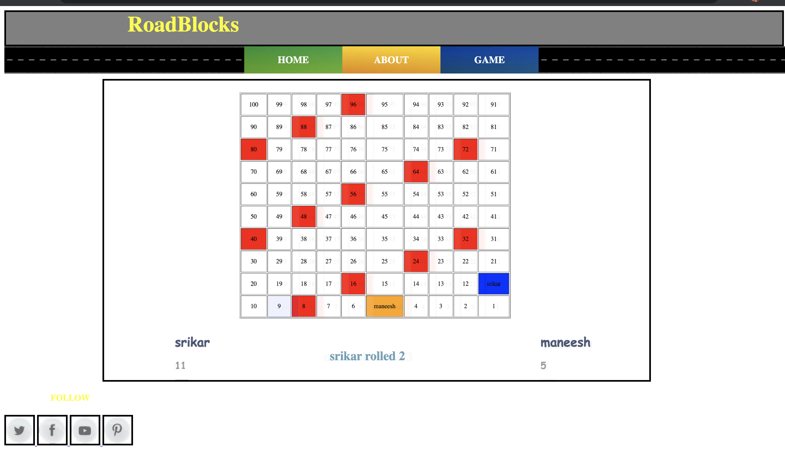
Homepage UI

Slide 6
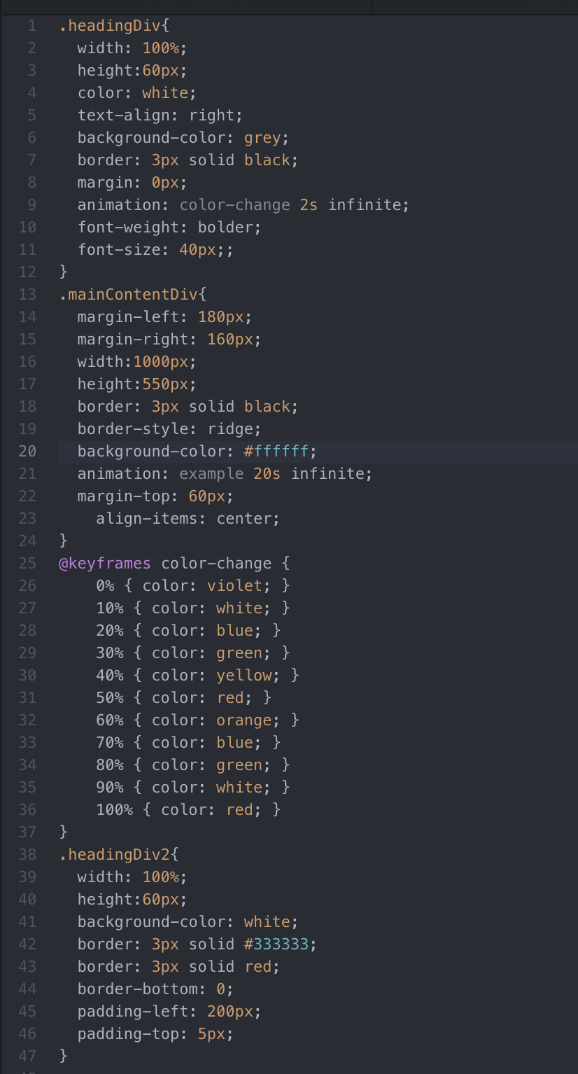
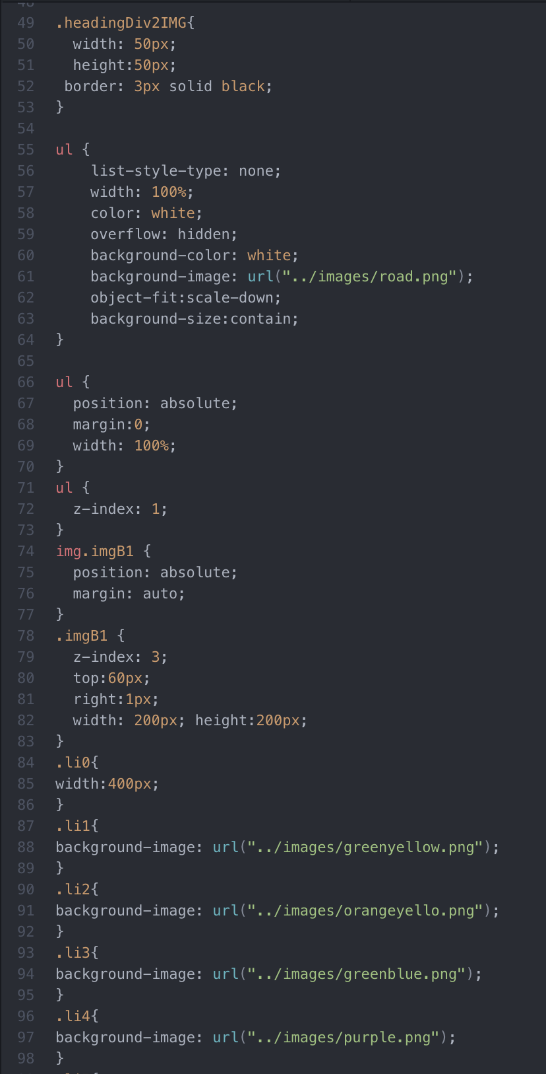
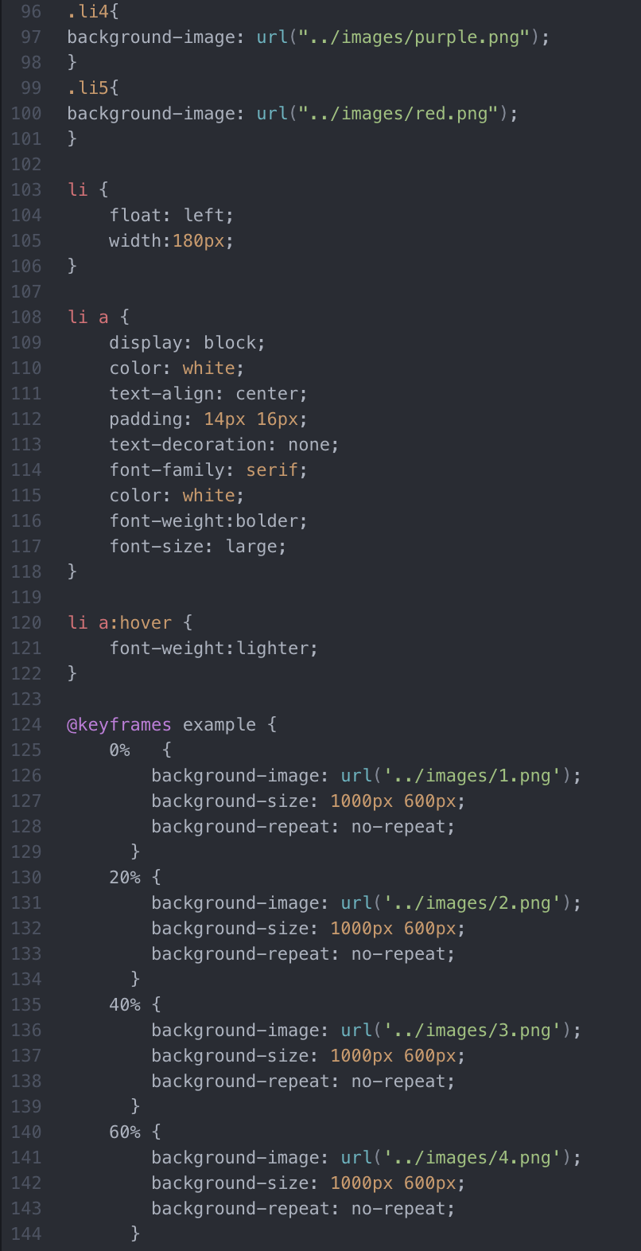
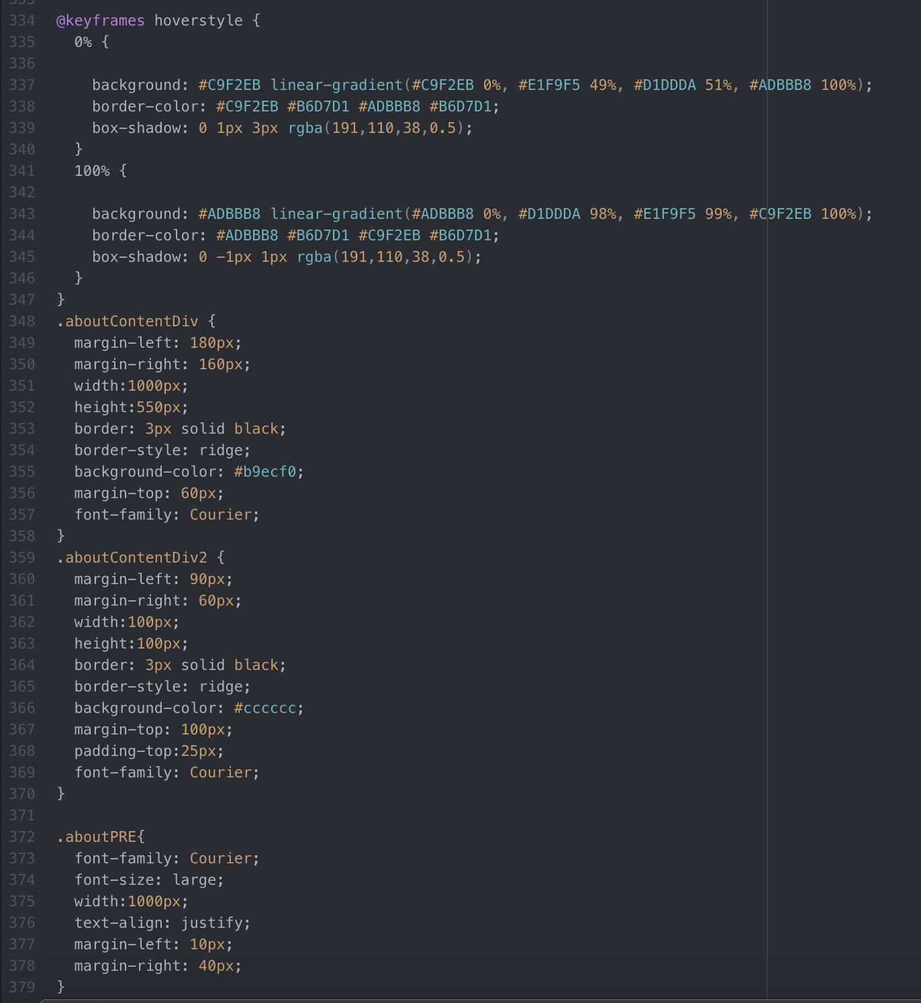
CSS

Slide 7
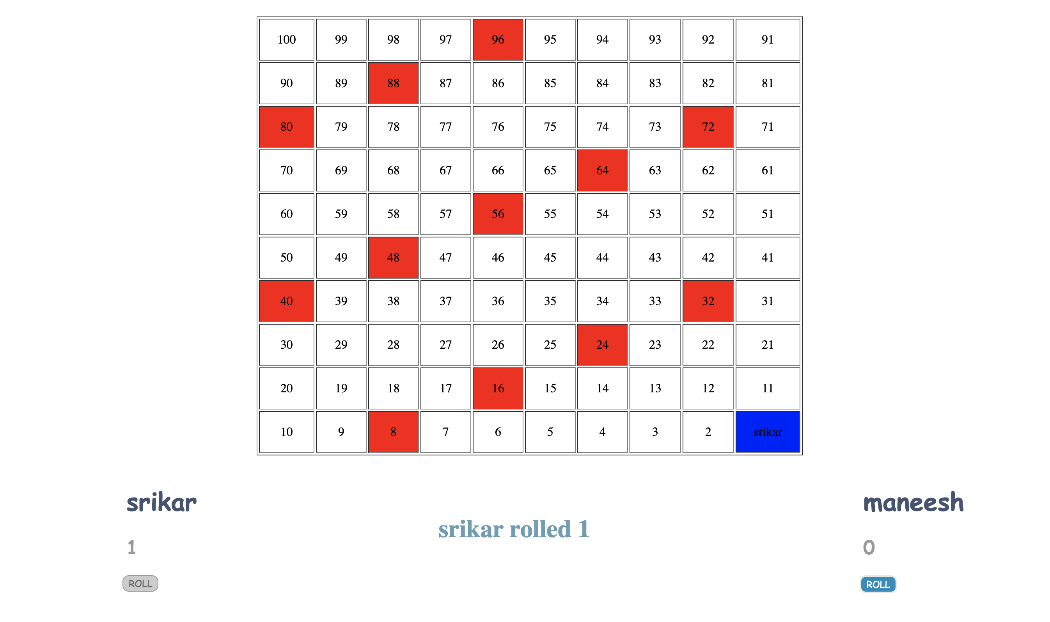
Game Page UI

Slide 8
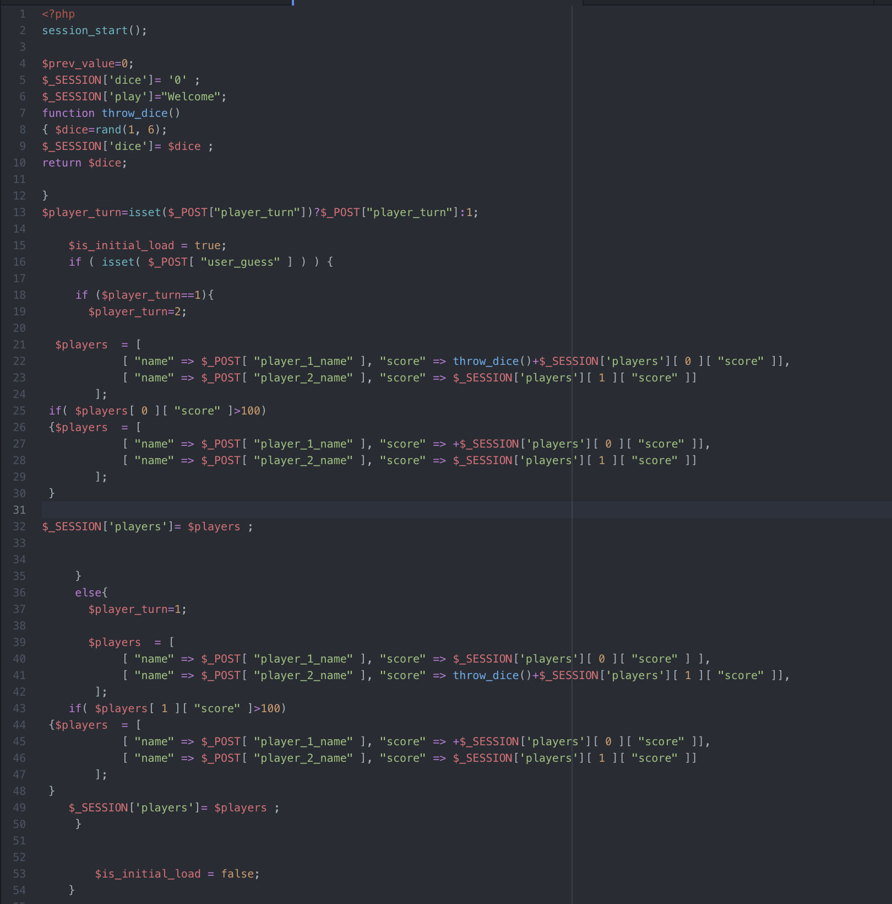
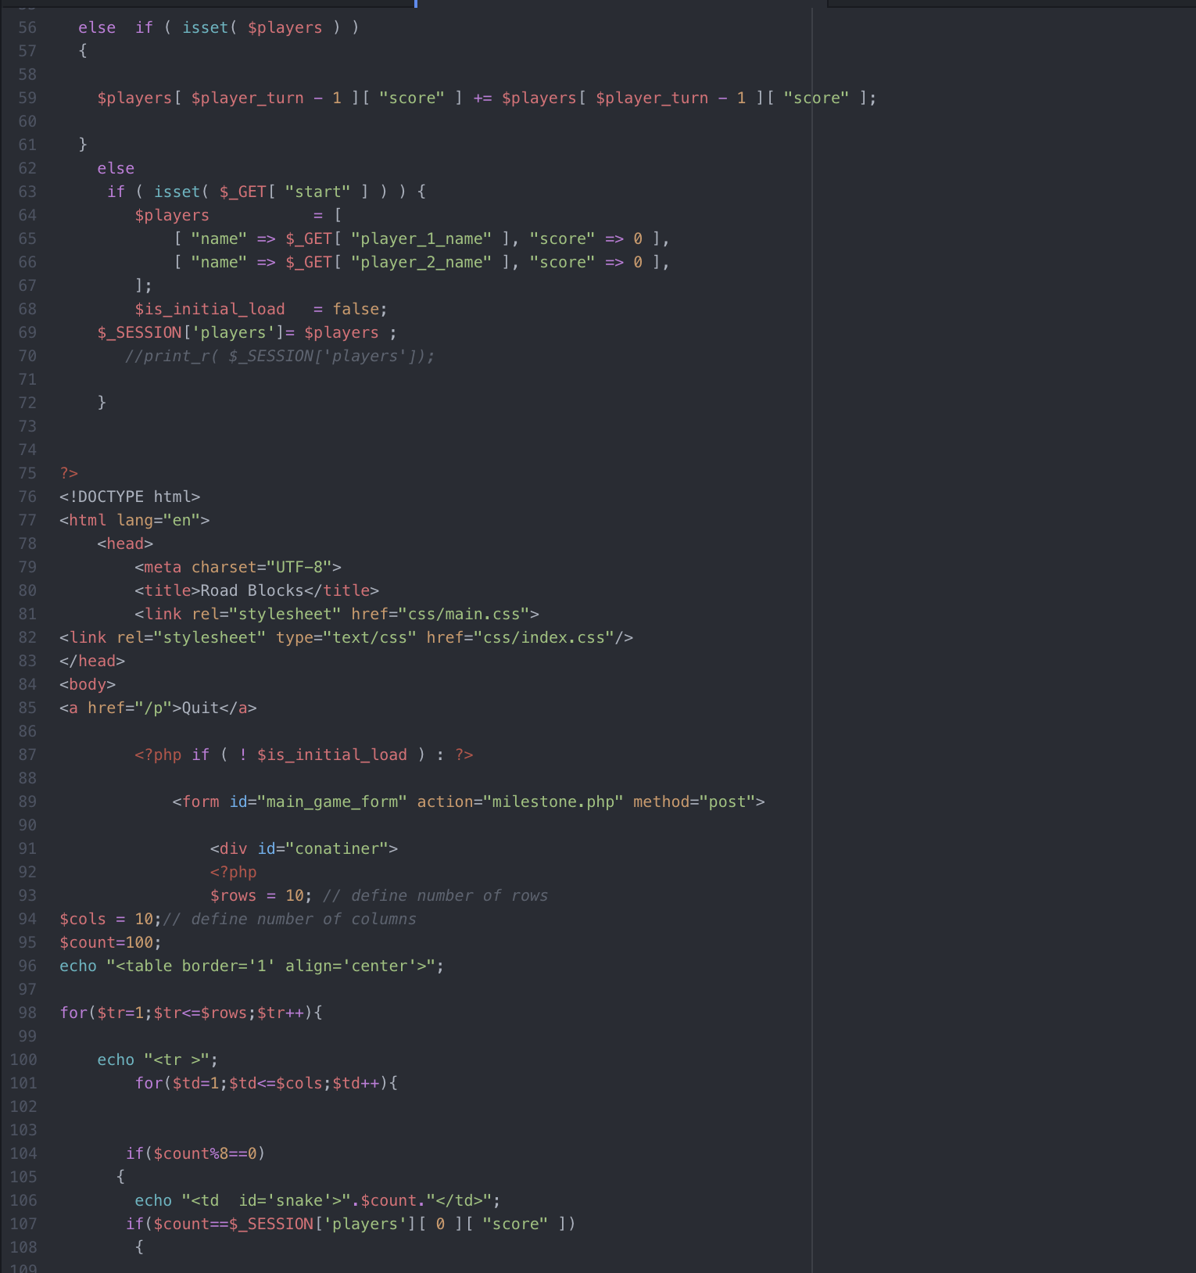
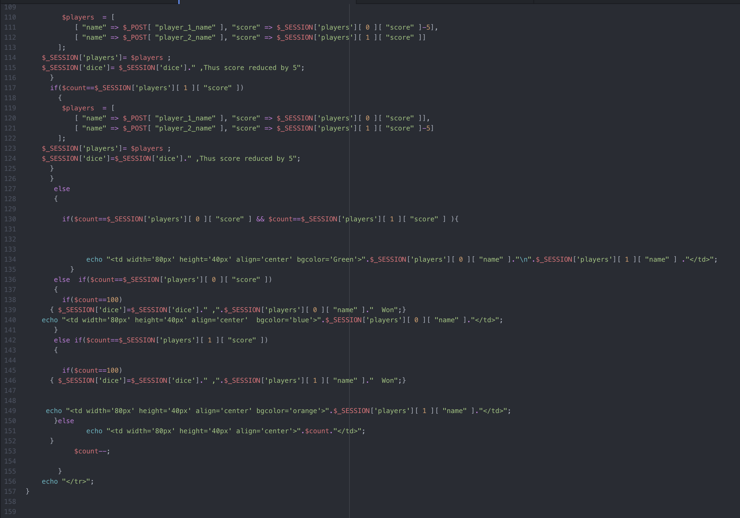
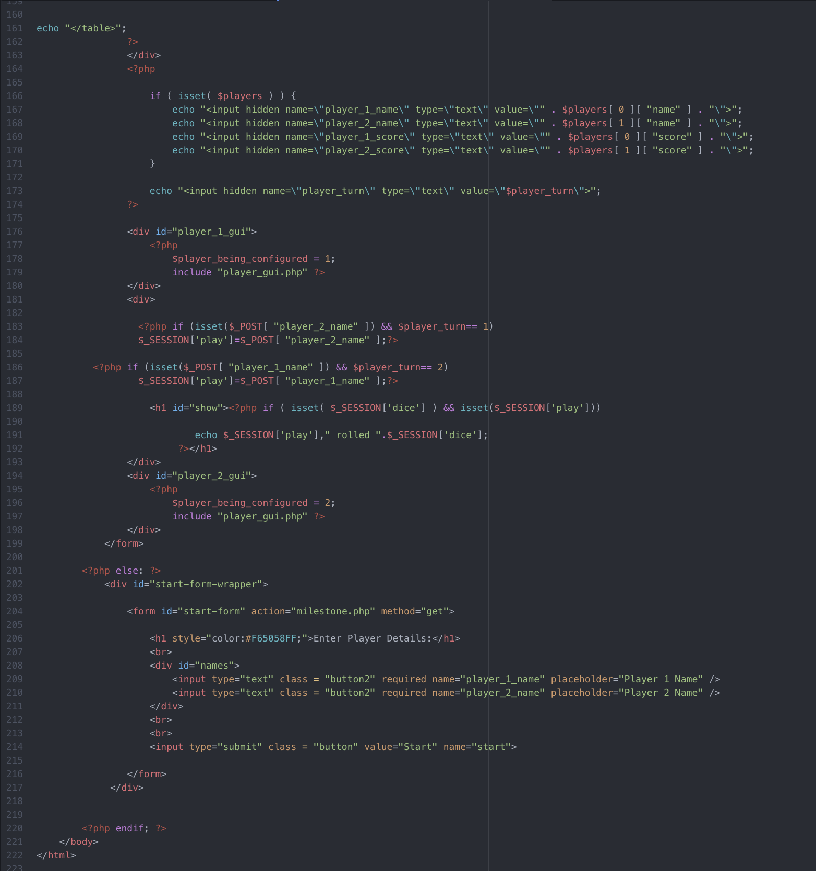
PHP Code

Slide 9
Testing
PHP Sessions
CSS Validator
Safari
Chrome
Mozilla

Slide 10
Tools
XAMP
Sublime and Atom Editor

Slide 11
Challenges
Creating a board
Scoring functionality
Dice functionality

Slide 12


