Slide 1
Internal threat detection B.V. SATYASRIKAR K.J SOMAIYA COLLEGE OF ENGINEERING 1/6/2023 – 31/7/2023

Slide 2
Problem Statement
Internal security threat detection system
Anomaly detection in communication logs
Understand what is normal behaviour and flag anomalies

Slide 3
The Data
Connection logs are received as .json objects in a .txt file
They contain the summary of the connections made
The train data has 601 samples which are 3 months of logs of a single IP
{"source_ip": "10.21.18.101", "destination_ip": "10.11.100.138", "destination_port": 13000, "eventcount": 119, "first_seen": "2023-06-01T04:14:53.184000Z", "last_seen": "2023-06-01T12:20:50.133000Z", "num_src_ports": 110, "num_proto": 1, "total_duration": 131.03564521297812, "total_orig_bytes": 2435638.0, "mad_orig_bytes": 1942.0, "total_orig_pkts": 29942.0, "total_resp_bytes": 13410978.0, "mad_resp_bytes": 206.0, "total_resp_pkts": 20659.0, "num_conn_state": 7, "connstate_SF": 93, "connstate_S3": 10, "connstate_SH": 6, "connstate_S2": 4, "connstate_S1": 3, "connstate_OTH": 2, "connstate_SHR": 1, "periodic_prob": 0.13022523635032635}

Slide 4
Pre-processing
Convert data to CSV form
Connection states information have been dropped
UTC timestamps converted to float form
Source IP has been dropped.
Destination IPs have been converted to float
The number of attributes have been reduced 16 after cleaning.
Perform 0.95 PCA (reduces to 10 dimensions)

Slide 5
Unsupervised Anomaly detection
This is a task of unsupervised learning and has no labelled data.
Therefore, to evaluate which model is best suited there is a need to create a test set.
Two approaches were studied for creating an evaluation set.
Mass Volume/Expected mass
Cross-evaluating
Out of these two the cross-evaluation method was chosen

Slide 6
Creating test set
The test set has essentially 3 components
Manually identified anomalous logs
Logs that are known to be anomalous in nature
Logs from a different IP
Logs form a different IP (Cross evaluation)
Time shifted data
Benign logs with time stamp shifted by 12 hours.
Total test data size was 97 with 61 anomalies and 36 benign cases

Slide 7
Models Tested
Isolation forests
One-Class SVM
DBSCAN
Statistical Profiling
LOF
LSTM
Auto-Encoder
Gaussian Mixture model

Slide 8
Selected Models
Two models were shortlisted: GMM and Auto-encoder(10:4)
GMM makes one cluster and measures the negative log-likelihood and based on a threshold raises anomalies
On the other had an autoencoder trains on benign data and is optimised on its reconstruction loss. A sample with high reconstruction error is considered as an anomaly
The GMM model gave an f1-score of 0.96
The Auto encoder model gave an f1-score 0.991
The final program uses an auto-encoder

Slide 9
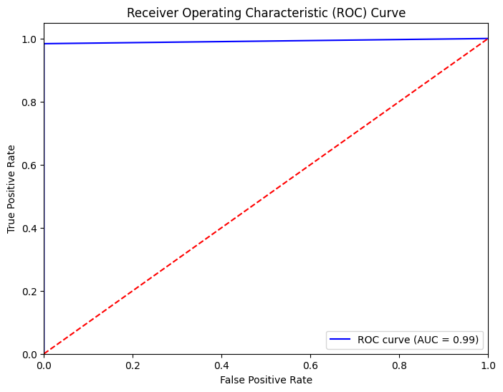
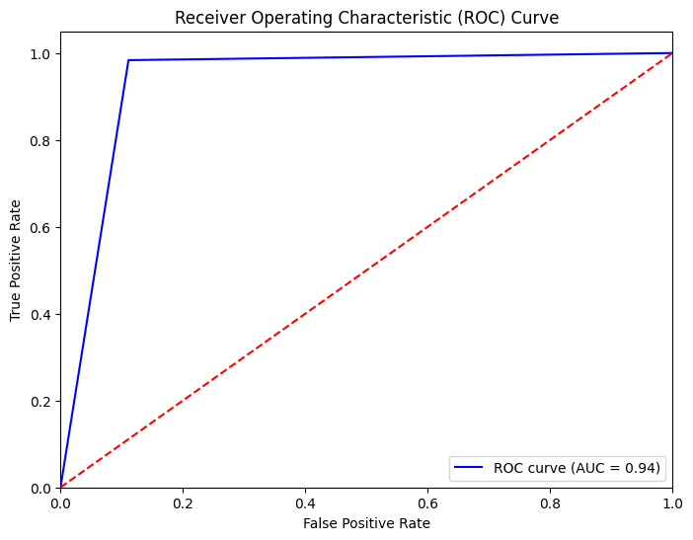
Performance of Models
Auto-Encoder
Gaussian Mixture model

Slide 10
Approach regarding the threshold
Dynamic threshold vs static thresholding
Percentile based vs statistic based threshold
Cross validating a hyper parameter “k” to create the model threshold.
Threshold = mean(reconstruction_error) + k*(std.(reconstruction_error))

Slide 11
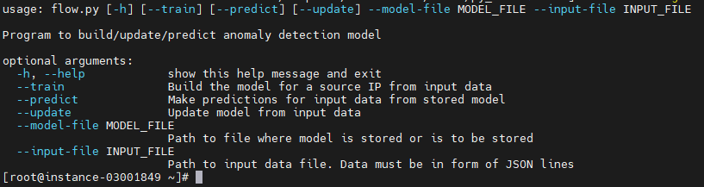
Final program
Takes input data and cleans and pre-processes it
Then depending on the command given does one of the following:
Create model
Predict using model
Update model

Slide 12
Future work
Scaling of project to multiple IPs
Classifying multiple Source IPs in one model
Static threshold approach
Explore significance of connection states

