Slide 1
Distributed learning using iterative step-wise averaging
Course Project: “Resource-/Time-Dependent Learning”
Srikar Chundury

Slide 2
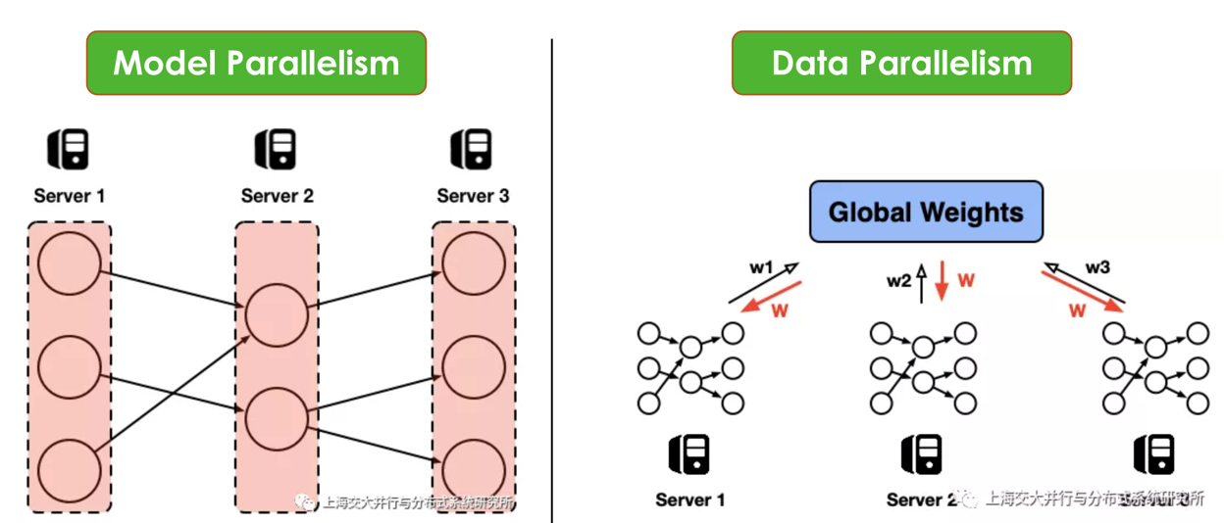
Source: http://www.juyang.co/distributed-model-training-ii-parameter-server-and-allreduce/,

Slide 3
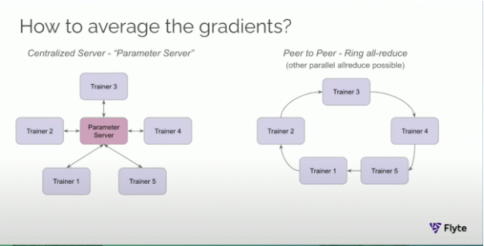
Source: https://www.youtube.com/watch?v=gF3cVTdgLUY

Slide 4
Iterative step-wise averaging
Experiments:
Pair-wise averaging: After each iteration, worker averages its weight and its predecessors weight for next iteration. This is similar to ring-reduce.
Step-wise averaging: In ring all-reduce, as it collects weights from each worker, it instantly triggers the next iteration based on average till that point.
Hypothesis:
Improvements lead to reduced network overhead, leading to improved training convergence time.

