Slide 1
Distributed learning using iterative step-wise averaging
Course Project: “Resource-/Time-Dependent Learning”
Srikar Chundury

Slide 2
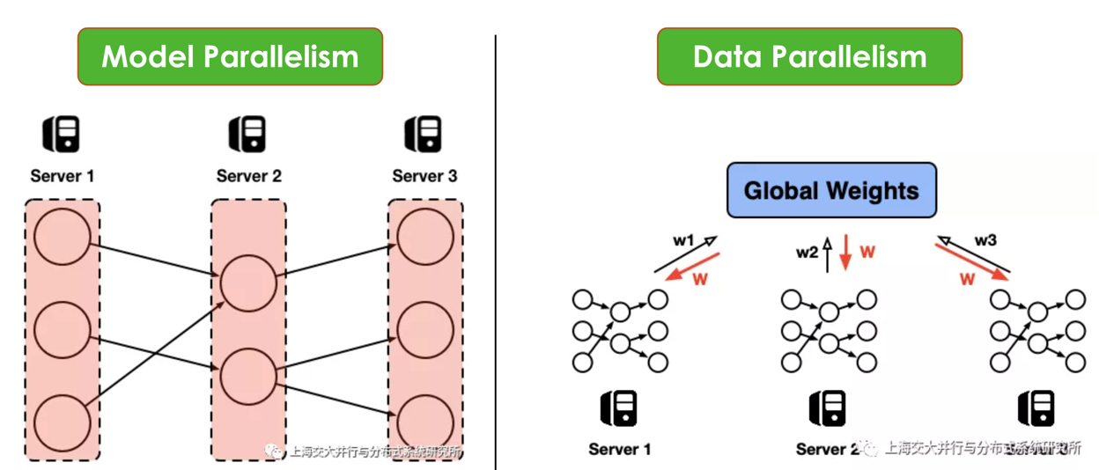
Source: http://www.juyang.co/distributed-model-training-ii-parameter-server-and-allreduce/,
Notes:
2 ways to achieve parallelism-
Model Parallelism: Splitting the network in multiple sub-networks, training the same data on each sub-network.
Data Parallelism: Splitting data into multiple chunks, training the model on all nodes. Each model learns a different set of weights. Hence, after each iteration, the workers communicate with each other to make sure they are training a consistent model- “Synchronous training”.
This gradient averaging step is the bottleneck because all workers are ideal and are waiting for the new set of weights.

Slide 3
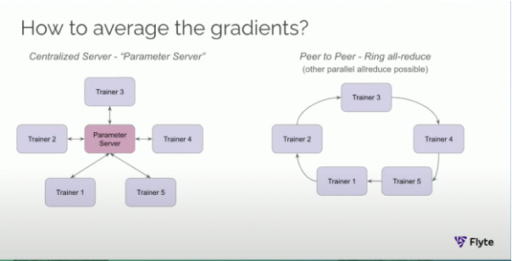
Source: https://www.youtube.com/watch?v=gF3cVTdgLUY
Notes:
A central parameter server that stores the average weight at all times could be used. But, it comes with it still has disadvantages like single point of failure.
Today, uber and lyft train their models using a peer-to-peer approach called ring all-reduce algorithm. It mitigates the bottleneck problem.
The weights learned by each worker travel in a ring format twice:
Once to calculate the average from all nodes.
Again to propagate the average to all nodes.
An alternative is ring-reduce algorithm which had little success because of dropped accuracies and marginal improvement in network activity.
I explore a hybrid approach in this project after performing detailed case studies of the above approaches.

Slide 4
Iterative step-wise averaging
Experiments:
Pair-wise averaging: After each iteration, worker averages its weight and its predecessors weight for next iteration. This is similar to ring-reduce.
Step-wise averaging: In ring all-reduce, as it collects weights from each worker, it instantly triggers the next iteration based on average till that point.
Hypothesis:
Improvements lead to reduced network overhead, leading to improved training convergence.
Notes:
Expectations:
A case study of ring all-reduce vs ring reduce algorithms with horovod framework with a 3VM spark cluster, detailing network activity, latency and models measurables like accuracies etc.
Implementing the new step-wise approach. Compare with ring all-reduce and ring-reduce algorithms. Think about solving the small synchronous step of weight sharing using queues?

