Slide 1
Quantum-Sparse Numerical Library
Blake Burgstahler
Srikar Chundury

Slide 2
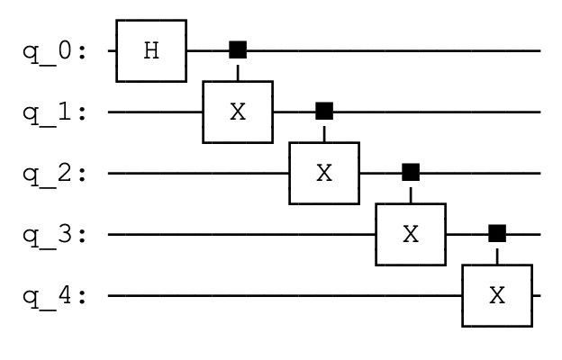
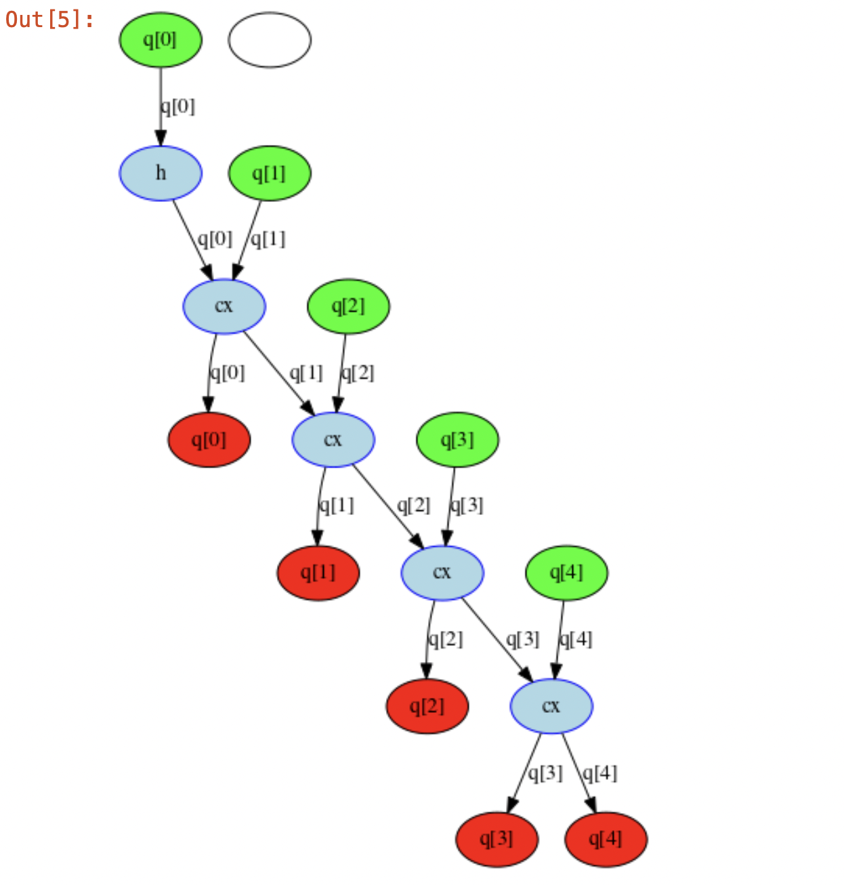
How does simulation work internally?

Slide 3
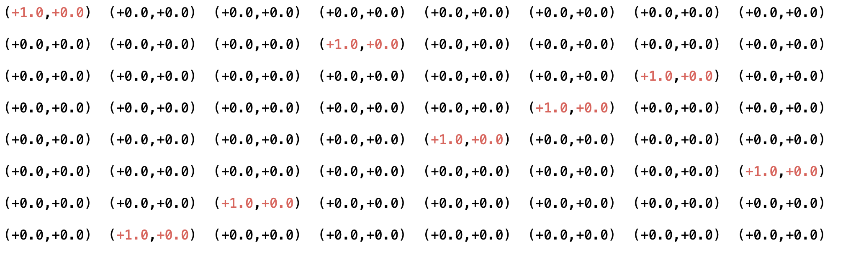
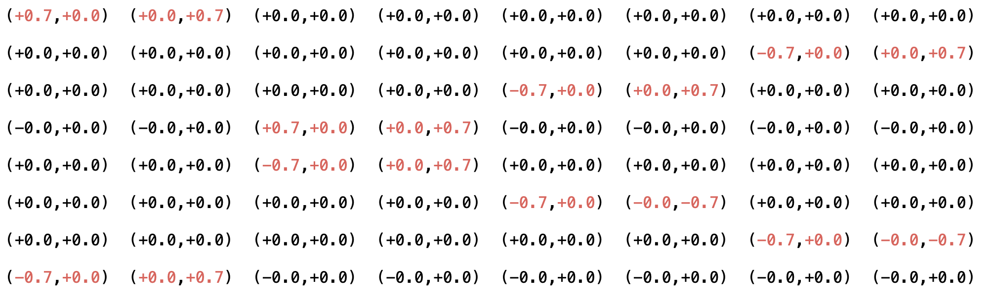
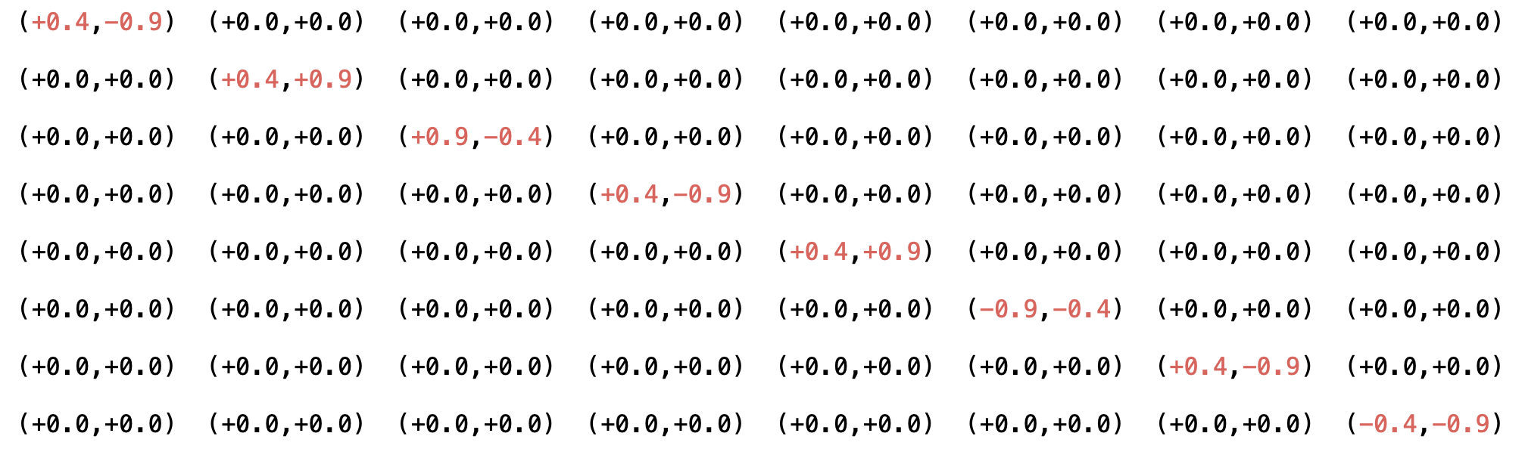
Analyzing Quantum Sparsity
Supermarq's GHZ circuit
Supermarq's Mermin Bell circuit
Supermarq's Hamiltonian circuit

Slide 4
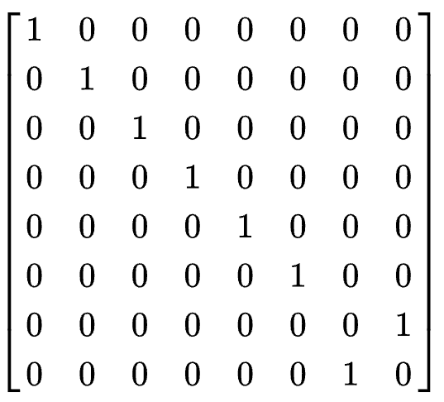
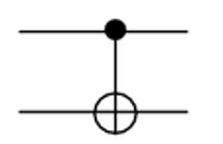
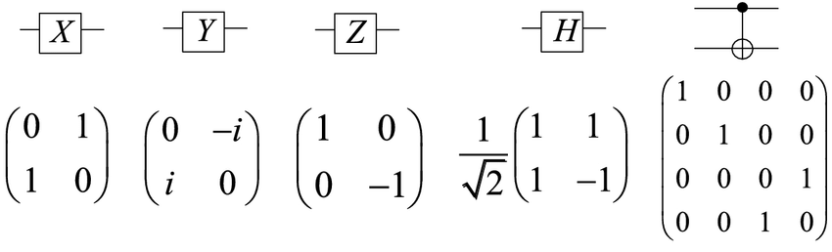
Simplifying Assumptions
”Tensors” :: Matrices
Tend to be very sparse
Non-zeros tend to be +/- 1 (potentially scaled)
Non-zeros tend to fall on diagonals

Slide 5
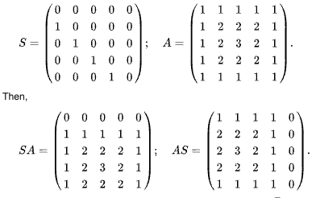
Focus on Diagonals
Matrix Product :: Only requires diagonals
Product of diagonals: O(n)
  Each of which is a shift and elementwise multiplication
Overall: O(d₁*d₂*n)
‘Sparse Diagonals’ and ‘Compressed Sparse Diagonals’
Notes:
Diagonals:
(dxd) Diagonal-Diagonal Products
Each O(n)
Overall: O(d x d x n)

Slide 6

Experiments
SupermarQ Benchmark: 10 qubit circuit 1024x1024 matrix
  GHZ (9 matrix multiplications)
  Mermin Bell (78 matrix multiplications)
  Hamiltonian (37 matrix multiplications)
Exported the intermediate matrices (gate unitaries) using Qiskit to .npz files.
Imported them and read them into our data structure and ran multiplications serially.
TODO: Run of ARC for larger #qubits and randomly generated matrices. Implement "Compressed Sparse Diagonal" version.

Slide 7
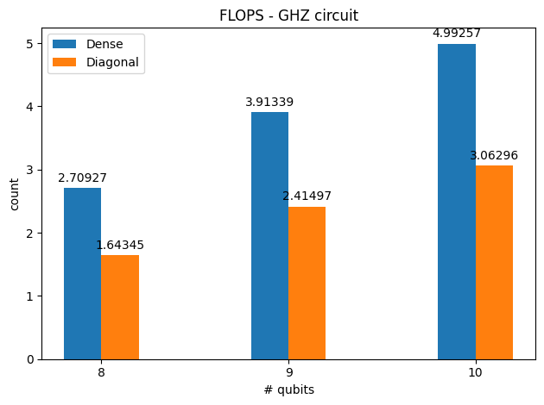
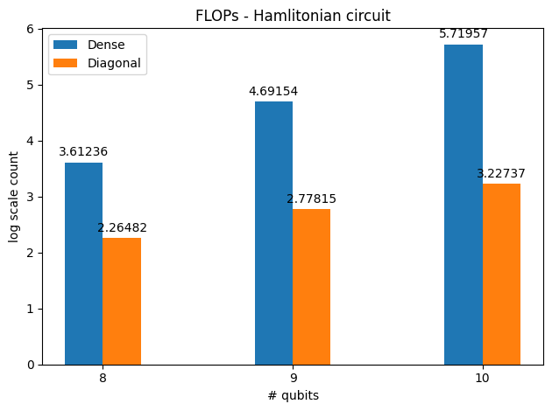
Sample Results
Supermarq's GHZ circuit
Supermarq's Hamiltonian circuit

Slide 8

Questions?

