Slide 1



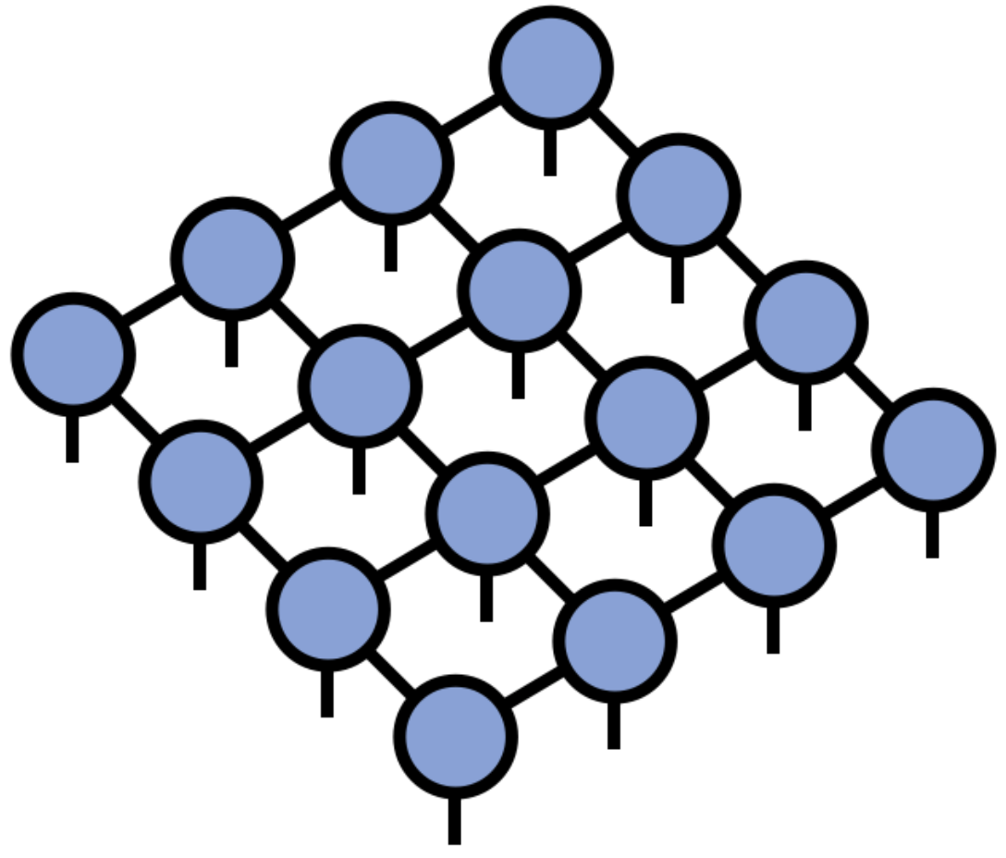
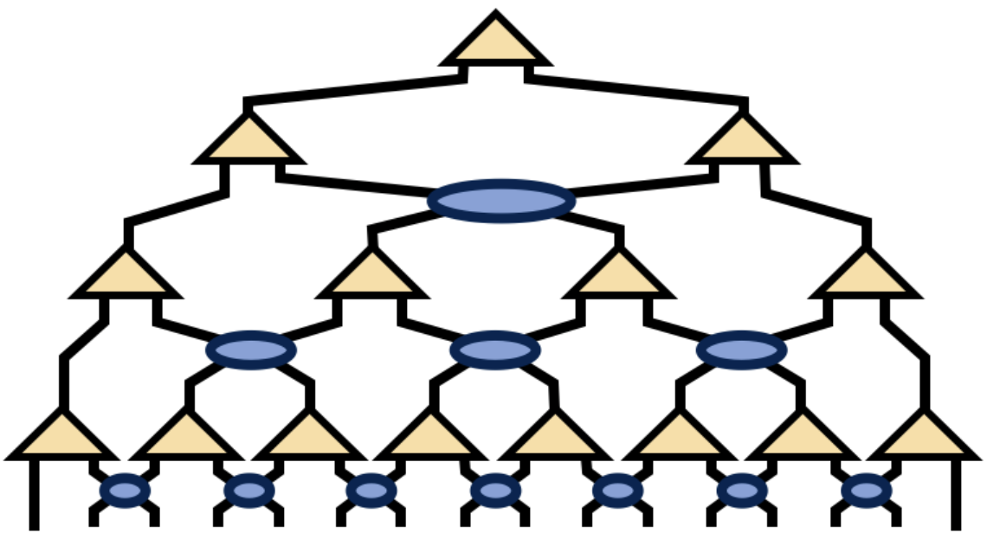
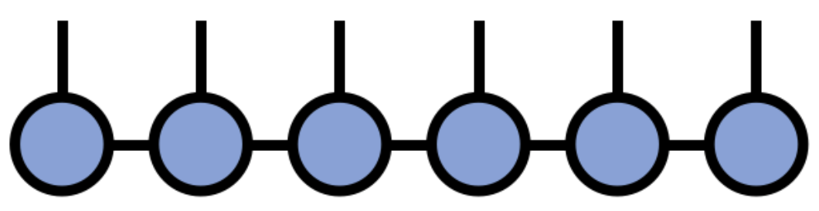
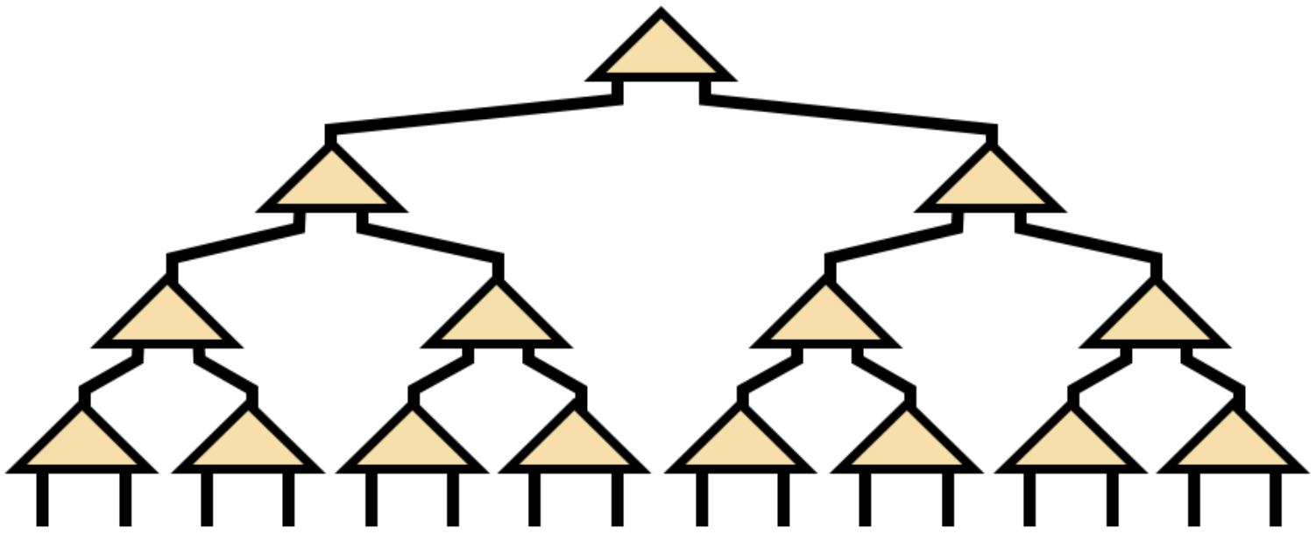
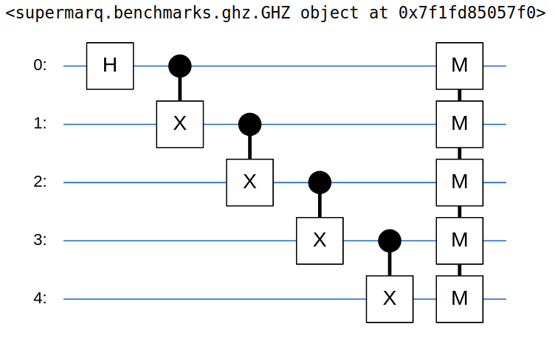
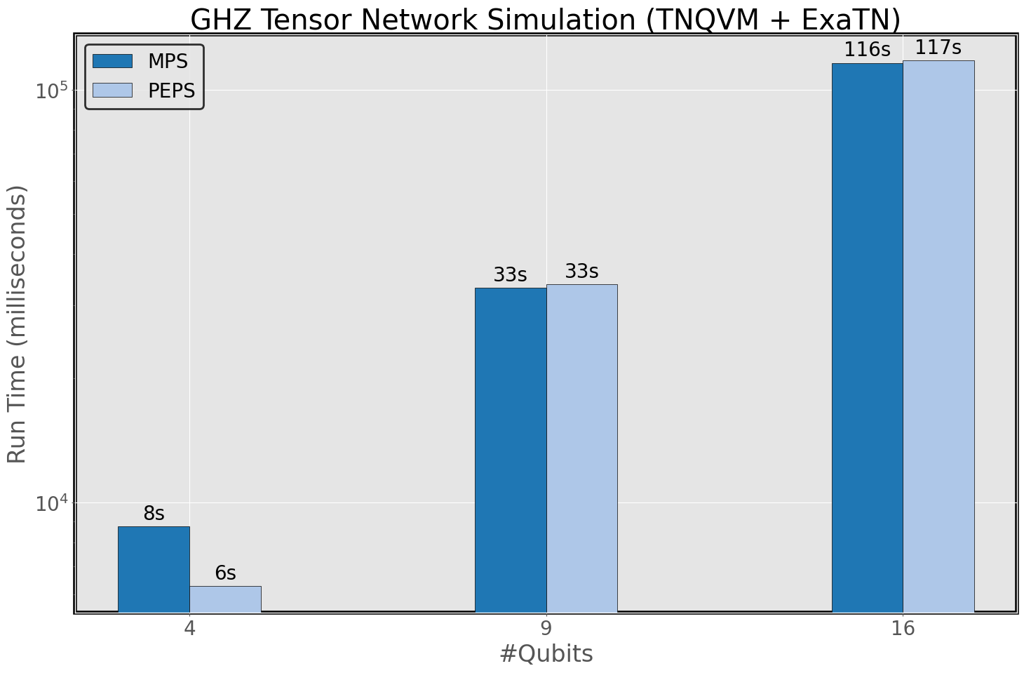
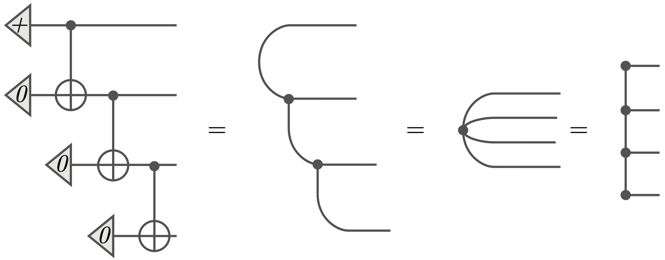
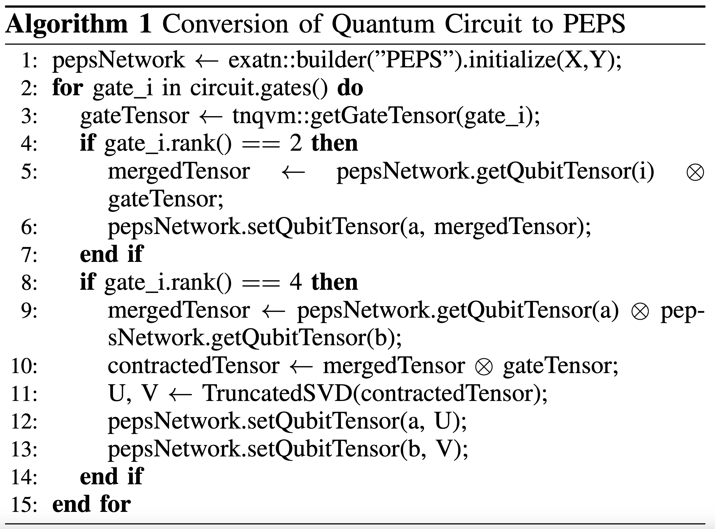
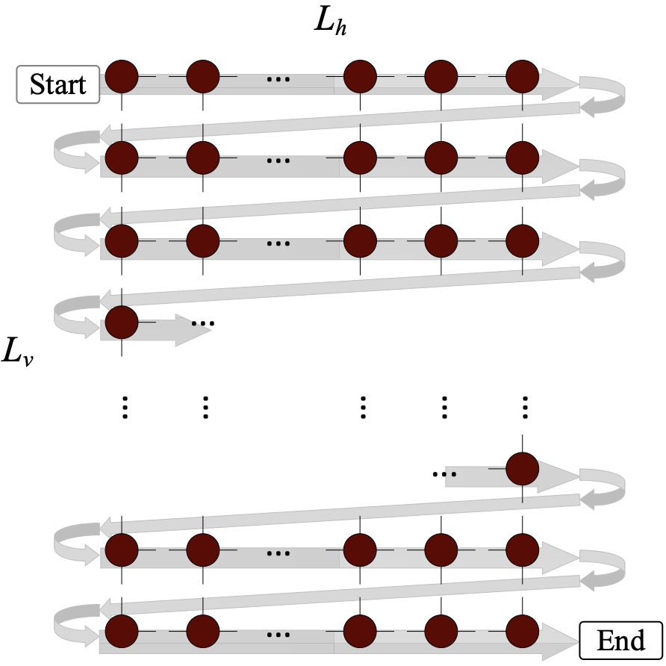
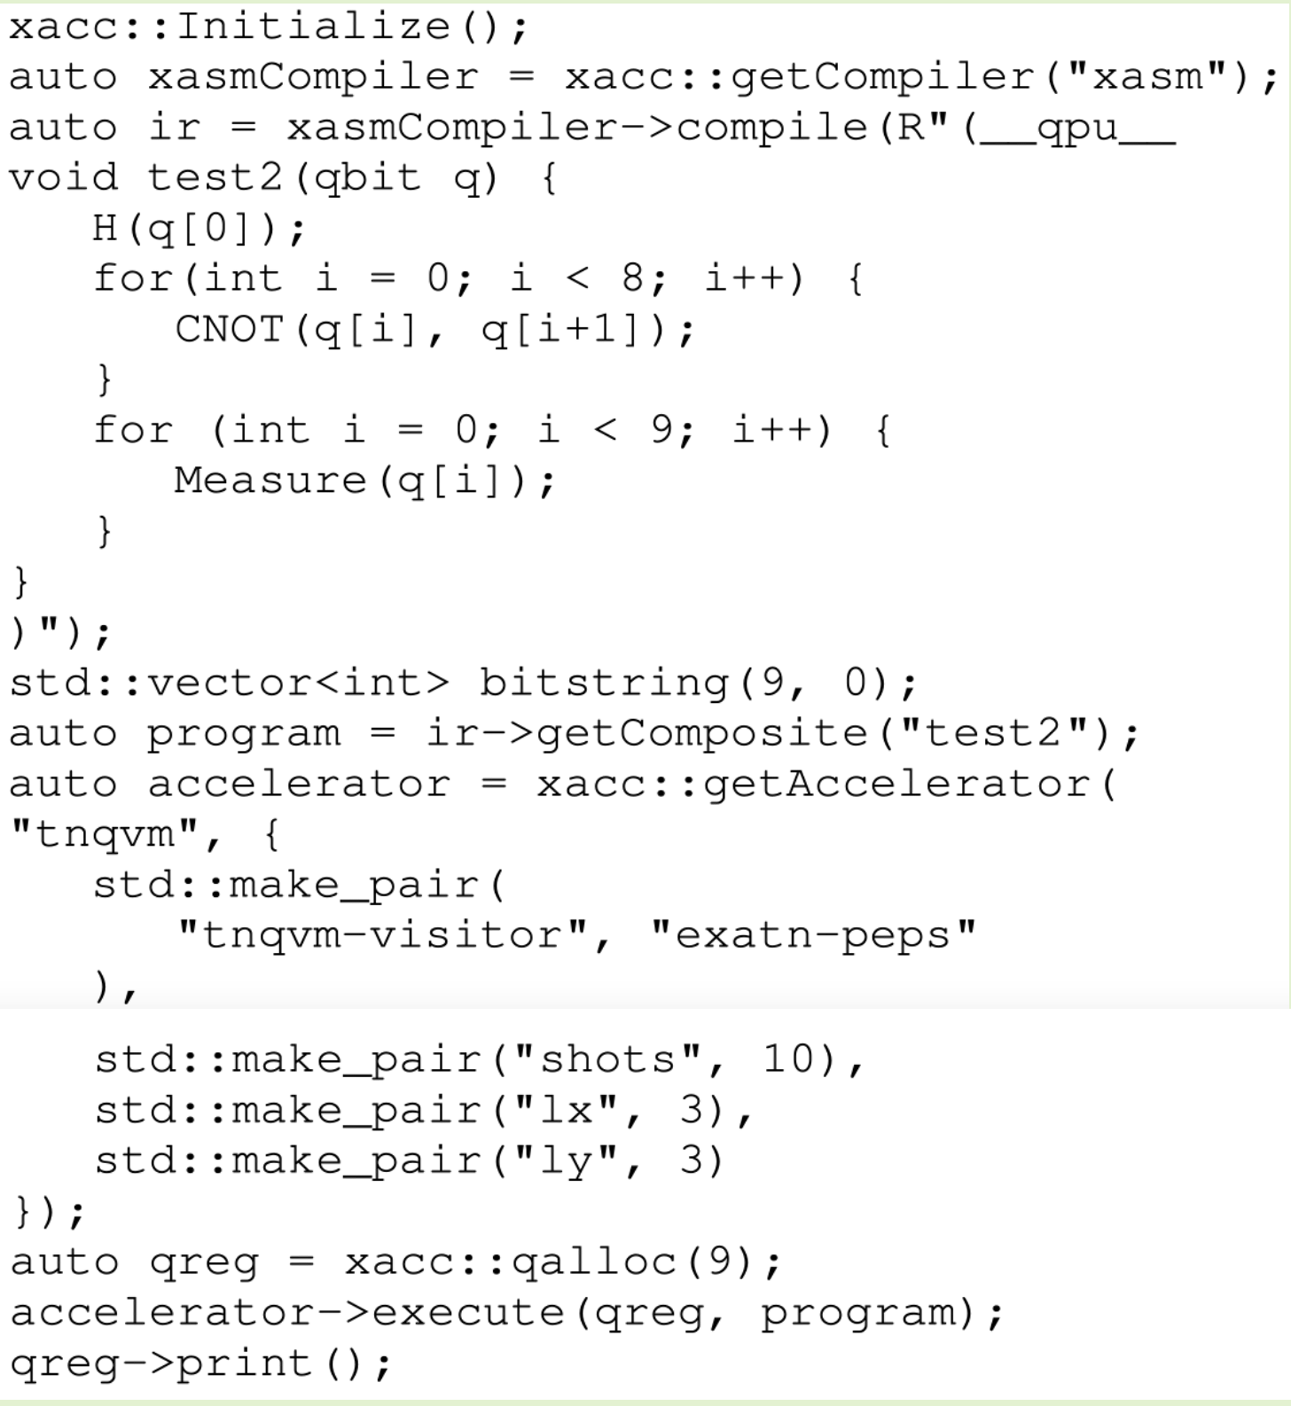
A PEPS plugin for TNQVM
S. Chundury^{1,2}, J. Lietz¹, E. A. C. Pérez², A. Shehata¹, I.-S. Suh¹, and F. Mueller²
¹ National Center for Computational Sciences, Oak Ridge National Laboratory, Oak Ridge, TN 37830
² Department of Computer Science, North Carolina State University, Raleigh, NC 27606
Summary
Here we integrate the Projected Entangled Pair State (PEPS) tensor network topology with Tensor Network Quantum Virtual Machine (TNQVM) and implement the snake boundary contraction algorithm leveraging pre-implemented topologies like MPS and MPO
2 Step Process ➔ Represent a Quantum Circuit as a PEPS tensor network
➔ Contract this tensor network using approximate algorithms for observables
Fig (1) MPS [3]
Fig (2) TTN [3]
Fig (3) PEPS [3]
Fig (4) MERA [3]
Motivation
Quantum Circuit to TN
Preliminary Results
2D Tensor Network (PEPS)
  Efficiently represent quantum many-body systems in two or higher dimensions
  2D Hamiltonians
Conversion to PEPS can be tricky to visualize!
All methods used in the above algorithm are pre-implemented in TNQVM already
Runtime(PEPS) ≈ Runtime(MPS)
Test of correctness using the PEPS plugin for the GHZ quantum circuit
Background
Fig (7) GHZ Quantum Circuit
Quantum Hardware
Simulators
XACC
IBM Q
IonQ
TNQVM
Visitor
iTensor
MPS
MPO
TTN
PEPS
exaTN
Graph Executor
cuQuantum
cuTENSOR
Node Executor
ExaTENSOR
TAL-SH
Fig (9) MPS vs PEPS for GHZ
Fig (8) GHZ Quantum Circuit to MPS [4]
Conclusion
This new “visitor”, PEPS, enables 2D tensor network simulation capturing multidimensional entanglement
Merit: Utilizes pre-developed tensor network topologies, such as MPS and MPO → contraction of PEPS
Fig (5) HPC Quantum Software Stack
Approach
Snake Boundary Algorithm
  Zig-Zag Pattern [2]
Re-use existing visitor features
Contraction sequence from above step → MPS Visitor
Build a new MPS Tensor Network (ExaTN)
Contract this MPS using pre-implemented methods
Future Work
Extensive tests and benchmarking at scale, for problems asking for 2D entanglement representation
Explore other PEPS approximate contraction algorithms
Explore sparsity induced in PEPS Tensor Networks
Plugin Usage (GHZ-9)
GHZ Circuit
References
[1] McCaskey, Alexander J. Tensor Network Quantum Virtual
Machine (TNQVM). Computer software.
https://www.osti.gov//servlets/purl/1340180. Vers. 00.
USDOE. 18 Nov. 2016. Web.
[2] Guo C, Liu Y, Xiong M, et al. General-Purpose Quantum
Circuit Simulator with Projected Entangled-Pair States and
the Quantum Supremacy Frontier. Phys Rev Lett.
2019;123(19):190501. doi:10.1103/PhysRevLett.123.190501
[3] https://tensornetwork.org
[4] Jacob Biamonte and Ville Bergholm. "Tensor Networks in
a Nutshell." 2017. arXiv:1708.00006 [quant-ph].
Fig (6) Snake PEPS contraction
PEPS Visitor Meta
Execute
This work was supported in part by NSF grants 2217020, 2120757 and 1818914. This research used resources of the Oak Ridge Leadership Computing Facility at the Oak Ridge National Laboratory, which is supported by the Office of Science of the U.S. Department of Energy under Contract No. DE-AC05-00OR22725.

