Slide 1


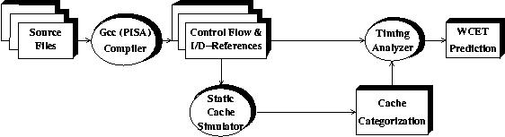
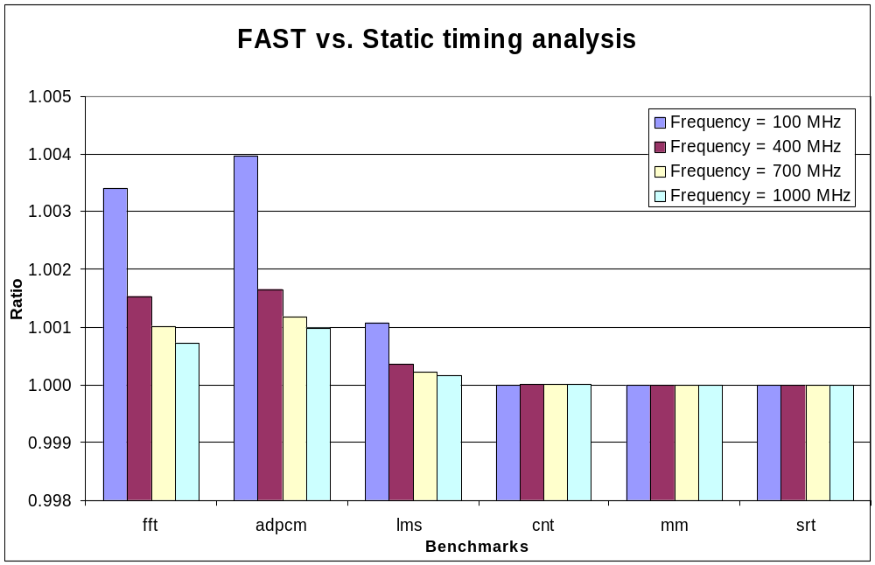
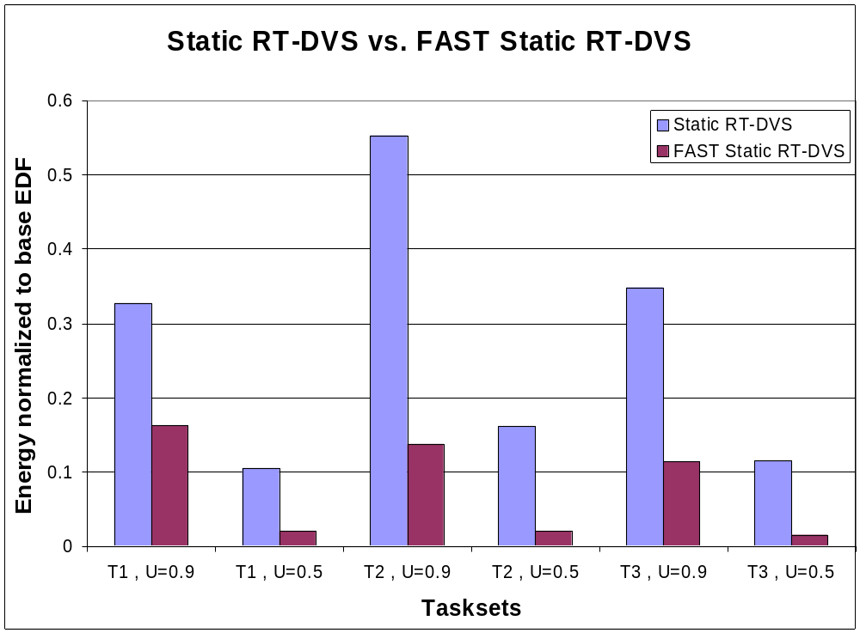
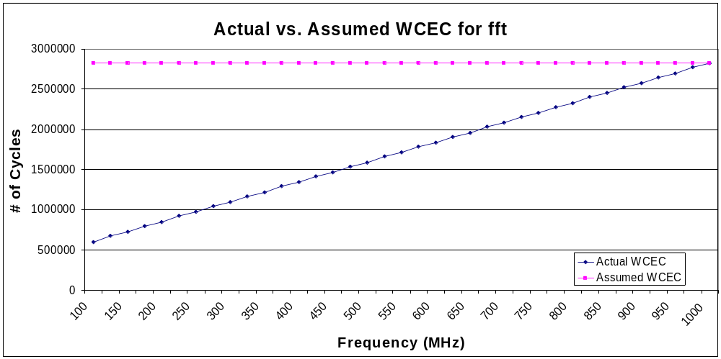
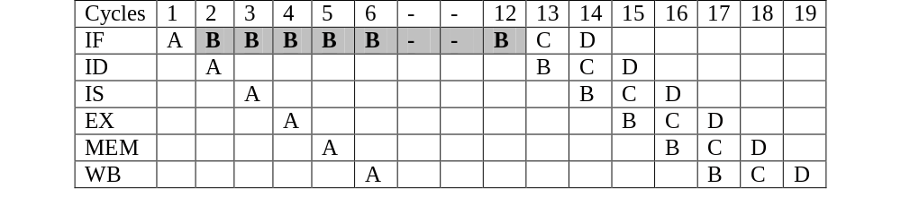
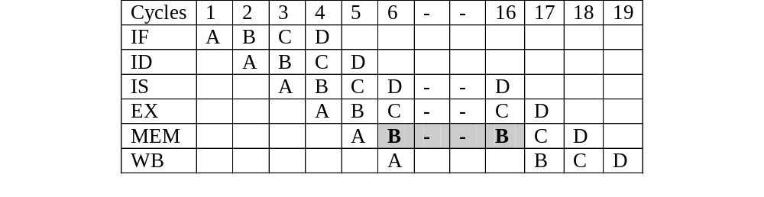
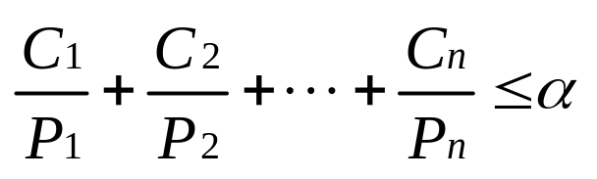
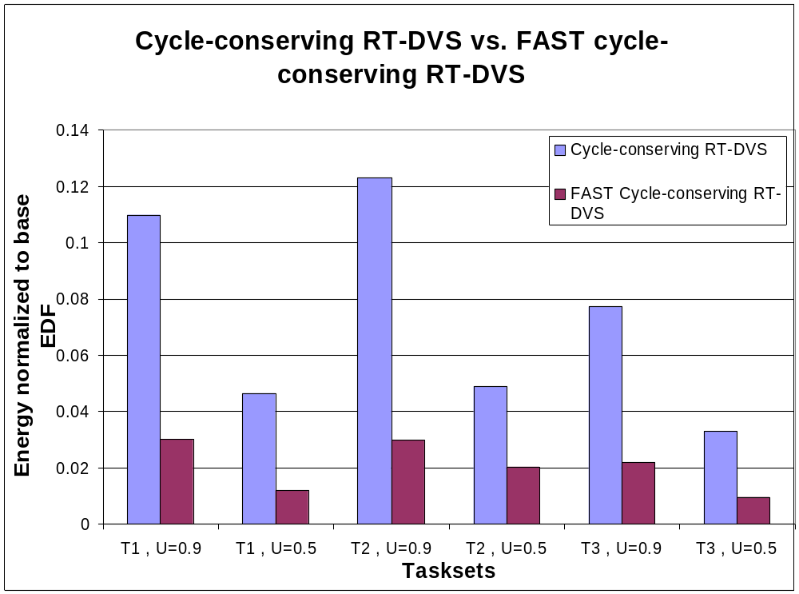
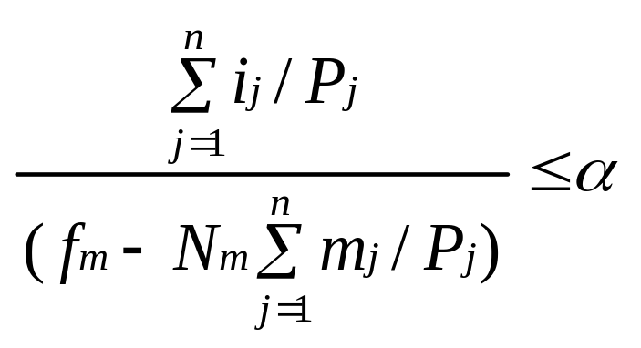
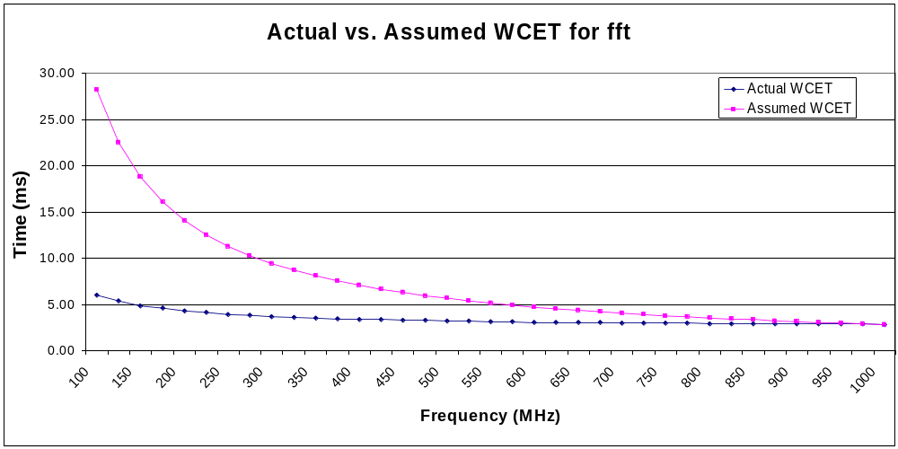
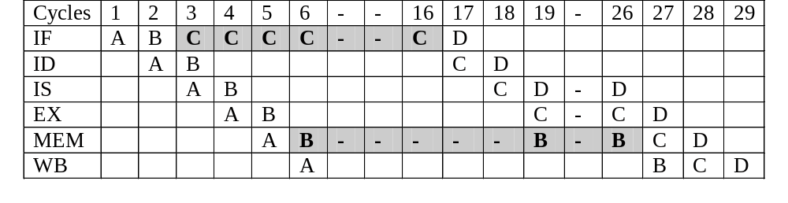
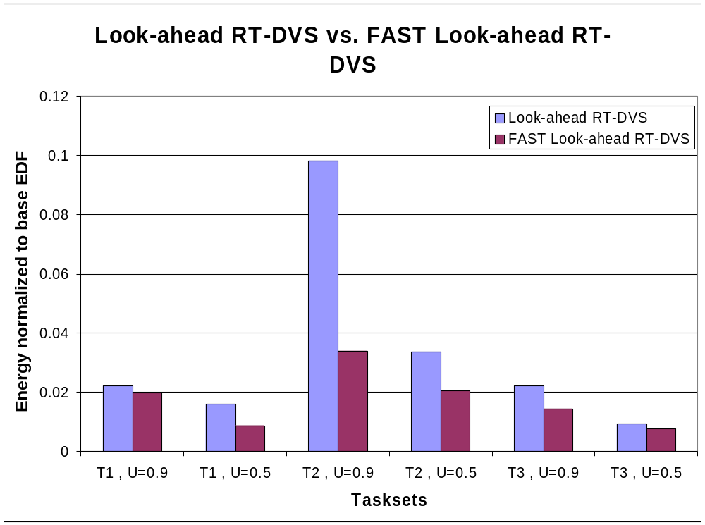
FAST: Frequency-Aware Static Timing Analysis
Kiran Seth & Aravindh Anantaraman
Center for Embedded Systems Research
North Carolina State University
Advisors: Dr. Frank Mueller & Dr. Eric Rotenberg
Motivation
Solution
Results
Scheduling in Real-Time systems requires
  Worst-case Execution time (WCET) and
  Worst-case Execution Cycles (WCEC)
Dynamic Voltage Scaling (DVS) saves energy
  Good fit for Real-Time Systems.
Calculate WCEC
  accounting for effects of memory accesses.
  new parametric frequency model.
Parametric Frequency Model
WCEC = i + mN
    i: Ideal # of worst-case cycles (for non-memory operations).
    m: Total # of worst-case memory accesses.
    N: # of cycles for memory access.
      Depends on frequency and memory latency.
Features of the frequency model
  can be used with any simple pipeline.
  can easily be incorporated into scheduling schemes.
  use of caches with the frequency model is optional.
Frequency Model
Static timing analysis tool
Frequency-Aware Static Timing Analysis (FAST) tool.
Static timing analysis
Traditional static timing analysis tool
Problem
6 C-lab benchmarks used (fft, adpcm, lms, cnt, mm and srt).
DVS schemes assume that with frequency modulation
  WCET scales linearly.
  WCEC remains constant.
Current DVS schemes ignore the effects of frequency scaling on WCET.
Assumption
  valid for most operations.
  BUT not valid for memory operations → constant memory latency systems.
DVS schemes overestimate WCET at lower frequencies.
  Cannot fully utilize available slack.
  Power savings potential largely wasted.
Extent of overestimation of WCET depends on cache analysis.
Not true ?
Using the Parametric Frequency Model
Consider the following sequence of instructions simulated through a simple pipe.
    A: add R2, R1, R3
    B: load R4, [M1]
    C: add R2, R1, R4
    D: add R2, R1, R5
The simple pipeline has 6 stages, a data and instruction cache for N = 10.
Overestimation by FAST tool is less than 1 %.
Frequency model improves DVS schemes → accurate WCET.
Implemented frequency model for 3 DVS algorithms (by [Pillai and Shin]).
Improved energy savings.
WCET and WCEC for 6-stage pipeline with caches for C-lab benchmark fft.
The 3 FAST DVS schemes are compared with the original algorithms.
3 tasksets composed of C-lab benchmarks.
utilizations = 0.5 and 0.9
Example 1: Capturing effect of I-cache miss (WCEC = 9 + 1N )
Original DVS schemes use :
FAST DVS schemes use :
Assumed WCEC is always the WCEC at the highest frequency.
Example 2: Capturing effect of D-cache miss (WCEC = 9 + 1N )
Static DVS scheme: most energy savings
FAST equations: lower power in
  cycle-conserving
  look-ahead
Example 3: Capturing effect of I-cache and D-cache miss (WCEC = 9 + 2N )
Assumed WCET is overestimated as compared to actual WCET.
As N changes with frequency, the frequency model accurately measures WCEC.
Benefits for FAST are observed in all cases.

