Slide 1


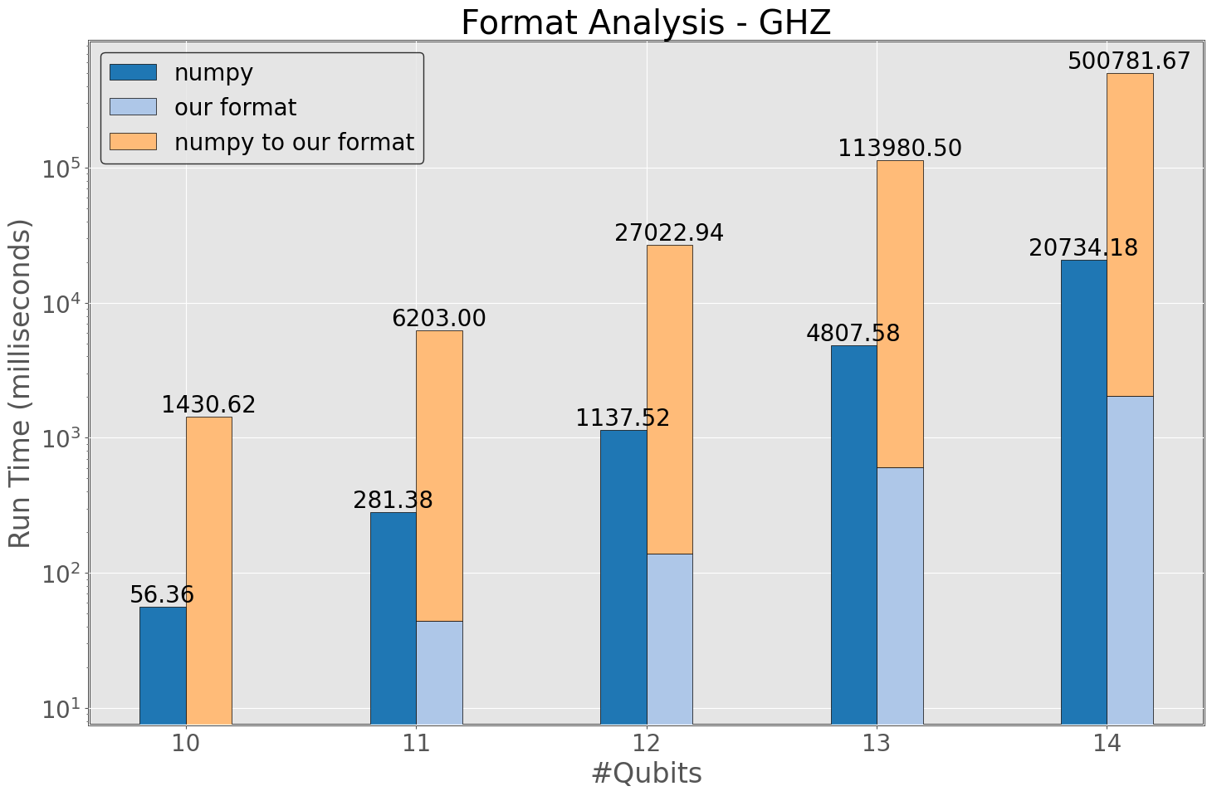
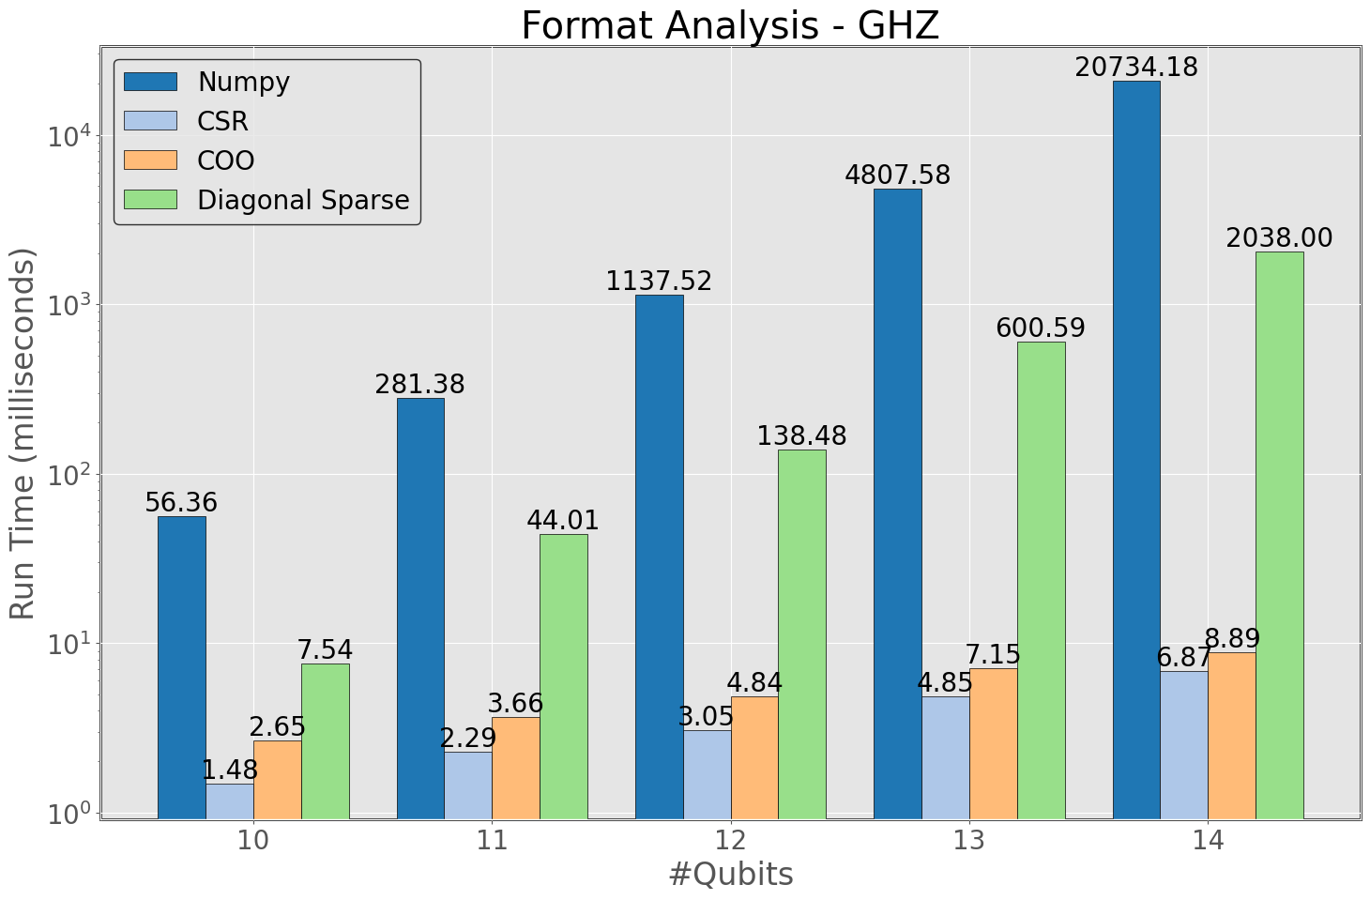
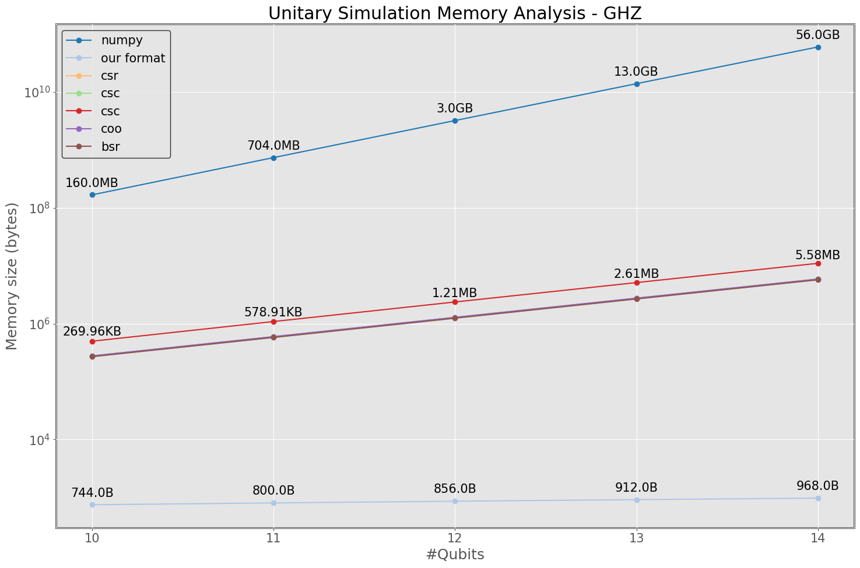
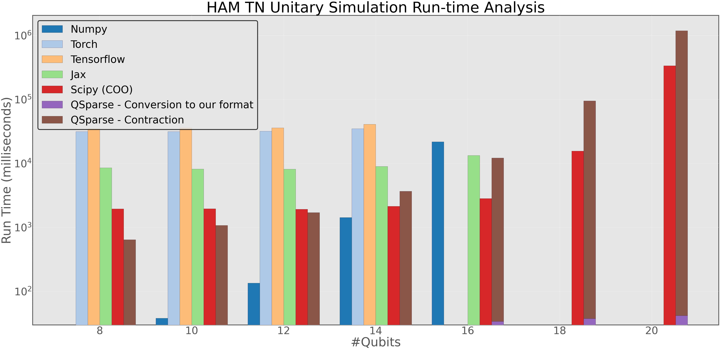
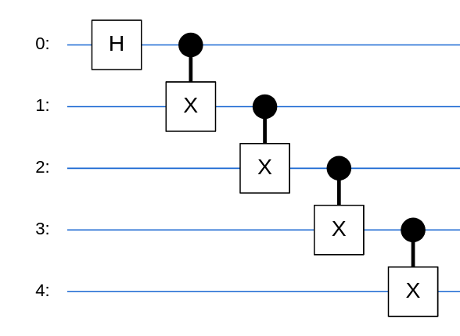
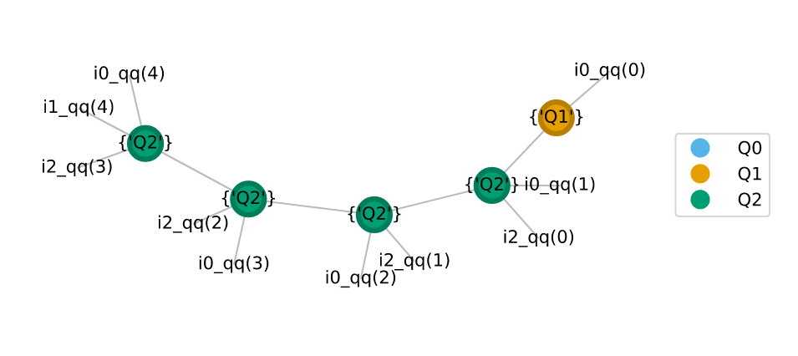
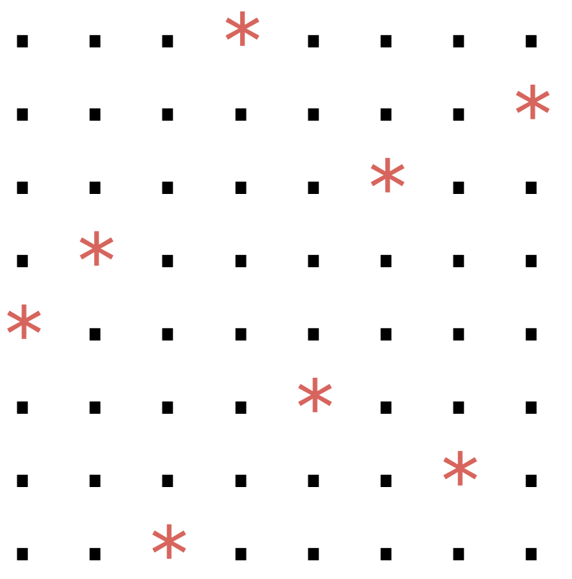
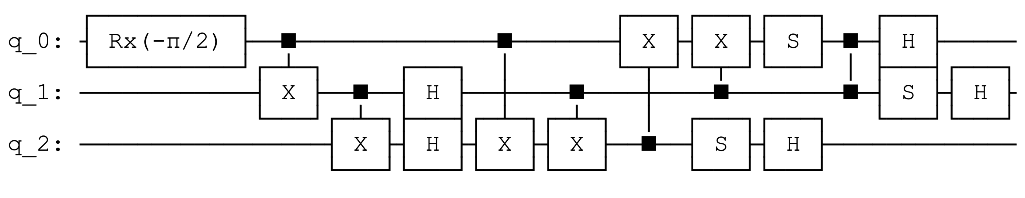
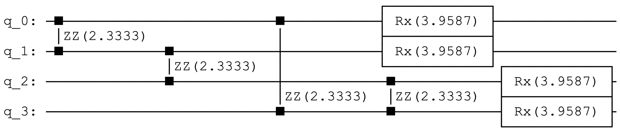
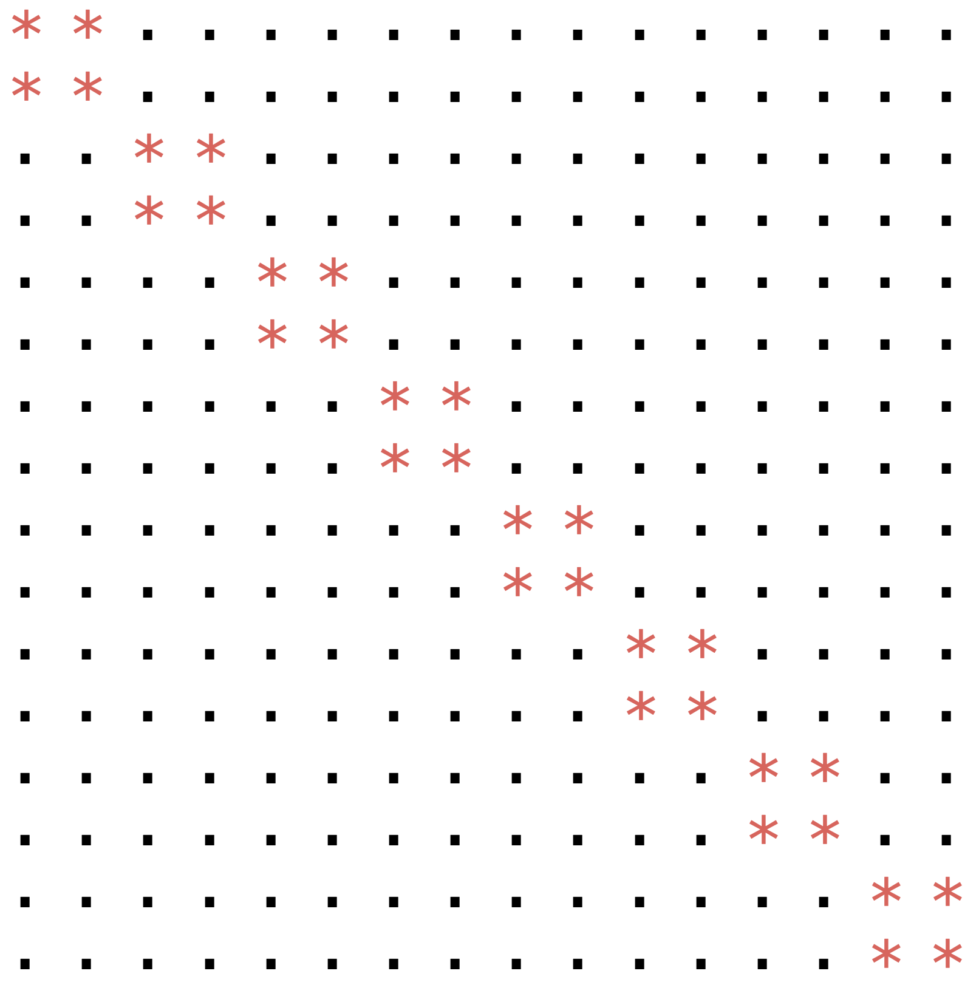
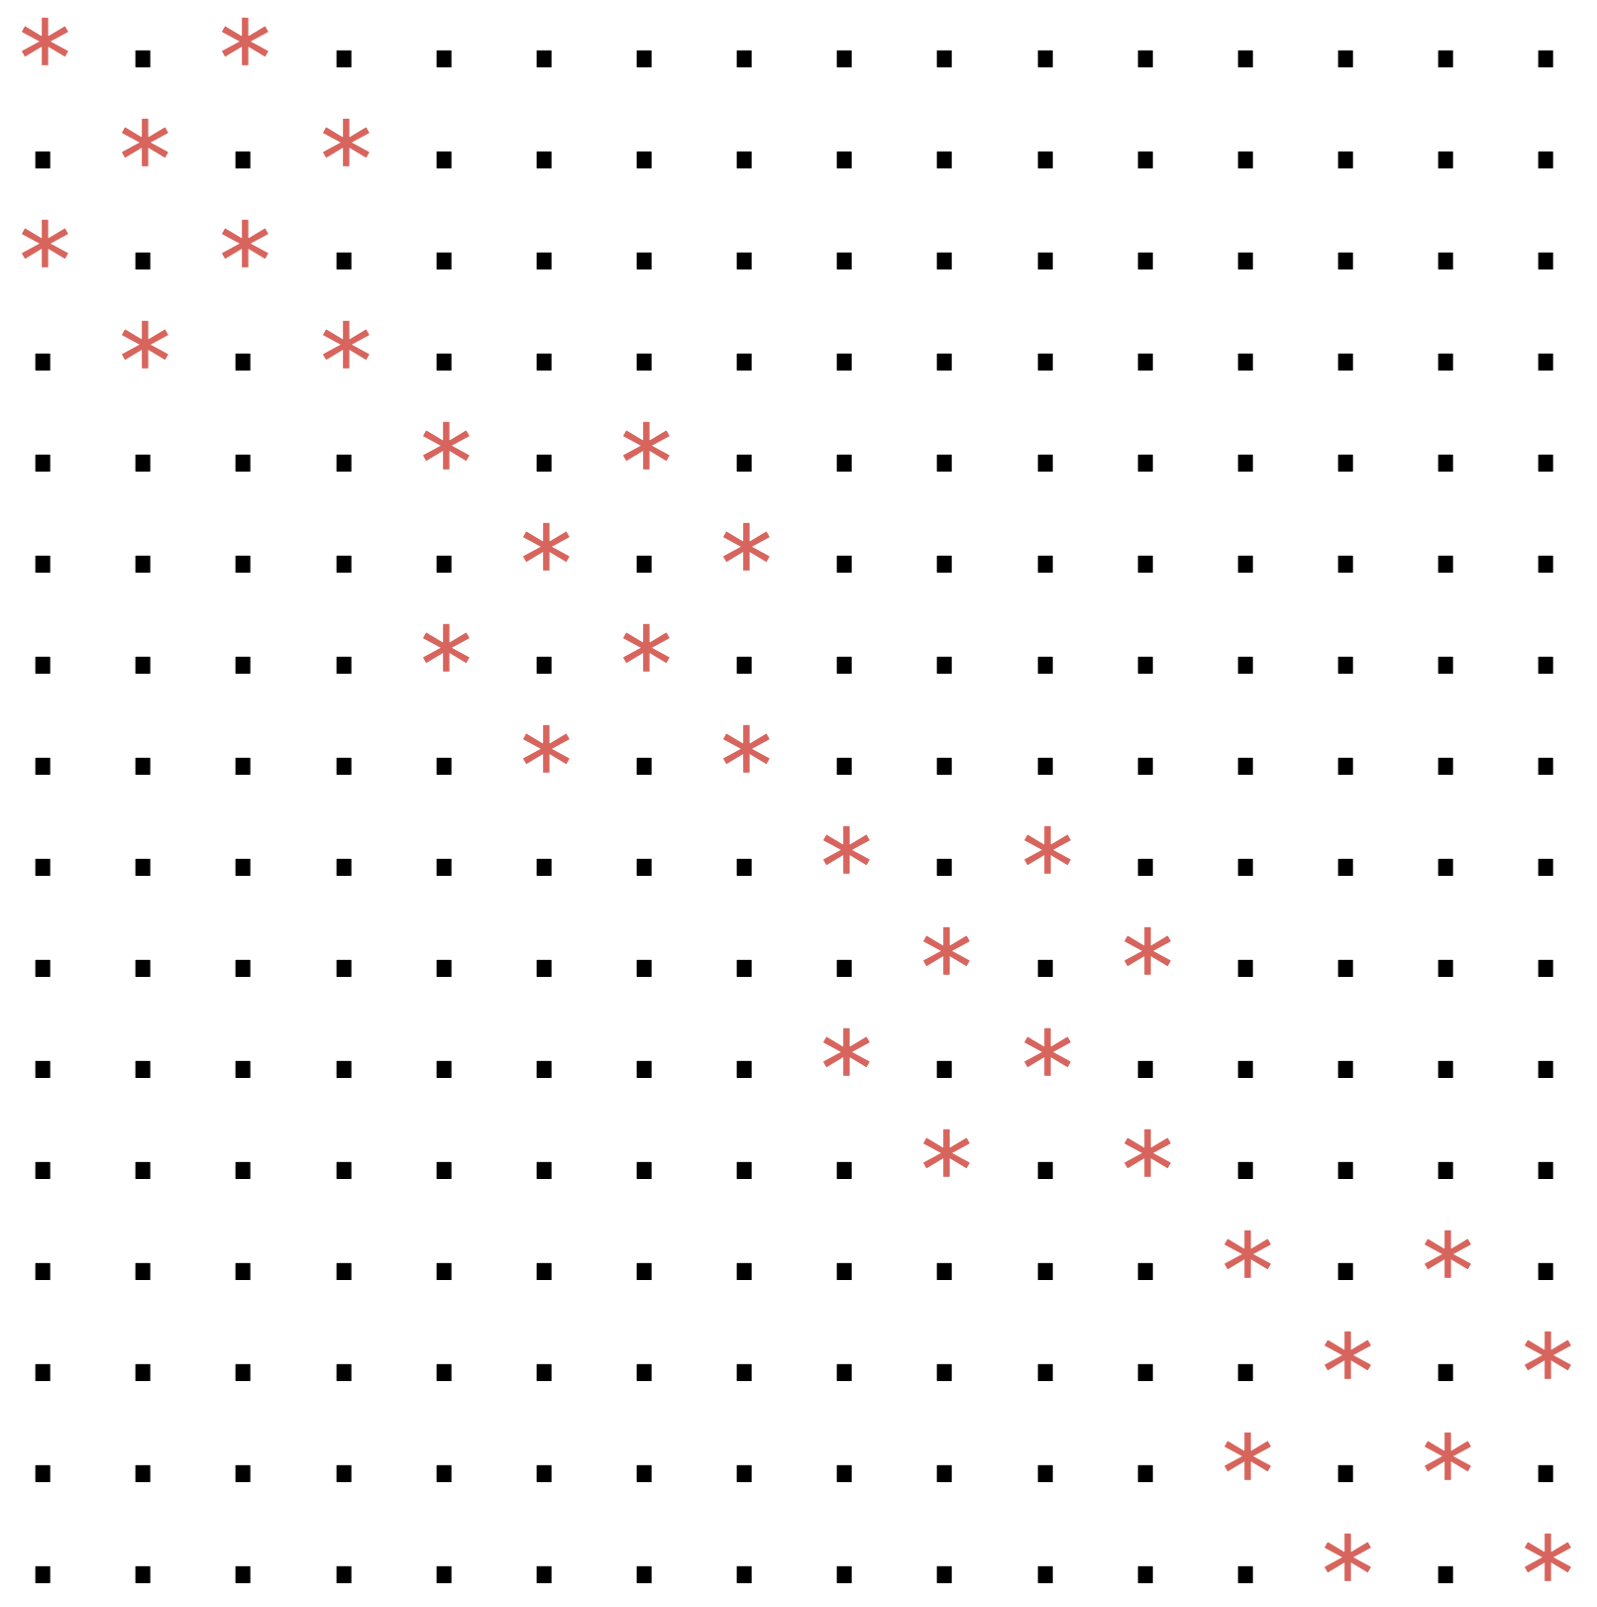
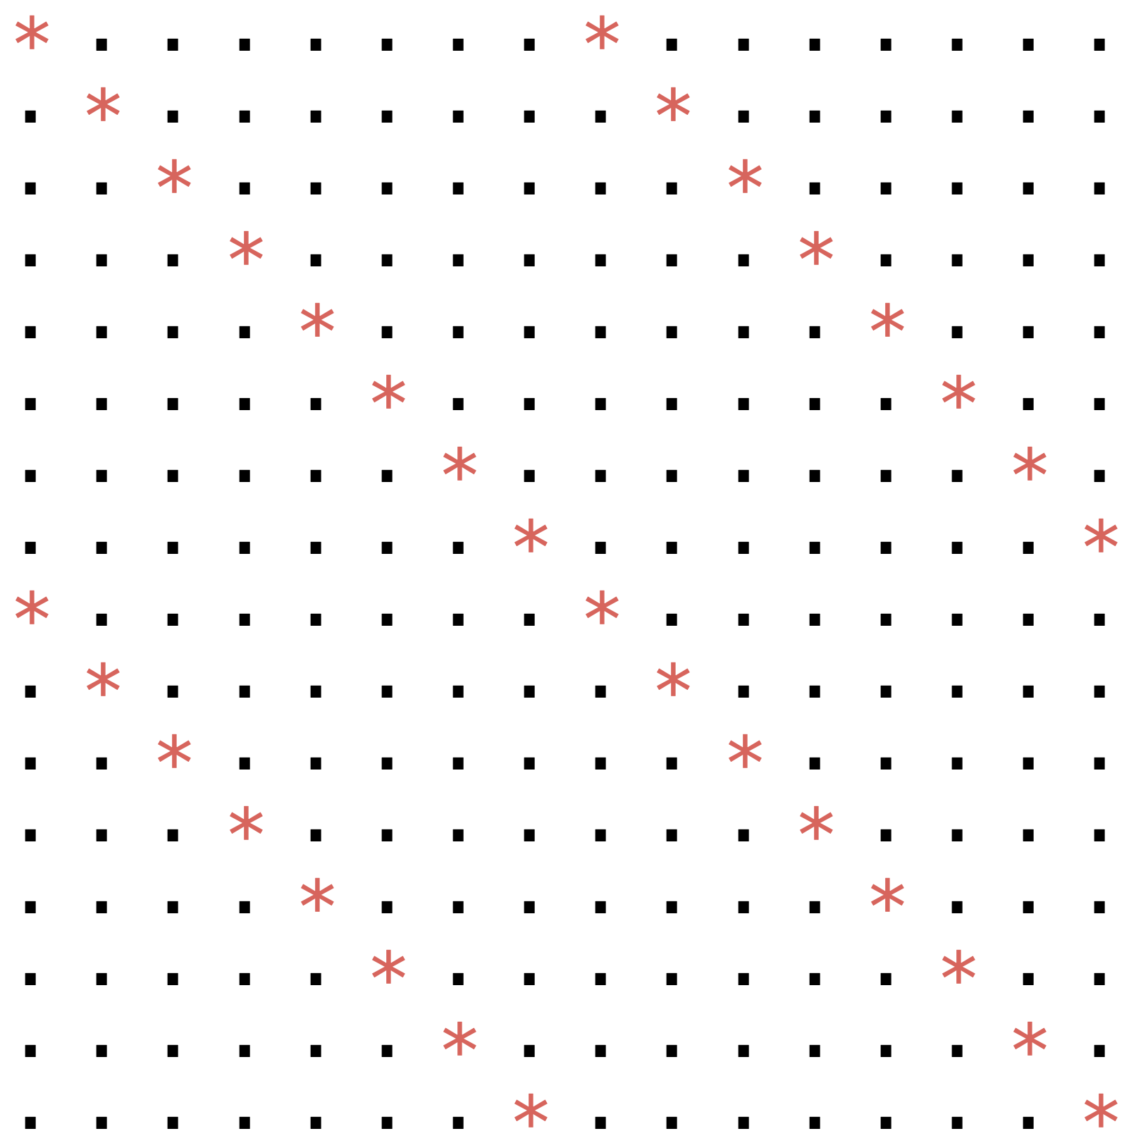
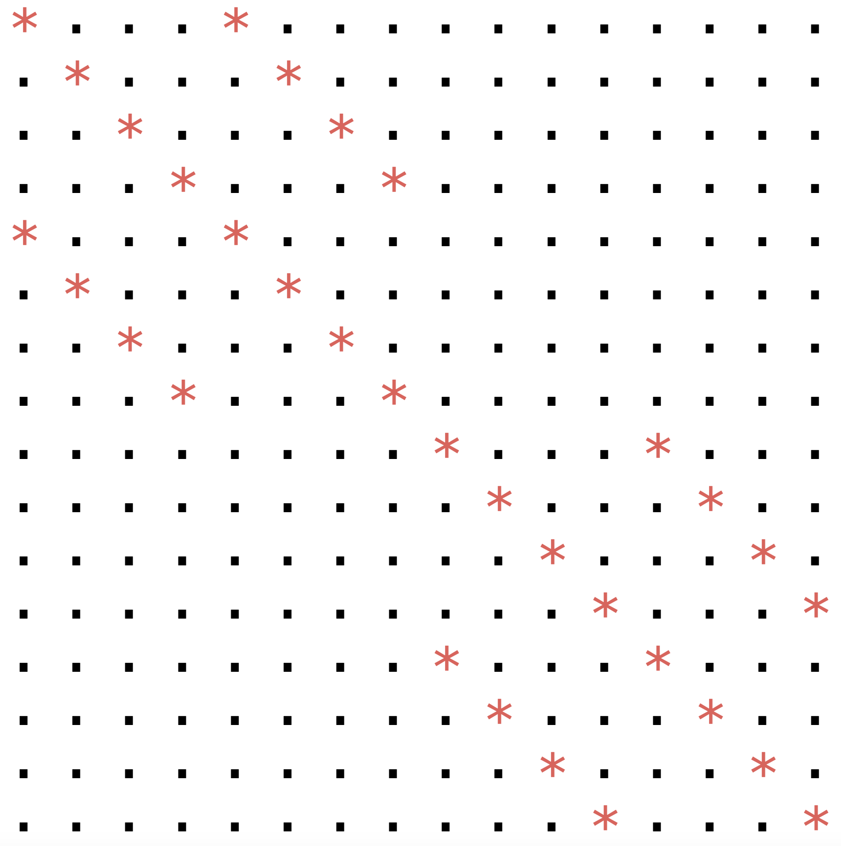
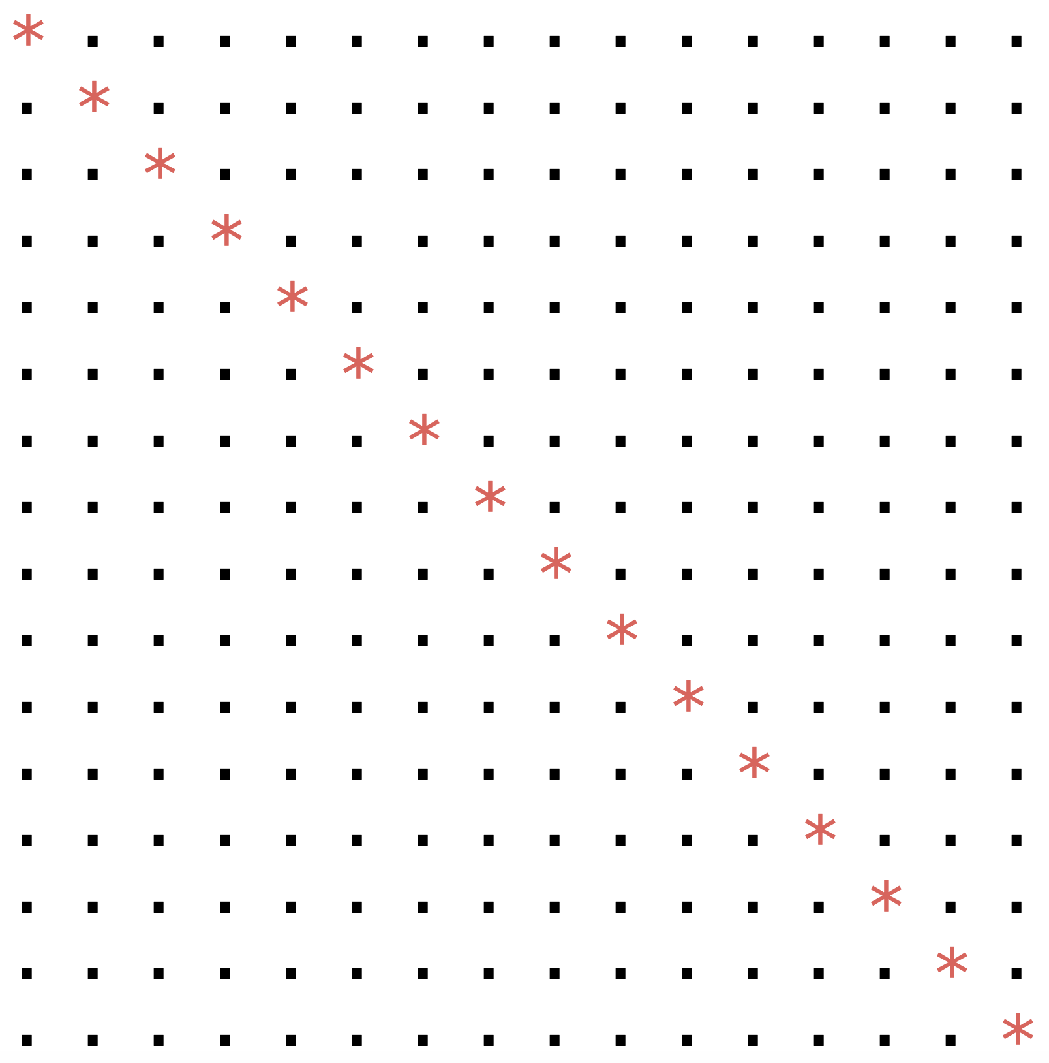
A Novel Approach to Sparsity in Quantum Simulations
Srikar Chundury^{1,2}, In-Saeng Suh², and Frank Mueller¹
¹ Department of Computer Science, North Carolina State University
² National Center for Computational Sciences, Oak Ridge National Laboratory
Problem
Solution
Results
Efficient simulation methods → crucial for quantum algorithms
  High cost
  Error-prone
  Decoherence
State Vector method does not scale well
  Memory requirements grow exponentially
Tensor Networks
  Break large tensors into a network of multiple tensors interconnected by bond interactions
  This approach delays the need for greater memory requirements until later contraction stages
Conserving Memory → crucial to enable the scalability of quantum simulations to large number of qubits
Exploit these patterns → new sparse data format
    Like SciPy[4] DIA but for arbitrary number of diagonals
  Offers significant memory savings
  Enables linear (or a factor of) spM-spM kernel: O(d × d × n)
  where d → number of non-empty diagonals, n → matrix size
Extend this sparse matrix format → matricized tensor format
  For tensor network simulations
  Sparsity patterns can be seen in tensors (stored as matrices) too
Our new format: ~10 times faster than the dense format for state vector simulation → see Fig 6
Other sparse formats run faster for fewer qubits → see Fig 7
  State vector: very inefficient for >14 qubits → use Tensor Networks
But all the dense formats fail to contract the HAM TN for >=18 qubits
  Numpy cannot go beyond 16 qubits → see Fig 8
For our format, the last transpose operation takes a very long time
  Omitted this step for the 20-qubit run
Opportunity: to simulate larger number of qubits with smaller memory
Challenges:
    Format Conversion operation: dense to our format
    Reshape operation: changing shape without moving data
    Transpose operation: moving internal data around
    data[diagonal index] ← diagonal elements
Quantum Simulation
State Vector Simulation
Tensor Network Simulation
Matrix Product State
Tree Tensor Network
Projected Entangled Pair State
And more..
Fig 6: Dense vs our format runtime analysis
Fig 7: State vector simulation for different formats
Fig 1: Quantum Simulation Methods
Fig 4: Memory requirements across formats for GHZ unitary simulation
Approach
Fig 8: Tensor Network contraction comparison across numerical libraries
Explore Sparsity Patterns → unique to quantum
  Seen in intermediate gates, sub-circuits, or circuit unitaries
Fig 5(a): GHZ Circuit
Fig 5(b): GHZ Tensor Network
i_{Time Step}_qq{Qubit Number}
Experiments
Fig 2(a): Mermin Bell Pair Generation
Fig 2(b): Unitary
SupermarQ[3] benchmark suite: (GHZ, Hamiltonian, Mermin-Bell Pair)
Empirical Analysis: Using Qiskit[1] unitaries at each time-step
  Naïve chain matrix multiplication → mimick state-vector simulation
Integrated with Quimb[2] for tensor-network based simulation
All tests have been run on a single node: 192GB DDR4, 16 physical cores @ 2.50GHz, Cache: L1: 32 KB, L2 cache: 1 MB, L3 cache: 10 MB
Conclusion and Future Work
Fig 3(a): Max-Cut (square) QAOA sub-circuit
This serves as a proof-of-concept for the advantages of our approach
  Can simulate for larger number of qubits with the same memory
Transpose operation is the bottleneck for tensor network contraction
  Demands a better specialized kernel and further optimization
Integrate with simulation libraries like TNQVM[5]
  To explore the possibility of bypassing the format conversion step
References
Qiskit: Framework for Quantum Computing; doi: 10.5281/zenodo.2573505
Quimb: Tensor network library; doi: 10.21105/joss.00819
SupermarQ: Quantum benchmark suite; doi: 10.1109/HPCA53966.2022.00050
Scipy: Scientific computing numerical library; doi: 10.1038/s41592-019-0686-2
TNQVM: Tensor Network Quantum Virtual Machine; doi: 10.1145/3547334
COO →Co-Ordinate format, CSR →Compressed Sparse Row format, DIA →Diagonal
Fig 3(b): Some of the intermediate unitary matrices
This work was supported in part by NSF awards DMR-1747426, PHY-1818914, MPS-2120757, and CCF-2217020. This research used resources of the Oak Ridge Leadership Computing Facility at the Oak Ridge National Laboratory, which is supported by the Office of Science of the U.S. Department of Energy under Contract No. DE-AC05-00OR22725.

