Slide 1
Iterative Step-wise Averaging
Srikar Chundury
Preliminary Results
Resource-/Time-Dependent Learning (CSC591)
Notes:
Association for the Advancement of Artificial Intelligence AAAI 2022 held in march this year. (March in Vancouver, Canada)

Slide 2
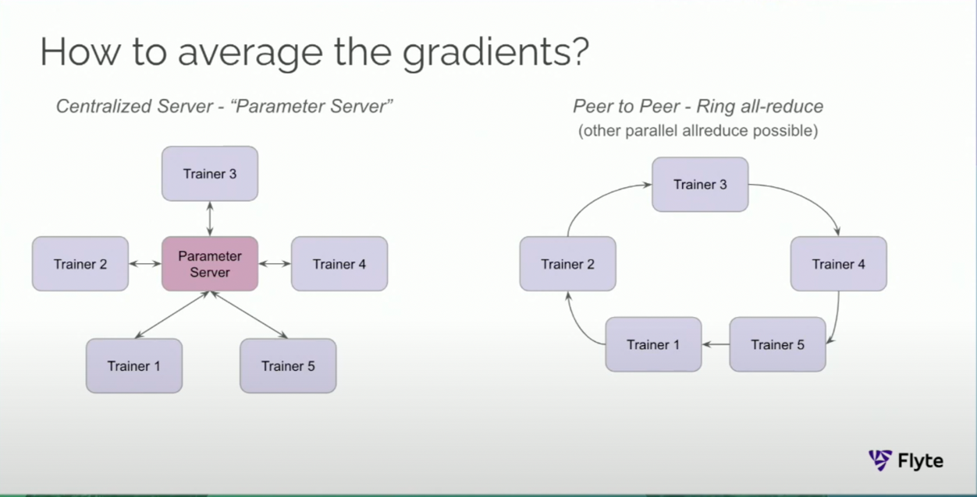
Ring Algorithms – Distributed Training
Picture(2) Source: https://www.youtube.com/watch?v=gF3cVTdgLUY
Notes:
Need to change the image

Slide 3
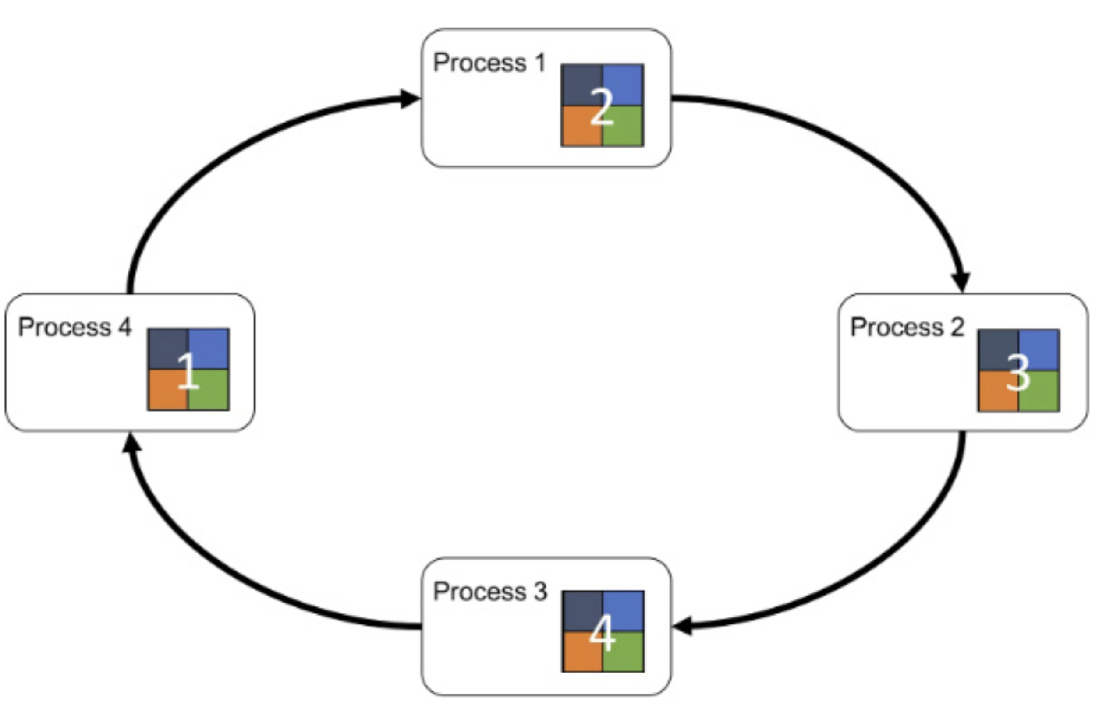
Approach
Alternative to all-reduce, asynchronous step-wise reduce?
Divided workers into groups, slightly tweaked horovod’s averaging step to “gather” within groups.
When num_groups is 1, it becomes step-wise averaging.

Slide 4
Experimental Setup
Spark Driver
Spark Master
Worker 1
Worker 2
Worker 3
Worker 4
Engineered a new docker image with pyTorch, horovod, pySpark, Spark
With ARM support (docker multi-platform image)
(2,4,6,8)-worker spark cluster on my MAC (M1 pro, 32GB)
Using docker stats to measure CPU%, Memory usage%, Network I/O, Block I/O
Only interested in Network I/O
CNN
Horovod/pyTorch - MNIST

Slide 5
Challenges
To setup was painful. There is very little documentation about errors during installation of horovod with pytorch etc.
MAC M1 trouble with libraries (needs virtualization layers in between).
Outcomes:
I now have an image that others can simply use irrespective of the platform.
Great learning! I can now actually do things. Some distributed training expertise.

Slide 6
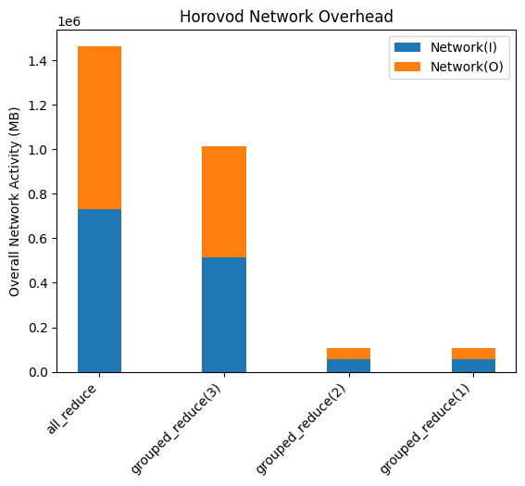
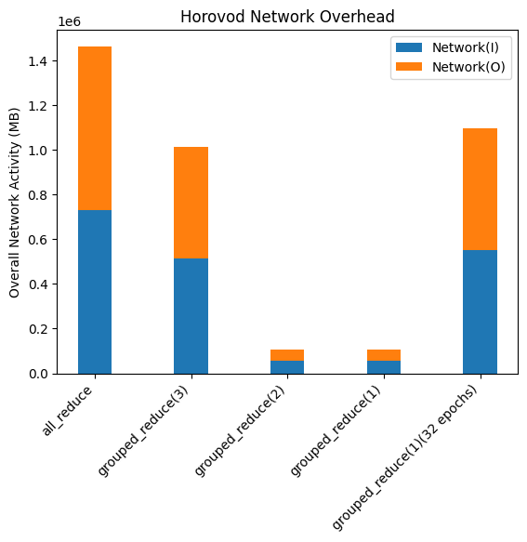
Results
92%
92%
89%
89%
89%
84%
77%
84%
77%

Slide 7
Before 5th December…
More analysis of network activity (per worker, per master/driver)
Tradeoff between number of epochs and group size for comparable accuracies with least network overhead

