Slide 1
DTIE | END SEMESTER 2026–27
AI-DRIVEN
CAMPUS NAVIGATOR
Find your place. Find your way.
A student-first campus guide for locations, class schedules and smarter routes.
GROUP 5
01 / 13

Slide 2
DTIE • DESIGN THINKING & ENTREPRENEURSHIP
Team Members
GROUP 5
A multidisciplinary team building a simpler campus experience.
01
02
03
04
Mangipudi Haasini 2620030081
Vyshnavi
2620030114
Srikari
2620040009
Vishnupriya
2620040052
AI-DRIVEN CAMPUS NAVIGATOR • GROUP 5
02 / 13

Slide 3
DTIE • DESIGN THINKING & ENTREPRENEURSHIP
Vision & Mission
OUR VISION
OUR MISSION
Make every campus visit feel intuitive, confident and connected.
•
Help students locate classrooms, faculty and campus facilities.
•
Show the next class and its location in one place.
•
Suggest clear, efficient routes between campus destinations.
A campus where no student or visitor feels lost.
•
Make campus navigation easier for freshers and visitors.
DESIGN PRINCIPLE: CLARITY FIRST
AI-DRIVEN CAMPUS NAVIGATOR • GROUP 5
03 / 13

Slide 4
DTIE • DESIGN THINKING & ENTREPRENEURSHIP
Problem Statement
Campus information is often scattered across maps, notices and informal messages.
01 • FINDING PLACES
02 • TIME PRESSURE
03 • FRAGMENTED INFO
New students may struggle to identify the correct block, classroom or faculty room.
Students need to reach their next class quickly, especially when buildings are unfamiliar.
Location details and class schedules may not be available in one convenient interface.
Design challenge: How might we help campus users find the right place and route with less confusion?
AI-DRIVEN CAMPUS NAVIGATOR • GROUP 5
04 / 13

Slide 5
DTIE • DESIGN THINKING & ENTREPRENEURSHIP
Research, Facts & Market Study
EARLY DISCOVERY • HYPOTHESES TO VALIDATE
USER NEED
USAGE MOMENTS
OPPORTUNITY
Quick access to building, room, faculty and timetable information.
First campus visit, room changes, class transitions and finding services.
A campus-specific layer can organize information around student tasks.
VALIDATION PLAN
Survey students and freshers • Interview visitors • Map common destinations • Test route clarity • Measure task completion time
Note: No survey results or market-size figures are claimed yet; collect primary data to substantiate demand.
AI-DRIVEN CAMPUS NAVIGATOR • GROUP 5
05 / 13

Slide 6
DTIE • DESIGN THINKING & ENTREPRENEURSHIP
Target Users / Customers
PRIMARY • FRESHERS
PRIMARY • EXISTING STUDENTS
SECONDARY • VISITORS
• New to campus layout
• Need orientation and destination search
• Benefit from simple, step-by-step routes
• Need to locate the next class
• Need faculty / classroom directions
• Want to move efficiently between blocks
• May not know building names
• Need event, office or meeting locations
• Need clear directions on arrival
Out of scope for the initial version: staff-focused workflows.
AI-DRIVEN CAMPUS NAVIGATOR • GROUP 5
06 / 13

Slide 7
DTIE • DESIGN THINKING & ENTREPRENEURSHIP
Competitors / Benchmarks
OPTION
WHAT IT DOES WELL
POTENTIAL LIMIT
OUR DIFFERENTIATOR
General map apps
Outdoor directions and familiar map UI
May not contain detailed room-level campus data
Campus-specific destinations and routes
Notice boards / PDFs
Official announcements and schedules
Information can be spread across sources
One searchable student-facing experience
Asking peers
Fast human help
Availability and directions vary
Self-service guidance at any time
Benchmarking is qualitative. Confirm features and campus coverage during prototype testing.
AI-DRIVEN CAMPUS NAVIGATOR • GROUP 5
07 / 13

Slide 8
DTIE • DESIGN THINKING & ENTREPRENEURSHIP
Risks & Gaps
DATA ACCURACY
Incorrect room or faculty information
Use verified campus data and assign update ownership
MAP QUALITY
Missing paths, entrances or floor details
Start with a validated map of high-use locations
SCHEDULE ACCESS
Timetable data may change
Use user-confirmed schedules or an approved data source
CONNECTIVITY
Weak network in some areas
Keep key location details lightweight; assess offline support
Key gap to close first: a reliable, structured campus map and destination database.
AI-DRIVEN CAMPUS NAVIGATOR • GROUP 5
08 / 13

Slide 9
DTIE • DESIGN THINKING & ENTREPRENEURSHIP
Concept / Product / Solution
A single student-first interface for campus discovery and navigation.
SEARCH
NEXT CLASS
01
02
Search buildings, rooms, faculty and facilities.
View the next class and its destination.
SMART ROUTE
CAMPUS GUIDE
03
04
Get a clear route between two campus points.
Offer a simple orientation flow for freshers and visitors.
MVP PRIORITY: destination search + campus map + route guidance.
AI-DRIVEN CAMPUS NAVIGATOR • GROUP 5
09 / 13

Slide 10
DTIE • DESIGN THINKING & ENTREPRENEURSHIP
Storyboard / System Architecture
1
2
3
4
→
→
→
CHOOSE DESTINATION
GET CONTEXT
FOLLOW ROUTE
ARRIVE & FEEDBACK
Search for a room, faculty member or facility.
See destination details and, where available, next-class information.
View a route between current point and destination.
Confirm arrival; report missing or outdated information.
USER APP
APPLICATION LOGIC
CAMPUS DATA
SCHEDULE DATA
Search + map UI
Search + route rules
Buildings + rooms
Classes + timings
Architecture is a proposed MVP model; implementation choices can change after feasibility testing.
AI-DRIVEN CAMPUS NAVIGATOR • GROUP 5
10 / 13

Slide 11
DTIE • DESIGN THINKING & ENTREPRENEURSHIP
Lean Canvas Model
PROBLEM
SOLUTION
UNIQUE VALUE
USERS
CHANNELS
Hard-to-find rooms
Scattered information
Search + campus map
Route guidance
Find the right place
with less confusion
Freshers + students
Visitors
Campus QR
Student portal
KEY METRICS
ADVANTAGE
COSTS
SUSTAINABILITY
EARLY TEST
Search success
Time to destination
Campus-specific
verified data
Development
Data maintenance
Institution support
Potential campus license
Pilot on one
campus zone
Business model and sustainability options are hypotheses to test with the institution—not confirmed revenue.
AI-DRIVEN CAMPUS NAVIGATOR • GROUP 5
11 / 13

Slide 12
DTIE • DESIGN THINKING & ENTREPRENEURSHIP
Capital (Financial)
Illustrative student-project MVP budget (INR) — planning estimate, not a vendor quote.
Prototype UI / design
₹0–₹2,000
Use student tools and editable mock-ups
Map & campus data preparation
₹0–₹3,000
Depends on source data and digitization effort
Hosting / database trial
₹0–₹2,000
Free tiers may be sufficient for a small demo
Testing & presentation
₹500–₹1,500
Printing, QR cards or demo materials
ESTIMATED TOTAL
₹500–₹8,500
Can be reduced if existing campus data and free tools are available.
AI-DRIVEN CAMPUS NAVIGATOR • GROUP 5
12 / 13

Slide 13
DTIE • DESIGN THINKING & ENTREPRENEURSHIP
Roadmap / Timeline
PHASE 1
PHASE 2
PHASE 3
PHASE 4
DISCOVER
→
DESIGN
→
BUILD MVP
→
TEST & IMPROVE
Interview users; map key destinations; validate pain points.
Create user flows, wireframes and clickable prototype.
Implement search, location records and basic route display.
Run task tests; fix confusing routes; verify data quality.
Success criteria: users find a target location accurately, understand the route, and complete key tasks with less assistance.
Timeline duration should be finalized against the team's actual semester milestones.
AI-DRIVEN CAMPUS NAVIGATOR • GROUP 5
13 / 13

Slide 14
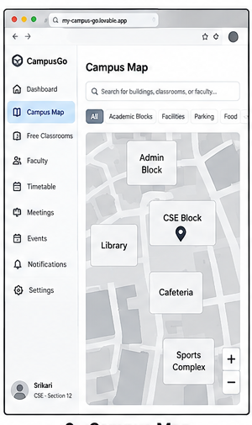
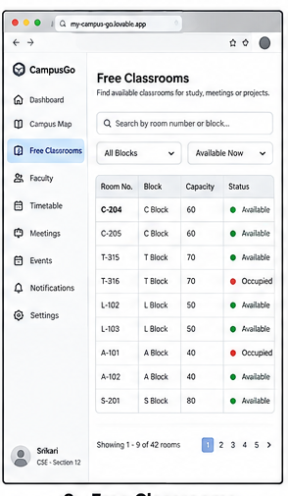
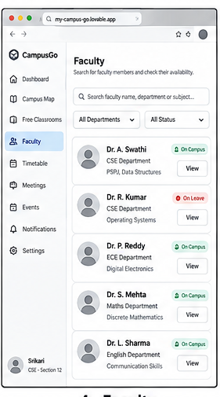
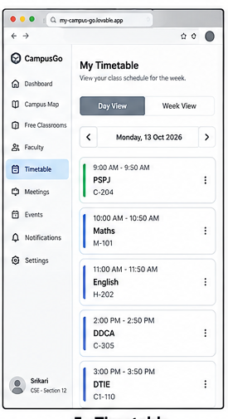
PROTOTYPE • ALIGNED TO ORIGINAL DTIE SCOPE
Current Website Prototype
The original MVP prioritised campus navigation, free-room discovery, faculty cabin location and faculty timetable information.
Campus Map
Free Classroom Finder
Show campus blocks and facilities as destinations.
Display room, block, capacity and availability.
Faculty Directory
Timetable
Find faculty and view department/location details.
Show class timings and classroom destinations.
Visual references only — use the live website for the demonstration and confirm each feature before describing it as working.
AI-DRIVEN CAMPUS NAVIGATOR • DTIE • GROUP 5
14 / 15

Slide 15
DEMO PLAN • SCOPE • VALIDATION
Demonstration, AI Scope & Next Steps
Keep the presentation accurate: separate implemented functionality from future enhancements.
LIVE DEMO — TWO CORE USER JOURNEYS
CURRENT SCOPE VS FUTURE AI
A. Find a faculty member
Describe only verified functionality
Open the website → search for a faculty member → check the listed cabin/location → show the route if available.
Basic search, stored location data and predefined routes are not automatically AI. Do not claim live positioning, real-time availability or an AI model unless implemented.
B. Find a free classroom
Future enhancements
Open the classroom finder → filter or search rooms → check availability details → select a room and show directions if available.
Natural-language search, context-aware route recommendations, verified timetable integration and conversational guidance for freshers.
Validation: survey students and freshers; test faculty-location and free-room tasks; record real sample size, success rate and completion time. Do not invent results.
Original DTIE MVP retained: campus navigation • digital map • free classroom discovery • faculty cabin locator • faculty timetable information.
AI-DRIVEN CAMPUS NAVIGATOR • DTIE • GROUP 5
15 / 15

