Slide 1

SAMSUNG PRISM
Generative AI
Hackathon
3rd Edition 2026 – 27
Theme ID – Theme 05
Team Name – Agents 007
College Name – VIT Vellore
Member Name & Email 1- Dhayapule Kartikesh Rao dhayapule.kartikesh2024@vitstudent.ac.in
Member Name & Email 2- Metta Venkata Surya Sai Srikar metta.venkata2024@vitstudent.ac.in
Member Name & Email 3- Venkataramana Akshith venkataramana.2024@vitstudent.ac.in
Submission Github link - https://github.com/srikarmetta/MindSpace

Slide 2
Theme
MindSpace directly addresses Theme 05: Interruptible Real-Time Agents by enabling an AI system architect that can listen, reason, execute, and adapt continuously as user requirements evolve. Instead of treating each request as an isolated interaction, MindSpace maintains the current architecture as live state while performing operations asynchronously in the background. When a user interrupts with a correction or new requirement, the system detects the updated intent, cancels or supersedes stale operations, preserves valid work, and replans the affected architecture without restarting from scratch. This creates a continuous
Listen → Understand → Plan → Execute → Interrupt → Replan → Commit loop, demonstrated through both voice interaction and a live architecture graph.

Slide 3
Existing Solutions & Gaps
Existing AI assistants such as ChatGPT and Claude can understand system requirements and generate architecture suggestions, while conventional architecture and diagramming tools provide static visual representations. However, these approaches are primarily turn-based and do not maintain an actively executing architecture that can be safely modified mid-process. Interruptions or changing requirements often require restarting the generation process, with limited handling of stale operations, partial progress, or dependency-aware updates. MindSpace bridges this gap by combining voice-native interaction, asynchronous execution, live architecture visualization, intent tracking, cancellation, state preservation, and automatic replanning—allowing users to continuously evolve a system architecture simply by thinking out loud.

Slide 4
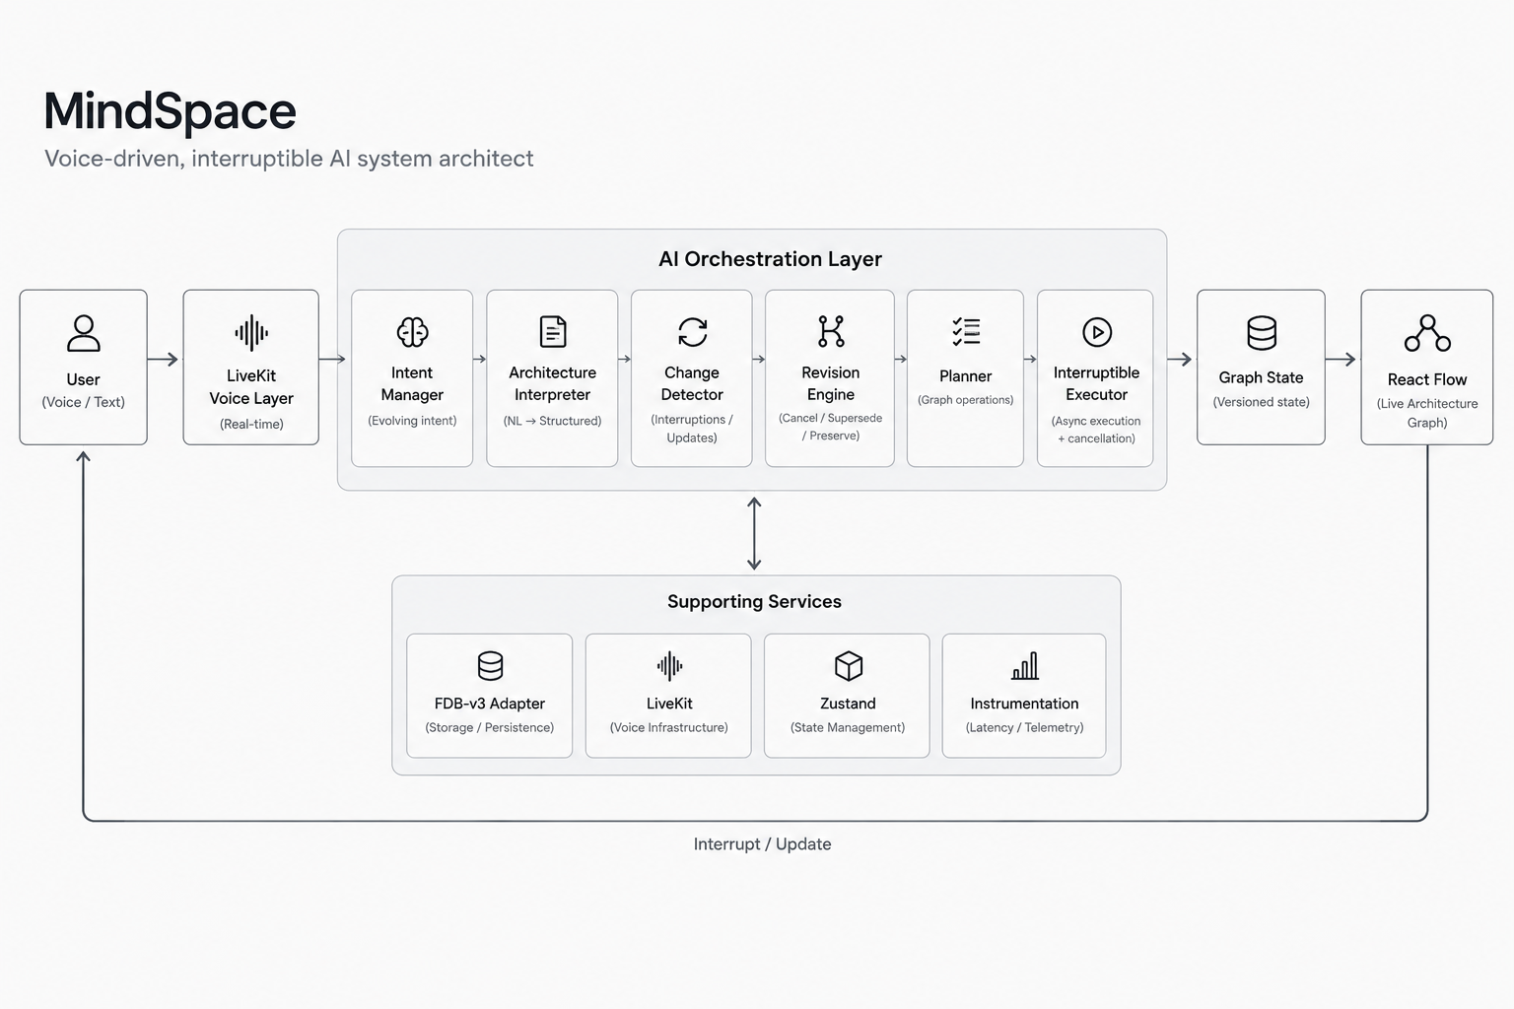
Our Solutions & Architecture Diagram
MindSpace is a voice-driven, interruptible AI system architect that converts natural-language requirements into a continuously evolving architecture graph. The system interprets user intent, creates an execution plan, and performs graph operations asynchronously. When the user interrupts with a correction or new requirement, MindSpace identifies stale operations, cancels or supersedes them, preserves valid completed state, and replans the affected architecture before continuing execution. This enables a continuous, state-aware architecture design process rather than generating a static diagram in a single turn.

Slide 5
Demo & Product Walkthrough
The walkthrough begins with the user describing a real-time social media platform and its required components. MindSpace interprets the requirement and progressively builds the architecture graph while operations execute asynchronously. During this process, the user specifies Kafka for asynchronous communication. Before the architecture is finalized, the user interrupts with a correction: “Actually, use RabbitMQ instead of Kafka.” MindSpace detects the change, cancels or supersedes the stale Kafka-related operations, preserves the valid components and relationships already created, and replans the affected portion of the architecture. The updated architecture then continues to completion with RabbitMQ as the message broker, demonstrating the complete cycle of Understand → Plan → Execute → Interrupt → Replan → Continue → Commit.

Slide 6
Tools and tech stack used
MindSpace is built using a modern full-stack architecture focused on real-time interaction and interruptible execution. The frontend uses React, TypeScript, Vite, Tailwind CSS, Zustand, and React Flow (@xyflow/react) for the interactive architecture workspace and live graph visualization. LiveKit provides the real-time voice communication layer, while the agent runtime handles intent detection, planning, asynchronous execution, interruption, cancellation, and replanning. The backend and core logic use Node.js/TypeScript, with structured Architecture IR, graph operations, versioned state management, and idempotent execution. Lucide React is used for interface icons, with lightweight animation and layout utilities where required. Git and GitHub are used for version control and collaboration, while automated tests and build validation are used to verify graph operations, interruption handling, state preservation, and self-correction.

Slide 7
Impact & Use case
MindSpace makes system architecture design more interactive, adaptive, and accessible by allowing users to describe and modify complex systems through natural voice or text. It is useful for software architects, developers, engineering teams, students, and product teams who frequently explore evolving system requirements. Instead of repeatedly rebuilding architecture diagrams when requirements change, MindSpace preserves valid work, handles interruptions, and dynamically updates the affected components. This can support use cases such as AI and multi-agent systems, cloud and distributed applications, SaaS platforms, event-driven systems, and real-time applications. By combining conversational interaction with state-aware architecture evolution, MindSpace reduces design friction and enables faster exploration of complex system designs.

Slide 8
Innovation highlights, results and limitations
Innovation Highlights: MindSpace combines voice-native interaction with an interruptible, state-aware architecture engine that can asynchronously execute architecture changes while continuously listening for updated requirements. Its key innovation is the ability to cancel or supersede stale operations, preserve valid state, and dynamically replan the affected architecture instead of restarting from scratch.
Results: The system successfully generates architecture graphs from natural-language requirements, supports real-time modifications and self-corrections such as Kafka → RabbitMQ, preserves unaffected components, and visually reflects the evolving architecture through React Flow.
Limitations: Complex or highly ambiguous requirements may require clarification, architecture quality depends on the underlying interpretation and planning model, and real-time voice performance can vary with the speech/LLM runtime and network conditions. Comprehensive benchmark performance should only be reported after formal FDB-v3 evaluation.

Slide 9
What’s next
The next phase of MindSpace is to introduce offline and local AI capabilities by integrating a lightweight local language model through a runtime such as Ollama. This will allow architecture requirements, intent interpretation, planning, and requirement corrections to be processed locally without depending entirely on cloud-based AI services. The system will support a hybrid approach where users can switch between local and cloud inference based on availability and performance requirements. Future development will also focus on improving architecture reasoning for complex systems, reducing response latency, expanding voice-native interaction, strengthening FDB-v3 benchmark performance, and enabling more advanced architecture analysis such as dependency validation, bottleneck detection, and automated design recommendations.

Slide 10
Brownie points slide( differentiation)
Unlike conventional AI assistants that primarily generate architecture suggestions or static diagrams, MindSpace is designed as an interruptible architecture execution system. It maintains a live, versioned architecture state while operations execute asynchronously, allowing users to interrupt, correct, or extend requirements at any point. Instead of restarting when the requirement changes, MindSpace identifies stale operations, cancels or supersedes them, preserves valid work, and replans only the affected architecture before continuing execution. Its combination of voice-native interaction, asynchronous execution, live graph evolution, state-aware interruption, self-correction, and dependency-aware replanning creates a specialized workflow for evolving system design. The planned offline/local AI capability will further enable architecture reasoning without continuous dependence on cloud-based models.

Slide 11
Checklist- Updated on Public GitHub
Working prototype code — public or shared GitHub repo (Y)
README with reproducible setup instructions (Y)
Demo video, max 5 minutes (YouTube or Drive link)
Presentation file (PPT or PDF) (Y)

Slide 12
Thank you
Organised by the Language AI Team and the PRISM Team, Samsung R&D Institute India
Notes:
Closing slide. Add the Google Form URL and a contact email before sharing. Edition 2 organising team for reference: Language AI - Sourabh Tiwari, Gaurav, Sanjeeth Pothireddy, Gorang Maniar; PRISM - Binny Lakra, Prakhar Chandrakar, Vishu Kumar; Kick-off and mentors - Giridhar Jakki, Deepraj Prabhakar Patkar (Language AI), Srimanu Prasad Nagaraju, Ashish Kumar (Tech Strategy).

