Slide 1
IT-304 Computer Networks
Instructor: P.S. Kalyan Sasidhar
FB2-2109
kalyan_sasidhar@daiict.ac.in

Slide 2
About Me
Associate Professor
Teaching Computer Networks
2014-2015: MTech (Wireless Networks, Cyber Security) Amrita Univ
2016-2020 : BTech, MSc IT
2022-Present : BTech
DAIICT

Slide 3
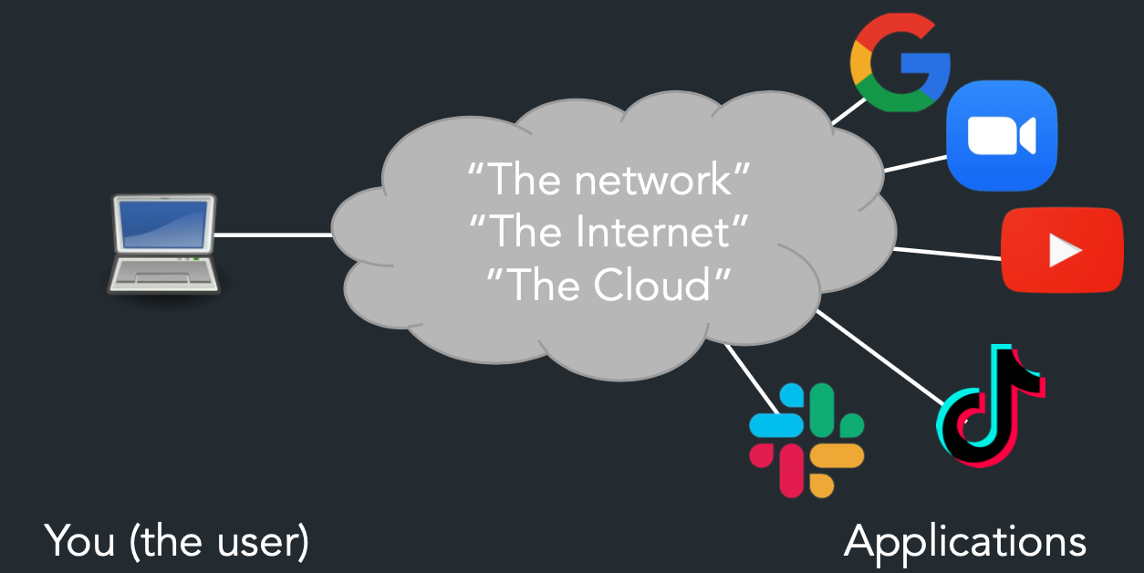
About the Course

Slide 4


Slide 5
What will you learn?
What is a network? What constitutes a network?
What is the Internet? What is WWW?
How invented - the Internet, WWW, Email, etc….?
How do machines connect and send data?
What goes behind the workings of Google, Facebook, Whatsapp, Instagram?
How to find who to talk to
Addresses and names, discovery, routing
Decide how to talk to them
Encodings, Protocols
Make sure communication is correct, only among intended parties, works for all
Mediation, Error correction, encryption, ...

Slide 6
How will you learn?
In-Sem I | 15%
In-Sem II | 20%
End sem | 30%
Labs & Network Programming exercises | 25%
Quizzes | 10%
Lectures – Conceptual understanding
Labs - Practical hands-on
Assignments – Programming
Quizzes

Slide 7
Reference Books
James F. Kurose and Keith W. Ross. 2012. Computer Networking: A Top-Down Approach (6th ed.). Pearson. (RECOMMENDED)
Douglas E. Comer. 2013. Internetworking with TCP/IP (6th ed.). Addison-Wesley Professional.
Andrew S. Tanenbaum and David J. Wetherall. 2010. Computer Networks (5th ed.). Prentice Hall Press, Upper Saddle River, NJ, USA.
Larry L. Peterson and Bruce S. Davie. 2011. Computer Networks, Fifth Edition: A Systems Approach (5th ed.). Morgan Kaufmann Publishers Inc., San Francisco, CA, USA.

Slide 8
What’s the Internet: “nuts and bolts” view

Slide 9



















What’s the Internet: “nuts and bolts” view
PC
millions of connected computing devices:
hosts = end systems
running network apps
mobile network
server
wireless
laptop
global ISP
smartphone
home
network
communication links
fiber, copper, radio, satellite
transmission rate: bandwidth
regional ISP
wireless
links
wired
links
Packet switches: forward packets (chunks of data)
routers and switches
router
institutional
network
Notes:
9

Slide 10
What’s the Internet: “nuts and bolts” view
Internet: “network of networks”
Interconnected ISPs
protocols control sending, receiving of msgs
e.g., TCP, IP, HTTP, Skype, 802.11
Internet standards
RFC: Request for comments
IETF: Internet Engineering Task Force
mobile network
global ISP
home
network
regional ISP
institutional
network

Slide 11
What’s the Internet: a service view
mobile network
Infrastructure that provides services to applications:
Web, VoIP, email, games, e-commerce, social nets, …
provides programming interface to apps
hooks that allow sending and receiving app programs to “connect” to Internet
provides service options, analogous to postal service
global ISP
home
network
regional ISP
institutional
network

