Slide 1

FEED KC
By Team PVM
Pavan kumar Chongala 16273361
Saivarun Gadewara 16273545
Manohar bollampally 16261464

Slide 2
About Feed kc
Feed kc is great project. The basic aim is to provide food donation service to the city.
Feed kc is a browser based system that is designed to store, process, retrieve and analyze information concerned with the administrative and inventory management.
This project aims at maintaining all the information pertaining to food donors, different food available in each Location and help them manage in a better way.

Slide 3
Software and tools used
Php
HTML
CSS
JAVASCRIPT
MYSQL
XAMPP

Slide 4
HARDWARE AND SOFTWARE REQUIRMENTS
Processor : Intel Core I3 PROCESSOR or more
RAM : 4 GB or More
Hard disk : 80GB or more
Front End : Visual Basic 2005 Express edition
With Sql Server Compact Edition
Microsoft SDK 2.0
Back End : MS Sql Server
Operation System : Windows 8.1

Slide 5
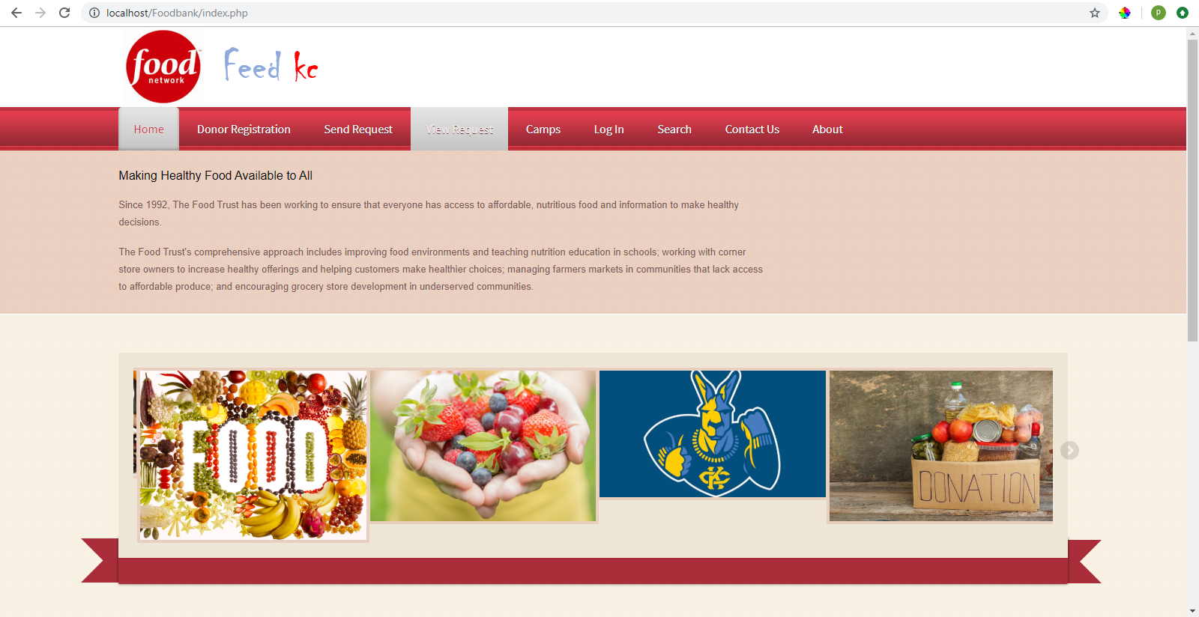
SCREENSHOTS OF THE PROJECT
Home page:- This is the home page or the main page of FEEDKC. This is the main page of a client side. This page define all about related to project. This page also includes the gallery of the camps.
the gallery of the camps.

Slide 6
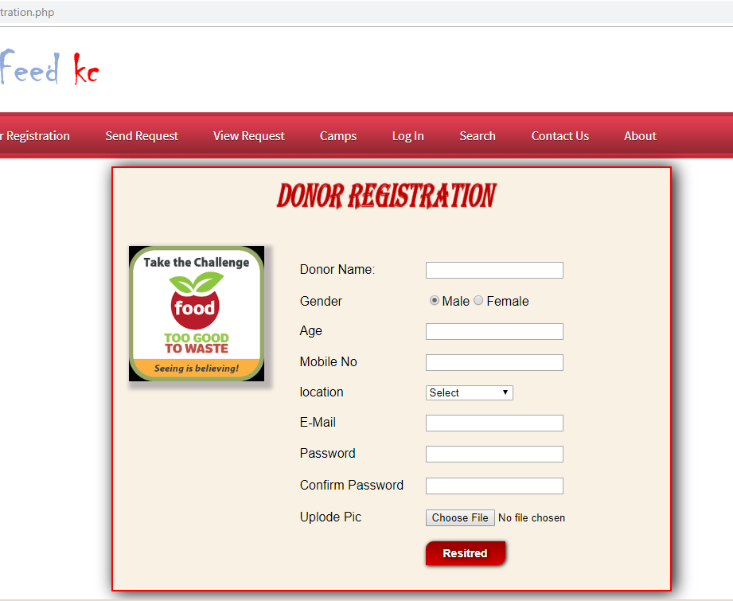
Registration
Registration page includes the information of the donor who want to register. Donor can register the account by clicking on new register. He/she can add the account for the further enquiry of the food donation.

Slide 7
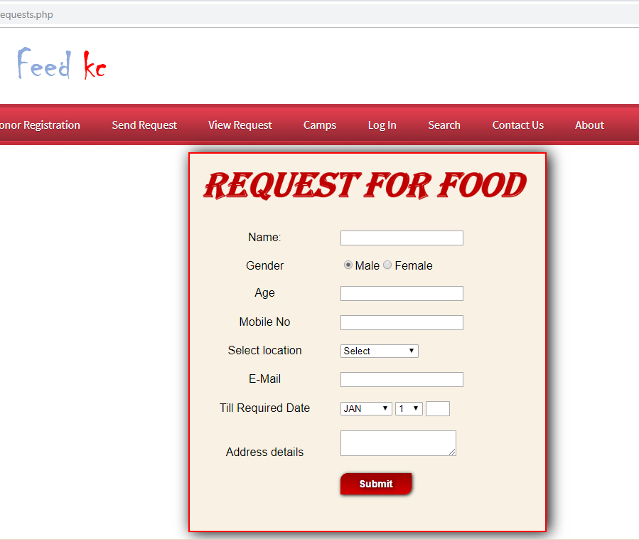
Request For Food
Anyone can request for food donation so that it will appear on view request page and to other donors

Slide 8
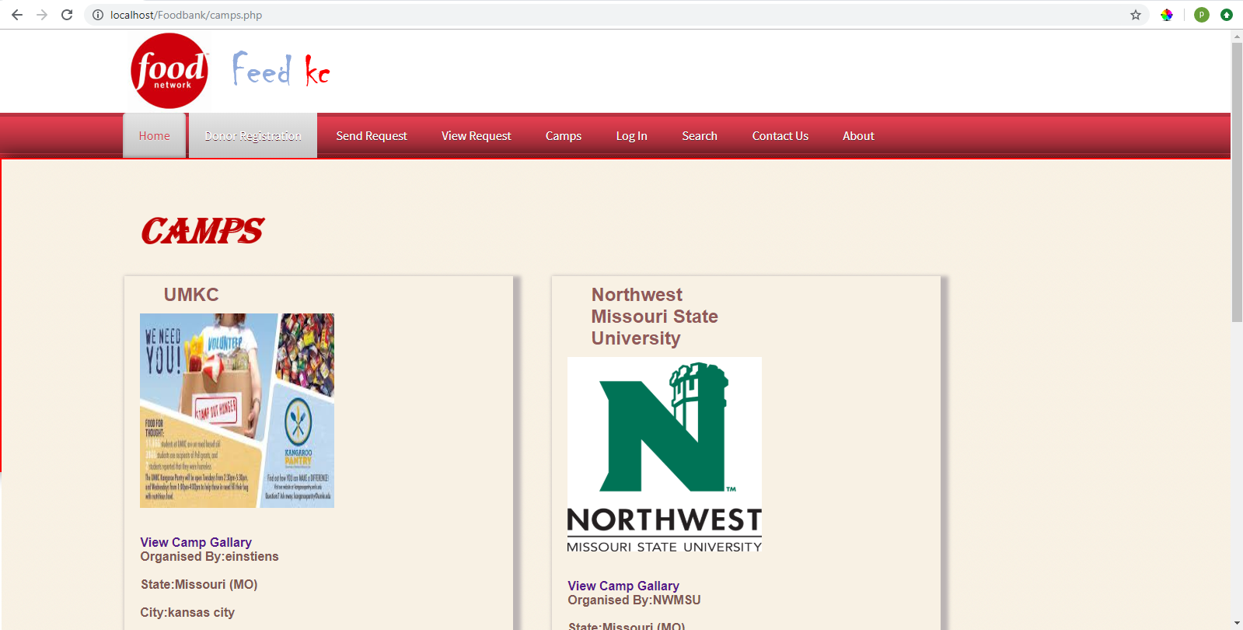
CAMPS
Camp page includes the information about camps, this camps organized the FOOD donation camp. Shows different Food camps near the location

Slide 9
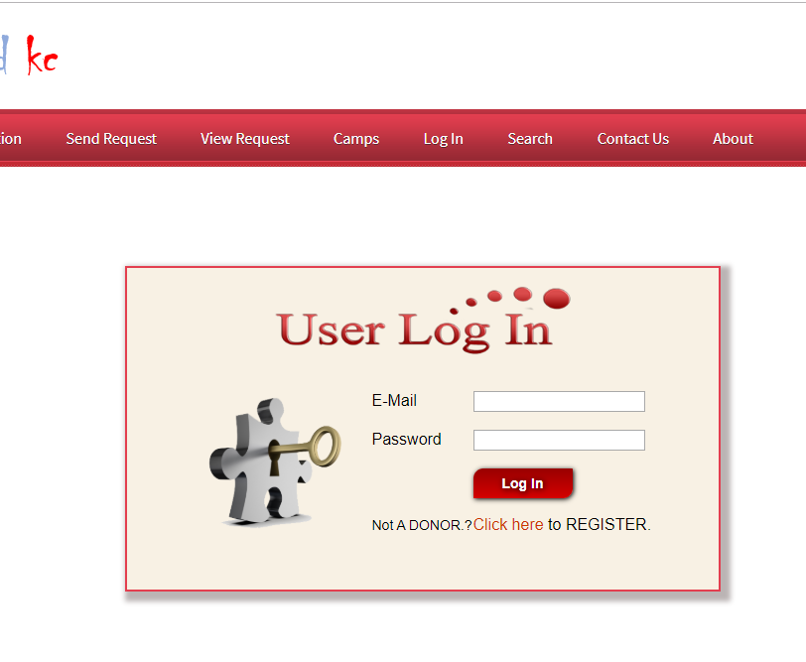
Donor Login
It is login menu, I have set a default E-mail and password for it. This mail id and password are store in a binary file inside this project. For Password security I have replace the password's alpha numeric character to special symbol, Dollar ($) symbol.

Slide 10
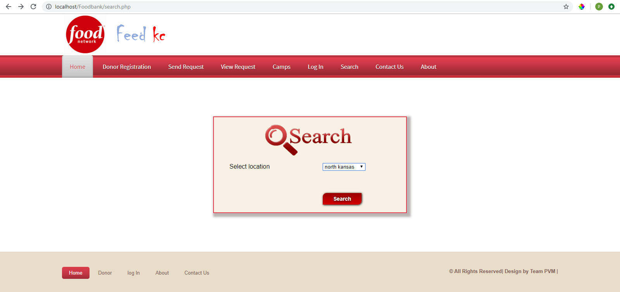
Search
Search button is used for search the FOOD DONORS from different LOCATIONS
LOCATIONS name-
SOUTH KANSAS
NORTH KANSAS
EAST KANSAS
WEST KANSAS
CENTRAL KANSAS

Slide 11
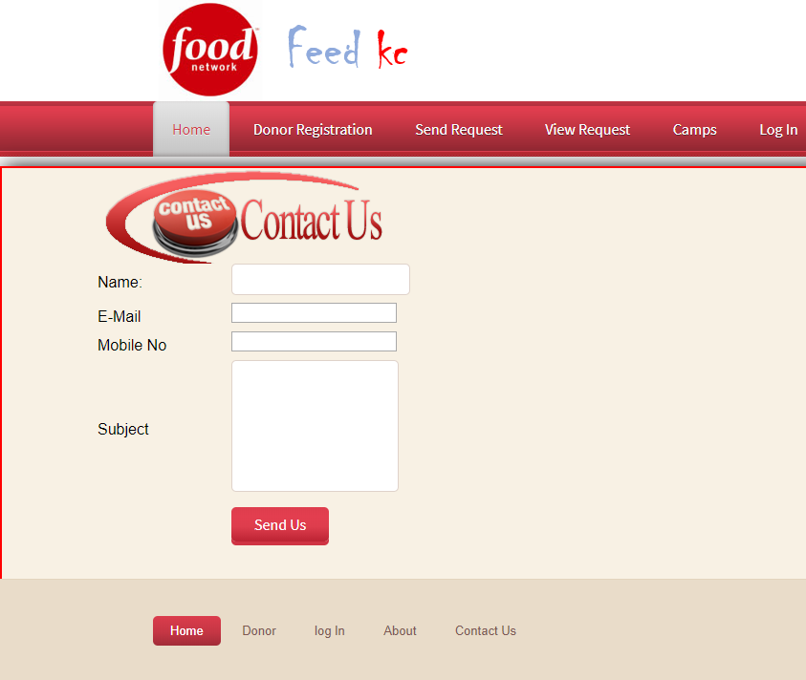
Contact
In contact page any one who wants to gaining a information about this system then he/she can contact with us.

Slide 12
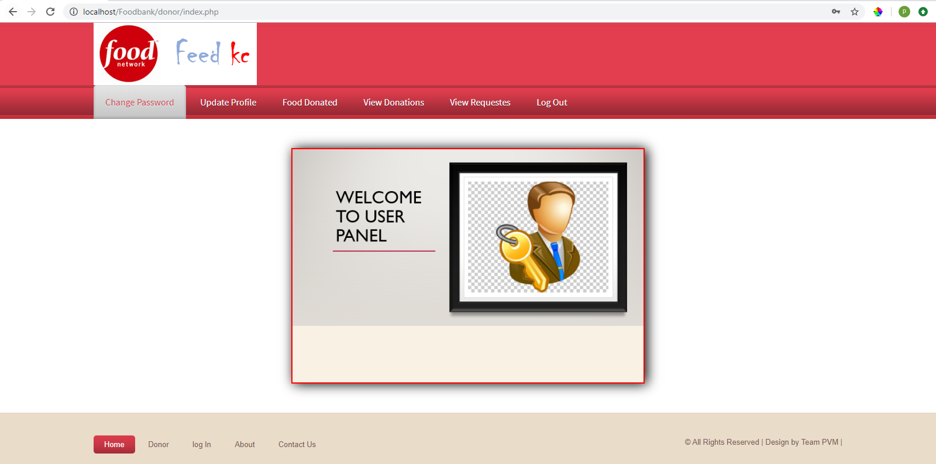
Donor Panel
This page is the the welcome page of the donor panel. In this page include all the module related to Donor like :
Change password
Update profile
DONATE FOOD
View donation
View requests
Logout

Slide 13
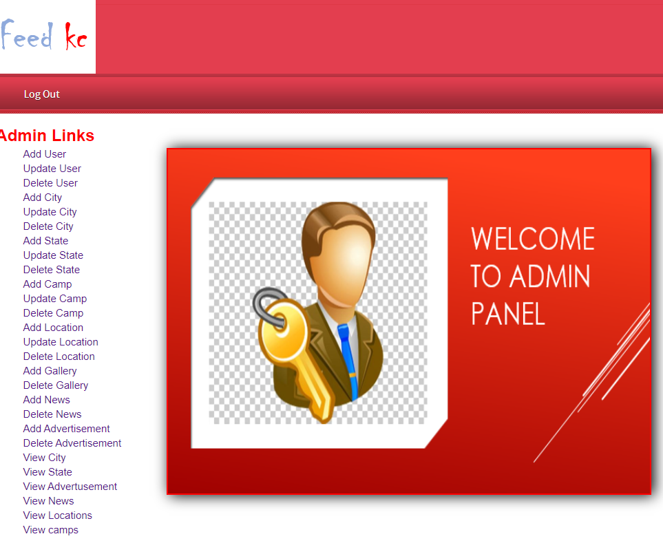
ADMIN PANNEL
This page is USED FOR ADMIN TO ADD, DELETE, UPDATE AND VIEW DETAILS OF
USER
CITY
STATE
CAMP
LOCATION
GALLERY

Slide 14
SUMMARY AND CONCLUSION
The building blocks of this Major Project ”BLOOD BANK Management System” was one of these opportunities. It gave us the requisite practical knowledge to supplement the already taught theoretical concepts thus making us more competent as a computer engineer. The project from a personal point of view also helped us in understanding the following aspects of project development:
The planning that goes into implementing a project.
The importance of proper planning and an organized methodology.
The key element of team spirit and co-ordination in a successful project.

Slide 15

Thank you

