Slide 1

IU Smart Course Selector AI Application
Your Intelligent Academic Companion

Slide 2

The Problem
Students struggle with course selection decisions
Overwhelming number of course options
Difficulty finding courses that align with career goals
Limited personalized guidance at scale
Time-consuming research process

Slide 3
Our Solution
Data from IU Data Catalog Search
Intelligent query processing
Personalized recommendations
User-friendly interface

Slide 4
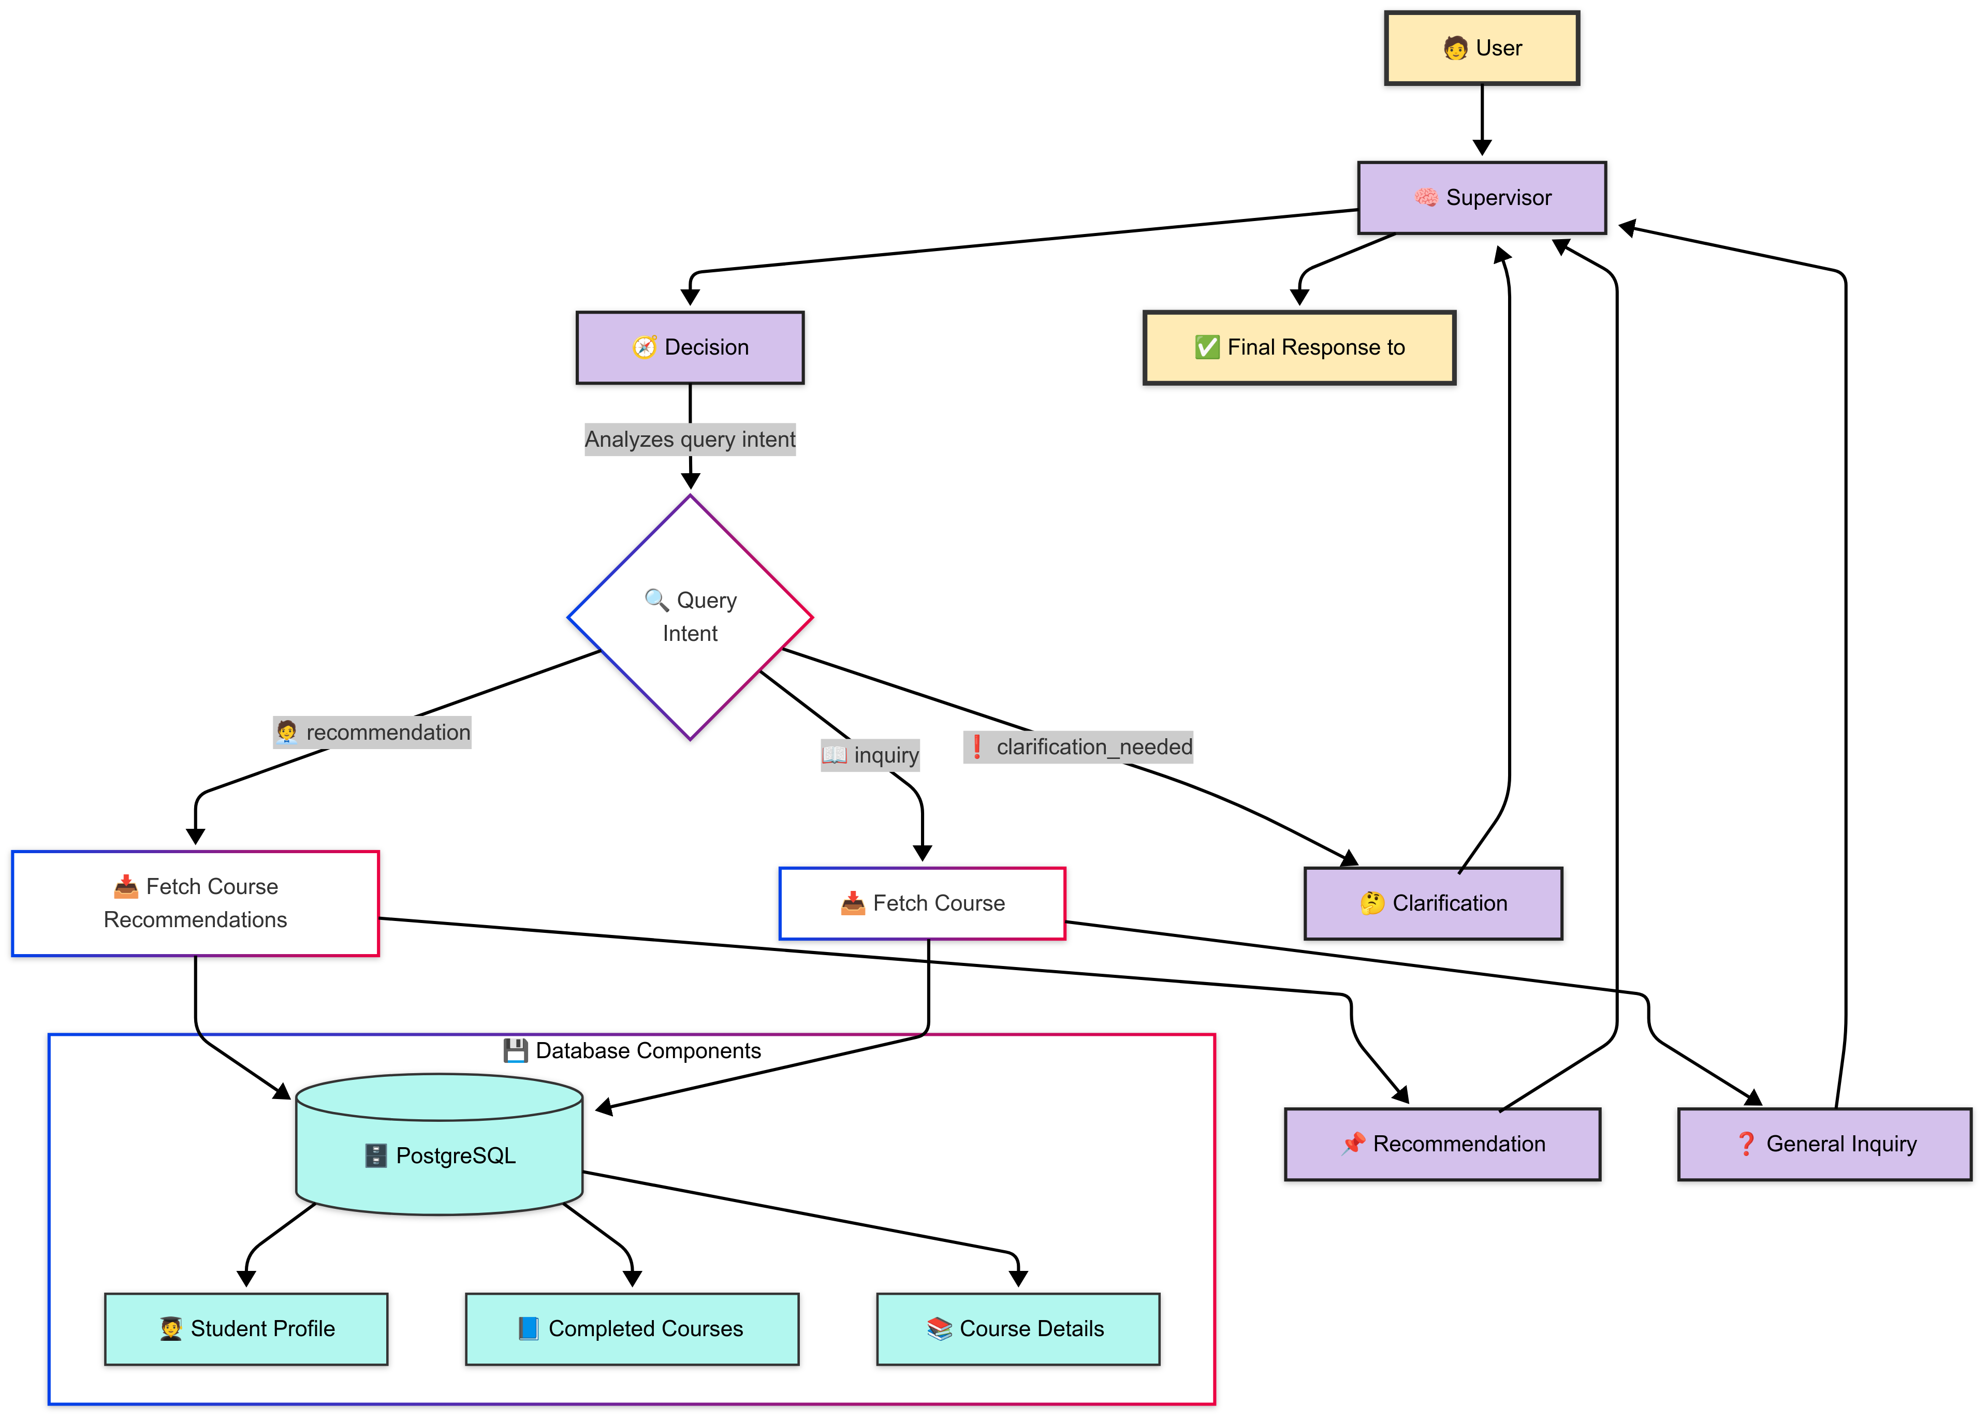
Multi-Agent Architecture

Slide 5
Future Enhancements
Professor Reviews Integration
Course Fill Prediction
Personalized Difficulty Assessment
Cross-Institution Course Recommendations
University Selection Guidance

Slide 6
Conclusion
Empowering Academic Journeys
From Choices to Careers
Reducing Decision Fatigue
Continuous Evolution

