Slide 1
Snag@Job
By
Srikar Reddy Mallareddygari (SM8XD)
Surekha Dani (SD3K3)
Lavanya Kumar Somu (LSXP7)
Sandesh Puppala (SPZC6)

Slide 2
Motivation:
The main aim of our project is to provide a platform to search and post jobs.
Jobs Includes both Technical and Non-Technical.
Simple User Interface.
To support individuals for their economic needs.

Slide 3
Technologies..
Tools:
Android Studio -- Application Development
Visual Studio 2010 -- REST API Development
MS SQL Server -- Database
Programming Languages
Java, C#, SQL
Testing
Functional -- NUNIT
Deployment -- WAPT, Systrace

Slide 4


System Architecture:
Snag@Job Application
My SQL
DB
REST API
WS Call
Insert/Query/Update
oAuth Access
External API

Slide 5
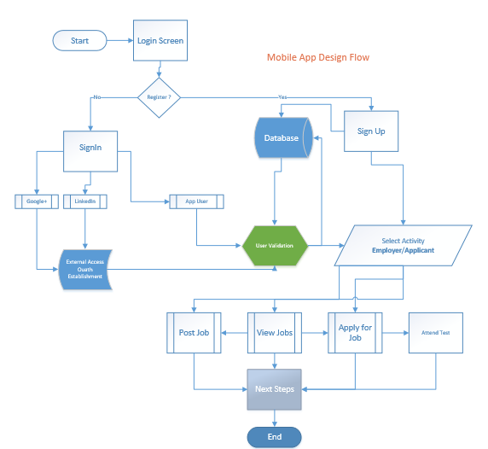
Design:

Slide 6
Implementation:
Sign In or Register to App
Sign In Using LinkedIn or Google+
Roles defined in Application- Employer, Applicant & Admin
Employer tasks include Post jobs, View/Modify posted jobs and View Applications.
Applicant tasks include Searching Jobs, Applying for jobs, Take Test and View Applied Jobs.
Admin tasks include adding/modify test questions.
Designed the activities in android application to facilitate user interface for both employer and applicant tasks.

Slide 7
Contd..
There are 12 REST APIs to perform application activities
4 Database table to perform storage, update and retrieval of data.
2 External APIs for Login

Slide 8
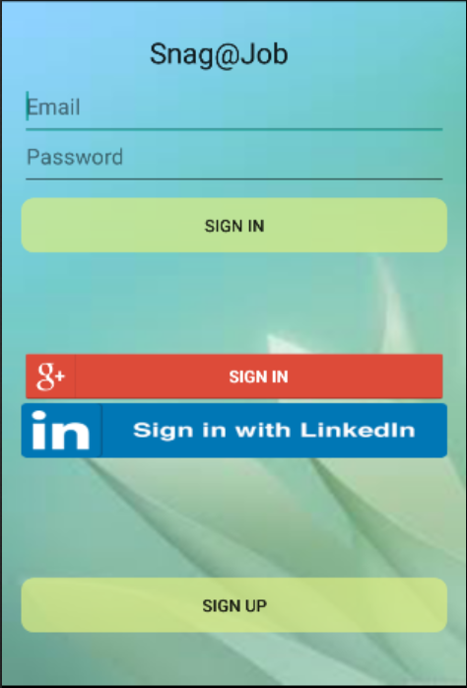
Demo

Slide 9
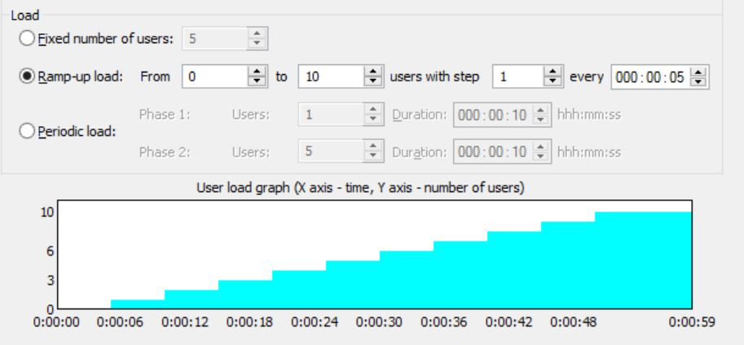
Testing
WAPT:
It is used to perform Load, Stress and performance testing on our web services.
Stress testing:
This testing is useful to test the applications ability to respond to an excessive load.

Slide 10
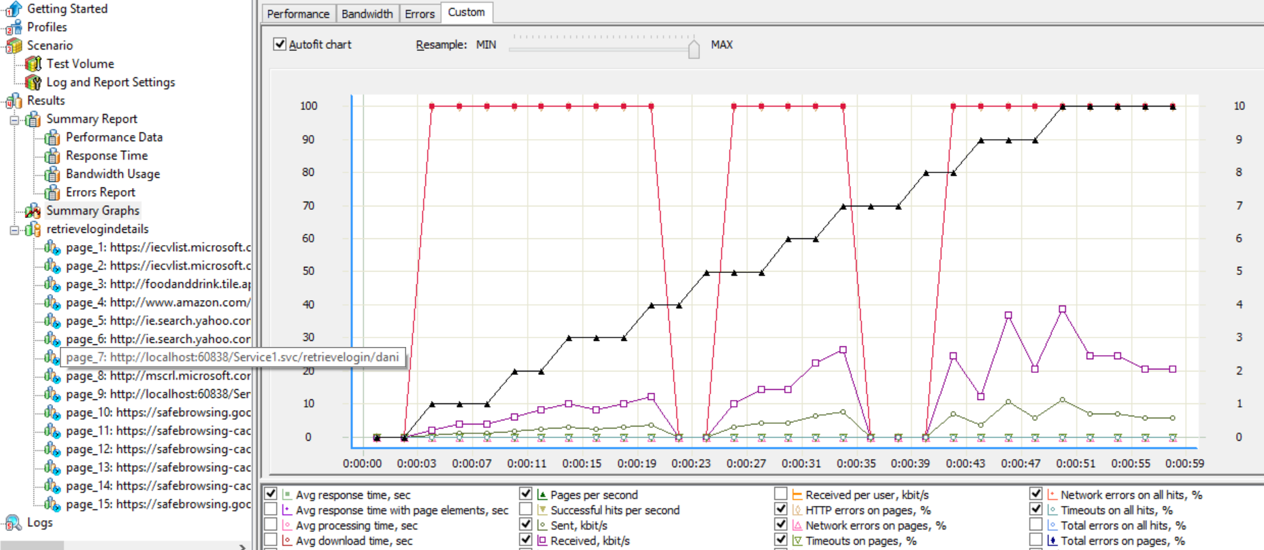
Contd..

Slide 11
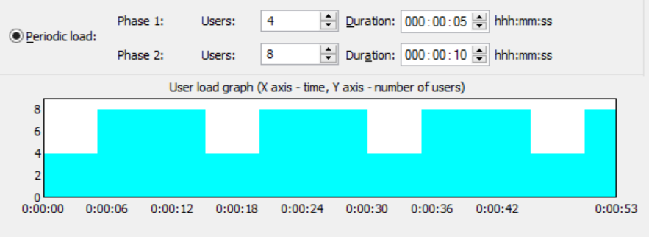
Contd.
Endurance Testing
The goal of this testing is that the application performance don’t degrade significantly during different testing phases.

Slide 12
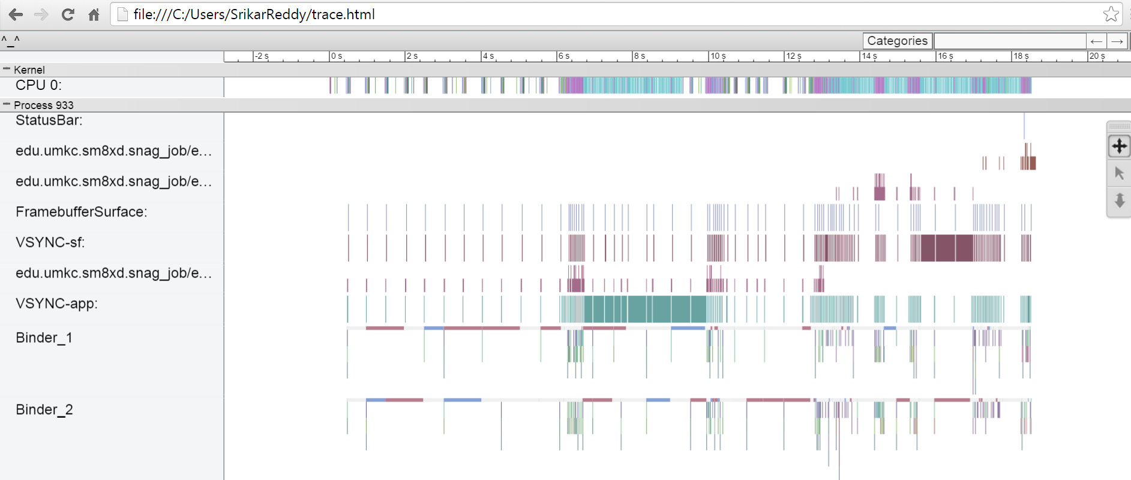
Contd..
Systrace
We are able to generate the device trace for a given period of time and analyzed the graphical output properly

Slide 13
Future Scope:
Facebook API Integration
Documents Verification
Employer will have the flexibility to set the exam questions for a job.

Slide 14
Queries..

Slide 15
Thank You!!

