Slide 1



TDMA Schedule Optimizer
TECHNICAL TASK · WIRELESS PROTOCOL DEVELOPMENT
0
1
2
0
3
4
5
3
6
7
8
6
Collision-free time slots from distance-2 graph colouring, verified in an EMANE emulation
0
1
2
0
Ramachandra TejSrikar Reddy
SRM Institute of Science and Technology · October 2026
The final schedule: 16 radios, 9 slots.
Cyan circles share their slot with another radio.
Notes:
Opening. Introduce yourself and the task: a centralised TDMA schedule planner for 16 static radios (Part 1, mandatory) and its enforcement in an EMANE emulation (Part 2, bonus). The picture on the right is the actual result: each circle is a radio on the 4 by 4 grid, labelled with the time slot the optimizer gave it. Cyan circles share their slot with another radio, which is spatial reuse.

Slide 2
Agenda
OVERVIEW
01
The problem: two ways radios collide
HEADLINE RESULTS
02
Part 1: the schedule optimizer
9 slots
03
Results: 9 slots, and why not 5
for 16 radios, provably the minimum
04
Part 2: EMANE emulation and the bridge
0
05
Live demo
collision drops in EMANE with the optimizer's schedule
06
Limitations and questions
99.9% vs 34.5%
delivery at 10 ms slots: optimizer vs a schedule that ignores hidden terminals
TDMA Schedule Optimizer
02
Notes:
The talk follows the two parts of the task. Part 1, the Python optimizer, is the mandatory core; Part 2 shows the schedule actually being enforced inside EMANE. Lead with the headline results: 9 slots for 16 radios, which is provably the minimum; no collision drops in EMANE with the optimizer's schedule; and with 10 ms slots, 99.9% delivery against 34.5% for a schedule that only separates direct neighbours.

Slide 3



Two ways radios collide
THE PROBLEM
Direct interference
1 hop
Hidden terminal
2 hops
A
in range
B
A
B
C
both arrive at B
A and B hear each other, so they need different slots.
A and C are out of range of each other, so neither knows the other is sending.
How TDMA works
The goal
Spatial reuse
All radios share one frequency and take turns in the time slots of a repeating frame.
Give every radio a slot with no collisions, using as few slots as possible.
Radios more than 2 hops apart can share a slot. That keeps the frame short.
TDMA Schedule Optimizer
03
Notes:
All radios share one frequency and take turns in time slots. A collision happens at the receiver, so always ask who is listening. Case 1, direct interference: A and B are in range of each other, so they cannot transmit in the same slot. Case 2 is the hidden terminal: A and C cannot hear each other, so neither knows the other is transmitting, but both signals land on B and B receives neither. Anything more than two hops apart is safe to reuse, and that reuse is what keeps the frame short.

Slide 4

The schedule optimizer
01
PART 1 · MANDATORY
A Python CLI: node coordinates in, a collision-free slot plan out, with proof of how good it is.
networkx graphs
Distance-2 colouring
DSATUR + largest-first
98 tests
Notes:
Part 1 is the mandatory part: the scheduling brain. In the next few slides: how the two interference rules turn into graph colouring, the two heuristics and why both run, the 9-slot result and why 9 is the minimum, why the task's 5-slot sample doesn't apply to this grid, and how every schedule is checked.

Slide 5
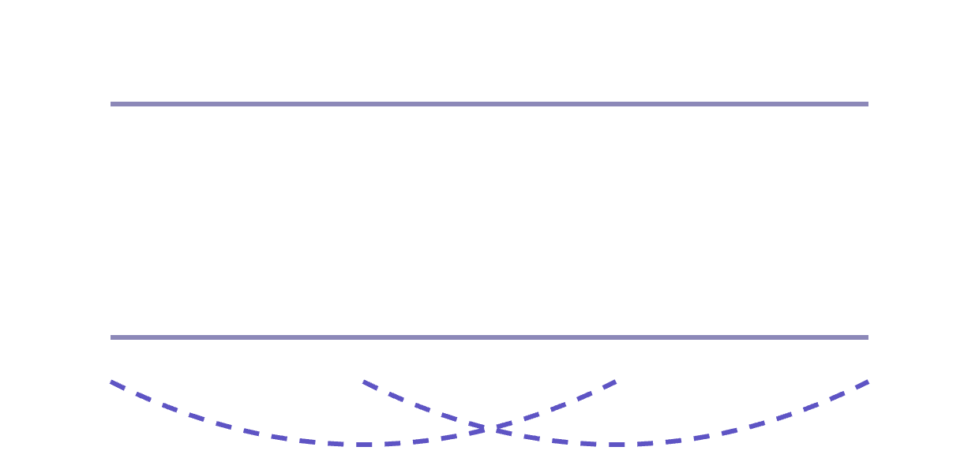
Scheduling as graph colouring
PART 1 · APPROACH
1
Radio graph
Link every pair of radios within 500 m (42 links).
KEY IDEA
2
Conflict graph
Square the graph
Join every pair 1 or 2 hops apart: G² (90 pairs).
Radio graph G
3
Greedy colouring
A
B
C
D
Each colour is a slot. DSATUR and largest-first.
4
Lower bound
Conflict graph G²
The busiest radio and its neighbours need distinct slots.
A
B
C
D
5
Self-check
Re-verify every shared slot from raw coordinates.
In: JSON coordinates of the radios. Out: node-to-slot map, Slot × Node matrix, frame length, and whether it is optimal.
A–C and B–D are 2 hops apart, so G² joins them (dashed). Colour G² so joined radios differ, and each colour is a time slot.
TDMA Schedule Optimizer
05
Notes:
Walk through the five steps. The key idea is step 2: the two interference rules together mean "different slots if within two hops", so squaring the radio graph (networkx.power(G, 2)) turns the problem into ordinary graph colouring, where each colour is a time slot. On the grid that takes 42 links to 90 conflicting pairs. Steps 4 and 5 are there so the result can be trusted: the lower bound says how good it is, and the self-check re-verifies it without reusing the conflict graph.

Slide 6
Visiting order decides the slot count
PART 1 · HEURISTICS
Greedy colouring never puts two conflicting radios in one slot. Only the order changes how many slots it needs, so the tool runs both and keeps the shorter frame.
Layouts (of 500) where one heuristic won
DSATUR shorter
largest-first shorter
142
DSATUR
Next radio: the one whose conflicting neighbours already hold the most different slots. The order adapts as slots are handed out.
25
17
3
0
1
largest-first
16 radios
30 radios
60 radios
Visit radios by number of conflicts, highest first. The order is fixed before colouring starts.
Best result equals the lower bound in 349 to 481 of 500 layouts per size.
TDMA Schedule Optimizer
06
Notes:
Greedy colouring never collides; only the visiting order changes how many slots it needs. Both orders are written by hand in graph_engine.py and checked against networkx. DSATUR adapts as it goes and is usually better, more so on bigger networks: with 60 radios it gave the shorter frame in 142 of 500 layouts. largest-first still won 18 times across the three sizes, so the tool runs both. Numbers are from 500 random layouts per size in a 2 km square with a 500 m range.

Slide 7
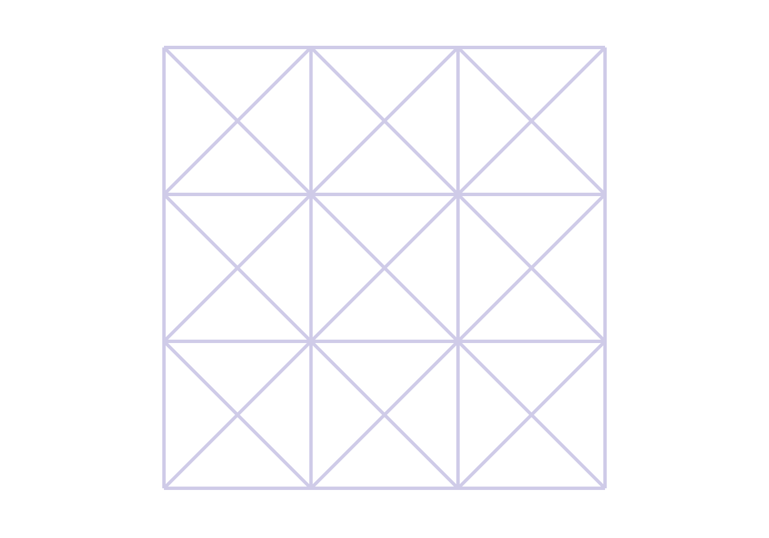
9 slots for 16 radios, zero collisions
PART 1 · RESULT
0
1
2
0
9
slots per frame
DSATUR and largest-first agree on the same frame length.
3
4
5
3
0
collisions
Confirmed by the independent check from the raw coordinates.
6
7
8
6
12
radios share a slot
0
1
2
0
Corners share slot 0; opposite edges share slots 1, 2, 3 and 6.
shared slot (spatial reuse)
used by one radio
TDMA Schedule Optimizer
07
Notes:
The number in each radio is its slot, on the 4 by 4 grid with 300 m spacing and a 500 m range. The four corners share slot 0, and slots 1, 2, 3 and 6 are each shared by two radios on opposite edges, three hops apart. The four interior radios are within two hops of everyone, so each needs its own slot: 1 + 4 + 4 = 9. Both heuristics give 9, and the independent validator found no collisions.

Slide 8

9 is the minimum.
PART 1 · OPTIMALITY
Node_06 and its 8 neighbours are all within two hops of each other, so those 9 radios need 9 different slots. No valid schedule for this grid can be shorter, and ours reaches that bound.
lower bound = max neighbours + 1 = 8 + 1 = 9
Notes:
This is the key claim, so make it explicit. At 500 m range with 300 m spacing, diagonal neighbours (424 m) are in range, so an interior radio such as Node_06 has 8 neighbours. Any two of those 9 radios are at most two hops apart through Node_06, so they form a clique in the conflict graph and need 9 different slots. That is the lower bound the tool reports: the busiest radio's neighbour count plus one. The heuristic reached it, so the schedule is provably optimal, not just good.

Slide 9
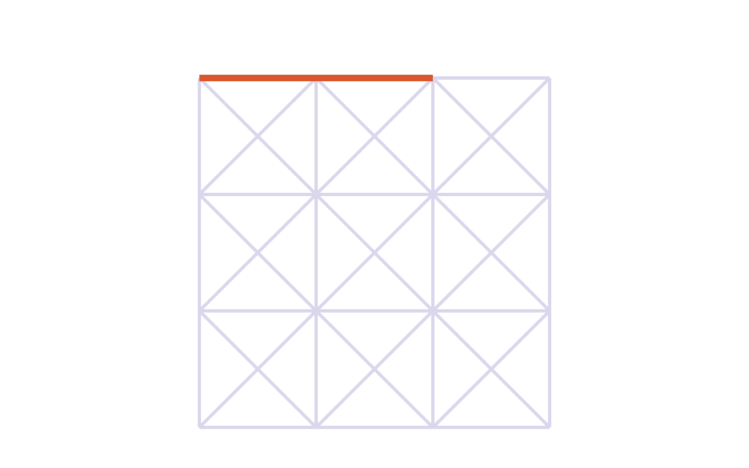
Why 9 slots, not the sample's 5
PART 1 · RESULT
The task's 5-slot sample, applied to this grid
1
9 is forced at 500 m
01
02
03
04
Diagonal neighbours (424 m) are in range, so an interior radio has 8 neighbours, and those 9 radios need 9 slots.
0
1
0
1
2
3
2
3
2
The sample collides on this grid
It separates direct neighbours, but 21 two-hop pairs share a slot. I read it as a format example, not a target.
0
1
4
1
3
5 is right for a shorter range
2
3
2
3
At 350 m there are no diagonal links, and the tool returns exactly 5 slots.
Coral: Node_01 and Node_03 both hold slot 0, and both are in range of Node_02, which hears neither.
TDMA Schedule Optimizer
09
Notes:
This will be asked. With a 500 m range and 300 m spacing, diagonal neighbours at 424 m are in range, so Node_06 has 8 neighbours and those nine radios are pairwise within two hops. Nine is forced. The task's 5-slot sample, applied to this grid, separates direct neighbours but breaks the task's own hidden-terminal rule: Node_01 and Node_03 both hold slot 0 and both reach Node_02, and 21 two-hop pairs share a slot in total, so the validator rejects it. I treated it as an example of the report format. With a 350 m range there are no diagonal links and the tool gives exactly 5 slots, and in EMANE the 5-slot assignment loses most of its traffic.

Slide 10

Two independent checks on every schedule
PART 1 · VERIFICATION
98
automated tests
Inside the tool: an independent validator
Outside the tool: pytest
Before printing, every pair of radios that shares a slot is re-checked from the raw coordinates: out of range of each other, and no common neighbour. It never reuses the conflict graph, so a bug there cannot hide a collision.
No links: every radio gets slot 0
Everyone in range: one slot per radio
A–B–C line: three different slots
$ python src/cli.py --file data/grid16.json
Optimized Frame Length : 9 unique timeslots
Heuristics Compared : DSATUR = 9, largest_first = 9
Slot Lower Bound : 9 -> schedule is optimal
...
Schedule verified conflict-free.
9-radio line: 3 slots, reuse at 3 hops
16-node grid: 9 slots, no collisions
Random layouts: never a collision
Validator catches both collision types
Hand-written DSATUR matches networkx
EMANE bridge lists the right transmitters
TDMA Schedule Optimizer
10
Notes:
Two layers of checking. Inside the tool, the validator recomputes interference from the coordinates and never looks at the conflict graph, so a bug in graph construction cannot hide a collision; if it finds one, the tool prints the pair and exits with status 1 instead of printing a schedule. Outside the tool, 98 pytest tests cover the edge cases the task implies, check that the validator rejects known-bad schedules (including the task's 5-slot sample on this grid), and check the hand-written colouring against networkx.

Slide 11

EMANE emulation
02
PART 2 · BONUS, APPROACH-WEIGHTED
16 TDMA radios in one Docker container, running the Part 1 schedule, with every packet counted.
EMANE 1.5.3
Native TDMA radio model
1 ms slots
Integration bridge
Notes:
Part 2 is the bonus part, where the task says the approach matters more than the result. The question it answers: does EMANE actually deliver or drop packets according to the Part 1 schedule? I'll show the setup, the bridge that converts the schedule, and the delivery numbers at 10 ms and 1 ms slots.

Slide 12



16 EMANE radios in one container
PART 2 · SETUP
Docker container (privileged) · EMANE 1.5.3 built from source
Part 1 optimizer
bridge.py
pathloss.py
coordinates → node-slot map
node-slot map → schedule XML
500 m rule → pathloss events
schedule events
pathloss events
Linux bridge emanebr: EMANE event channel + over-the-air channel (multicast)
namespace node1
namespace node2
namespace node16
EMANE TDMA radio, NEM 1
EMANE TDMA radio, NEM 2
. . .
EMANE TDMA radio, NEM 16
emane0 10.100.0.1
emane0 10.100.0.2
emane0 10.100.0.16
traffic.py probe
traffic.py probe
traffic.py probe
TDMA Schedule Optimizer
12
Notes:
Everything runs in one Docker container. It is privileged because the demo creates network namespaces and TUN devices. EMANE 1.5.3 is compiled from source in the image, so the same Dockerfile builds on ARM as well as x86. Each radio is one EMANE instance in its own network namespace, using EMANE's native TDMA radio model, with a virtual interface emane0. The Linux bridge carries EMANE's over-the-air and event multicast. The schedule and the pathloss both reach the radios as EMANE events; traffic.py in each namespace sends and counts packets.

Slide 13
From the Part 1 schedule to EMANE
PART 2 · INTEGRATION BRIDGE
Part 1 | EMANE
Node, in input order | NEM id 1 to 16
Slot (colour) of a node | tx entry in that slot
Frame length | slots per frame
Silent in other slots | receive (EMANE default)
Within 500 m | free-space pathloss
Beyond 500 m | 300 dB pathloss (not heard)
schedule.xml, generated by bridge.py
<emane-tdma-schedule>
<structure frames="1" slots="9"
slotoverhead="0" slotduration="1000"
bandwidth="1M"/>
<multiframe frequency="2.4G"
power="20" datarate="11M" class="0">
<frame index="0">
<slot index="0" nodes="1,4,13,16">
<tx/>
</slot>
<slot index="1" nodes="2,14">
<tx/>
</slot>
...
1 ms slots
2.4 GHz
11 Mbit/s
20 dBm
default reception curve
Sent with emaneevent-tdmaschedule (one protobuf event per NEM), then confirmed from each radio's ScheduleInfoTable.
TDMA Schedule Optimizer
13
Notes:
The mapping is one-to-one. Node order gives the NEM ids, each colour becomes a slot element listing its transmitters, and EMANE treats every other slot as receive. EMANE has no range setting, so the 500 m rule becomes pathloss: free-space loss inside 500 m, 300 dB outside, which is far below receiver sensitivity. The schedule is sent with EMANE's own emaneevent-tdmaschedule tool, which turns it into one protobuf event per NEM, and confirmed from each radio's ScheduleInfoTable. Radio settings: 1 ms slots, 2.4 GHz, 1 MHz bandwidth, 11 Mbit/s, 20 dBm, EMANE's default reception curve.

Slide 14
The schedule decides what gets delivered
PART 2 · RESULTS, 10 MS SLOTS
Optimizer schedule (9 slots)
Distance-1 control (5 slots)
100%
100%
100%
100%
100%
20%
20%
100%
99.9%
100%
99.8%
99.8%
99.7%
20%
12.5%
25%
60%
with the optimizer's schedule
0 bytes lost to SINR in any of three runs
100%
99.8%
100%
99.7%
20%
25%
0%
20%
34.5%
100%
99.7%
99.7%
99.6%
100%
60%
20%
100%
with the distance-1 control
763,194 bytes lost to SINR; 55 of 84 links hit
Each cell is one radio, laid out as on the grid: the share of its neighbours' packets it received. Darker means more loss. No packet was heard beyond 500 m.
TDMA Schedule Optimizer
14
Notes:
All 16 radios broadcast at once, 300 packets each at 50 packets per second. Each cell is one radio and shows the share of its neighbours' packets it received, with 10 ms slots. With the optimizer's schedule EMANE recorded zero SINR drops, and delivery was 99.9% in the recorded run and 100% in the other two. The control schedule is the task's 5-slot sample, which only separates direct neighbours: 55 of 84 links lost packets, and every lost byte was an SINR drop. Node_11 hears nothing because each of its neighbours shares a slot with another neighbour. The corners are fine because their three neighbours all hold different slots.

Slide 15
1 ms slots: timing loss, not collisions
PART 2 · RESULTS, 1 MS SLOTS
Packets delivered over in-range links
No collision drops at 1 ms either
Optimizer schedule: 0 bytes lost to SINR, and 446,276 bytes lost to timing (Slot Error, Long).
Optimizer schedule
Distance-1 control
99.9%
83.4%
It varies from run to run
65.2%
At 1 ms, three runs delivered 99.4%, 88.1% and 83.4%. At 10 ms: 100%, 100% and 99.9%.
34.5%
Cause: emulator timing
16 EMANE processes share a 4-CPU virtual machine, so some packets arrive after their 1 ms slot has ended and are discarded.
1 ms slots
10 ms slots
TDMA Schedule Optimizer
15
Notes:
The task asks for 1 ms slots. With the optimizer's schedule, delivery at 1 ms was 83.4% in the recorded run and 88.1% and 99.4% in two others, and every dropped byte had a timing reason (Slot Error or Long), none SINR. EMANE's slot statistics show transmissions leaving a quarter to half a millisecond into the slot, so some arrive after the slot ends and are discarded. That is 16 EMANE processes sharing a 4-CPU virtual machine, not the schedule. The control looks better at 1 ms than at 10 ms only because radios use about one in four of their slots at this traffic rate, so shared slots collide less often.

Slide 16
Coordinates in, schedule out
LIVE DEMO
1
Generate the schedule
python src/cli.py --file data/grid16.json
WHAT TO LOOK FOR
Frame length 9, marked "schedule is optimal"
2
Show the 5-slot case
python src/cli.py --file data/grid16.json --range 350
Slot × Node matrix: exactly one 1 in every column
3
Run the test suite
At 350 m: exactly 5 slots
python -m pytest
All 98 tests pass
EMANE log: 0 SINR drops with the optimizer's schedule
4
EMANE run (recorded log as backup)
docker run --rm --privileged tdma-emane
TDMA Schedule Optimizer
16
Notes:
Run the CLI live on the 16-node grid and point at the frame length, the "schedule is optimal" line and the Slot × Node matrix, which has exactly one 1 per column. Then rerun with --range 350 to show the tool gives exactly 5 slots once the diagonal links drop out. Run pytest and show all 98 pass. EMANE takes a while to build, so show the recorded output in emane/out/demo_log.txt unless they want it live; to keep the results, the full command mounts emane/out with -v "$PWD/emane/out:/work/emane/out".

Slide 17




Limitations and next steps
WRAP-UP
Assumed coordinates
Disc interference model
One slot per radio
Only 3 of the 16 positions are given. Any other layout needs only a new input file.
Radios beyond 500 m count as silent. An SINR-based model would be more realistic.
Busy relays get the same share as edge radios. Next: extra slots where the frame has room.
Static and centralised
Heuristic, not exact
Emulator timing
Moving radios mean recomputing the schedule and sending a new schedule event.
An exact solver could close the gap when a result sits above the lower bound.
1 ms slots were only tested in a VM. Bare-metal Linux with more cores is untested.
TDMA Schedule Optimizer
17
Notes:
Be upfront about these. The coordinates are an assumption: the task gives only Node_01, Node_02 and Node_16, and a regular grid is the simplest layout that fits. The disc model ignores the summed interference of far-away radios. Every radio gets one slot regardless of traffic. The schedule is static and centralised. The heuristic is not exact, though the lower bound shows when it is optimal. And 1 ms timing was only tested in a 4-CPU virtual machine.

Slide 18


Questions?
SUMMARY
0
1
2
0
Part 1: a 9-slot schedule for the 16-node grid, with zero collisions and proof that 9 is the minimum.
3
4
5
3
Part 2: in EMANE, no collision drops with the optimizer's schedule, against 34.5% delivery without hidden-terminal protection.
Code, documentation and slides:
github.com/srikarreddyram/tdma-schedule-optimizer
6
7
8
6
0
1
2
0
16 radios, 9 slots, zero collisions.
Cyan circles share their slot with another radio.
Notes:
Close with the two results, then take questions. If there is time, run the CLI live: python src/cli.py --file data/grid16.json. The EMANE demo is docker run --rm --privileged tdma-emane if they want to see it; the recorded output is in emane/out/demo_log.txt. Everything, including this deck and the documentation PDF, is in the GitHub repository.

